Slide 1


Albinism &
Global Stigma
PART I
February 2014

Slide 2
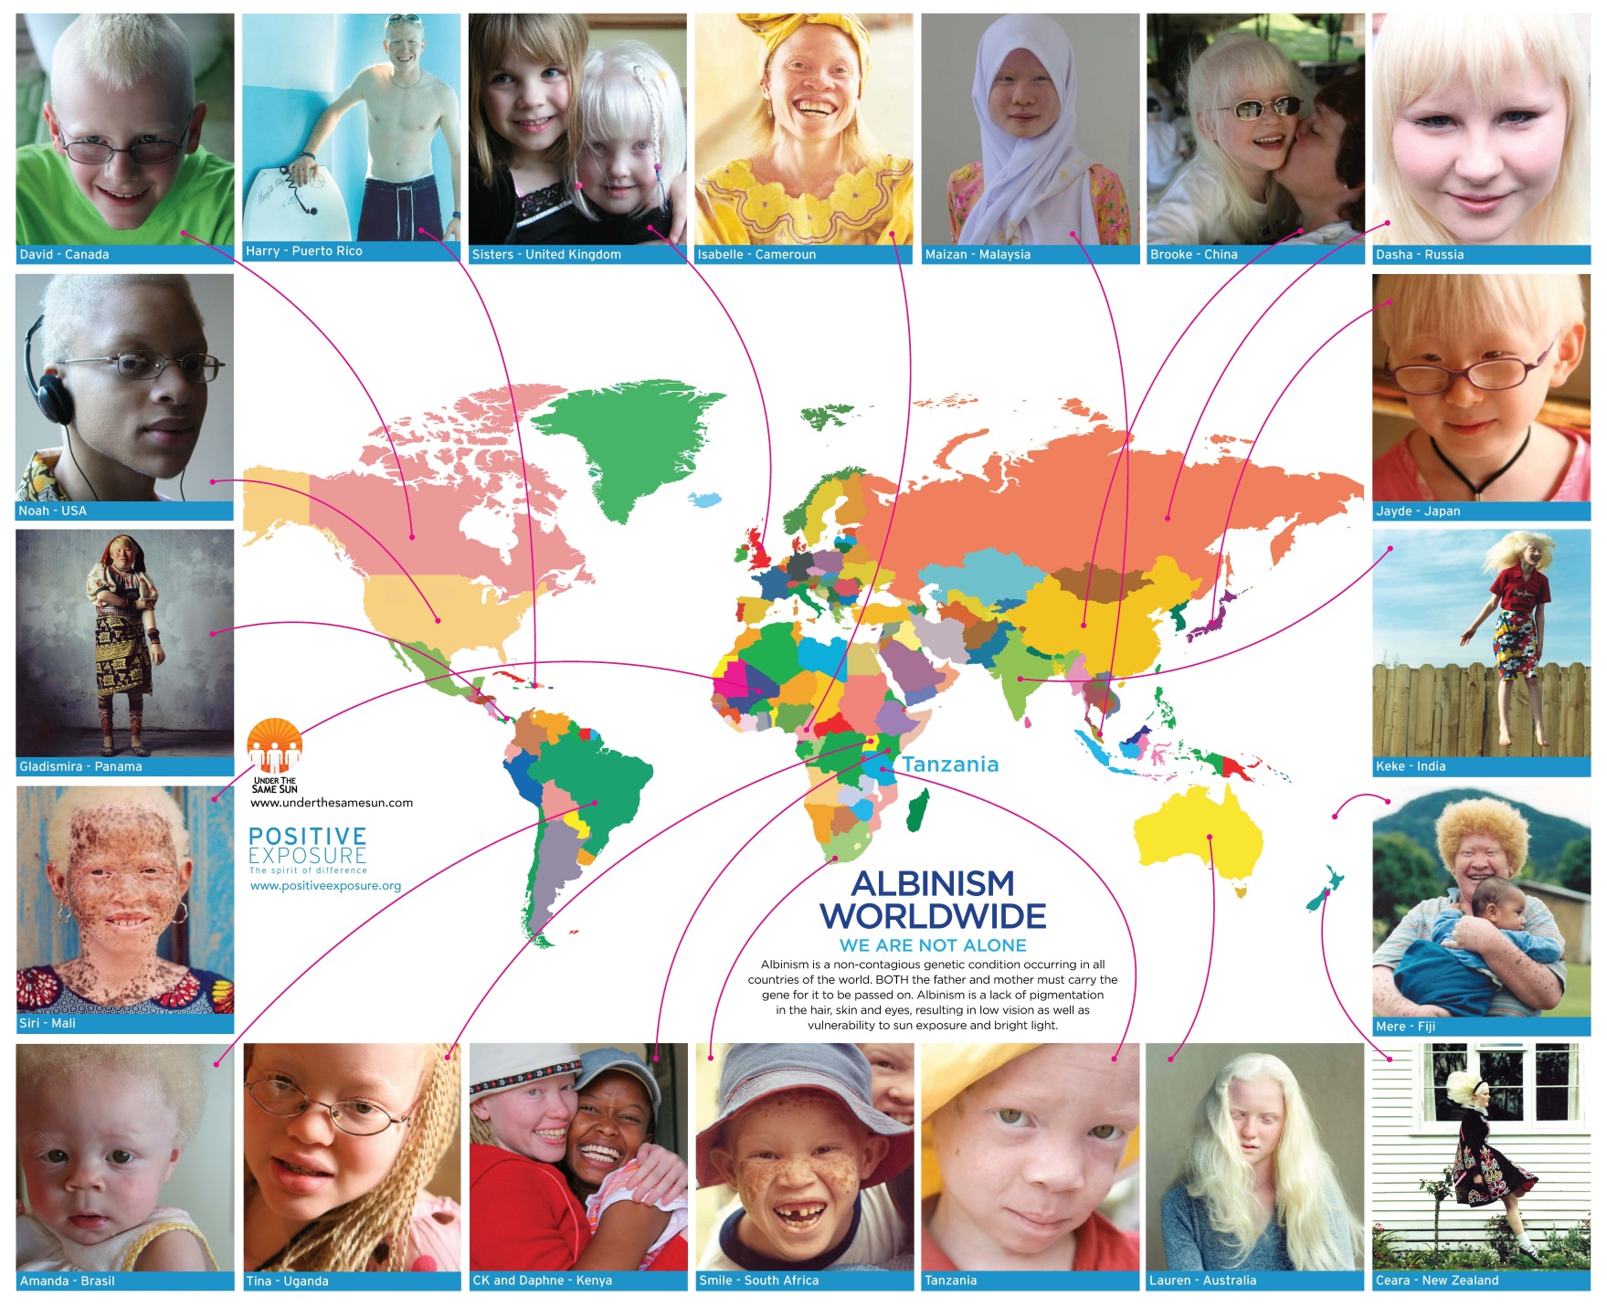
ALBINISM EFFECTS PEOPLE FROM ALL RACES

Slide 3
WHAT IS ALBINISM?
A rare genetically inherited difference occurring in both genders regardless of race, in all countries of the world.
Results in a lack of pigmentation in the hair, skin and eyes, causing vulnerability to sun exposure and bright light.
Almost all people with albinism are visually impaired, with the majority being classified as “legally blind”.
North America / Europe: 1 in 17,000 people.
Africa: in several communities estimates as high as 1 in 1,000 people being affected.
The term “person with albinism” (PWA) is preferred to the term “albino”.

Slide 4
HOW DOES A PERSON BECOME A PWA?
Both parents of a PWA, whether they have albinism or not, must carry the genetic trait of albinism before a child with albinism can be born.
(25%) chance at each pregnancy that the baby will be born with albinism.
Normal pigmented children born to such parents might also carry the genetic trait for albinism.

Slide 5
TYPES OF ALBINISM:
Albinism only effecting the eyes. This is called Ocular albinism (OA), and is much less common. Most cases are recorded in males. May have skin and hair color that are normal.
Albinism affecting the skin, hair and eyes. This is known as OCA or Oculocutaneous albinism. This is the most visible form of albinism.
4 forms of OCA are now recognized – OCA1, OCA2, OCA3 and OCA4; some of these are further divided into subtypes. In each the degree of colour apparent in the individual varies slightly.
Hermansky-Pudlak Syndrome (HPS): In addition to having albinism, people with HPS have bleeding problems, bruising lung and bowel disease.

Slide 6
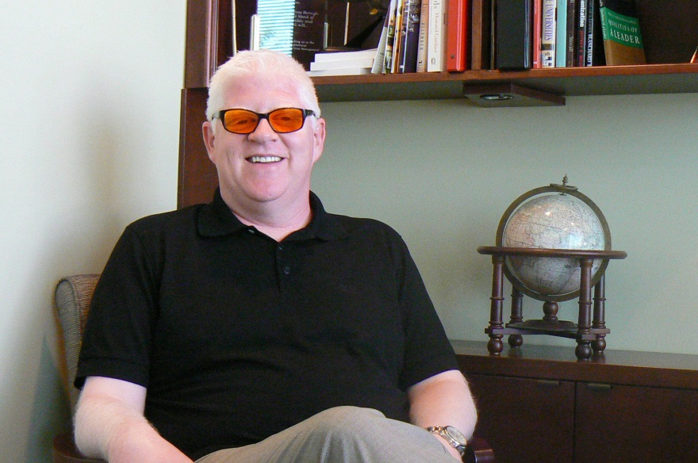
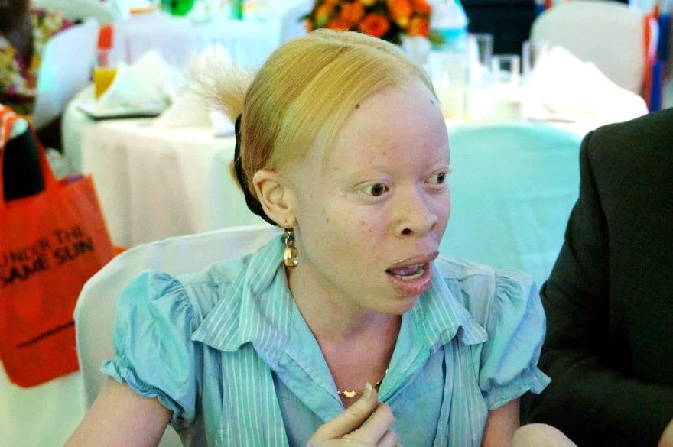
OCA1
OCA2

Slide 7
3 MAJOR ISSUES FACE PWA:

Slide 8
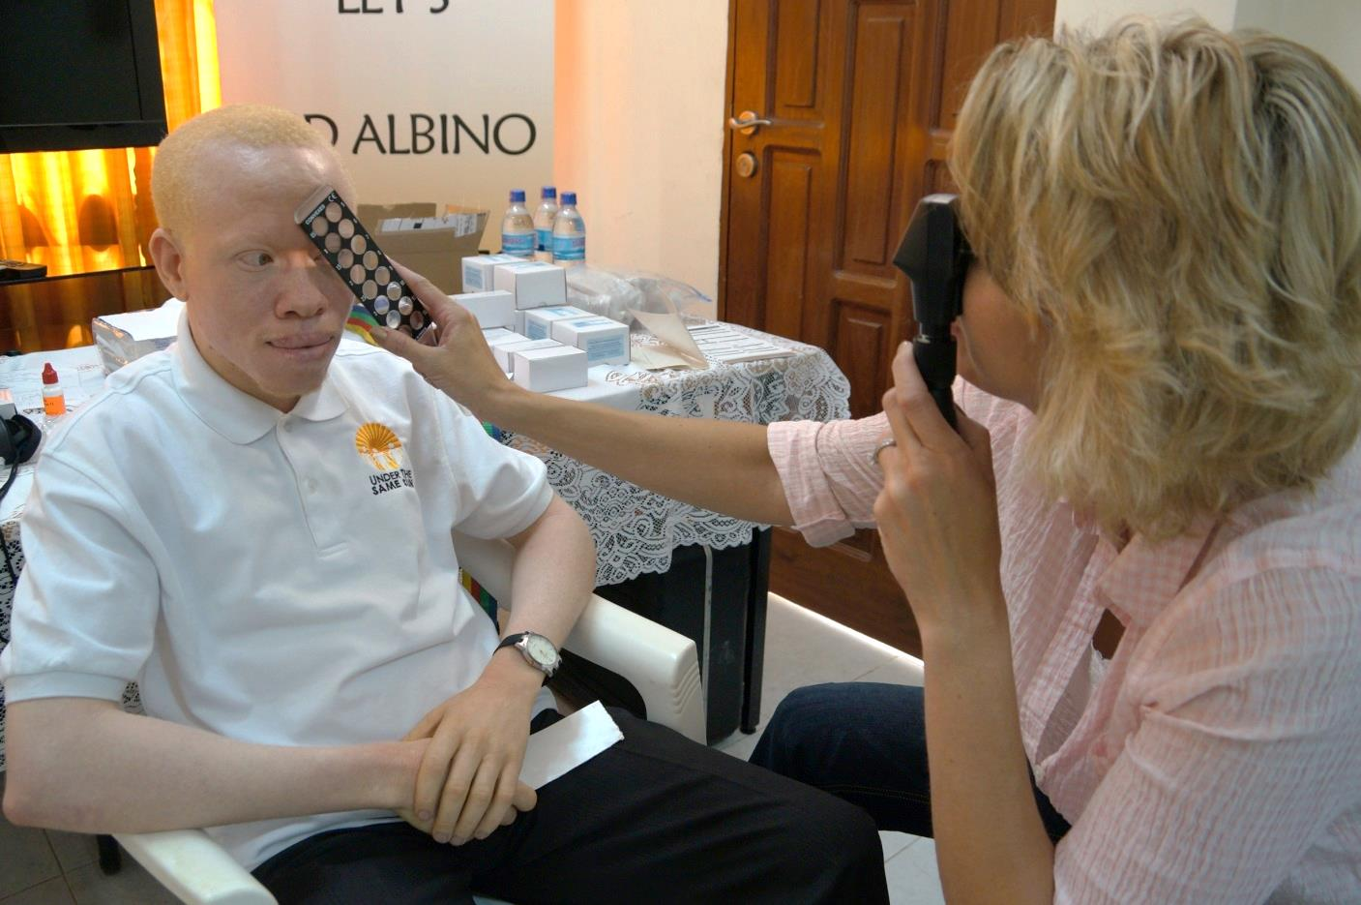
1. LOW VISION

Slide 9
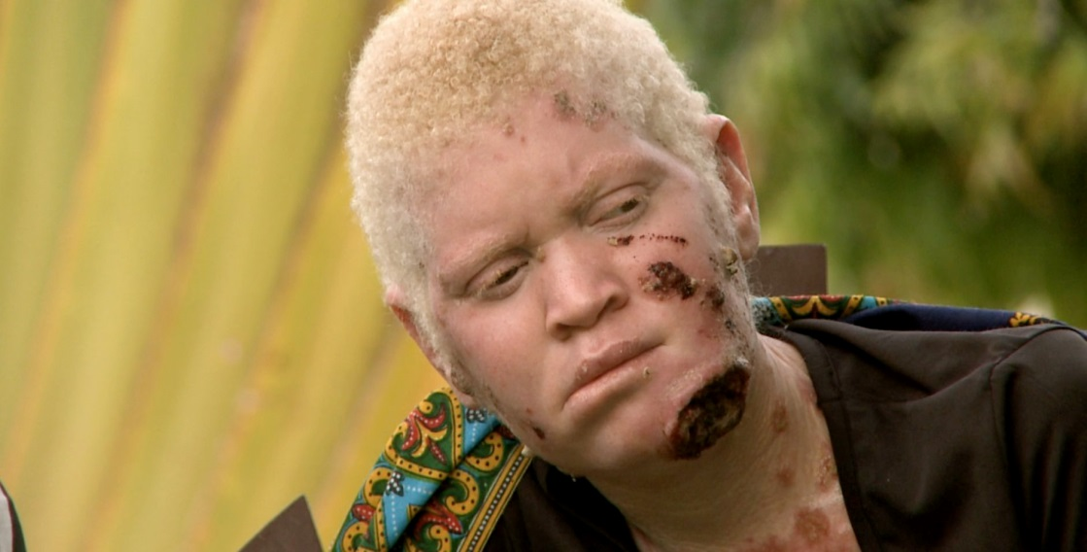
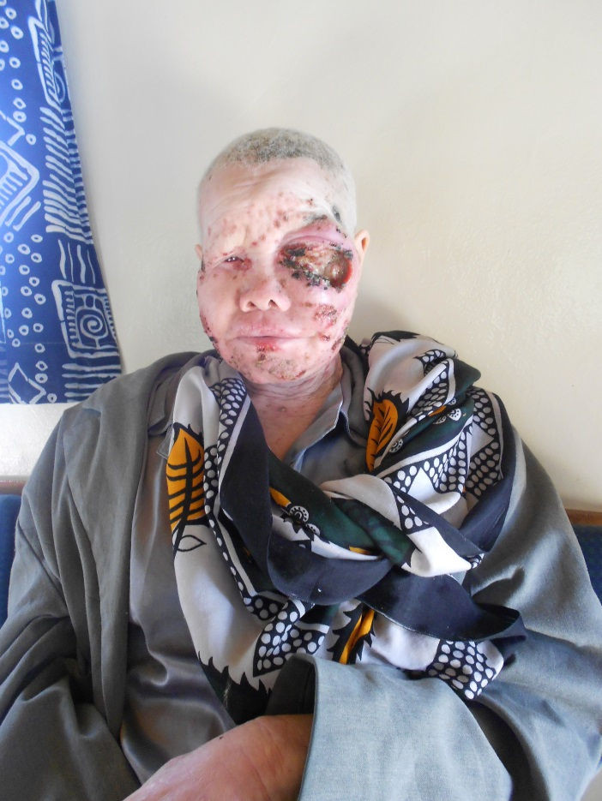
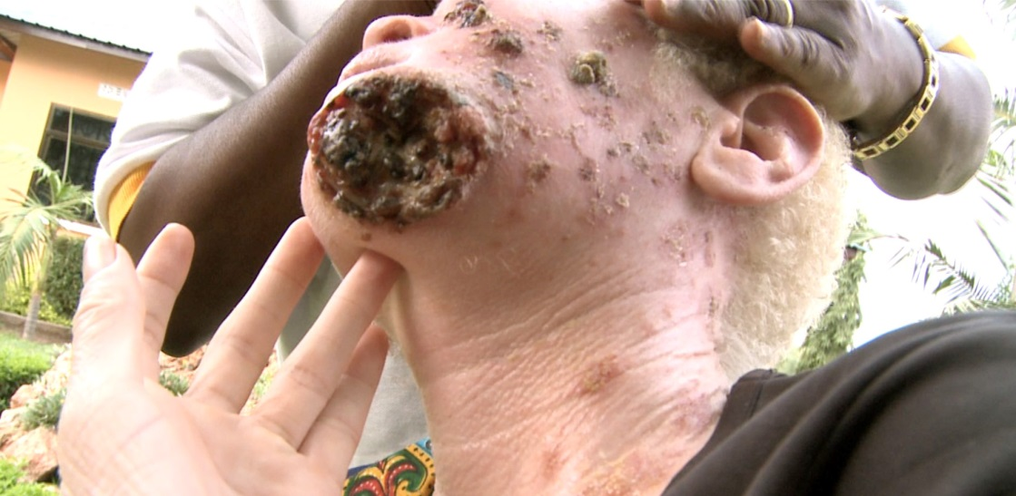
2. RISK OF SKIN CANCER
In Africa, most PWA die by age 40

Slide 10
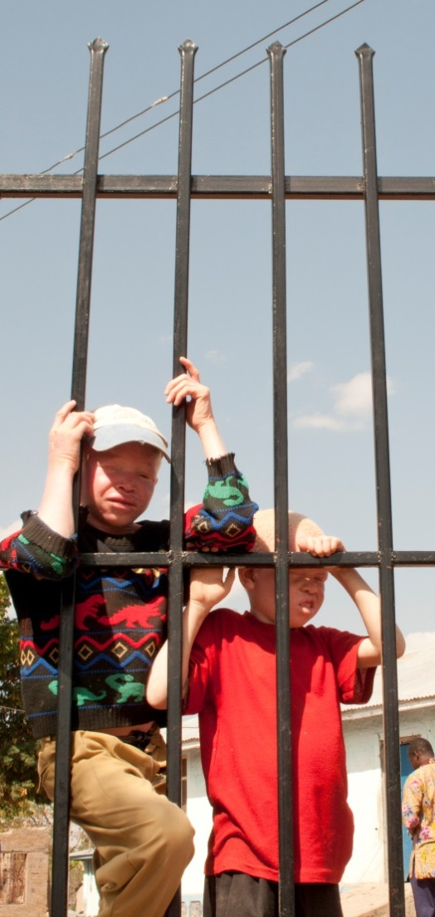
3. MAJOR SOCIAL EXCLUSION/REJECTION
Mystification
Global Stigma
Discrimination
Human Rights Violations

Slide 11
But why do PWA face social exclusion/ rejection?
  “From the 19th century freak show to the East African black market in body parts to the modern cinema, the image of “the albino” has seized the popular imagination. Popular culture attributes many qualities to "the albino;" an outsider; a magical being; a human embodiment of evil. In some cultures, albinism is associated with mystical or prophetic power or even ghosts. The albino body has long been an object of ridicule and fascination; of fear and fetishism.” (SOURCE: Garth Mullins, Canadian Sociologist on CBC Radio Show “The Imaginary Albino”)
“What is it about the Albino man that so peculiarly repels and often shocks the eye, as that sometimes he is loathe by his own kith and kin… this mere aspect of all pervading whiteness makes him more strangely hideous than the ugliest abortion. Why should this be so?” (SOURCE: Herman Melville, Moby Dick)

Slide 12
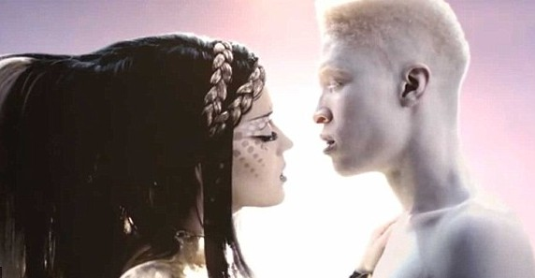
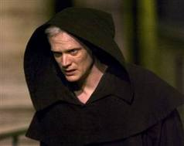
THE SPECTRUM OF STIGMA/DISCRIMINATION
ON ONE END…
No positive/accurate portrayal of PWA in the arts, literature and media. It’s seen as normal to portray PWA as villains, demons, ghosts, freaks of nature, mystical anomalies, village idiots, etc.
Katy Perry Music Video – “Extra Terrestrial”
Silas the Albino Monk – The DaVinci Code

Slide 13
Names used for PWA
THE SPECTRUM OF STIGMA/DISCRIMINATION
ON ONE END…
(Sampling Only. Present Catalogue = 182 Names FROM 35 COUNTRIES)

Slide 14
THE SPECTRUM OF STIGMA/DISCRIMINATION
ON THE OTHER END…
WITCHCRAFT (MUTI/JUJU)
Dehumanization lays the foundation for witchcraft attacks:
  Murder
  Mutilation
  Rape
  Grave robberies
  Trafficking in PWA organs.

Slide 15
WARNING:
The following slides contain images of an Extremely graphic nature

Slide 16
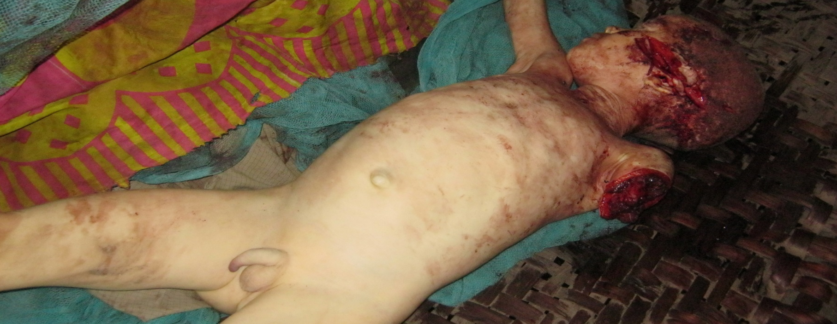
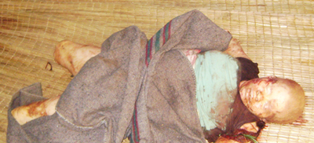
7 year old Lugolola Bunzari, killed January 31, 2013 in Tanzania
18 year old Chantal Ngendakumana, killed May 6, 2012 in Burundi

Slide 17
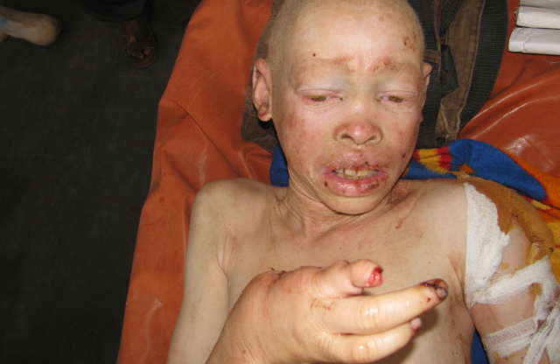
12 year old Adam Robert, attacked October 14, 2011 in Tanzania

Slide 18
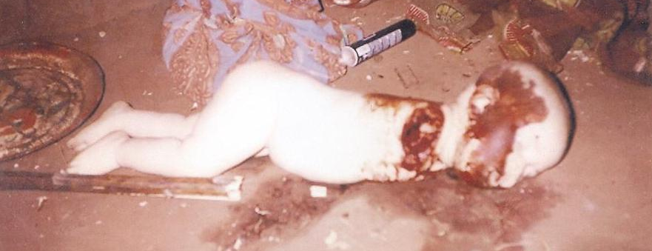
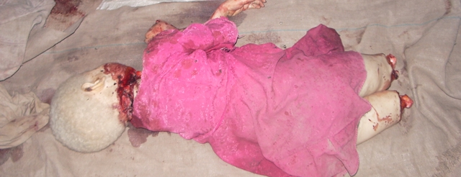
7 month old Mariamu Kija Mbogo, killed July 11, 2008 in Tanzania
5 year old Mariamu Emmanuel, killed January 21, 2008 in Tanzania

Slide 19
Record of Attacks
305 separate crimes against PWA’s in 23 African Countries.
26 of these attacks occurred in 2013.
Hundreds more not yet uncovered, likely in many other nations.
“…muti activities are often shrouded by a “code of silence” which makes reporting, and the necessary prosecution and investigation all the more difficult.”
Fellows, Simon, Trafficking Body Parts in Mozambique and South Africa (2008), Human Rights League, Mozambique. http://www.scribd.com/doc/23729111/Trafficking- Body-Parts-in-Mozambique-and-South-Africa-Mozambique-Human-Rights-League Accessed August 3, 2010.

Slide 20
Record of Attacks
Benin: 2
Botswana: 3
Burkina Faso: 9
Burundi: 21
Cameroon: 7
DRC: 27
Egypt: 1
Ghana: 1
Guinea: 9
Ivory Coast: 21
Kenya: 12
Malawi: 3
Mali: 8
Mozambique: 2
Namibia: 2
Nigeria: 7
Rwanda: 1
Senegal: 7
South Africa: 4
Swaziland: 9
Tanzania: 139
Zambia: 1
Zimbabwe: 2

Slide 21

The link between African elections and muti-killings
Swazi albinos plead for protection ahead of vote
Posted Friday, May 24 2013 at 06:27
Swaziland’s albinos have called on the government for protection ahead of elections expected later this year, fearing their body parts will be harvested by candidates seeking good luck.
“Those in authority must make sure that our safety is guaranteed,” Skhumbuzo Mndvoti, an albino community leader living in the southern town of Nhlangano told AFP.
“I can warn both adults and parents of albino children to take extra care during these election days,” Mndvoti said.
Ritual killings are common of in Swaziland, and elsewhere in Africa, with “muti” practitioners -- a catch-all for traditional medicine and witchcraft -- using limbs or body parts as amulets.
Full story available at: http://www.nation.co.ke/News/world/Swazi-albinos-plead-for-protection-ahead-of-vote/-/1068/1861356/-/item/1/-/blp9q0z/-/index.html

Slide 22
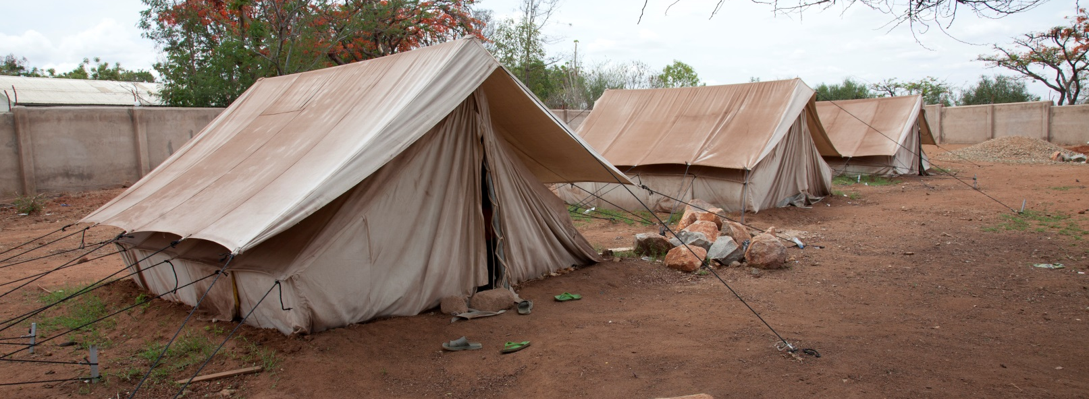
Refugee PWA
  Attacks or threats of deadly attacks propel them to seek refuge.
  15 PWA fleeing 9 countries received asylum.
  UTSS has given expert testimony in various courts and tribunals in these matters.
  This trend is expanding.
Displaced PWA
  Hundreds of PWA in centers in East Africa.

Slide 23
General Sources of Protection for PWA
Basic human rights treaties that broadly cover the human rights of PWA:
  United Nations Charter
  Universal Declaration on Human Rights
  International Covenant on Civil and Political Rights (ICCPR)
  International Covenant on Economic Social and Cultural Rights (ICESCR)
  Convention on the Rights of the Child (CRC)
  Convention against Torture (CAT)
Are there specific mechanisms of protection for PWA?
  Yes, but first, where do we fit in?

Slide 24
Classifying Albinism: Transforming Perceptions & Ushering Protection
PART II

Slide 25
Key Considerations for Classification:
PWA are attacked and shunned because of their appearance.
Stigmatized not only because they have pale skin and low vision issues; but also because of mystification of the totality of their albinistic appearance.
Stigma and discrimination is a global phenomenon grounded in mystification and misconceptions of albinism.
  In North America/Europe/Australia PWA suffer from:
    Aggressive name calling
    Persistent/violent bullying
    Persistent demonizing in pop culture
  In Sub-Saharan Africa: PWA suffer from:
    Aggressive name calling
    Persistent/violent bullying
    Persistent dehumanizing from myths
    Witchcraft attacks
    Harmful traditional practices (ie. cultural infanticide)

Slide 26
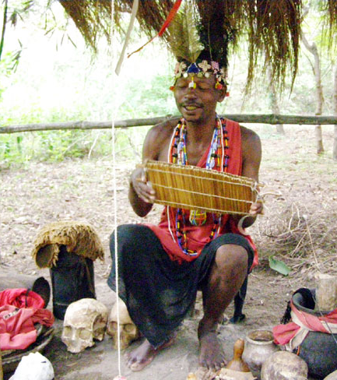
Key Considerations for Classification:
Witchcraft is a reality for thousands of PWA
  It is: combination of natural and supernatural beliefs, philosophies and practices aimed at manipulating nature for the benefit of the practitioner.
  May involve use of human body parts from live victims because of belief that the screams of victims increases potency of potion.
  Historians say witchcraft formed part of the social fabric of many pre-colonial African societies.
  2010 PEW Forum: beliefs in witchcraft remain influential today in a significant number of African countries.

Slide 27

The Main/Default Classification of PWA
A specific people group with particular needs that must be given special attention in IHRL (“specific people group”)

Slide 28
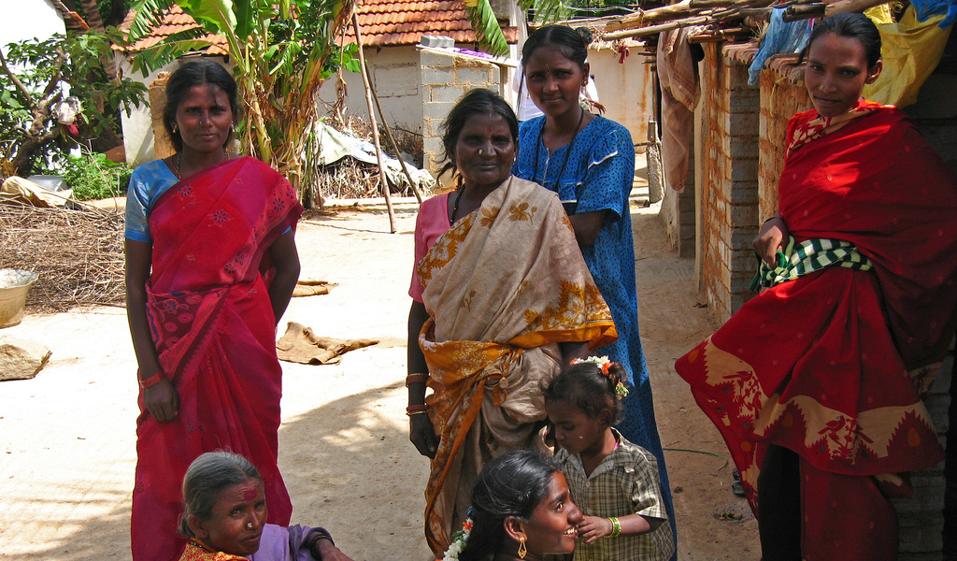
Similar attention has been drawn to certain analogous groups such as:
  the elderly,
  person living with HIV/AIDs,
  and more recently, the dalits or “untouchables” of South Asia.

Slide 29
Three Proposed Sub Classifications
Particular Social Group
Visible Minority Group
Group with Disabilities

Slide 30
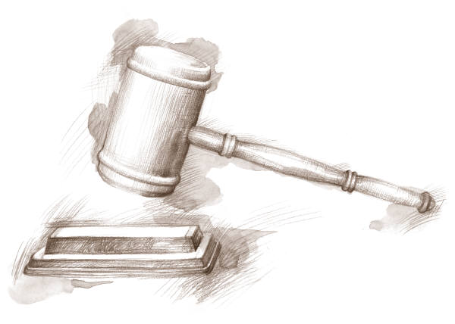
1. “Particular Social Group”
From 1951 Refugee Convention
One of the five grounds enumerated in Article 1A(2) on which refugee status may be determined
PWA fit all elements of the definition of PSG (see definition below)
Women, tribes or homosexuals from several countries are a PSG for the purposes of granting them asylum. UTSS proposes the same for PWA
In some national jurisdictions PWA have been granted asylum based on their membership in a particular social group
“a particular social group is a group of persons who share a common characteristic other than their risk of being persecuted, or who are perceived as a group by society. The characteristic will often be one which is innate, unchangeable, or which is otherwise fundamental to human identity, conscience or the exercise of one’s human rights.” (UNHCR Guidelines, para.11)

Slide 31
2. “Visible Minority” Group
  PWA experience colourism
  Albinism as new category of “colour”
Access to CERD and Durban Declaration
UN Independent Expert on minority issues stated that the problems faced by PWA such as stigma, lifelong social exclusion and discrimination, are similar to the experiences faced by vulnerable racial minorities because of their skin colour. (See Joint Press Release by UN Rapporteurs, 4 May 2013)

Slide 32
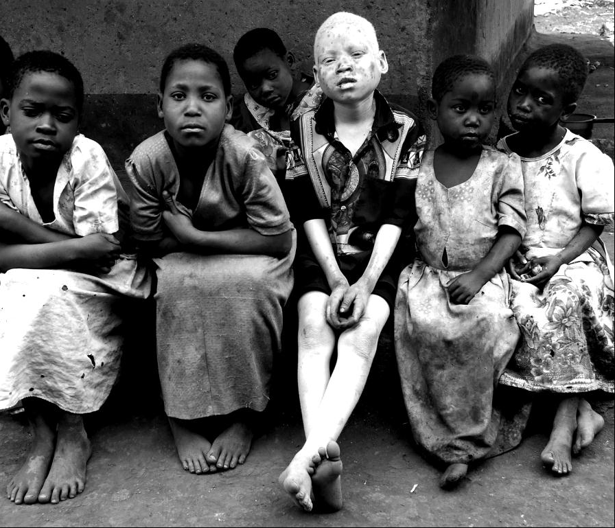
3. Persons with Disabilities (PWD)
Disability currently centres on human rights (CRPD)
  PWD = impairment + various barriers to effective social participation
PWA have both a visual and skin impairment
  PWA classified as “legally blind” in some countries.
  Some African countries also refer to PWA as PWD due to skin’s absence of melanin.
Under the HR approach to disability, PWA are classifiable as PWD
PWA divided on disability issue
  Why: added stigma and rejection within PWD
  Particular PWA needs camouflaged in PWD movement.

Slide 33
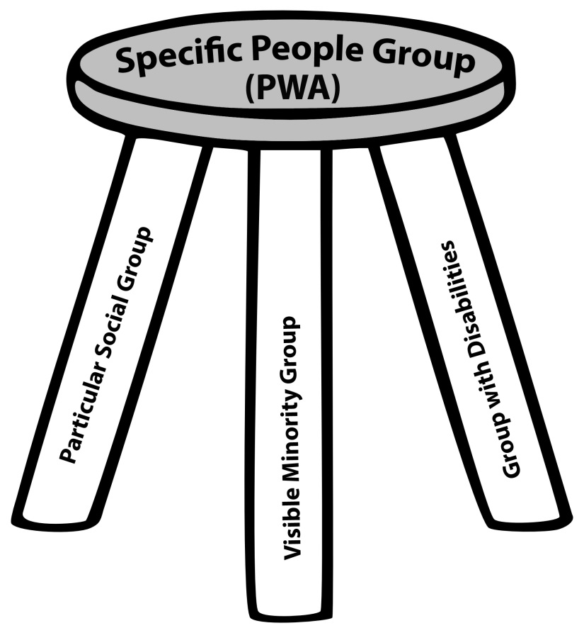
UTSS POSITION
CLASSIFICATION
SUB CLASSIFICATIONS

Slide 34

FOR MORE INFORMATION:
UNDER THE SAME SUN
#200 – 15127 100th Avenue
Surrey, BC, CANADA, V3R 0N9
+1-604-336-8868
Email: info@underthesamesun.com
www.underthesamesun.com
www.facebook.com/underthesamesun

