Slide 1
“A Journey of 100 Lifetimes”
By: José Ramirez Jr., LCSW
USA Coordinator for IDEA
Member, International Working Group for Human Rights
Managing Editor, The STAR
United nations human rights committee
Geneva, Switzerland
Wednesday, august 12, 2015

Slide 2
Article I – U.N.
Declaration of Human Rights…”All human beings are born free and equal in dignity and human rights”

Slide 3
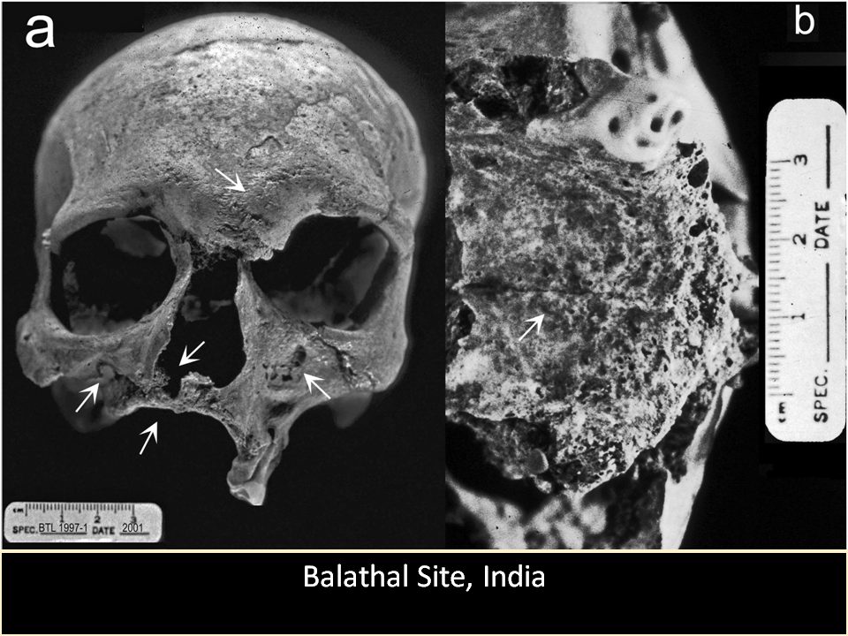
Origins of Stigma I

Slide 4
X
=
LOSSES

Slide 6
S t I g m a
S t I g m a
AN ACT OF LABELING, REJECTION OR UNEXPLAINED FEAR OF A PERSON
Ramirez

Slide 7
Blindness
Lost Sight
Disappearing Horizon
Darkness
Stars

Slide 8
Law of Silence
Law of Silence – the practice of silently refusing to take a stand against stigma, and it’s accompanying pain created by inaction.
Ramirez

Slide 9
The Eye of Exclusion
Law of Silence
Limited Knowledge
Economics
Stereotypes lead to fear
Education
Limited
Education
Unemployment
Lack of
Intellectual
Stimulation
Social
Isolation
Employment Discrimination
Low
Occupational
Level
Low Income
Limited or Inaccurate Information
Exclusion
from
mainstream
Stereotypes
Housing
Media
INDIVIDUAL
Exclusion
Overcrowded
Rental or Homeless
Life Expectancy may be Affected
Exclusion
from Power
FAMILY
Inhibiting Development of Political Power
Few Visits to M.D.
Lack of
Health
Services
NEIGHBORHOOD
Lack of Political
Power
SYSTEM
Health
Politics
By: José Ramirez, Jr., LCSW

Slide 10
The Eye of Inclusion
Law of Knowledge
Training
Economics
Eliminate Stereotypes
Individualized Education/
Training
Education
Employment
Intellectual
Stimulation
Social
Opportunity
Higher
Occupational
Level
Diversity in Employment
Higher
Income
Eliminate
Stereotypes
Accurate Information
Inclusion
Media
Housing
INDIVIDUAL
Inclusion
Community
Living
Ownership
Higher Life Expectancy
Inclusion
FAMILY
Visits to M.D.
Development of Political Power
Health
Services
NEIGHBORHOOD
Political
Power
SYSTEM
Health
Politics
By: José Ramirez, Jr., LCSW

Slide 11
KNOWLEDGE ABOUT LEPORSY IS POWERFUL
We are all human beings
IGNORANCE ABOUT LEPROSY IS MORE POWERFUL
Images lead to stigma
LEPROSY CAN CAUSE BLINDNESS
Inability to blink darkens sight
SOCIETY IS BLINDED BY MYTHS AND FEAR OF LEPROSY
Creates “Eye of Exclusion”
PERSONS AFFECTED AND IMPACTED ARE STARTING TO BOND
Creates “Eye of Inclusion”

Slide 12
Pyramid of Stigma
Rejection
Labeling
Fear

Slide 13
MUCHAS GRACIAS
MERCI
THANK YOU

