Slide 1
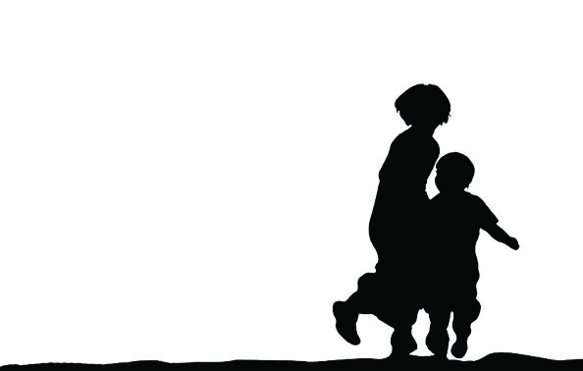
Destination Unknown Campaign
Unaccompanied and on the move
Which rights are not yet violated

Slide 2
Few facts and figures (i)
By end of 2014 a total of 59.2 million people were forcibly displaced worldwide
19.5 million of them are refugees
Main hosting countries: Turkey, Pakistan, Lebanon, Iran, Ethiopia, Jordan

Slide 3
Few facts and figures (ii)
1 in 2 refugees is a child
1.200.000 of Syrians hosted in Turkey are under 18 years old
8% of the asylum seekers and migrants arriving in Italy in the first half of 2015 were unaccompanied children
An estimated 47.000 unaccompanied children entered USA only in one year

Slide 4
Facts and figures (iii)
As young as 8-10 years old
Alone
In peers
Accompanied by adults other then the parents

Slide 5
Reasons behind
Fleeing war and natural disaster
  Syrian unaccompanied children
Escaping violence and human rights violations home
  Unaccompanied children reaching US
  Eritrea, Afghanistan, Somalia, DRC, Rohingya

Slide 6
Reasons behind (ii)
Very often a migration project of the child and/or family
  Strategy of dealing with limited food supplies
  Lack of economic opportunities home
  Expectation for better opportunities elsewhere
  Forced marriage arrangements
  Lack of education or qualitative education
  Abuses at school/home or community
  Failing States incl to respond to child abuse

Slide 7
Movement can be of benefit for the child
It can also entail many risks, esp when moving unaccompanied
A long and exhaustive route
Being victim of adults or older children abusing/exploiting the child
  Still many cases of child trafficking
Irregular migration involves higher risks

Slide 8
Situation on the move and upon reaching destination
In 2006 CRC points out in a General Comment to serious child rights violations
Situation has become of further concern today
  Increased xenophobia and racism against foreigners including children

Slide 9
Irregular migration
Mediterranean Maritime Crisis, South East Asia boats and the numbers of death at sea, including children
Reported cases of sexual and physical violence/torture on the way
Child immigration detention and similar practices
Deportations and return without any risk assessment and best interests assessments

Slide 10
Lack of access to rights and services
Common reception facilities shared with adults
Alleged cases of reported abuse
Poor hygienic conditions
Lack of health care, incl psychosocial support
Lack of access to education
Uncertainty about the future, no durable solutions, no place for the views and opinions of the child

Slide 11
Lack of collaboration
Many host countries poor child rights standards
No cooperation between immigration and child rights agencies within the country
State immigration control rather then the rights and interest of the child prevail
No transnational collaboration in child protection
The children concerned not involved in public debate and decisions affecting them

Slide 12
Recommendations
CRC and national child rights law as applicable law
Stop child immigration detention
  http://endchilddetention.org/
Addressing xenophobia by speaking to citizens
Investing in research and evidence and giving voice to the children concerned

Slide 13
Countries of origin
Improving human rights standards and addressing inequality
Qualitative education
Employment opportunities
Systems of protecting children from violence, incl gender based violence
Information on safe migration
More opportunities for safe migration

Slide 14
Transit/destination countries
Invest in collaboration with countries of origin
Insure a human rights approach when addressing child trafficking and smuggling, especially around border areas
Life saving operations at sea
Information on existing child protection services and access to them
Specialized services based on the needs of unaccompanied children

Slide 15
Destination Unknown Campaign
http://destination-unknown.org/
Thank You!

