Slide 1



Embassy of the Kingdom of Morocco to the United Nations and International Organizations in Vienna
Human Rights, Gender and Corruption – Linkages, Good Practices, Potential and Limitations
Wednesday, 18 December 2019, 13-14:00, CR1
The contribution of the Kingdom of Morocco for introducing corruption on the agenda of the Human Rights Council
Mr. Azzeddine FARHANE Ambassador,
Permanent Representative of the Kingdom of Morocco to the United nations and International Organizations in Vienna

Slide 2

Table of Contents
Background and genesis
Various steps undertaken by Morocco for introducing corruption on the agenda of the HRC
The different resolutions adopted by HRC on corruption (2013-2019)
The Way Forward

Slide 3
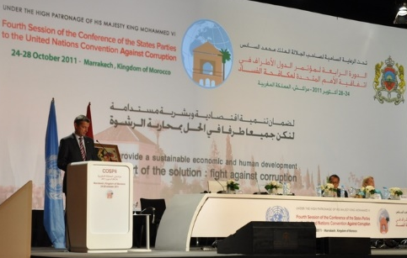
I – Background and Genesis
1- Context of the organization of the 4th Conference of the State Parties (CoSP) in Morocco, Marrakech, 24-28 October 2011;
2- The main innovations introduced by the 4th CoSP:
The consolidation of the first resolution on the review mechanism through the adoption of a 2nd resolution entitled “Mechanism for the Review of Implementation of the United Nations Convention against Corruption”;
The setting-up of open-ended intergovernmental expert meetings to enhance international cooperation;

Slide 4
I – Background and Genesis
The adoption of a resolution aiming at conducting a briefings for the NGOs on the outcomes of the review process, including on the technical assistance needs identified;
The adoption of the Marrakech declaration which underlines, inter alia, the importance of the prevention of corruption as a fundamental component of the Merida’s Convention architecture;
3- Organization of a Side event of the OHCRH in cooperation with UNODC entitled “Human Rights and Fight Against Corruption”.

Slide 5

Main ideas emerging from the side-event
Discuss the value of using a HR approach to enhance the sustainability and effectiveness of anti-corruption efforts ;
Debate possible concrete measures to integrate HR considerations into the UN anti-corruption agenda ;
Update participants on the work of the UNHRC, its subsidiary bodies in the area of HR and the fight against corruption ;
Exchange views and ideas aimed at promoting policy coherence in the implementation of HR and anti-corruption conventions and treaties ;
Share examples, case studies and best practices in implementing anti-corruption activities, programmes and strategies fully in line with international HR standards.

Slide 6


II - Steps undertaken by Morocco for introducing corruption on the agenda of the HRC
(a) The cross regional statement on Corruption and Human Rights (June 2012):
Process:
During the 20th session of the Human Right Council, held in June 2012, a cross regional statement on “Corruption and Human Rights” was pronounced by Morocco, on behalf of 134 States which highlighted the following points:
Negative impact of widespread corruption on the enjoyment of HR
Corruption as one of the biggest obstacles to the promotion of HR, and the achievement of the Millennium Development Goals
The ability of civil society and media to use HR principles in fighting against corruption
The importance of coordination between Member States in Geneva and Vienna, as well as close collaboration between the OHCHR and UNODC

Slide 7
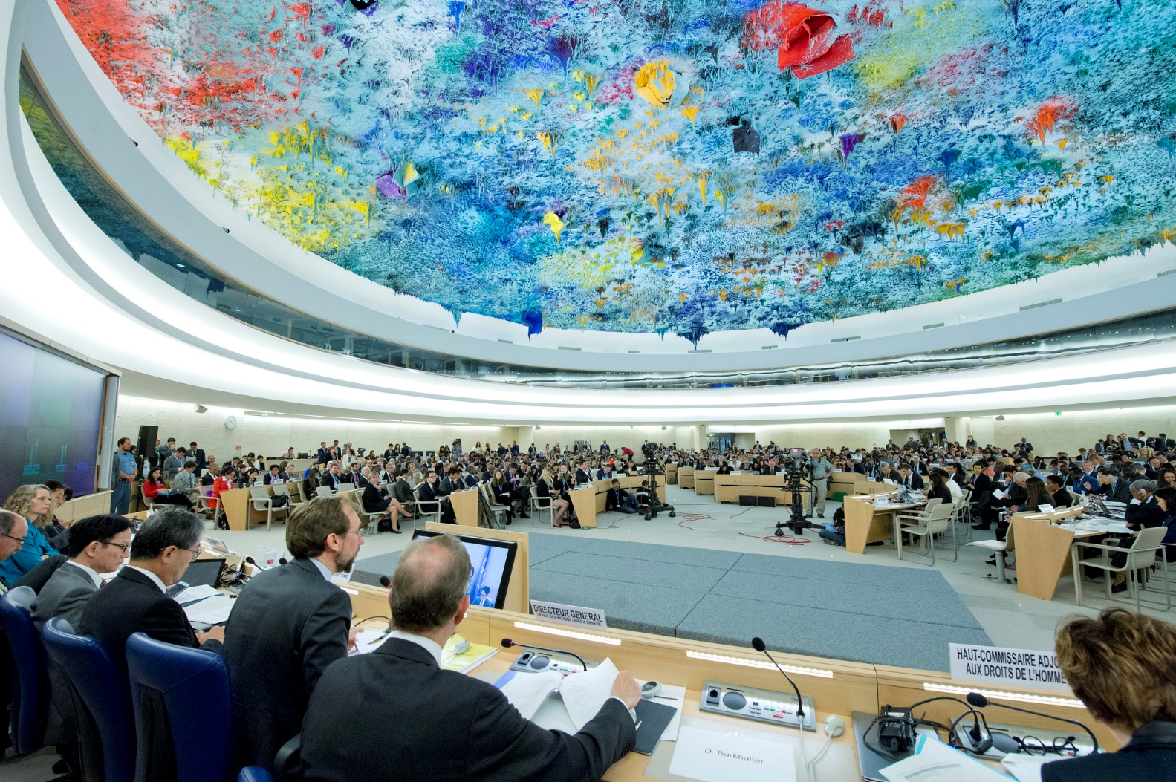
II - Steps undertaken by Morocco for introducing corruption on the agenda of the HRC
(b) Panel discussion on the negative impact of corruption on the enjoyment of Human Rights (September 2012)
Morocco and 4 other countries (Austria, Poland, Indonesia, Brazil) submitted to the HRC on its 21st session, a draft resolution entitled “Panel discussion on the negative impact of corruption on the enjoyment of Human Rights”;
Following adoption of this resolution, without a vote, the Council decided to convene this Panel discussion, on the 13 March 2013.

Slide 8

Objectives of this Panel discussion
Emphasize the very strong link existing between anti-corruption efforts and Human Rights, examine how those efforts could receive the sustained attention of the Council;
Consider the need for regular reporting on HR and corruption, in order to assess how corruption could lead to direct and specific Human Rights violations;
Highlights efforts to combat corruption are most effective and sustainable when coupled with an approach that respects all Human Rights and puts people at the centre of the issue.

Slide 9
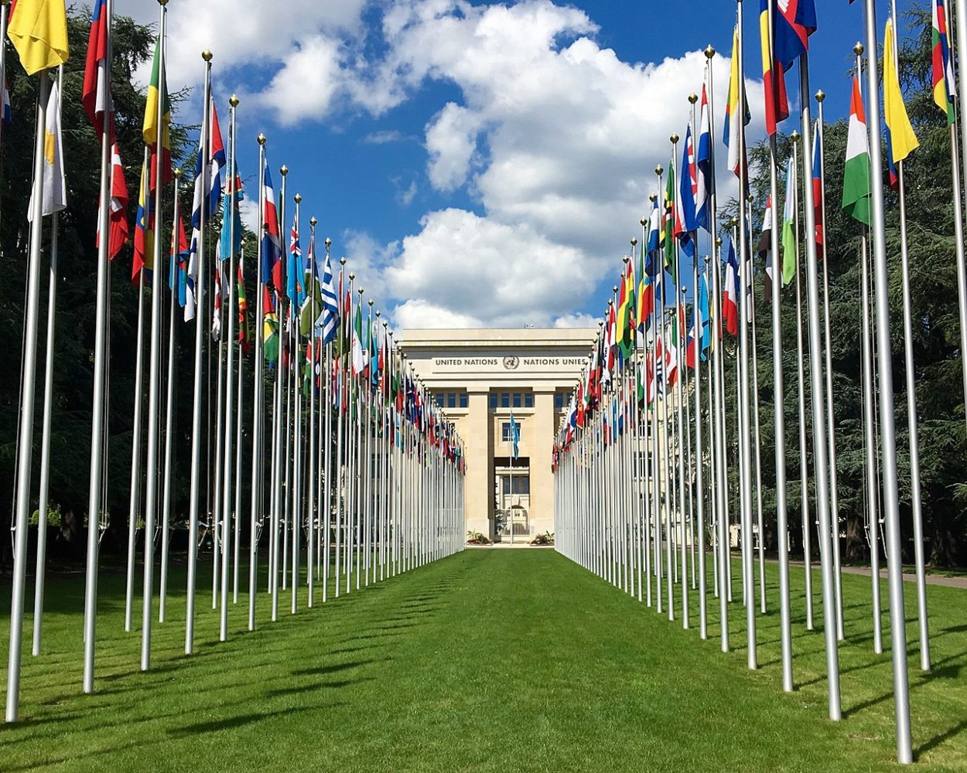
The participation of Morocco in this Panel
During this Panel, the President of the Central Instance for the prevention of corruption in Morocco, shared the national experience in combatting corruption by highlighting the following elements :
12 years prior to the ratification by Morocco of the Convention, Moroccan civil society started campaigning against corruption;
Corruption was widespread at the grassroots level, high-level corruption was still unclear in the minds of the public;
Examples on how anti-corruption campaigners involved families, doctors, paramedics, to carry out risk-mapping and identify gaps.

Slide 10
Main Outcomes of this panel
The consensus regarding the link existing between anti-corruption efforts and HR;
The need to address the negative impact of corruption on the enjoyment of HR;
The importance of a follow-up mechanism and for regular reporting on HR and corruption.

Slide 11
III - The different resolutions adopted by HRC on corruption (2013-2019)
The Kingdom of Morocco has reaffirmed, since 2013, its full and constant commitment to address corruption as one the most enormous obstacles to the enjoyment of HR;
Morocco submitted four resolutions together with Austria, Indonesia, Poland, Ethiopia, Brazil, Argentina, United Kingdom, in 2013, 2015, 2017 and 2019. Thereby addressing the negative impact of corruption on the enjoyment of HR;
All these resolutions were adopted without a vote.
In September 2012, the resolution (A/HRC/RES/21/13) decided to convene, at its 22 session a panel discussion on the issue of the negative impact of corruption on the enjoyment of human rights;
In June 2013, the resolution (A/HRC/RES/23/9) requested the Committee to submit a research-based report on the negative impacts of corruption on HR & to make recommendations on how to consider this issue;
In July 2014, the HRC decided (A/HRC/DEC/26/115) to request the Committee to submit the final research-based report
to the Council at its twenty-eighth session
In July 2015, the resolution (A/HRC/RES/29/11) requested the High Commissioner to prepare a compilation of best practices of efforts to counter the negative impact of corruption on the enjoyment of all HR
In June 2017, the resolution (A/HRC/RES/35/25) requested the HC to organize an expert workshop, to exchange best practices on how the UN supports States in preventing and fighting corruption, with a focus on HR
In July 2019, the resolution (A/HRC/RES/41/9) stressed the importance of policy coherence among the intergovernmental processes in Geneva, Vienna and New York on the issue of corruption and its impact on human rights

Slide 12
III - The different resolutions adopted by HRC on corruption (2013-2019)
The first resolution submitted by Morocco (A/HRC/RES/23/9) to the HRC on the negative impact of corruption on the enjoyment human rights, was adopted during 23th session of the HRC, held in June 2013, under the agenda item 3. In this resolution the Council recognized:
The link between anti-corruption efforts and human rights, and the importance of exploring how to better utilize UN human rights mechanisms in this regard;
Requested the Advisory Committee to submit a research-based report to the HRC on the issue of the negative impact of corruption on the enjoyment of human rights, and to make recommendations on how the Council and its subsidiary bodies should consider this issue.
In June 2013, the resolution (A/HRC/RES/23/9) requested the Committee to submit a research-based report on the negative impacts of corruption on HR & to make recommendations on how to consider this issue;

Slide 13
III - The different resolutions adopted by HRC on corruption (2013-2019)
In July 2014, the HRC adopted during its 26th session (02-27 March 2015) a decision (A/HRC/DEC/26/115) through which the Council :
Accepted the request made by the Committee to extend the time schedule envisaged for the research-based report to allow for better informed work, inter alia, by analysing the numerous recently received responses to the Questionnaire;
Decided to request the Committee to submit the final research-based report to the Council at its 28th session.
In July 2014, the HRC decided (A/HRC/DEC/26/115) to request the Committee to submit the final research-based report
to the Council at its twenty-eighth session

Slide 14

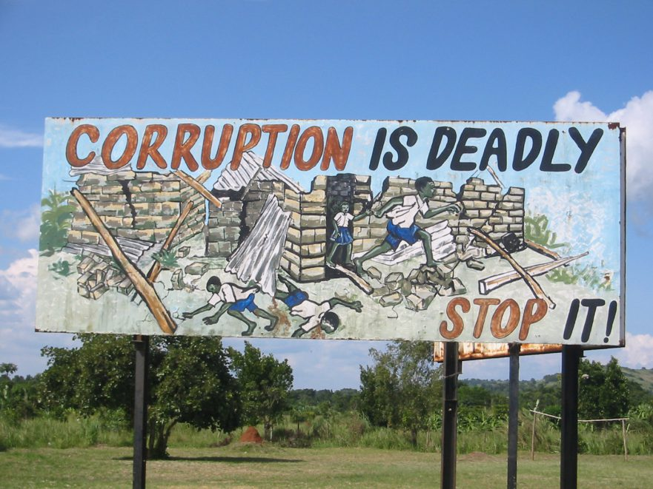
III - The different resolutions adopted by HRC on corruption (2013-2019)
Final report on the negative impact of corruption on the enjoyment of Human Rights (Jan. 2015)
On the 05 January 2015, the Advisory Committee published its final report on the issue of the negative impact of Corruption on the enjoyment of HR and concluded, inter alia, that:
The link between corruption and impairment of the enjoyment of HR does not necessarily require to develop a clear-cut definition of corruption;
From a HR perspective, the differentiation of corruption in the public sector and the private sector makes sense, as both sectors can lead to violations of HR;
The difficulty to identify all of the HR that can be violated by corruption;
The HR perspective should not be seen as jeopardizing any effort to combat corruption under criminal law.

Slide 15
III - The different resolutions adopted by HRC on corruption (2013-2019)
The second resolution submitted by Morocco (A/HRC/RES/29/11) to the HRC on the negative impact of corruption on the enjoyment human rights, was adopted during 29th session of the HRC, held in July 2015, under the agenda item 3. In this resolution the Council emphasized that:
Human rights education and awareness-raising campaigns and other measures are important enablers for the prevention of and the fight against corruption;
Recognized that the negative impact of corruption on human rights and sustainable development can be combated through anti-corruption education;
Encouraged the mechanisms of the HRC to consider, within their existing mandates, the issue of the negative impact of corruption on the enjoyment of human rights.
In July 2015, the resolution (A/HRC/RES/29/11) requested the High Commissioner to prepare a compilation of best practices of efforts to counter the negative impact of corruption on the enjoyment of all HR

Slide 16
III - The different resolutions adopted by HRC on corruption (2013-2019)
The third resolution submitted by Morocco (A/HRC/RES/35/25) to the HRC on the negative impact of corruption on the enjoyment human rights, was adopted during 35th session of the HRC, held in July 2017, under the agenda item 3. In this resolution the Council urged States to:
Create and maintain, in law and in practice, while addressing the negative impact of corruption on the enjoyment of human rights, a safe and enabling environment in which civil society can operate free from hindrance and insecurity;
Requested the Office of the High Commissioner to organize an intersessional, half-day open-ended expert workshop, with the objective of exchanging best practices on how the United Nations system supports States in preventing and fighting against corruption, with a focus on human rights;
In June 2017, the resolution (A/HRC/RES/35/25) requested the HC to organize an expert workshop, to exchange best practices on how the UN supports States in preventing and fighting corruption, with a focus on HR

Slide 17
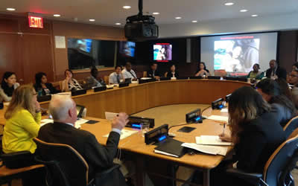
III - The different resolutions adopted by HRC on corruption (2013-2019)
On 11 June 2018, the OHCHR organized in coordination with the UNODC an intersessional half-day open-ended expert workshop aiming to exchange best practices on how the UN system supports States in preventing and fighting corruption, with a focus on HR. This workshop concluded, inter alia, that :
The measurement of corruption is inherently difficult, and measuring its impact on HR even more so ;
Corruption affects most significantly the HR of the poor, marginalized and vulnerable segments of society;
International HR mechanisms increasingly address corruption as a structural impediment to the realization of HR;
Anti-corruption and HR actors stand to benefit from a greater exchange of information, sharing of approaches and practices, and coordination.

Slide 18
III - The different resolutions adopted by HRC on corruption (2013-2019)
The fourth resolution submitted by Morocco (A/HRC/RES/41/9) to the HRC on the negative impact of corruption on the enjoyment human rights, was adopted during 41th session of the HRC, held in July 2019, under the agenda item 3. In this resolution the Council underlined :
The importance of HRC mechanisms, such as the Universal Periodic Review, and the treaty bodies in raising awareness and strengthening the commitment to tackle the negative impact of corruption;
Stressed the importance of policy coherence among the intergovernmental processes in Geneva, Vienna and New York on the issue of corruption and its impact on human rights;
Requested the Office of the High Commissioner to prepare a report on the challenges faced and best practices applied by States in integrating human rights into their national strategies and policies to fight against corruption, including those addressing non-State actors.
In July 2019, the resolution (A/HRC/RES/41/9) stressed the importance of policy coherence among the intergovernmental processes in Geneva, Vienna and New York on the issue of corruption and its impact on human rights

Slide 19

IV - The Way Forward
The current debate on the negative impact of corruption on the enjoyment of Human Rights reveals the unanimity of the international community regarding:
The importance and the need to raise awareness on the negative impact of corruption on the enjoyment of HR
The detrimental impact of widespread corruption on HR through both the weakening of institutions and the erosion of public trust in government
The central role, that promotion and protection of HR can play in the prevention and the fight against corruption at all levels
The vulnerable groups of society are incurring higher risks of suffering from the adverse impact of corruption on the enjoyment of HR.

Slide 20
IV - The Way Forward
The Kingdom of Morocco is of the view of maintaining the momentum through:
Engaging a broad debate on the ways to generate the required interactive synergy, positive dynamic and comprehensive complementarity among the intergovernmental process in Geneva, Vienna and New York on the issue of corruption and its impact on human rights . We should focus on the following elements:
Ensuring the effective means for the full and effective implementation of the resolutions on the negative impact of corruption on the enjoyment of Human Rights;
Building an efficient correlation between the Universal Periodic Review and the Review Mechanism in order to continue raising awareness and strengthening our commitment to tackle the negative impact of corruption;
Deepening the understanding of the nexus between corruption and Human Rights;
Underlining the role of the upcoming report of the High Commissioner in assisting Member States to set up procedures that go beyond the current studies.

Slide 21
IV - The Way Forward
8 years after the organization of the first side-event on “Human Rights and Fight Against Corruption” in Morocco, and 6 years following the adoption of the first resolution on the negative impact of Corruption on the enjoyment of HR in the HRC, the Kingdom of Morocco is of the view that it’s high time to emphasize the following :
Geneva process:
the importance of setting up a transparent, efficient, inclusive and impartial, special procedure or mechanism (Working Group, Independent Expert);
The importance of the UPR and HRB recommendations for preventing and countering corruption ;
Vienna process:
The central role of implementing the UNCAC Convention;
The importance of issuing implementable recommendations through the review mechanism ;
New York process:
the importance of policy coherence among the intergovernmental processes in Geneva, Vienna and New York on the issue of corruption and its impact on human rights, in line with OP 12 of the resolution on the negative impact of corruption on the enjoyment of Human Rights 2019;
The political declaration of the Special session of the General Assembly against corruption 2021 , could be a new opportunity for the international community to be united for an enhanced and sustained action against corruption, in line with OP 12 of the resolution on the negative impact of corruption on the enjoyment of Human Rights 2019.

Slide 22
UNITED AGAINST CORRUPTION
UPR/HRB
Geneva Process (negative impact of corruption on the enjoyment of HR)
Review Mechanism
Vienna Process (Convention UNCAC )
UNGASS 2021
New York Process (political declaration)
Interactive synergy Positive dynamic Comprehensive complementarity

Slide 23

Thank you for your attention

