Slide 1
The SDGs and Economic Rights
Jeffrey D. Sachs
University Professor at Columbia University
Human Rights and the 2030 Agenda
United Nations Human Rights Council
January 16, 2019

Slide 3
The SDGs are Largely About Economic Rights
Social Protection (SDG 1)
Food (SDG 2)
Health (SDG 3)
Education (SDG 4)
Water and Sanitation (SDG 6)
Energy services (SDG 7)
Decent livelihoods (SDG 8)
Safe Environment (SDG 11, 12, 13, 14, 15)

Slide 4
Massive Shortfall in SDG Outcomes and Financing in Sub-Saharan Africa
 | SDG Target | Current Situation in SSA
Neonatal Mortality | 12/1,000 | 27.2/1,000
Under-5 Mortality | 24/1,000 | 75.9/1,000
Maternal Mortality (Africa) | 70/100,000 | 542/100,000
Upper-Secondary Completion | 100% | 27%
Public Spending on Health | $110 per capita (LICs) | $8.10 per capita (LICs), median
Public Spending on Education | $110 per capita (LICs) | $23 per capita (LICs), median

Slide 5
IMF Staff Calculations

Slide 6
IMF Staff Calculations

Slide 7
Roughly
$350 Billion
Financing Gap

Slide 8
SDG 17 Targets on Resource Mobilization for the Achieving the SDGs
17.1 Strengthen domestic resource mobilization, including through international support to developing countries, to improve domestic capacity for tax and other revenue collection
17.2 Developed countries to implement fully their official development assistance commitments, including the commitment by many developed countries to achieve the target of 0.7 per cent of ODA/GNI to developing countries and 0.15 to 0.20 percent of ODA/GNI to least developed countries; ODA providers are encouraged to consider setting a target to provide at least 0.20 per cent of ODA/GNI to least developed countries
17.3 Mobilize additional financial resources for developing countries from multiple sources
17.4 Assist developing countries in attaining long-term debt sustainability through coordinated policies aimed at fostering debt financing, debt relief and debt restructuring, as appropriate, and address the external debt of highly indebted poor countries to reduce debt distress
17.5 Adopt and implement investment promotion regimes for least developed countries

Slide 9
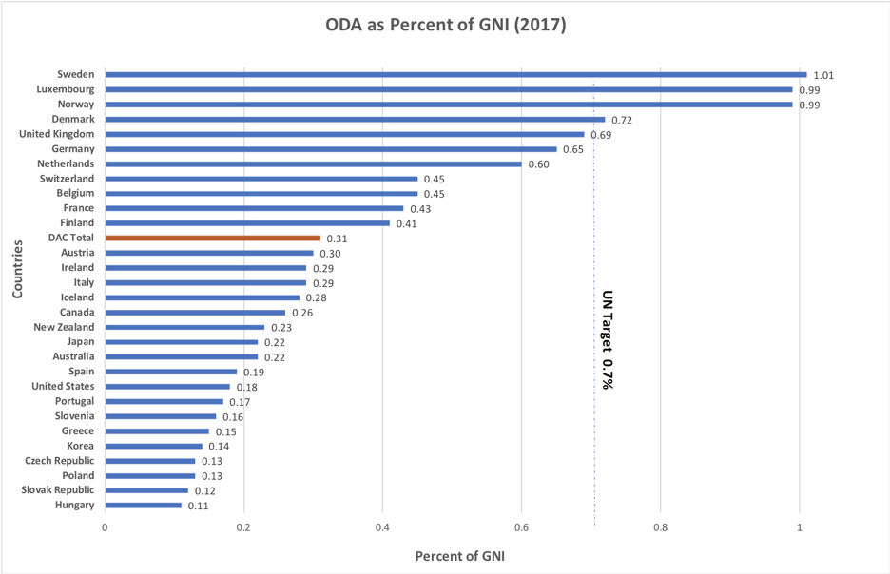
ODA as Share of Donor Gross National Income

Slide 10
7X inflation-
adjusted
5X

Slide 11
Revenue Source | Resource Base | Target Revenues | Current Revenues
Official Development Assistance | > $50 Trillion | $350 Billion | $140 Billion
US ODA | $20 Trillion | $140 Billion | $35 Billion
Carbon Tax | 35 Gt CO2 Emission | $175 Billion | <$25 Billon
Billionaires’ Levy | $9.1 Trillion | $91 Billion | <$10 Billion
Financial Transactions Tax | $50 Trillion | $50 Billion | <$5 Billion
Offshore Account Tax | $20 Trillion | $50 Billion | $0
Technology Tax | $500 Billion (estimate) | $10 Billion (estimate) | $0
Luxury Tax | $1 Trillion (estimate) | $50 Billion (estimate) | TBD
Sumptuary Taxes (tobacco, sugar beverages, alcohol) | TBD | TBD | TBD
Debt Relief Operations | TBD | TBD | TBD

