Slide 1
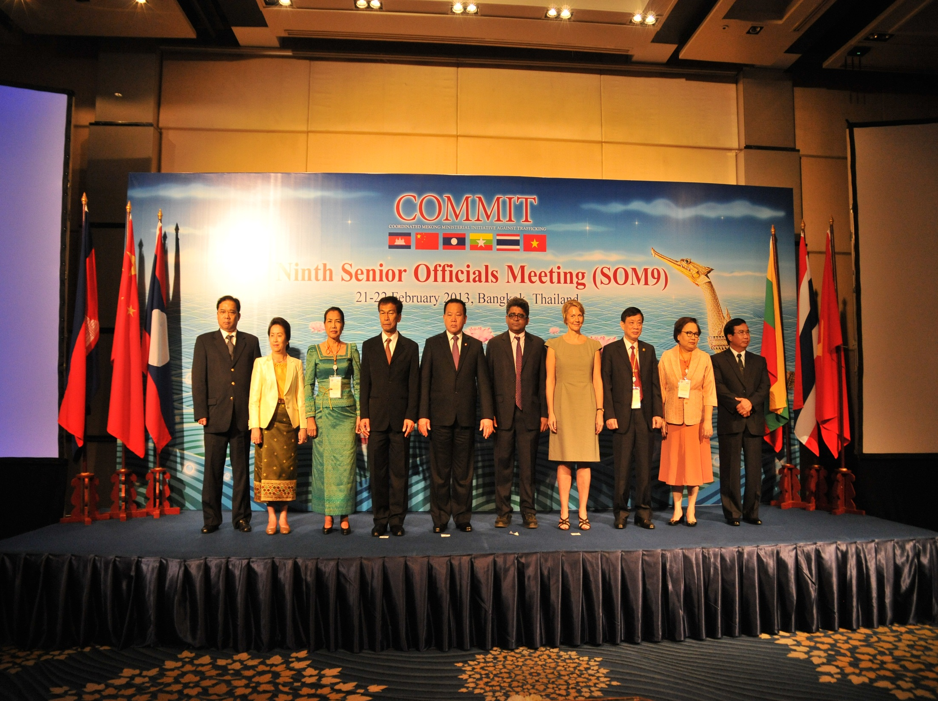


REGIONAL INIATIVES IN
THE MEKONG REGION
CAMBODIA | CHINA | LAO PDR | MYANMAR | THAILAND | VIETNAM

Slide 2
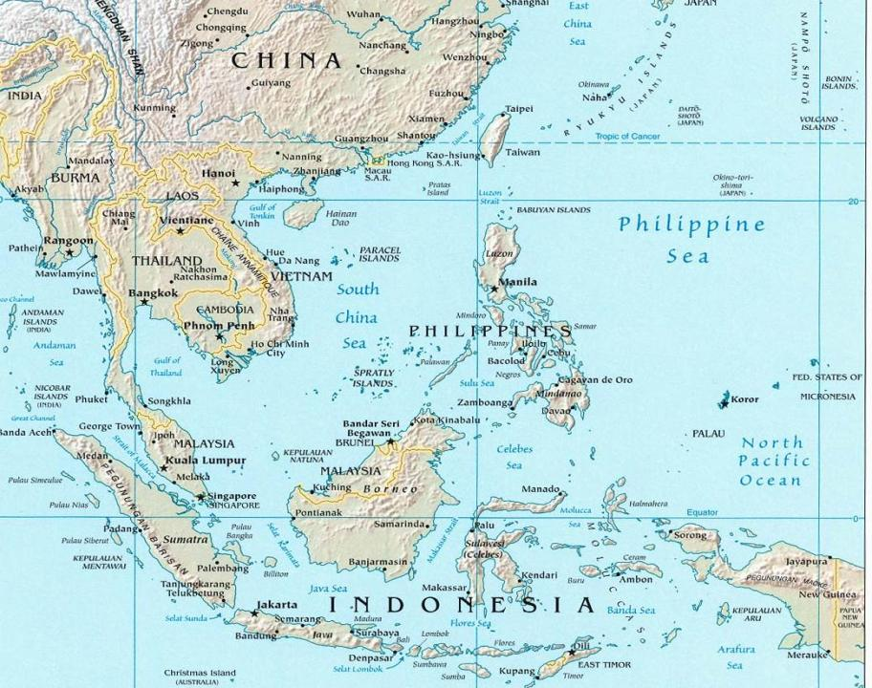
Government-led process between 6 GMS governments (China, Cambodia, Lao PDR, Myanmar, Thailand, Vietnam)
COMMIT Memorandum of Understanding signed by 6 countries in 2004 (Ministerial level)
Multi-sectoral COMMIT Task Forces established to oversee national activities across all 4 Ps
Sub-regional Action Plans (COMMIT SPAs) and annual COMMIT SOMs provide operational framework
Annual Workplans developed and implemented

Slide 3
How does COMMIT work?
National COMMIT Task Forces: Multi-sectoral action
Police
Women’s Affairs
Justice
iNGOs
Local NGOs
National COMMIT Workplan
Social Welfare
UN
Tourism
IOs
Academics
Foreign Affairs
UN
IOs
Education
Labor

Slide 4
SPA evolution process
SPA 1. Coming together
SPA 2. Consolidation
SPA 3. Aligning with MoU
SPA 4. Systems building/
Sustainability

Slide 5
UN-ACT Project outline
REGIONAL
COOPERATION
Southeast Asia & Beyond
COMMIT
PROCESS
Cooperation &
Mutual Support
Greater Mekong
Sub-region
INCREASED & SUSTAINED CAPACITY
CIVIL SOCIETY & OTHER NON-STATE ACTORS
KNOWLEDGE
BASE

