Slide 1
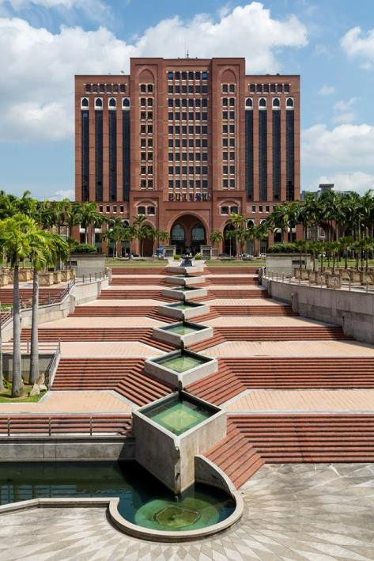

Second Consultative Meeting on Strengthening Partnerships with National Rapporteurs on Trafficking In Persons and Equivalent Mechanisms
Syuhaida Abdul Wahab Zen
Secretariat to the Council For Anti-trafficking in Persons and Anti-smuggling of Migrants,
International Division,
Ministry of Home Affairs Malaysia
21-22 May 2014
Chatrium Residence Sathon, Bangkok
Notes:
This template can be used as a starter file for presenting training materials in a group setting.
Sections
Right-click on a slide to add sections. Sections can help to organize your slides or facilitate collaboration between multiple authors.
Notes
Use the Notes section for delivery notes or to provide additional details for the audience. View these notes in Presentation View during your presentation.
Keep in mind the font size (important for accessibility, visibility, videotaping, and online production)
Coordinated colors
Pay particular attention to the graphs, charts, and text boxes.
Consider that attendees will print in black and white or grayscale. Run a test print to make sure your colors work when printed in pure black and white and grayscale.
Graphics, tables, and graphs
Keep it simple: If possible, use consistent, non-distracting styles and colors.
Label all graphs and tables.

Slide 2
SCOPE OF PRESENTATION
Background
Strategic Cooperation
The Council

Slide 3
BACKGROUND

Slide 4
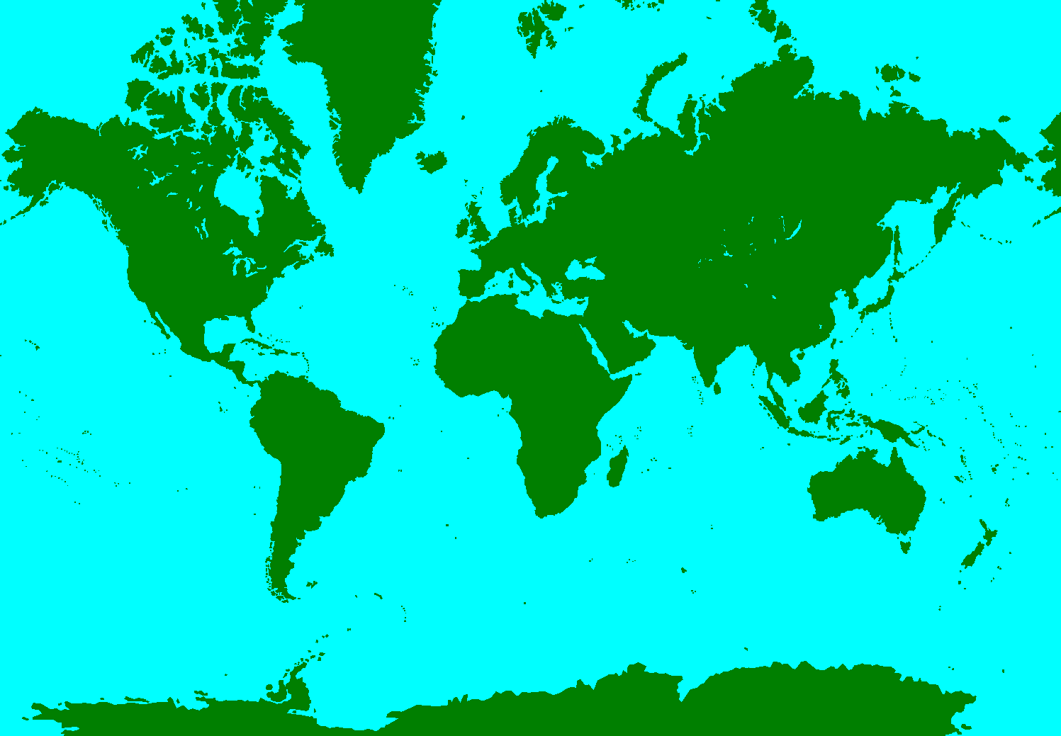
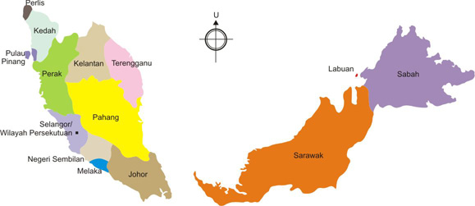
The Geography of Malaysia
MALAYSIA
THE PUSH
THE PULL
COUNTRY OF ORIGIN
  SOCIO ECONOMIC STATUS
  THE POLITICAL CLIMATE
  NATURAL DISASTER
MALAYSIA
  THE ECONOMIC AND POLITICAL STABILITY
  GEOGRAPHICAL DISTANCE

Slide 5
BACKGROUND
15 Nov 2010
Amendment to ATIP Law 2010
2010
31 March 2010
Provisions used :
Immigration Act 1959/63
Child Act 2001
Penal Code
Focus on:
Prosecution
28 Feb 2008
National Action Plan
Extension on:
Labour Exploitation
Smuggling of Migrants offences
Year
ATIP Act 2007
2007
5 Guiding Principles
9 Strategic Goals
9 Program Areas
Prior to ATIP Law
Policy
Prevention
Prosecution
Protection
The Council
The Committees
2000
Development

Slide 6
Anti-Trafficking in Persons Act 2007 [Act 670]
Part I – Preliminary
Part II – Council for Anti-Trafficking in Persons
Part III – Trafficking in Persons Offences, Immunity, Etc
Part IIIA – Smuggling of Migrants
Part IV – Enforcement
Part V – Care & Protection Trafficked Persons
Part VI – Miscellaneous

Slide 7
THE COUNCIL

Slide 8
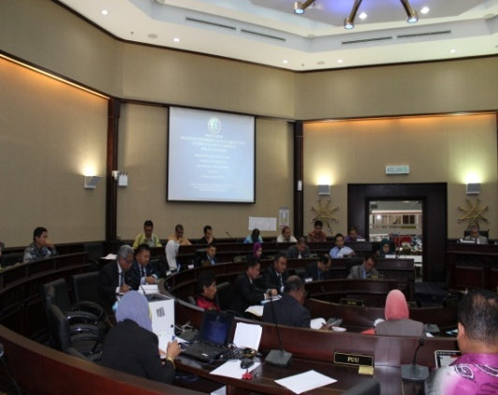
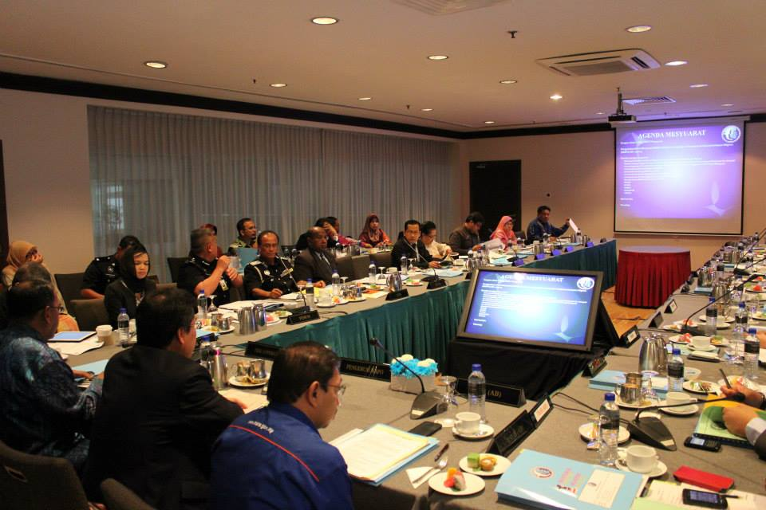

The Secretary General of the Ministry of Home Affairs
(Chairman)
The Secretary General of the Ministry of Foreign Affairs
The Secretary General of the Ministry of Women, Family and Community Development
The Secretary General of the Ministry of Transport
The Secretary General of the Ministry of Human Resources
The Secretary General of the Ministry of Communication and Multimedia
Attorney General
Inspector General of Police
COUNCIL
MEMBERS
Director General of Immigration
Director General of Customs
Director General of Malaysian Maritime Enforcement
A representative of Ministry of Home Affairs
5 Representative from Non-Government Organization
(MKKM, IKMAS (UKM), NCWO, SUHAKAM)

Slide 9
THE COMMITTEES
COUNCIL FOR ANTI TRAFFICKING IN PERSONS AND ANTI SMUGGLING OF MIGRANT
Secretariat to the Council
Legislation Committee
Attorney General’s Chamber
Enforcement Committee
Royal Malaysian Police
Protection and Rehabilitation
Committee
Ministry of Women, Family and Community Development
Special Committee to Combat
Labour Trafficking
Ministry of Human Resources
Media and Publicity Committee for Anti Trafficking in Persons
Ministry of Communication and Multimedia

Slide 10
Strategic Cooperation

Slide 11
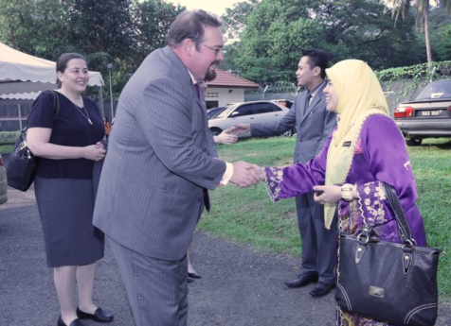
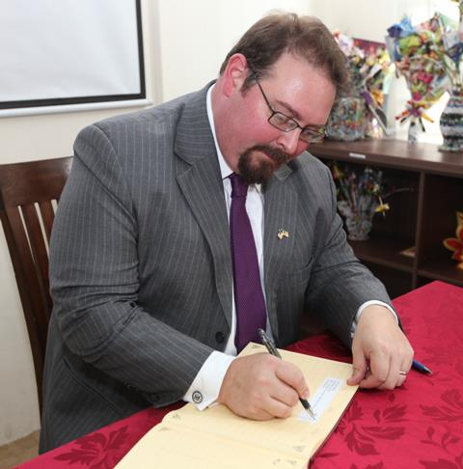
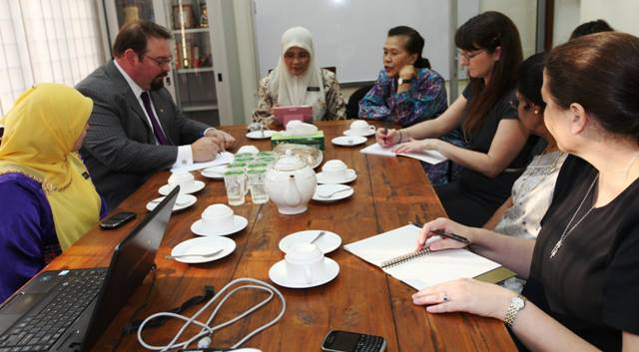
LUIS CDEBACA VISIT - US AMBASSADOR FOR HUMAN TRAFFICKING (30 JULY 2013)
Environment of the Shelter Home
Income generated activities for victims
Greater involvement of NGOs
Medical screening
Higher level of representation in the Council

Slide 12
The Five (5) P Approach
Partnership
Protection
Policy
Prosecution & Enforcement
Prevention

Slide 13
policy
Cases involving non-nationals to be investigated under ATIPSOM 2007
Victims of trafficking to work after completion of Protection Order
Victims of labour trafficking who does not require further care and protection to work
Policy

Slide 14
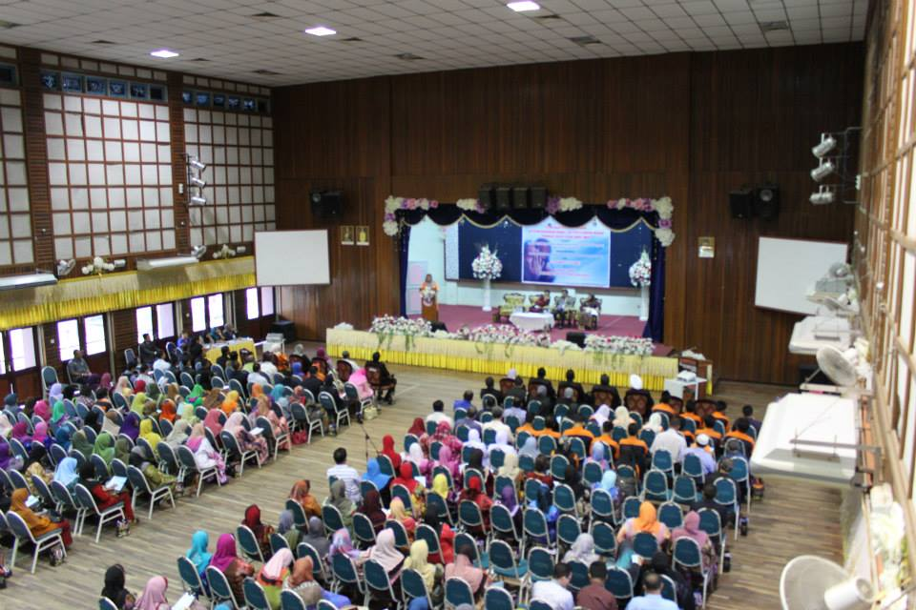
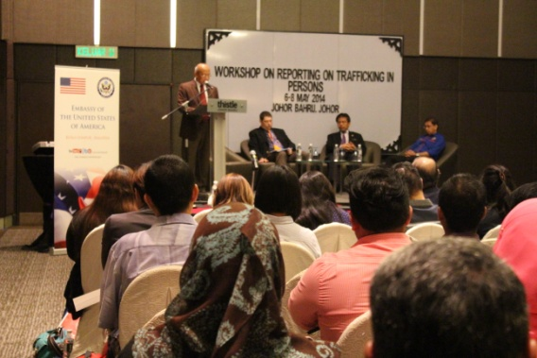
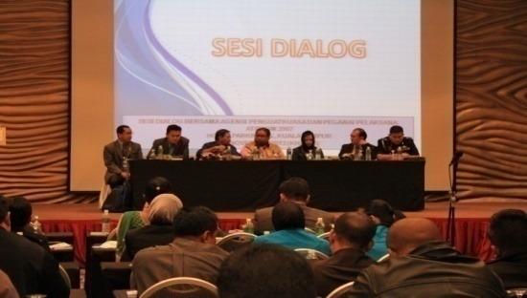
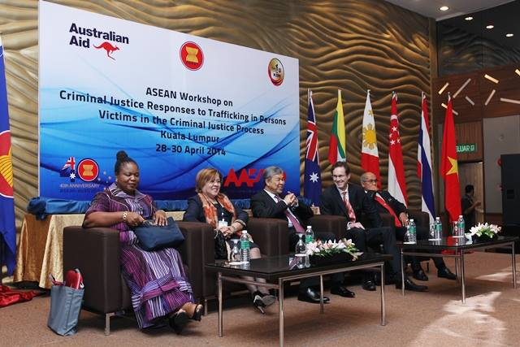
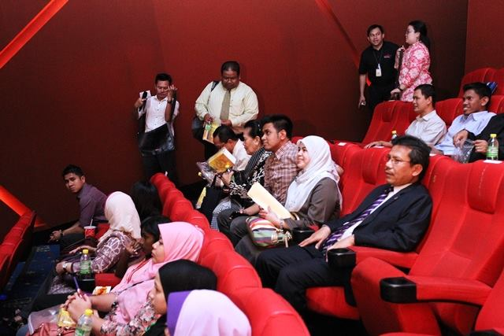
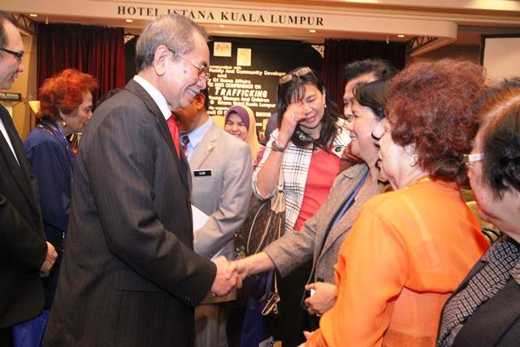
prevention
Capacity Building
Awareness
Outreach
Dialogues
Criminal Practitioners
State level awareness program
Students
Media and publicity
NGO/Workers
Enforcement Officers
Trainings

Slide 15





Slide 16
prosecution
ENFORCEMENT
752 cases investigated
1925 victims
1058 arrests
(28.02.2008 – 31.03.2014)
(28.02.2008 – 31.03.2014)
PROSECUTION
562 cases charged
128 convictions

Slide 17
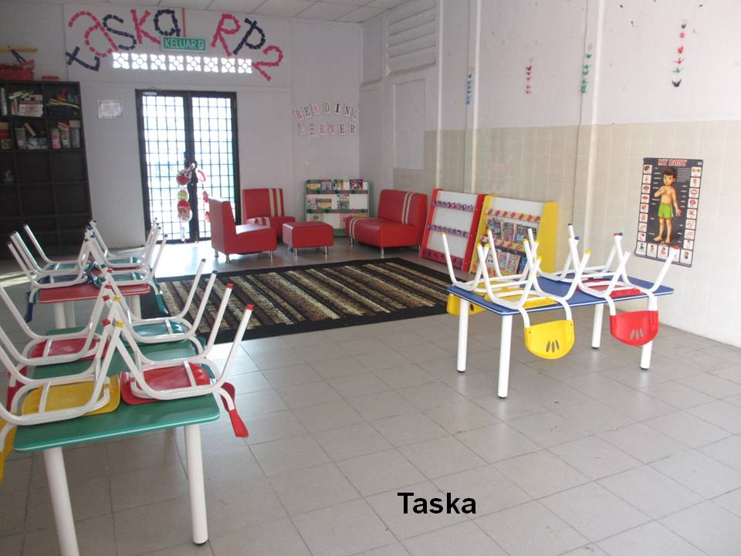
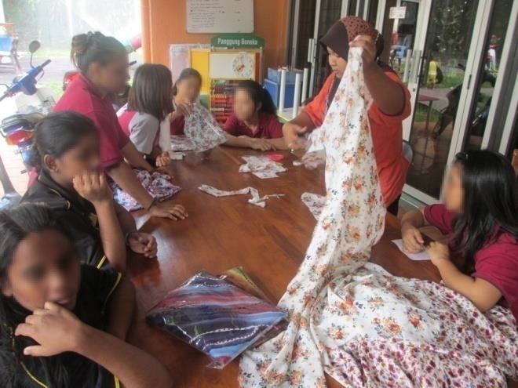
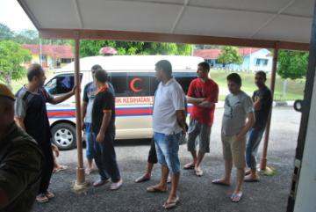
protection
Shelter Homes
Seed funding for NGO Support Shelter Homes
Income generated Programme
Vocational training
Case management
Medical assistance

Slide 18











partnership

Slide 19











partnership

Slide 20






Bilateral cooperation
18 April 2011
25 July 2011
2 August 2012
17 July 2012
26 November 2012
6 October 2013
Notes:
Realising on the greater threats posed by transnational crime, the direction of the Ministry now is to go for a comprehensive cooperation covering these issues and not on any particular crime per se.
The increase of intel / information exchange, capacity building, exchange of experts.
In the pipeline, China + Vietnam

Slide 21


Future Cooperation
MoU on TIP
[in the pipeline]
MoU on TIP
[in the pipeline]

Slide 22






Future Cooperation
MoU on TNC
[in the pipeline]
MoU on TNC
[in the pipeline]
MoU on TNC
[in the pipeline]
MoU on TNC
[in the pipeline]
MoU on TNC
[in the pipeline]
MoU on TNC
[in the pipeline]

Slide 23

Thank You
Secretariat to the Council for Anti-Trafficking in Persons and Anti Smuggling of Migrant
International Division
Ministry of Home Affairs MALAYSIA

Slide 24

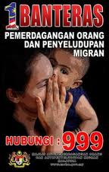

Slide 25
How can NREMs foster cooperation with State actors in destination, transit and source countries while retaining independence and impartiality? Challenges and good practices
What is the role of national rapporteurs in strengthening cooperation with non-state actors (including CSOs, business and medical communities)? Challenges and good practices

Slide 26
INTERNATIONAL
COOPERATION
Regional
Multilateral
Bilateral
Notes:
Regionally: AMMTC, SOMTC, Bali Process
ASEAN Declaration Against Transnational Crime 1997
Plan of Action to Combat Transnational Crime 1999
ASEAN Declaration against Trafficking in Persons, particularly Women and Children 2004
Considering to establish ASEAN Convention against Trafficking in Persons
Multilaterally : Signatory UNTOC 2003. Accede to the TIP Protocol under UNTOC in 2009. UN.GIFT 2009
International Organisations – IOM, UNHCR, UNIAP
Accede & Ratify to the TIP Protocol under UNTOC

Slide 27
MULTILATERAL
ENGAGEMENT
United Nations Convention against Transnational Organized Crime (UNTOC)
Protocol to Prevent, Suppress and Punish Trafficking in Persons, Especially Women and Children (TIP Protocol)

Slide 28
Regional Cooperation
ASEAN Convention on Trafficking in Persons (ACTIP)
Regional Plan of Action (RPA) to Combat Trafficking in Persons

Slide 29
SWOT ANALYSIS
Primary factors
MECHANISM
Policy
Some unforseen uneffectiveness of government programmes
Some agencies have competence and capabilities issues
Gap in experience, knowledge and skills of RRU to handle security threats
Resources and financial aspects and readiness are not planned well
Reliability and trust vacuum between government officials and politicians
Geographical factors limit the movements
P1
Directive to investigate cases involving foreign nationals under ATIPSOM 2007
Allowing victims of trafficking to work after completion of Protection Order
Allowing victims of labour trafficking who does not require further care and protection to work
.
Prevention
P2
Prosecution
Protection
O
A strategic alliances, partnerships
A chance to sell RRU templates to JPA as career development tool dan tool for other ministries.
RRU product innovation and development
Import, export advanced knowledge and skills
T
Scarcity and non-strategic networking
Unrecognised internal and external threat within organisation / structure
Information trade / leakage
Strong and aggressive competition in technology and information
Competitors continuously invent new products and innovation

Slide 30
partnership
Multi-lateral
Domestic
Regional
Bilateral
State Actors
Ministries
Agencies
ASEAN
ASEAN Ministerial Meeting (AMMTC)
ASEAN Senior Officials Meeting (SOMTC)
ASEAN Senior Officials Meeting On Drug Matters (ASOD)
ASEAN Directors General Of Immigration And Head Of Consular Affairs Meeting (DGICM)
Opportunities
Inter-agencies collaboration
Threats
Limited accessibility of information and networking.
Non State Actors
NGOs
Human Rights Council
Bali Process
Consulrative approach
Opportunities
Intra-agencies collaboration
Threats
Limited skills and knowledge in analyzing accessible information and networking.

Slide 32
prevention
Capacity Building Programmes
Enforcement officers
Practioners
Awareness Programmes
Media
Campaign
Outreach Programmes
Students
Communities

Slide 33
The Framework
Prosecution
Enforcement
Protection
Offences:
Part III (Trafficking in Persons)
Part IIIA (Smuggling of Migrants)
Part IV (Enforcement officers)
Power of investigation
Part V (Care and Protection of Trafficked Persons)
Place of refuge
Interim Protection Order (IPO)
Protection Order (PO)
- Sect. 12 – 15A
- Sect. 26A – 26K
Power of arrest
Power to examine persons
Institution of prosecution
Protection Officer

Slide 34
TRAFFICKING IN PERSONS OFFENCES
SECTION 12
Offence of trafficking in persons
SECTION 13
Offence of trafficking in persons by means of threat, force, etc.
SECTION 14
Offence of trafficking in children
SECTION 15
Offence of profiting from exploitation of a trafficked person
SECTION 15A
Offence in relation to trafficked person in transit
Not exceeding 15 years imprisonment
Liable to fine
Between 3 – 15 years imprisonment
Liable to fine
Between 3 - 20 years imprisonment
Liable to fine
Not exceeding 15 years imprisonment
Between RM500,000 to RM1,000,000
Not exceeding 7 years imprisonment
Liable to fine
247 charges
116 charges
29 charges
3 charges

Slide 35
SMUGGLING OF MIGRANTS OFFENCES
SECTION 26A Offence of smuggling of migrants
SECTION 26B Aggravated offence of smuggling of migrants
SECTION 26C Offence in relation to smuggled migrant
SECTION 26D Offence of profiting from the offence of smuggling of migrants
SECTION 26E Fraudulent travel or identity documents
SECTION 26F Providing facilities in support of smuggling of migrants
SECTION 26G Providing services for purposes of smuggling of migrants
SECTION 26H Concealing or harboring smuggled migrants and migrant smugglers
SECTION 26I Supporting offence of smuggling of migrants
SECTION 26J Offence of conveyance of smuggled migrants
SECTION 26K Obligation of owner, etc., of conveyance

Slide 36
THE WORKFLOW
APPLY IPO
(24 HRS)
SECT. 44
SHELTER HOME
(14 DAYS)
SECT. 44(2)
RESCUED PROCESS
RECORDING OF
STATEMENT
SECT. 34
MEDICAL SCREENING
SECT. 46
INVESTIGATION
(WITHIN THE PERIOD OF 14 DAYS
REPORTS WILL HAVE TO
BE BROUGHT TO
MAGISTRATE FOR DECISION
REPORT. SEC 51(1)
INVESTIGATION OFFICER INVESTIGATE :
PURPOSE OF DETERMINING WHETHER THE VICTIM
IS A TRAFFICKED PERSON
PROTECTION OFFICER : ENQUIRE INTO THE
BACKGROUND OF THE PERSON.
PO: SHELTER HOME – SEC 51(3)
- NATIONALS - NOT EXCEEDING 2 YRS
- FOREIGN– NOT EXCEEDING 3 MTHS
CRIMINAL PROSECUTION
INSTITUTED AGAINST SUSPECT
MAGISTRATE TO RECORD
EVIDENCE OF VICTIM’
WITHIN 7 DAYS FROM
THE DATE OF THE PRODUCTION
OF VICTIM BEFORE HIM/HER.
SEC. 52(3)
RELEASE OF TRAFFICKED PERSON– SEC 54
- LOCAL– RELEASE THE PERSON TO RELATIVE/GUARDIAN
FOREIGN – RELEASE TO IMMIGRATION DEPT
TO FACILITATE RETURN TO COUNTRY OF ORIGIN

Slide 37
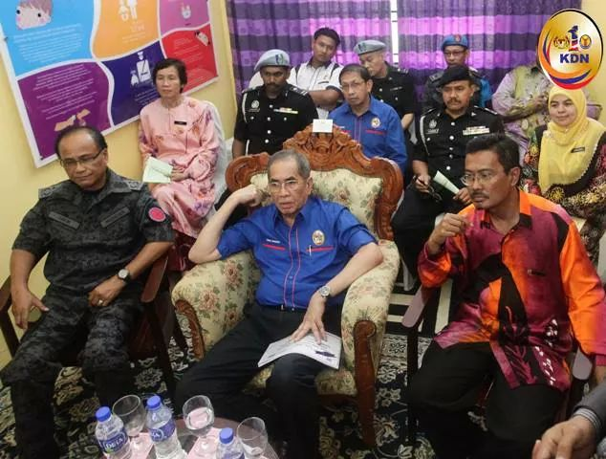
ACTIVITIES

Slide 38
Distinguished Characters
Trafficking in Persons
Migrant Smuggling
Crime against individual
Exploitation
Victim of trafficking
Cross and within border
UN Protocol to Prevent, Suppress and Punish Trafficking in Persons
Crime against state
Consensual
Immigration violation
Cross border
UN Protocol Against Smuggling of Migrants by Land, Sea and Air

Slide 39
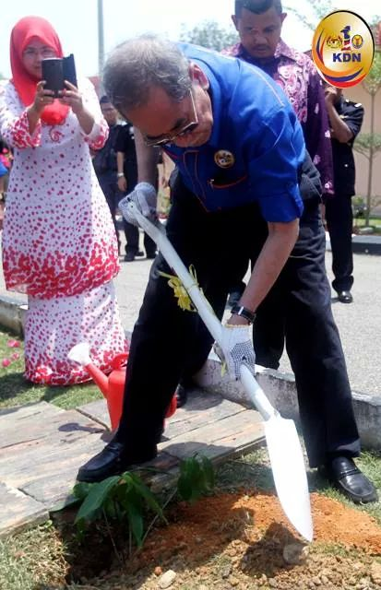
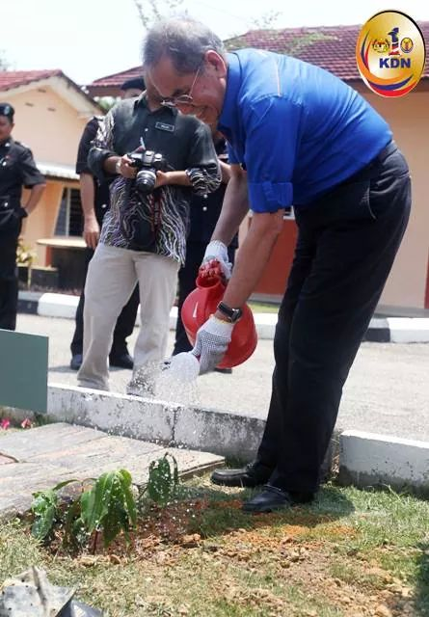

Slide 40
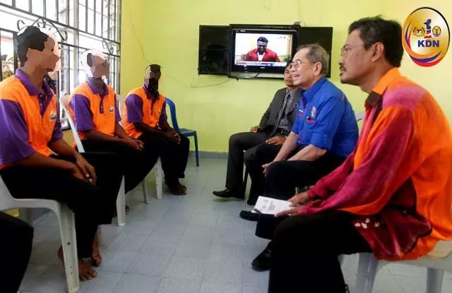

Slide 41
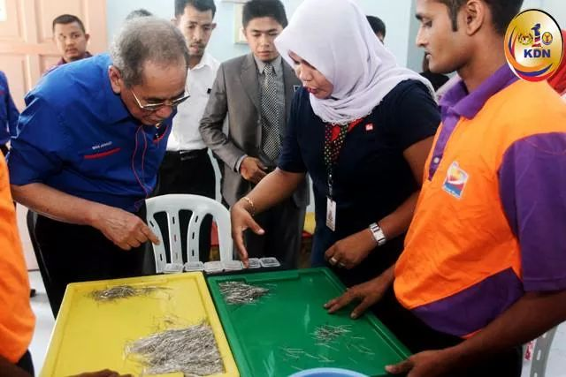

Slide 42
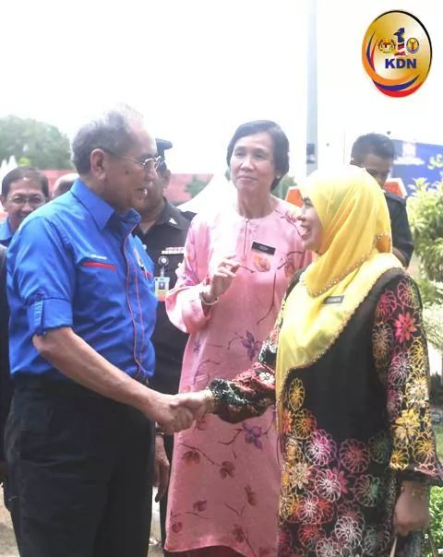

Slide 43
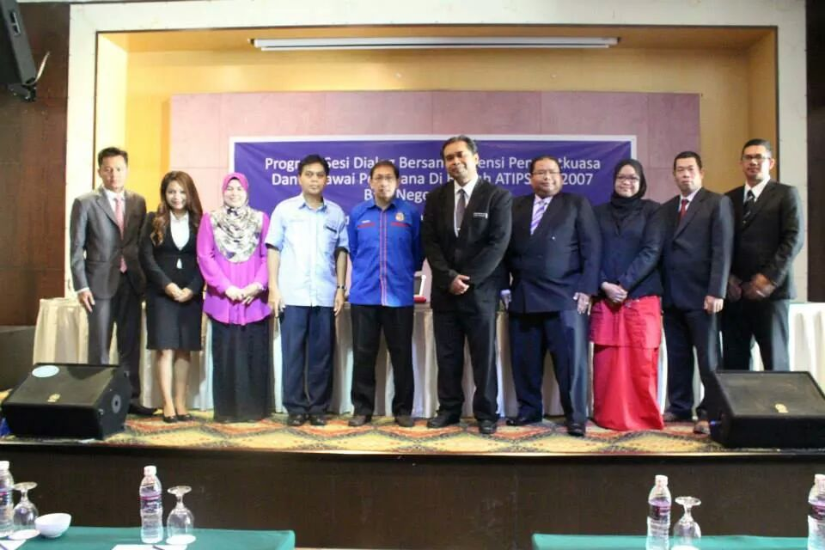

Slide 44
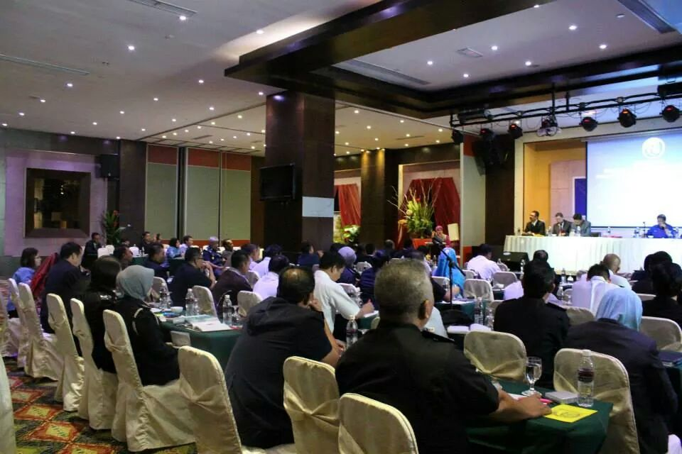

Slide 45
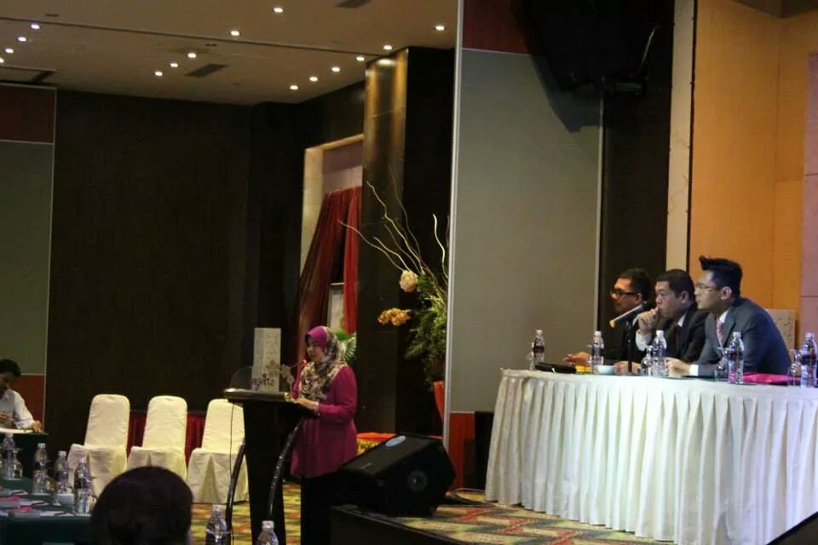

Slide 46
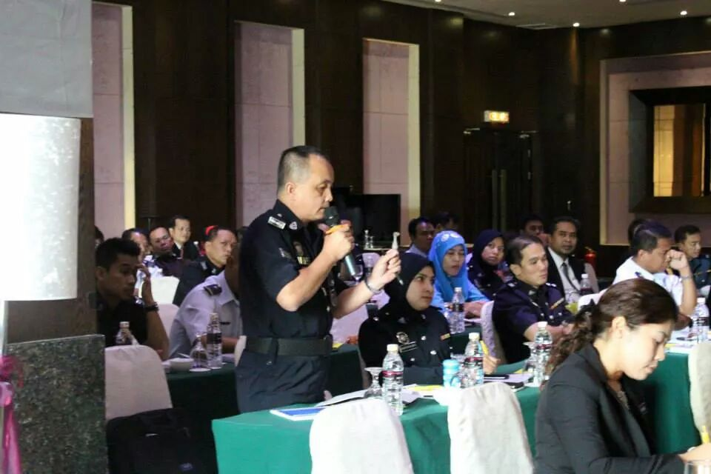

Slide 47
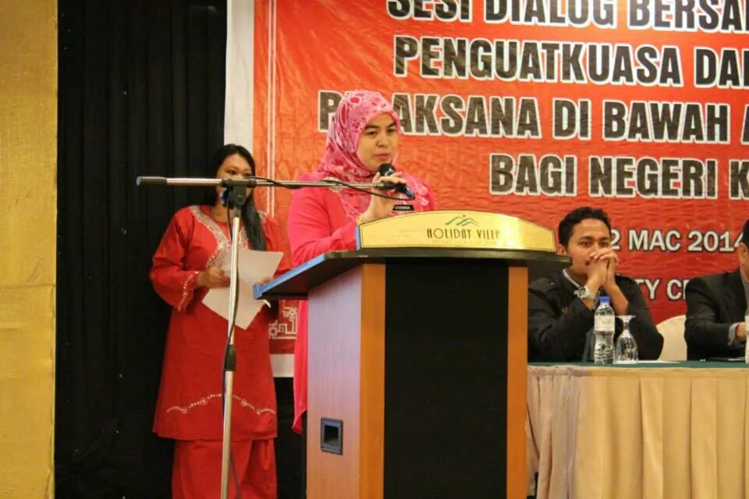

Slide 48
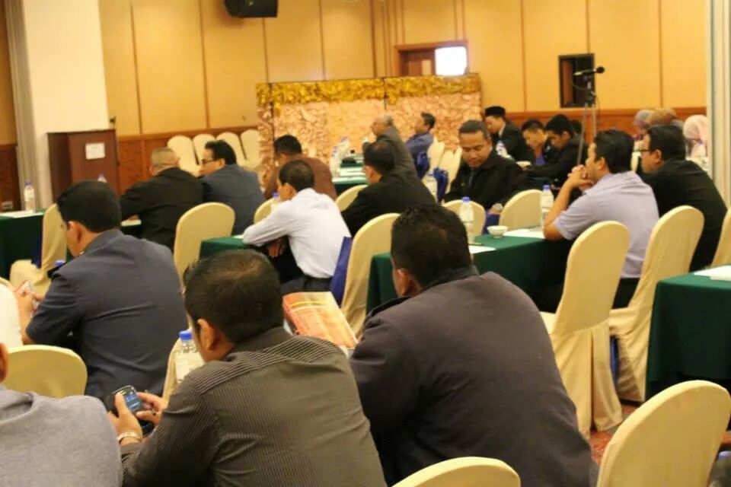

Slide 49
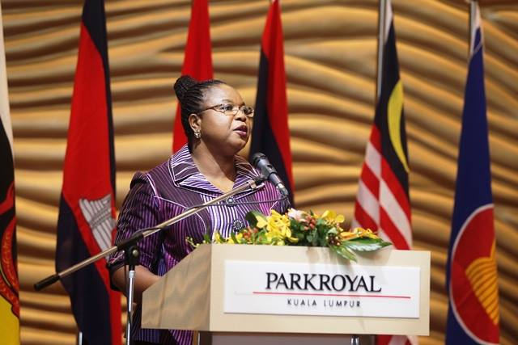

Slide 50
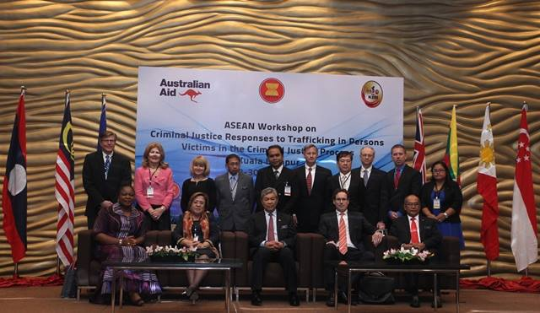
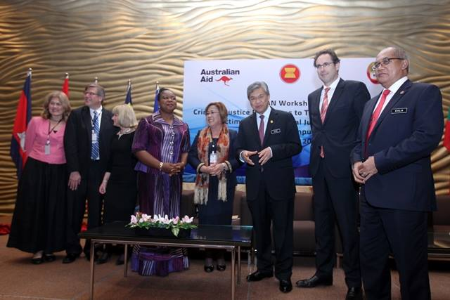

Slide 51
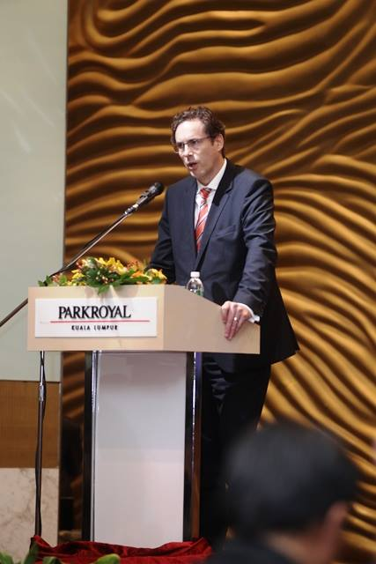
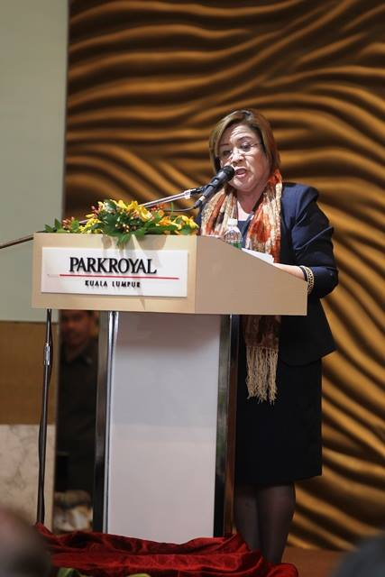

Slide 52
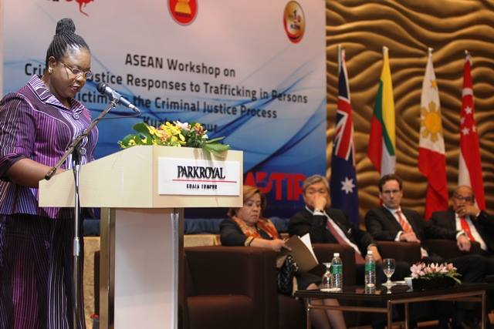
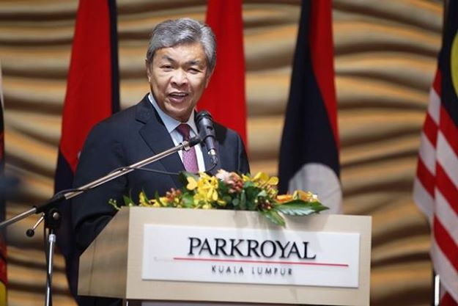
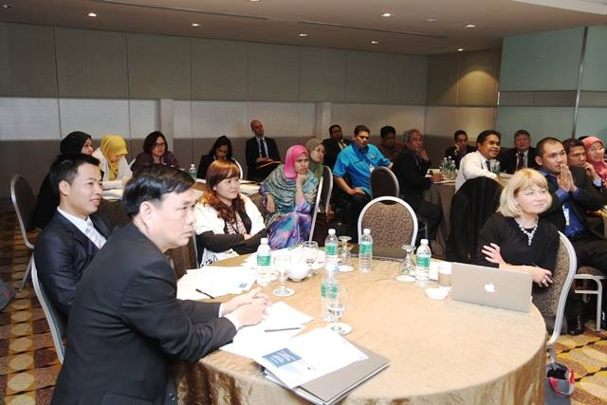

Slide 53
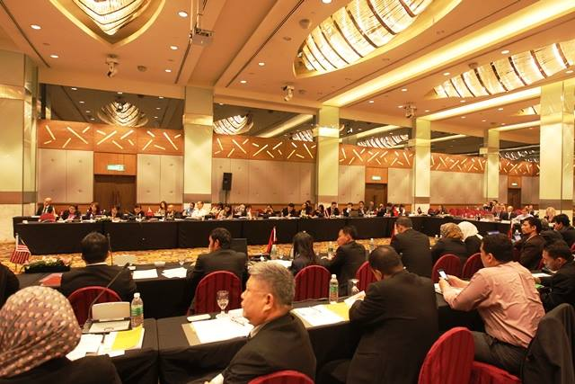
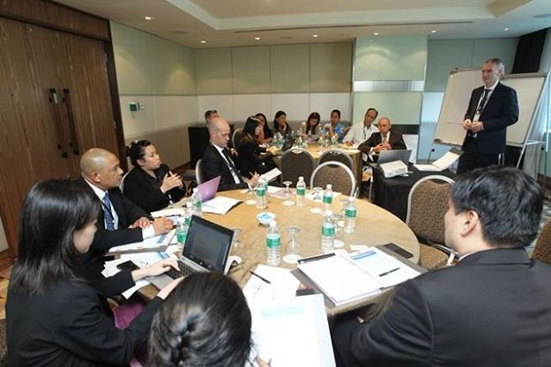

Slide 54
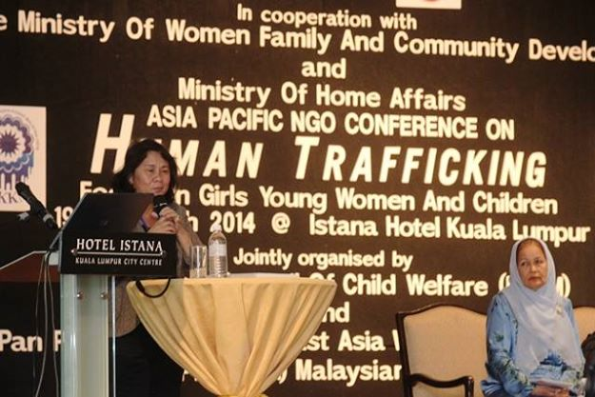

Slide 55
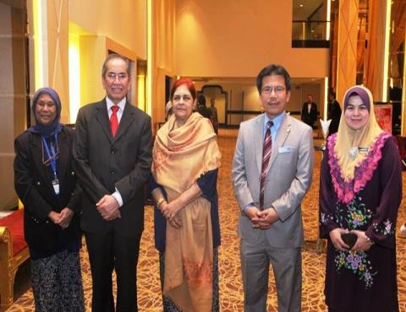
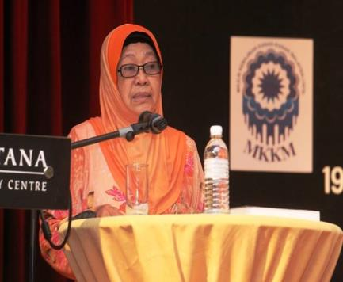
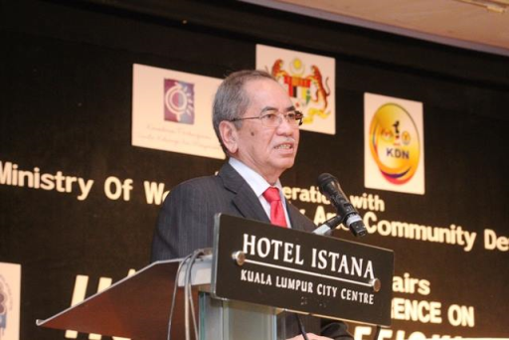
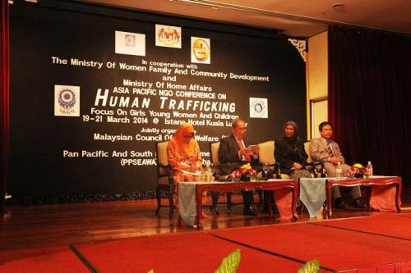

Slide 56

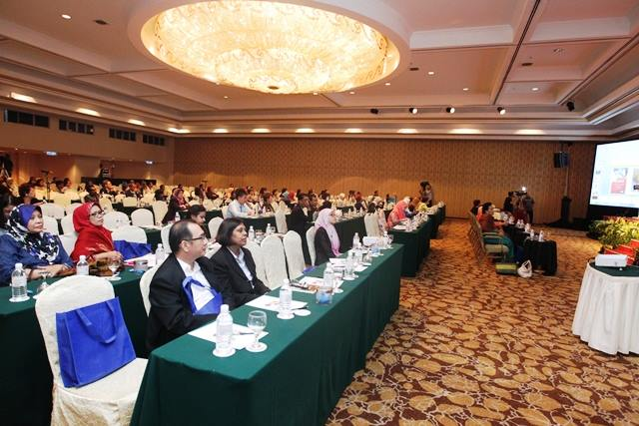

Slide 57
Cdebaca visit to shelter – 30 July

Slide 58
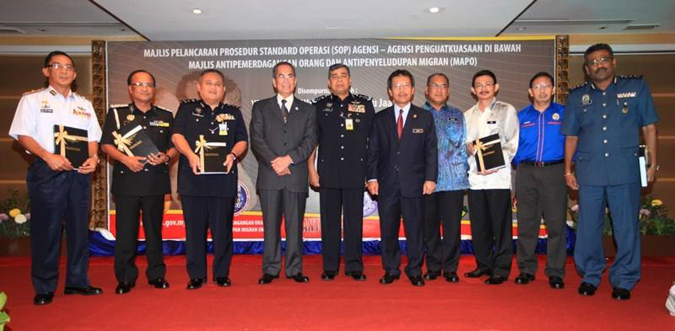
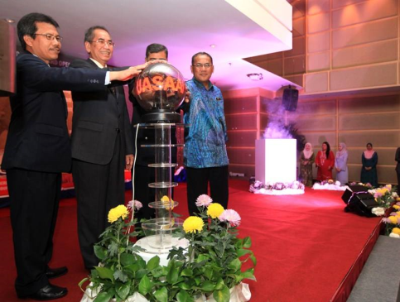
Launching of Sop – 21 nov 2013

Slide 59
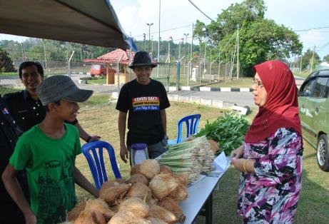
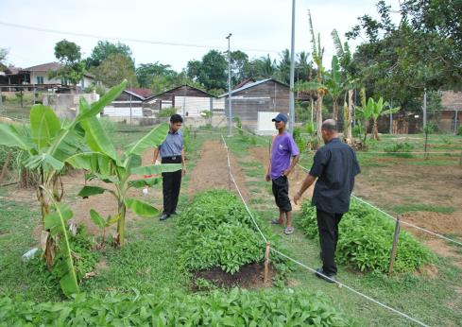



Slide 60

Strategic partners

Slide 61

NST – 19/11/2013

Slide 62




Slide 63


Slide 64

US TIP REPORT
Evaluation by the US State Department
188 countries
Malaysia had been evaluated since 2006
Evaluation based on:
  Palermo Protocol (UNTOC)
  US Trafficking Victim Protection Act (TVPA)

Slide 65
ROLES AND FUNCTIONS
1
coordinating the implementation of this Act
formulating policies and programmes to prevent and combat trafficking in persons and smuggling of migrants;
formulating protective programmes for trafficked persons;
initiating education programmes to increase public awareness of the causes and consequences of the act of trafficking in persons and smuggling of migrants
monitoring the immigration and emigration patterns in Malaysia for evidence of trafficking in persons and smuggling of migrants and to secure the prompt response of the relevant government agencies, and non-governmental organizations to problems on trafficking in persons and smuggling of migrants brought to its attention;
2
3
4
5

Slide 66
ROLES AND FUNCTIONS
6
advising the Government on the issues of trafficking in persons and smuggling of migrants including developments at the international level against trafficking in persons and smuggling of migrants
making recommendations to the Minister on all aspects of the prevention and combating of trafficking in persons and smuggling of migrants
coordinating the formulation of policies and monitoring the implementation of such policies on issues of trafficking in persons and smuggling of migrants with relevant government agencies and non-governmental organizations;
cooperating and coordinating with governments and international organizations on trafficking in persons and smuggling of migrants
collecting and collating data and information, and authorising research, in relation to the prevention and combating of trafficking in persons and smuggling of migrants
performing any other functions for the proper implementation of this Act
7
8
9
10
11

Slide 67
IMMIGRATION COOPERATION & INTERNATIONAL / REGIONAL BODIES
MoU on Immigration Cooperation
Working Group on Human Trafficking & People Smuggling
MoU on Immigration Cooperation
incorporate TIP & people smuggling
MoU on Immigration Cooperation
incorporate TIP & people smuggling
Capacity Building
Shelter homes
+
Protection of TIP Victims
+
Interview & Investigation Techniques
MIEUX
People Smuggling
+
Human Trafficking
+
Border Management

Slide 68
Way forward
Leverage the media
Empower state actors and non-state actors
Engage more NGOs – locally and internationally
Learn from the experts on human rights issue
Frequent dialogues with NREMs

