Slide 1
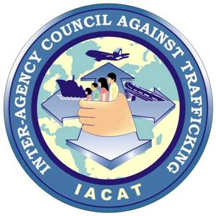
Second Consultative Meeting on Strengthening Partnerships with National Rapporteurs On Trafficking In Persons And Equivalent Mechanisms
DARLENE R. PAJARITO
Executive Officer, Task Force Operations Monitoring Section
Inter-Agency Council Against Trafficking Secretariat
May 21-22, 2014, Chatrium Residence Sathon, Bangkok, Thailand

Slide 2
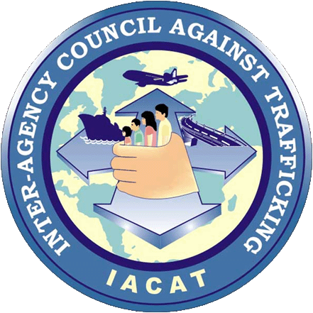
PHILIPPINE EXPERIENCE…
Expanded Anti-Trafficking in Persons Act of 2012 (R.A. No 10364)
Creation of Inter-Agency Council Against Trafficking (IACAT)
Most effective framework for the establishment of NREMs?
Anti-Trafficking in Persons Act of 2003
(R.A. No. 9208)
LEGISLATION

Slide 3
PHILIPPINE EXPERIENCE…
INTER-AGENCY COUNCIL AGAINST TRAFFICKING (IACAT)
Monitors and oversee the strict implementation of the TIP law
Its mandate is broad enough to cover the 4 key areas: PREVENTION, PROTECTION, PROSECUTION, PARTNERSHIP

Slide 4
PHILIPPINE EXPERIENCE…
Challenges and dilemmas encountered by IACAT in the course of its implementation:
LACK OF MANPOWER
INCOMPLETE DATA BASE
POLITICS
BUDGETARY CONCERNS
CORRUPTION
POOR MONITORING
CULTURAL DIVERSITIES

Slide 5
PHILIPPINE EXPERIENCE…
Concrete impacts and results IACAT has on the effective implementation of anti-trafficking policies and legislation:
Amendment of the TIP law and its implementing rules and regulations
Revising the Guidelines on Departure Formalities
Victims Assistance Center
ACTIP and RPA
Creation and strengthening the Task Forces against Trafficking in Persons

Slide 6
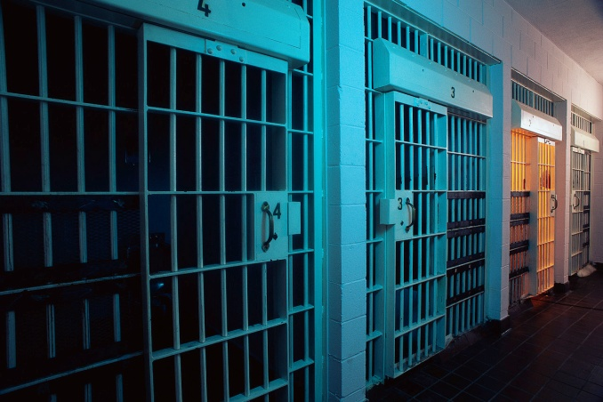
Conviction Updates
127 Convictions
145 Traffickers
Latest – Manila City (March 17, 2014)

Slide 7
Thank you!

