Slide 1
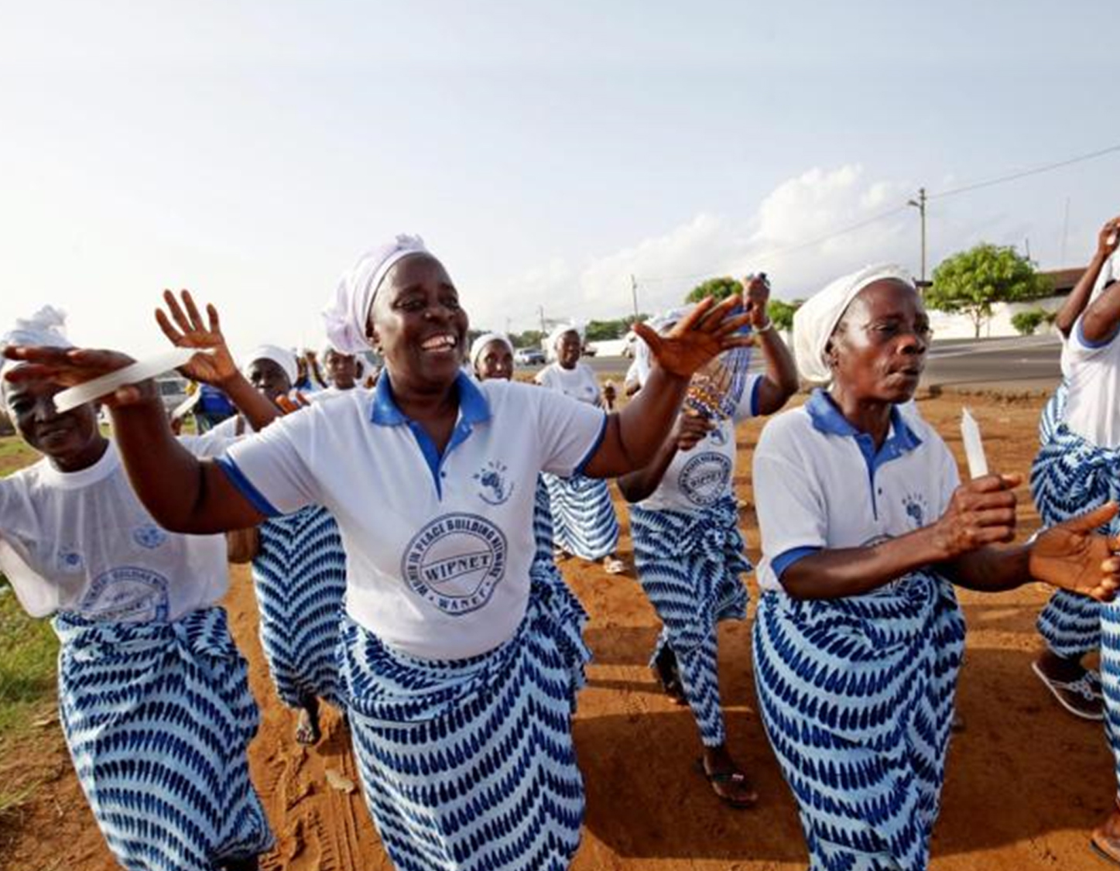


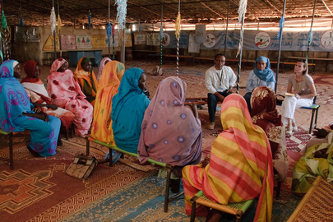
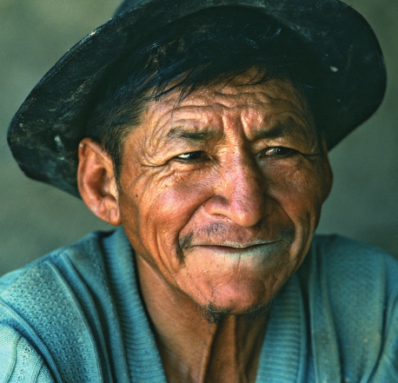
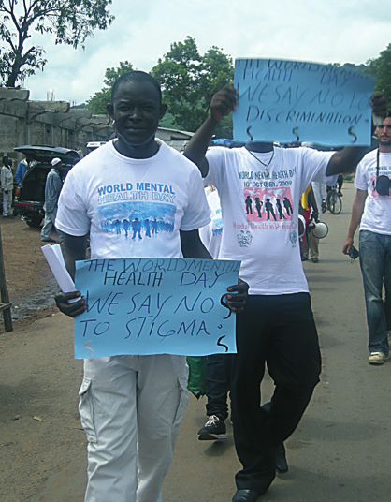

WHO QualityRights
Transforming services &
promoting rights in mental health
Dr Michelle Funk
Policy, Law and Human Rights (PLR)
Department of Mental Health & Substance Use,
World Health Organization
Notes:
First of all, before starting, I want to thank the Office of the High Commissioner for Human Rights for inviting me to participate in this panel discussion.
I would also like to thank the governments of Portugal and Brazil for the leadership that they have shown in promoting human rights in mental health over the last 6 years
My presentation will focus on the need to scale up investment in rights based mental health services – including services that are free from coercion and forced treatment.
This is in recognition of the current situation, in all parts of the world, where violations of human rights are common and legitimized in policy and law.
Important rights that are taken away from people with mental health conditions and psychosocial disabilities include:
the right for people to decide about their own treatment and care,
the right to NOT be subject to coercion such as forced treatment, seclusion and restraints,
peoples rights to be able to decide about their life, .. where they will live, how they will spend their money, and
peoples right to be included in the community
In countries everywhere we also see a predominant focus on the bio-medical model which limits treatment to diagnosis & treatment with medications and fails to address important areas of people lives which are often the root cause of a persons’ mental health condition and essential for recovery and community inclusion–
Here I am referring to issues around relationships, meaning and belonging as well as opportunities for employment, education, housing, social protection and good quality health care more broadly.
And it is with this in mind and in response to this need that in June this year, we published and launched the WHO Guidance on person-centred and rights-based community mental health services which I will talk about now.

Slide 2
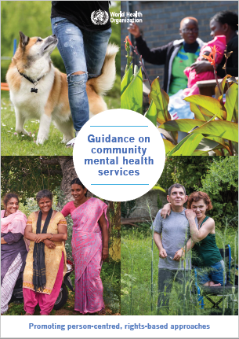
WHO Guidance and technical packs on rights-based
community mental health services
Aims and objectives
Inform all stakeholders of benefits of community mental health services that respect rights & focus on recovery
Demonstrate that it is possible to develop these services and achieve good health outcomes
Inspire countries to develop or scale-up these services and provide required know-how
Notes:
This new guidance on rights based services has several main aims and objectives which are to:
inform mental health care providers of the benefits of services that are respectful of human rights and focused on recovery.
Demonstrate that it is possible to develop these services and achieve good health outcomes - often at comparable or lower costs than the existing mainstream services.
And thirdly to inspire countries to develop and scale-up these services and ALSO to provide clear guidance on how to do this.

Slide 3

WHO Guidance on good practice community-based services: Promoting person-centred, rights-based approaches
Global context
International human rights standards and recovery approach
Summary good practice services promoting rights and recovery
Steps to move to holistic services that link with housing, education, employment & social protection
Recommendations and action steps for integrating good practices into health and social sectors
Notes:
In terms of content…the WHO guidance is made up of several different documents.
Firstly there is an overall document which:
sets the global context that we are facing in the area of mental health and human rights
Outlines the key international human rights standards and the recovery approach.
AND showcases 28 good practice rights based services from low, middle and high income countries around the world
The document also:
Explains the steps needed to move towards the provision of holistic services, taking into account housing, education, employment and social protection.
And finally the document presents specific recommendations and action steps for integrating person-centred and rights-based services into health and social sectors.

Slide 4
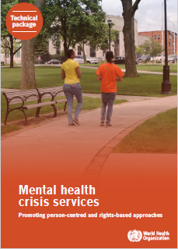
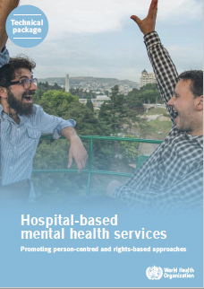
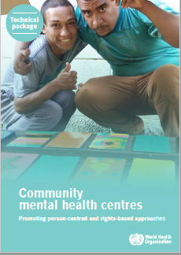
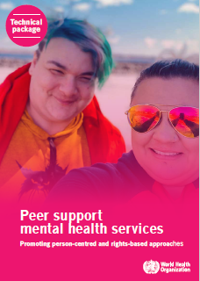
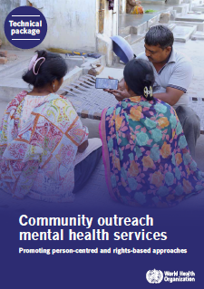
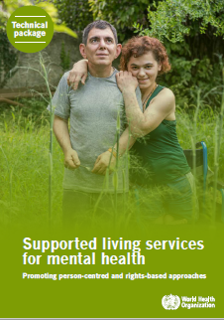
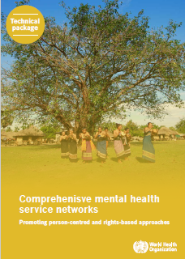
Seven technical packages on good practice community-based services: Promoting person-centred, rights-based approaches
Detailed description of services and how they operate
Challenges and solutions to overcome them
Practical action steps for setting up good practice services
Notes:
In addition to the overall document, the WHO guidance also includes seven supporting technical packages.
Each technical package addresses a different category of service. So there are separate packages which include the good practice examples for:
Crisis services;
Hospital-based services;
Community centres;
Peer support services;
Community outreach services;
Supported living;
and Comprehensive mental health service networks – this means networks of services that bring together all the different services I mentioned just now to form a comprehensive mental health network which interfaces with the social sector.
Each of the technical packages shows how each service (i) operationalised a rights based approach and (ii) how they overcame the many challenges and obstacles to implementation.
Finally, each technical package concludes with a series of very concrete action steps that people can work through to set up a similar service in their country.

Slide 5
Afiya House, USA
Link House, UK
Open Dialogue, Finland
Tupu Ake, NZ
BET Unit, Blakstad Hospital, Norway
Kliniken Landkreis Heidenheim, Germany
Soteria Berne, Switzerland
CAPS III – Brasilândia, Brazil
Aung Clinic, Myanmar
Phoenix Clubhouse, China, Hong Kong SAR
Hearing Voices support groups
Nairobi Mind Empowerment Peer Support Group, Kenya
Peer Support South East Ontario, Canada
Atmiyata, India
Friendship Bench, Zimbabwe
Home Focus, Ireland
Naya Daur, India
Personal Ombudsman, Sweden
Hand in Hand supported living, Georgia
Home Again, India
KeyRing Living Support Networks
Shared Lives, UK
Mental health networks:
Campinas, Brazil
East Lille, France
Trieste, Italy
Peru
Bosnia & Herzegovina
Lebanon
Notes:
On this slide I have listed each of the 28 services showcased in the guidance according to each service category in order to provide a flavor of the breadth and variety of services showcased.

Slide 6
WHO Guidance on rights-based community mental health services
Key service selection criteria
Rights-based community mental health services that:
Respect people’s legal capacity - choice and decisions in treatment, care & support
Implement strategies to end coercion – seclusion, restraint, physical, sexual & emotional abuse
Involve and include people with lived experience in running of services
Link people to relevant community services and supports - social protection and disability benefits, housing, employment opportunities etc.
Provide person-centered holistic care addressing relationships, work, family, and education – not just diagnosis, medication and symptom reduction
Notes:
So what do all the showcased good practice services have in common?....
What is important to note is that each of the services was selected because it met a number of specific criteria including:
Respect for people’s legal capacity, their choices and decisions about their treatment, care and support, including when people were in crisis
Services that implemented strategies to end the use of coercive practices such as seclusion and restraint as well as any form of physical, sexual and emotional abuse.
Services that promoted participation and involved and included people with lived experience in how the services themselves were run.
Services that promoted community inclusion by linking people to social protection and disability benefits, housing, employment opportunities amongst others
And services that provided person-centered & holistic care, focused on the persons own goals and aspirations

Slide 7
WHO Guidance on rights-based community mental health services
Recommendations
Increasing funding to develop/scale up rights- based services
Establishing legal and policy frameworks that align with human rights standards
Establishing a comprehensive rights based network of community mental health services that interface with a strong social sector
Widescale capacity building on mental health, human rights and disability for all stakeholder groups
Integrating training on rights, disability and person centred, recovery-oriented approaches undergraduate and graduate course curricula
Collecting data on health and social outcomes for people using rights-oriented services
Increasing funding for research on services using a rights-based approach
Engaging organizations of people psychosocial disabilities as advisors on policy, planning, law and service development
Notes:
But for the development and scale up of these services to happen on a grand scale - - fundamental changes are required to mental health and social care systems in place in low, middle and high income countries alike.
Some of the key recommendations that WHO is making to countries are around:
Increasing funding for mental heath and social care services while at the same time ensuring that this funding is allocated to the development and scale up of RIGHTS based services.
Establishing legal and policy frameworks at national level that align with international human rights standards, such as the CRPD.
Establishing a comprehensive rights based network of community mental health services that interface with a strong social sector.
Widescale capacity building on mental health, human rights and disability for all stakeholder groups, and WHO has already developed the QualityRights training materials to enable this
Integrating training on human rights, and recovery-oriented approaches into health, mental health and social sector undergraduate and graduate course curricula
Collecting data at national and service levels on health and social outcomes for people using mental health services.
Increasing research funding for rights based mental health services and approaches as opposed to traditional mainstream services.
And importantly engaging organizations of people with psychosocial disabilities as advisors on policy, law, training & service development.

Slide 8
Thank you!
Notes:
I would like to leave everyone participating in this meeting with the message that there IS hope for a better way forward. That there ARE services dotted around the world that are rights based and producing good health and social outcomes in a cost effective way.
The problem is that these ‘rights based services’ remain on the margins - and not enough people have access to them.
We have to turn that around and in order to do that countries also need to put in place polices and laws which are built upon a solid rights based framework as promoted by the CRPD – a framework which commits to leaving coercion behind but which will leave no person behind.
Thank you

