Slide 1
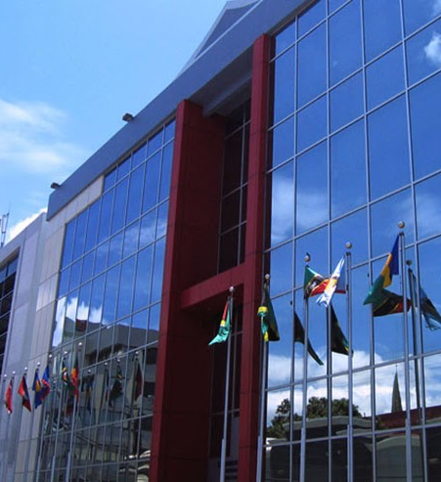
Workshop on Regional Arrangements for the Promotion and Protection of Human Rights
PANEL 1: “Taking stock of developments in cooperation between United Nations and regional human rights mechanisms”
21 October 2019 Kerine J Dobson - Legal Officer, Caribbean Court of Justice

Slide 2
CCJ’s HYBRID STRUCTURE & MANDATE
ORIGINAL JURISDICTION
(interprets/
applies RTC)
APPELLATE JURISDICTION (Barbados, Guyana, Belize and Dominica)
APEX COURT (Justice Sector Reform & Education)
Notes:
CCJ is the creation of the Agreement Establishing the Caribbean Court of Justice

Slide 3
TAKING STOCK: The Caribbean Context
Racism, racial discrimination, xenophobia and related intolerance complex & subtle
Other intersectional components such as gender
Notes:
See for eg study done by IACHR - 2012

Slide 4
TAKING STOCK: Durban Declaration & Programme of Action (Areas of Focus)
special measures/positive actions
rights of indigenous peoples
capacity development
mainstreaming of gender perspectives

Slide 5
TAKING STOCK: DDPA
Maya Leaders Case:
recognized Maya customary land rights (CLR) in Belize
CLR subject to the Constitutional protection:
no arbitrary/unfair deprivation of basic constitutional rights;
positive action required to secure/ensure the enjoyment of rights.
Notes:
Paragraph [47] of Judgment – The Maya Leaders Alliance v AG of Belize [2015] CCJ 15 (AJ)
No specific reference to DDPA but it wholeheartedly embraces several principles therein

Slide 6
TAKING STOCK: DDPA
Progress by both sides
CCJ retains a supervisory/ compliance monitoring role
Notes:
Paragraph [47] of Judgment – The Maya Leaders Alliance v AG of Belize [2015] CCJ 15 (AJ)
No specific reference to DDPA but it wholeheartedly embraces several principles therein

Slide 7
TAKING STOCK: Cooperation with UN
Gender equality protocols & gender-sensitive adjudication training
South-South (Caribbean/South Africa) knowledge exchange/tour
Training & CAJO Conference Sessions addressing gender bias in adjudication

Slide 8
TAKING STOCK: Cooperation with UN
Methodology for gender-sensitive adjudication targeting judicial officers
CCJ/CAJO/JURIST asked UN Women to develop generic Gender Protocol which would then be adapted to local judiciaries and training conducted

Slide 9
TAKING STOCK: Cooperation with UN
Indigenization of Protocols
Belize – indigenous persons; race
Intersectionality: gender, race, ethnicity
Trinidad & Tobago
took into account study done by local judicial education institute on procedural fairness

Slide 10
TAKING STOCK: Cooperation with UN - Advantages/Added Value
International best practices
Fit for purpose
Harmonization/ uniformity
Resource mazimization

Slide 11
TAKING STOCK: Cooperation with UN - Challenges
Resources
Effective training/roll-out mechanisms
Measurement
Attitudes/ Awareness

Slide 12
TAKING STOCK: Cooperation with UN - Recommendations
Local trainers
‘Train-the-trainer’ Models
Centralization/ Decentralization

Slide 13
TAKING STOCK: Lessons learnt – Role of Courts
Be Proactive
Be (Self-) Aware
Judicial Education
Alignment with int’l Law & best practices

Slide 14
Website: www.ccj.org
Twitter: twitter.com/CaribbeanCourt
LinkedIn: linkedin.com/company/
caribbean-court-of-justice
Facebook: www.facebook.com/yourCCj/
Website: juristproject.org/ Facebook: www.facebook.com/juristproject
Website: www.thecajo.org
Website: www.ccjacademy.org/

