Slide 1
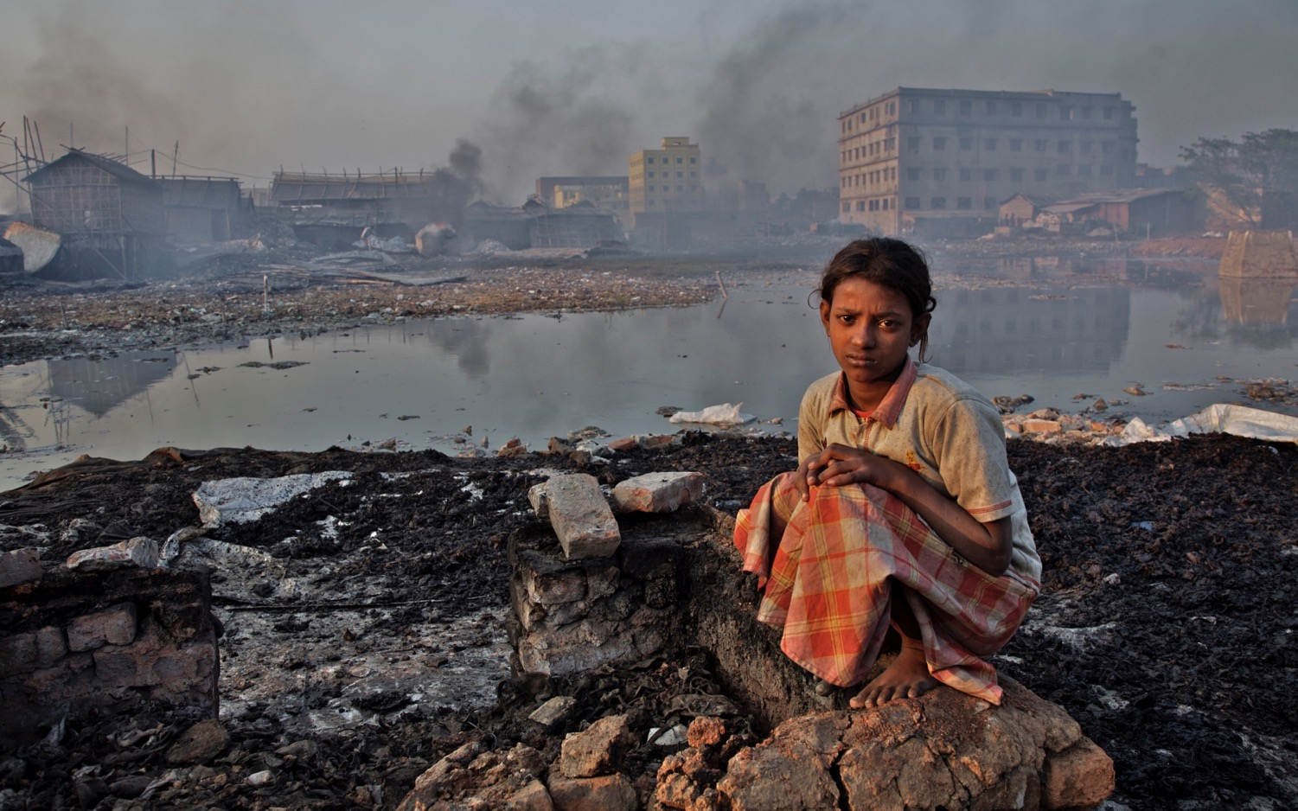

Breath-Less
© UNICEF/UNI9946/Noorani
The impact of air pollution on children
Nicholas Rees
DRAFT VERSION

Slide 2
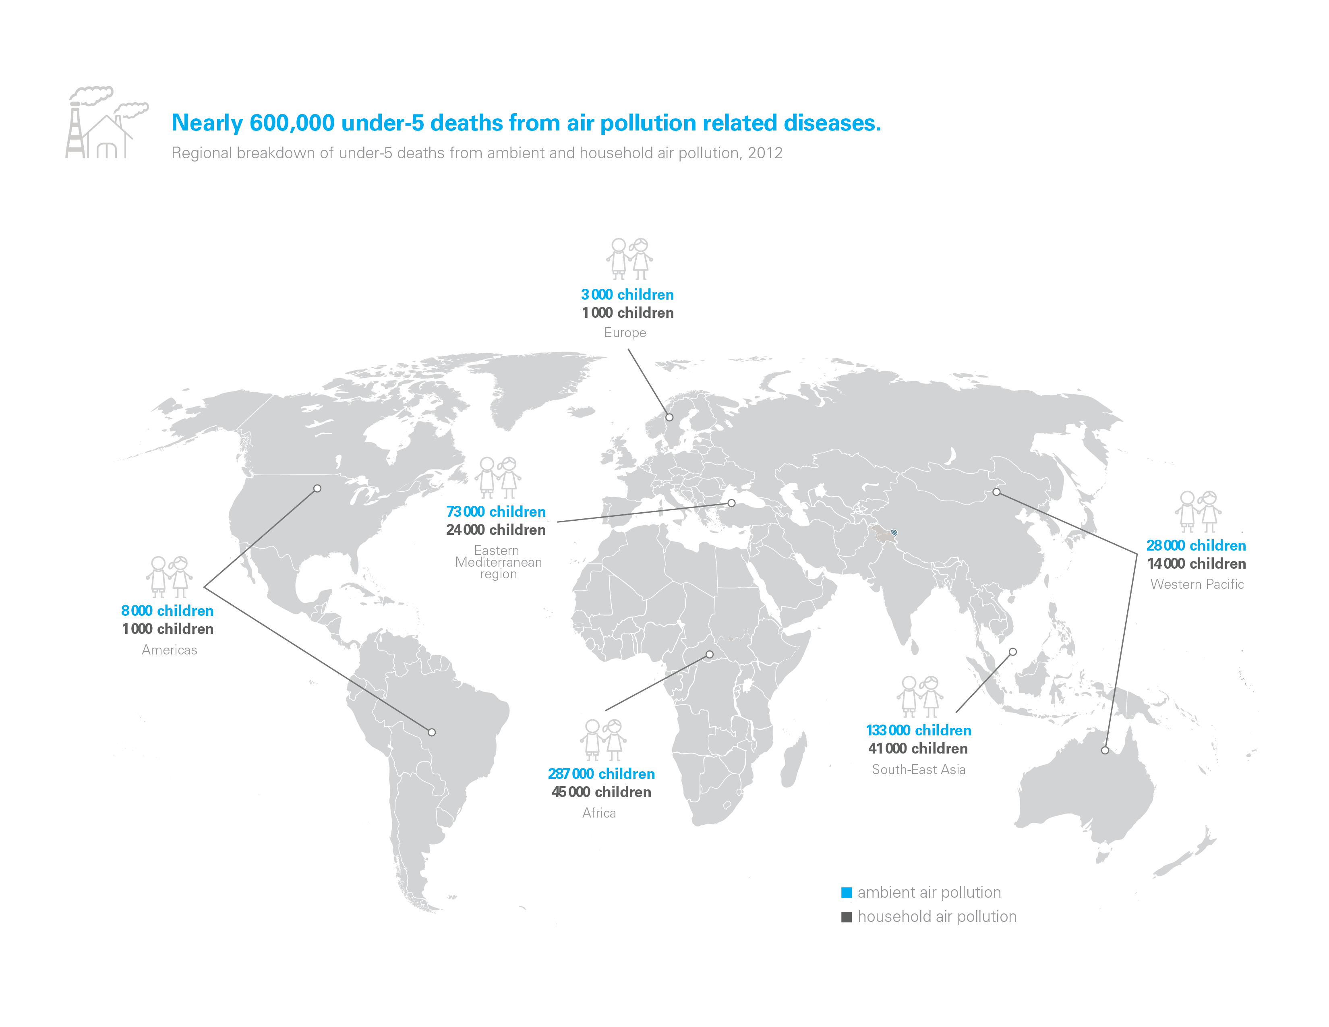

Slide 4
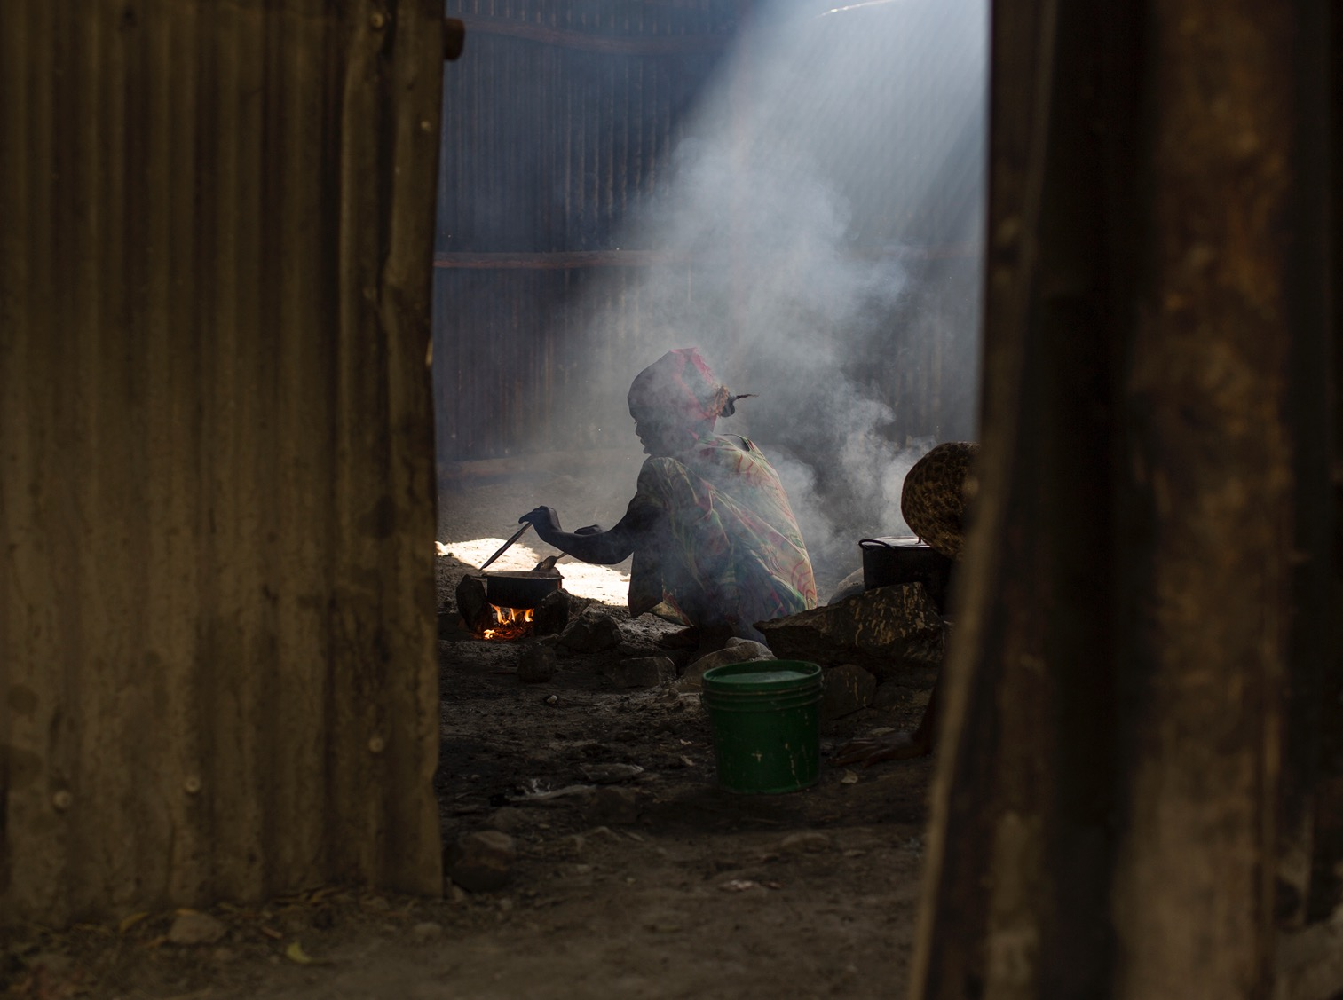
© UNICEF/UNI193479/Bindra

Slide 5

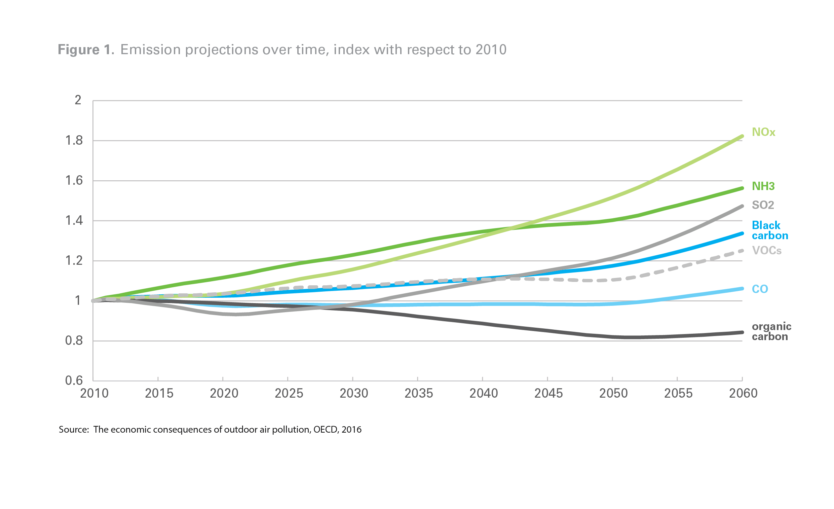
Air pollution causes and trends

Slide 6
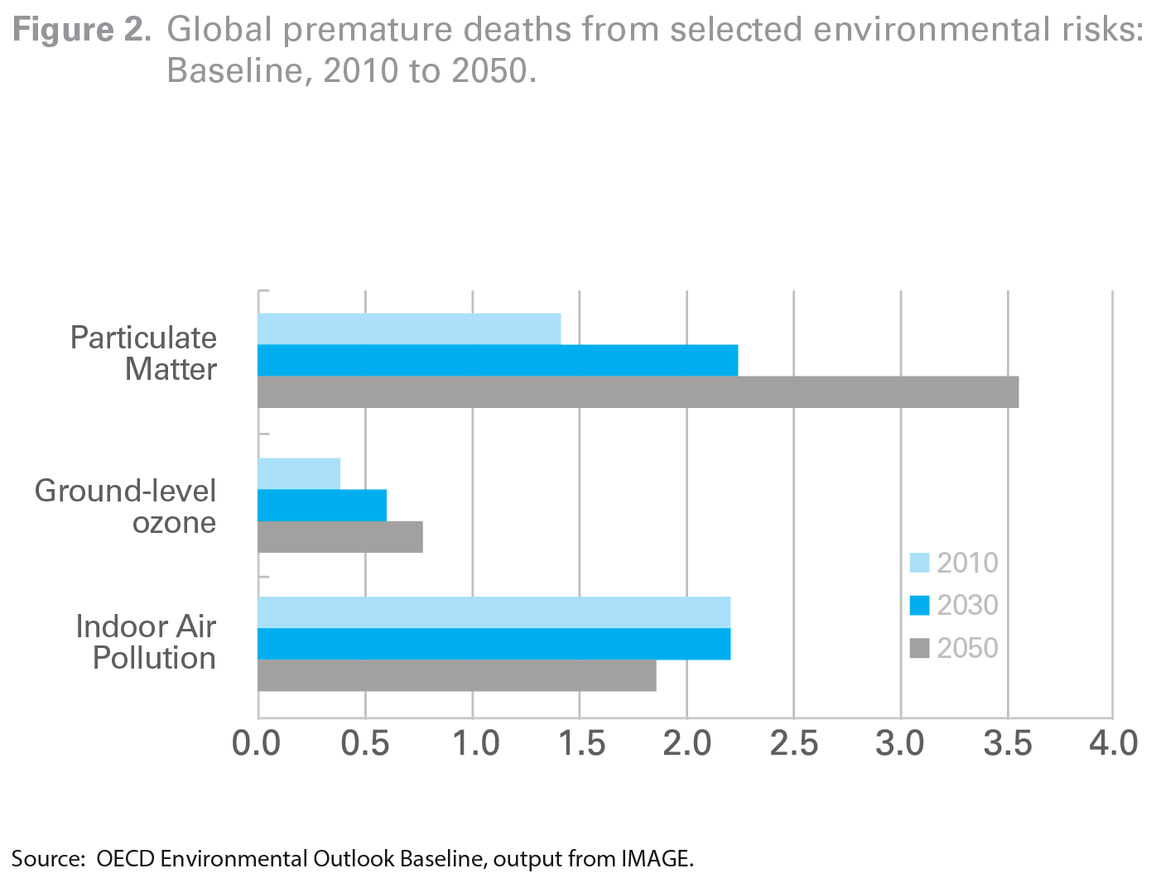
Air pollution causes and trends

Slide 7
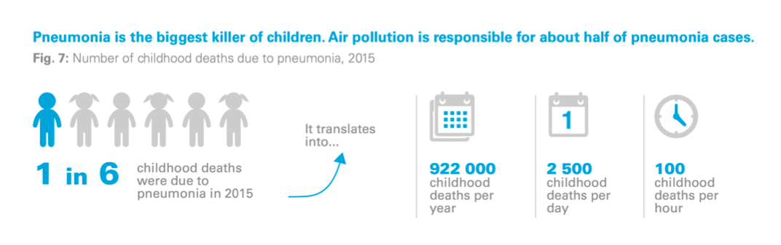
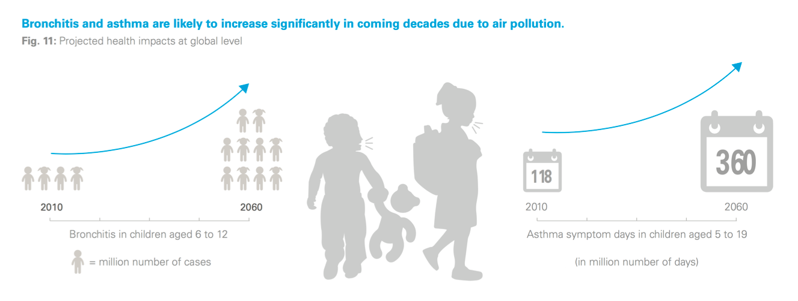

Slide 8
Studies show that air pollution could impact health and wellbeing

Slide 9

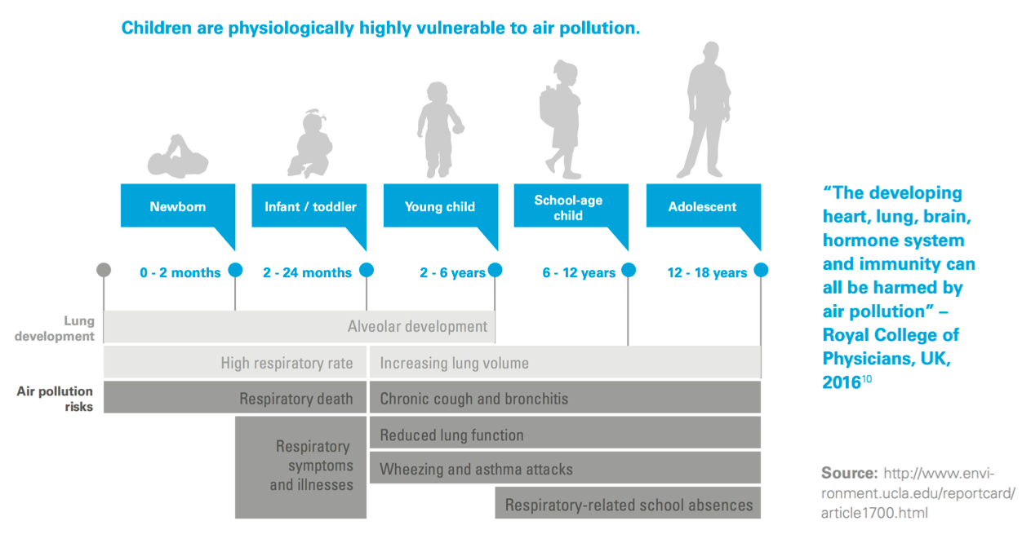
Unique vulnerability of children to air pollution

Slide 10
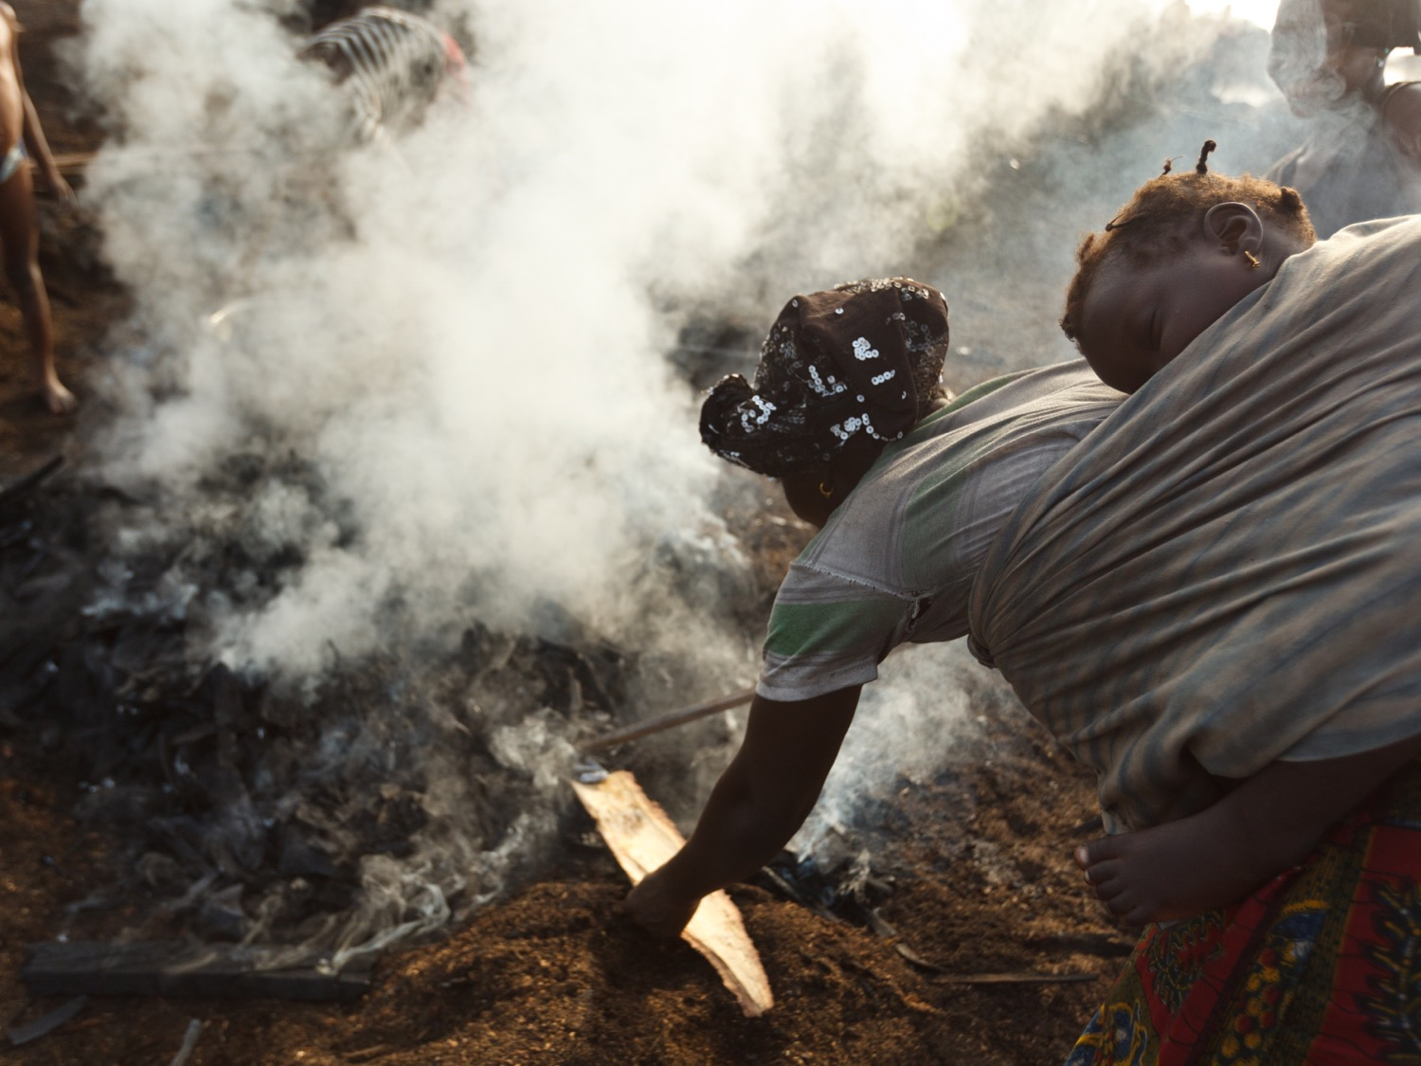
© UNICEF/UNI129900/Asselin

Slide 12
Most Polluted Cities (PM10 Annual mean, ug/m3)
WHO Global Urban Ambient Air Pollution Database (update 2016)
Country | City/town | Annual mean, ug/m3
Nigeria | Onitsha | 594
Pakistan | Peshwar | 540
Iran (Islamic Republic of) | Zabol | 527
Pakistan | Rawalpindi | 448
Nigeria | Kaduna | 423
Nigeria | Aba | 373
Saudi Arabia | Riyadh | 368
Saudi Arabia | Al Jubail | 359
Afghanistan | Mazar-e Sharif | 334
India | Gwalior | 329
Bahrain | Hamad Town | 318
India | Allahbad | 317
China | Shijiazhuang | 305
Pakistan | Karachi | 290
Saudi Arabia | Dammam | 286
Nigeria | Umuahia | 274
India | Raipur | 268

Slide 13
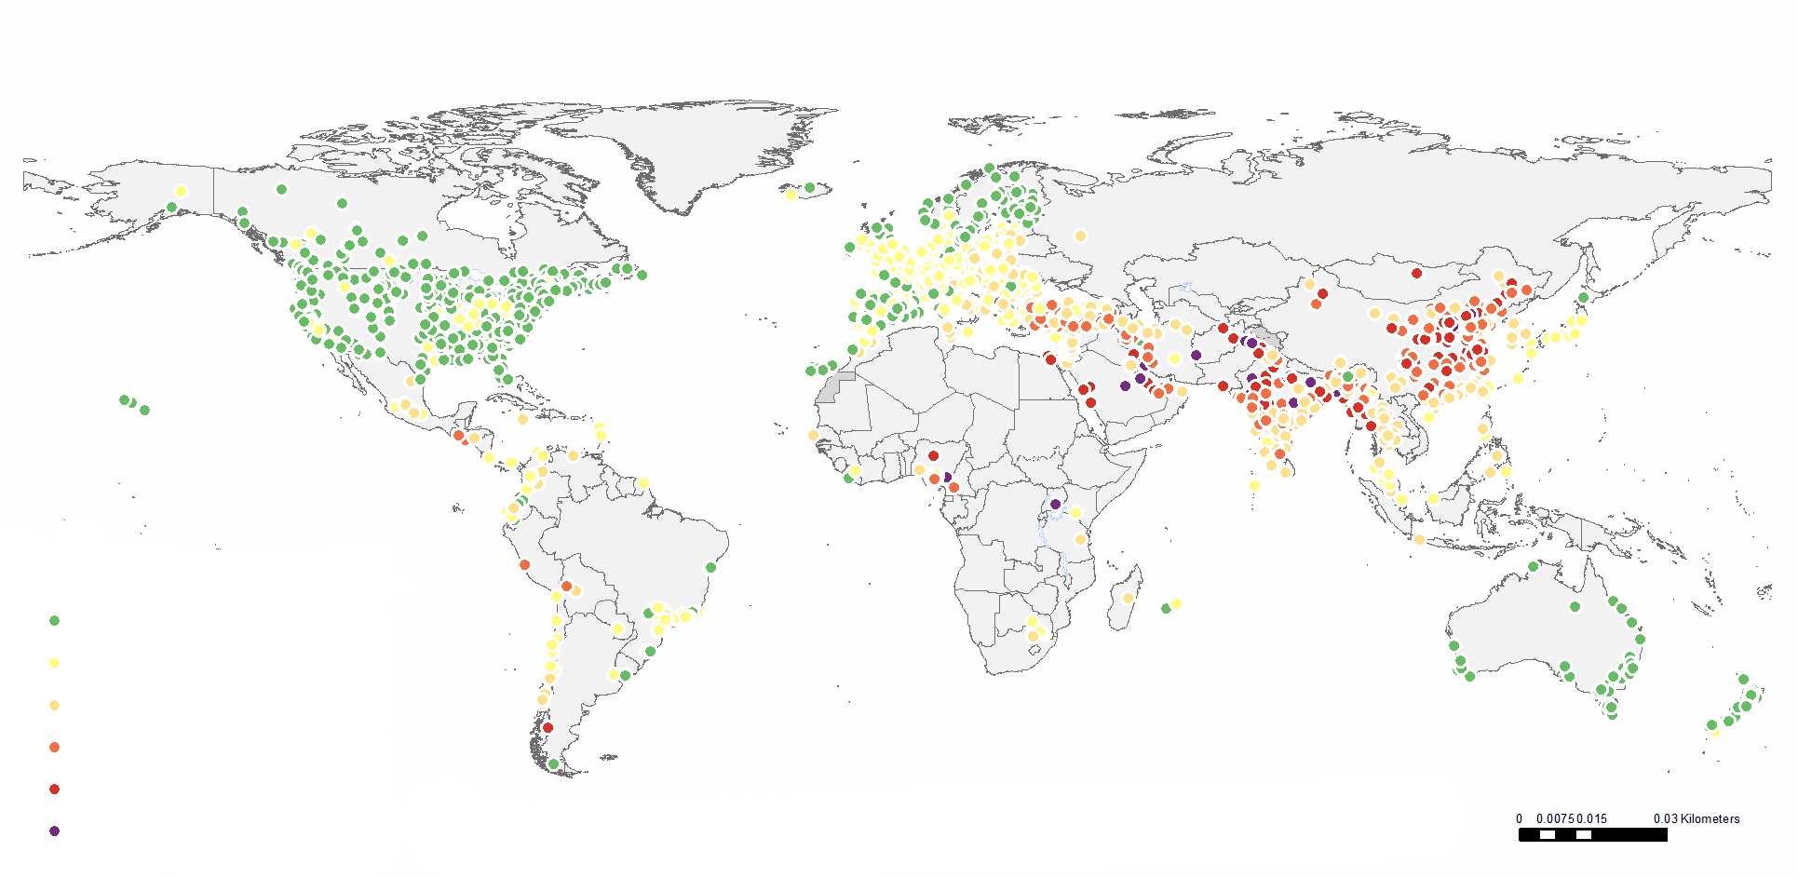
Air pollution levels
<10
10 - 19
20 - 39
40 - 59
60 - 99
>= 100
Data Source: World Health Organization
Map Production: Information and Evidence Research (IER) World Health Organization

Slide 14
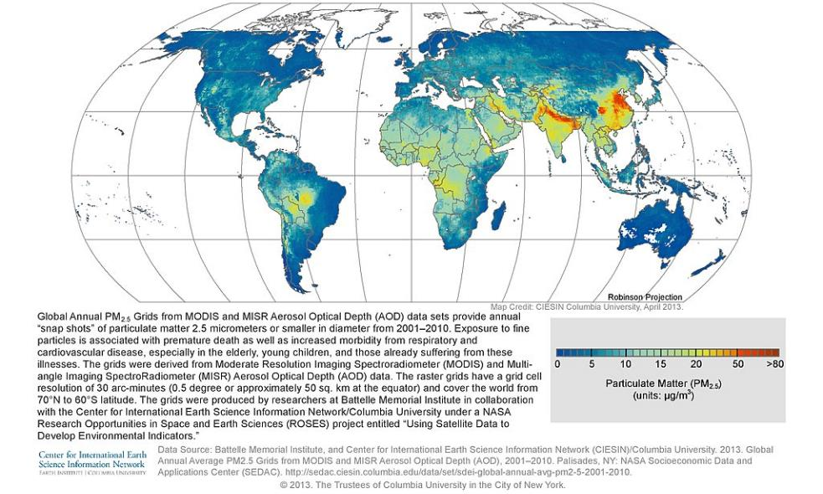
Global Annual Average PM2.5 Grids from MODIS and MISR Aerosol Optical Depth (AOD), 2010
Satellite-Derived Environmental Indicators

Slide 15




Policy Responses
Reduce air pollution
Prevent children’s exposure to it
Improve children’s health so that when they are exposed, they are more resilient
Monitor air pollution better

Slide 16
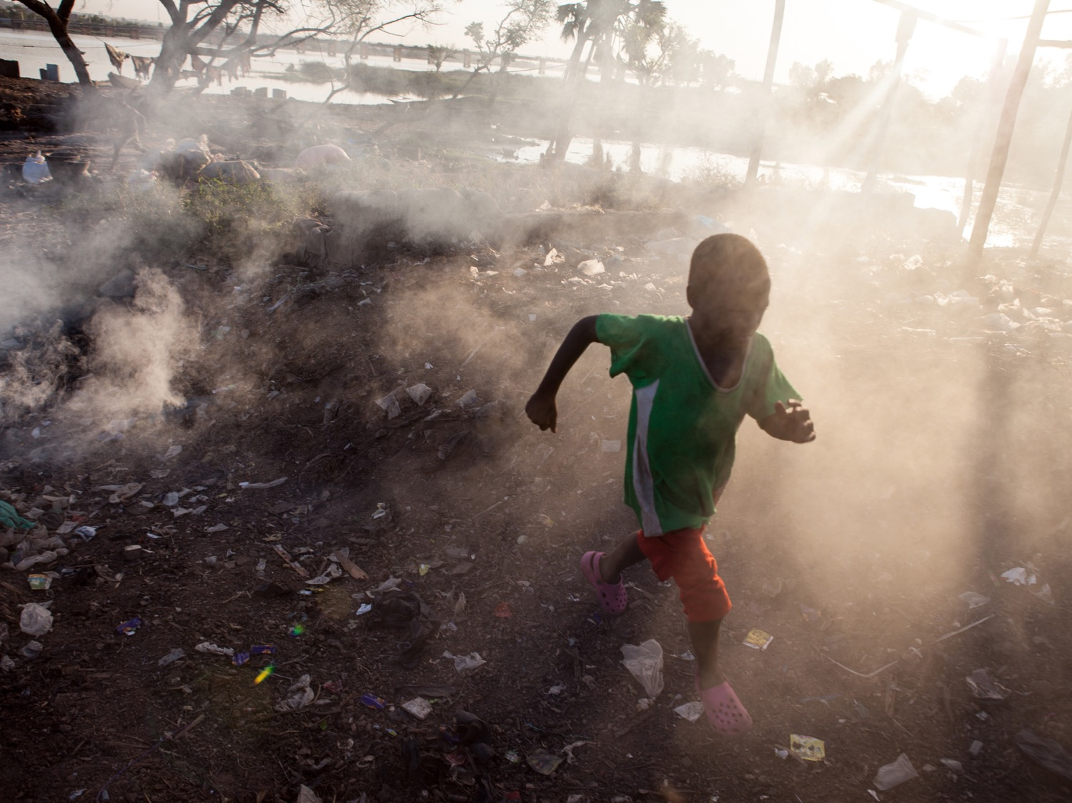
© UNICEF/UNI134171/Bindra

