Slide 1

Children’s Exposure to Environmental Toxicants
Strategies to Protect Child Rights
Juliane Kippenberg,
Human Rights Watch

Slide 2
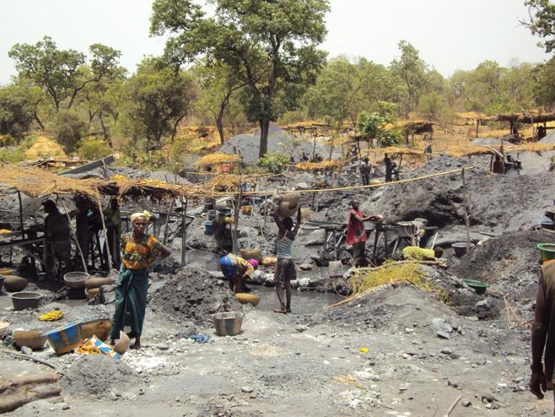
ARTISANAL GOLD MINING

Slide 3

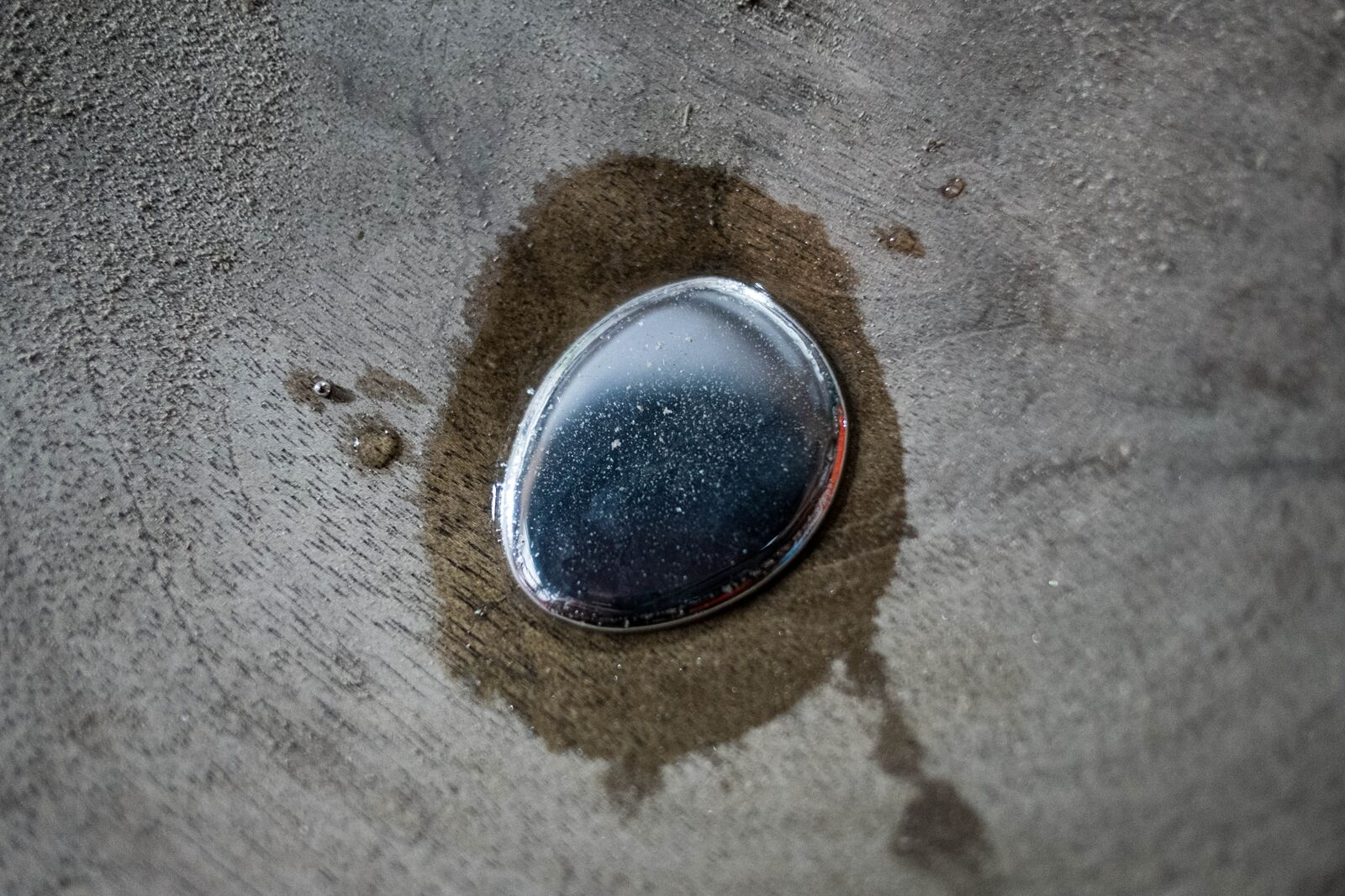
ARTISANAL GOLD MINING

Slide 4
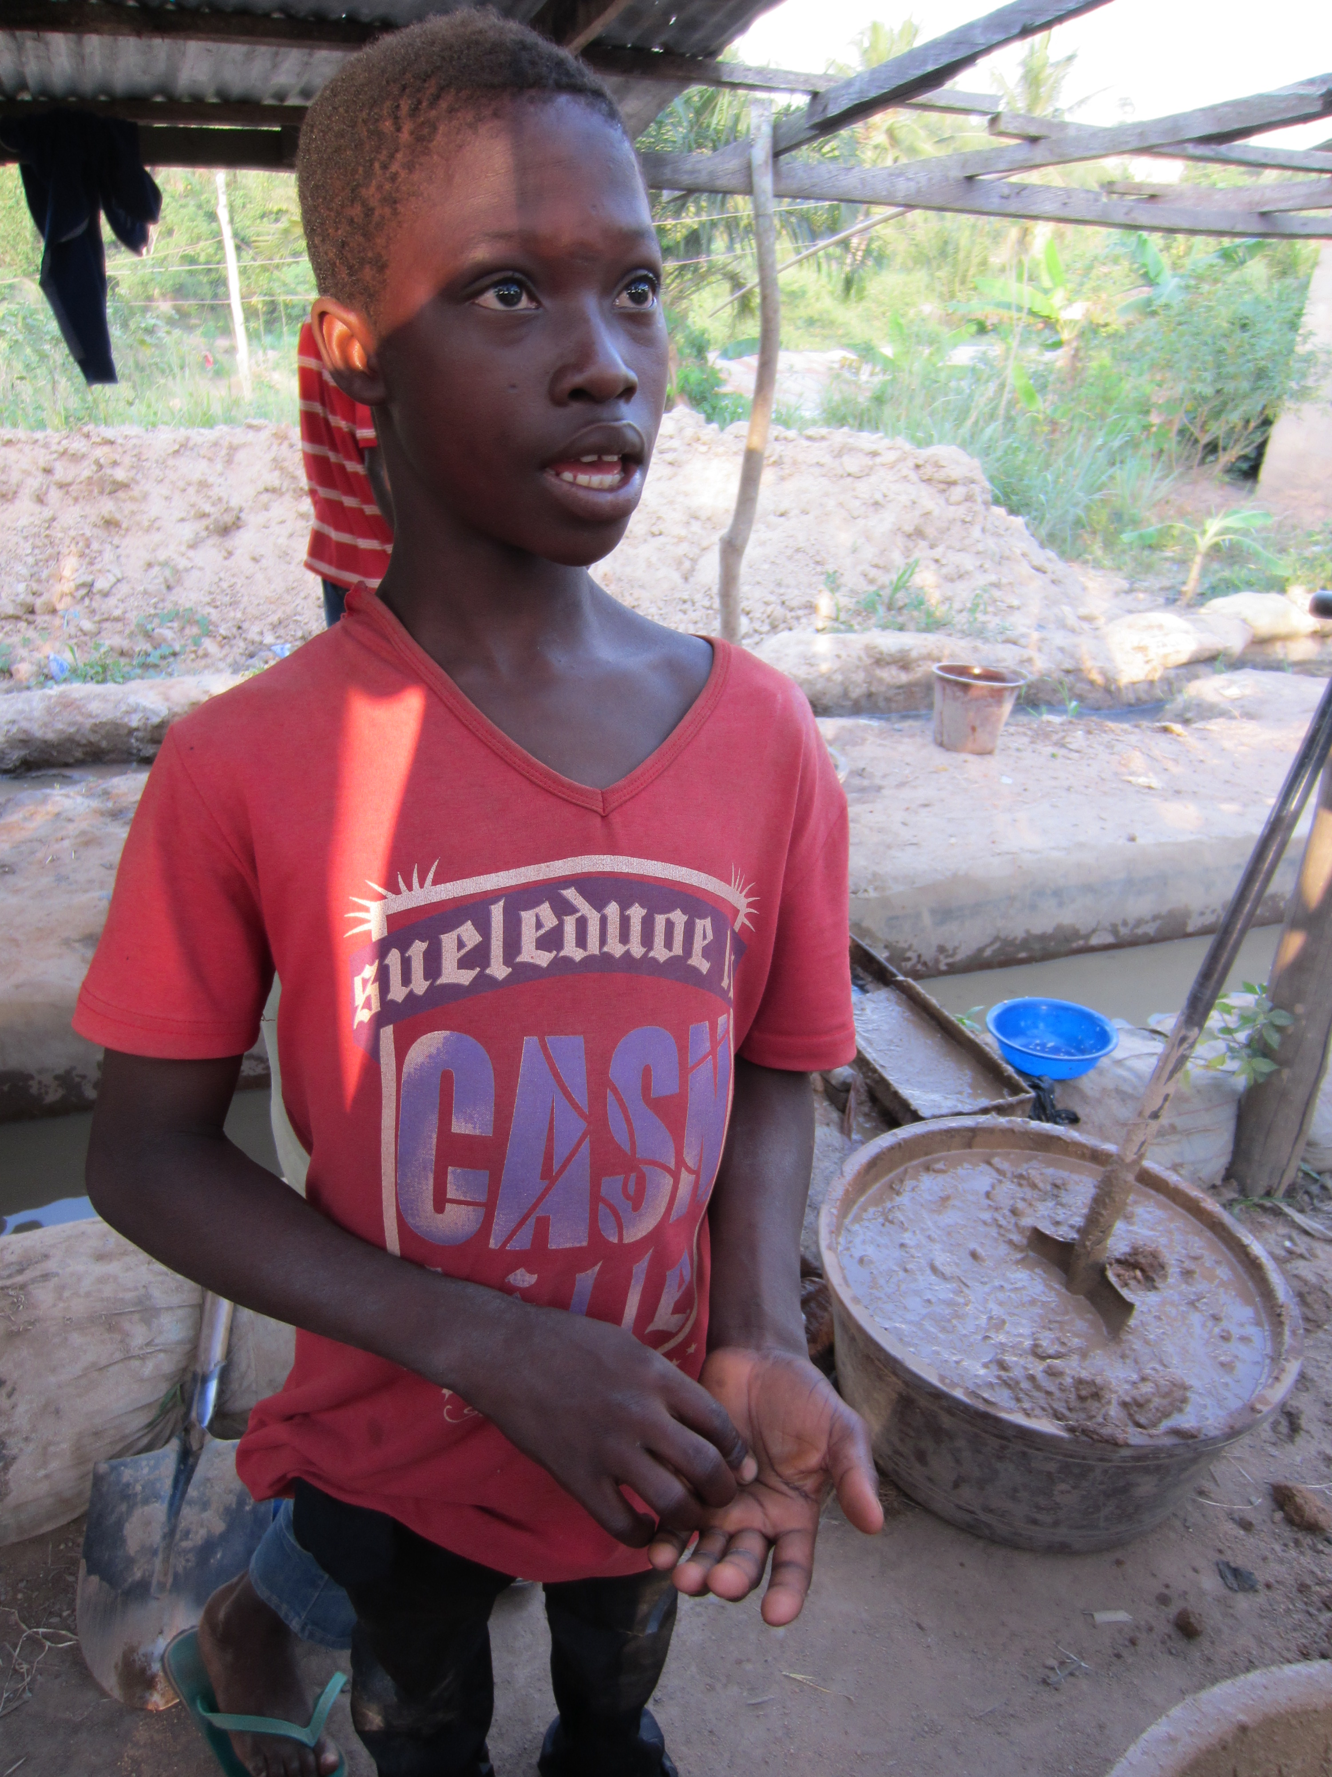
GHANA

Slide 5
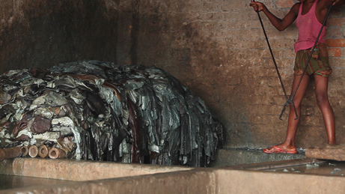
BANGLADESH

Slide 6
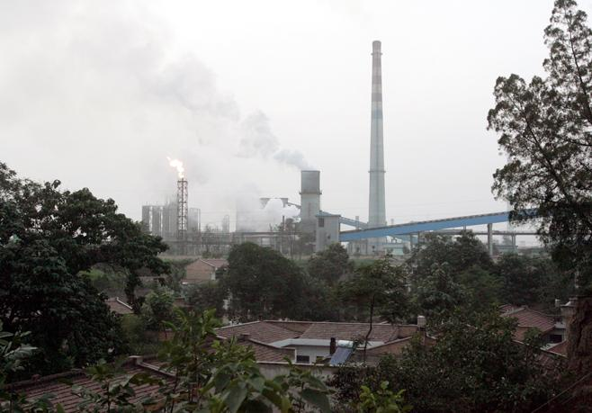
CHINA

Slide 7
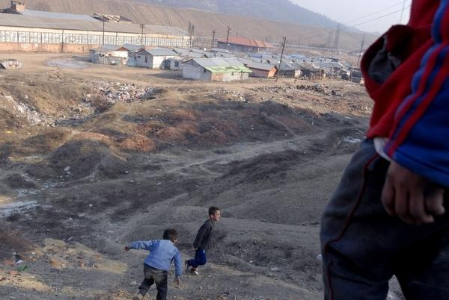
KOSOVO

Slide 8
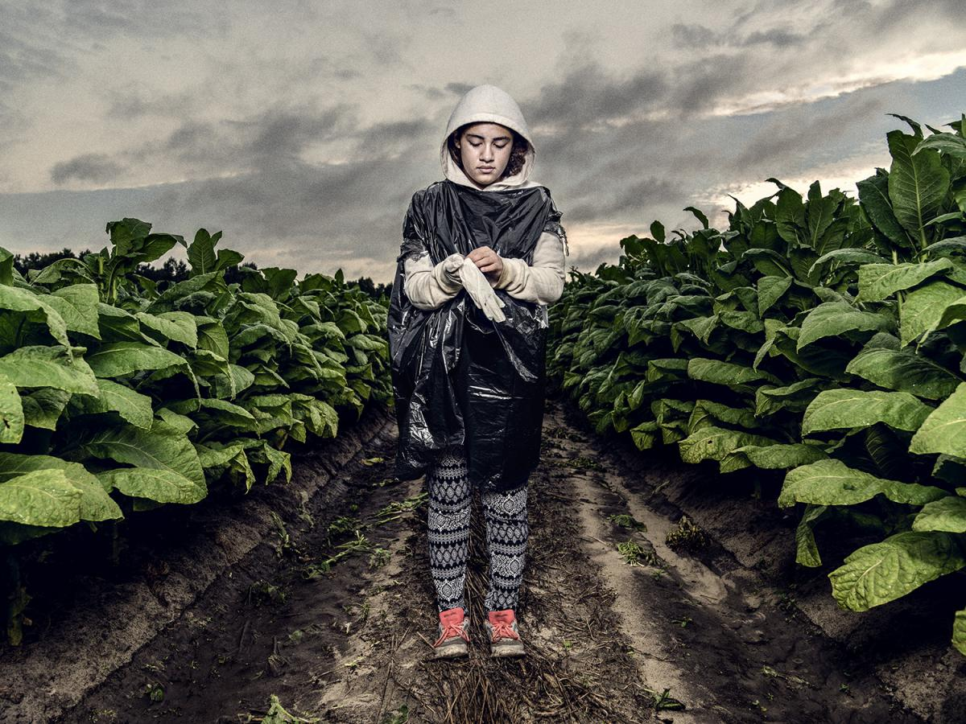
UNITED STATES

Slide 9
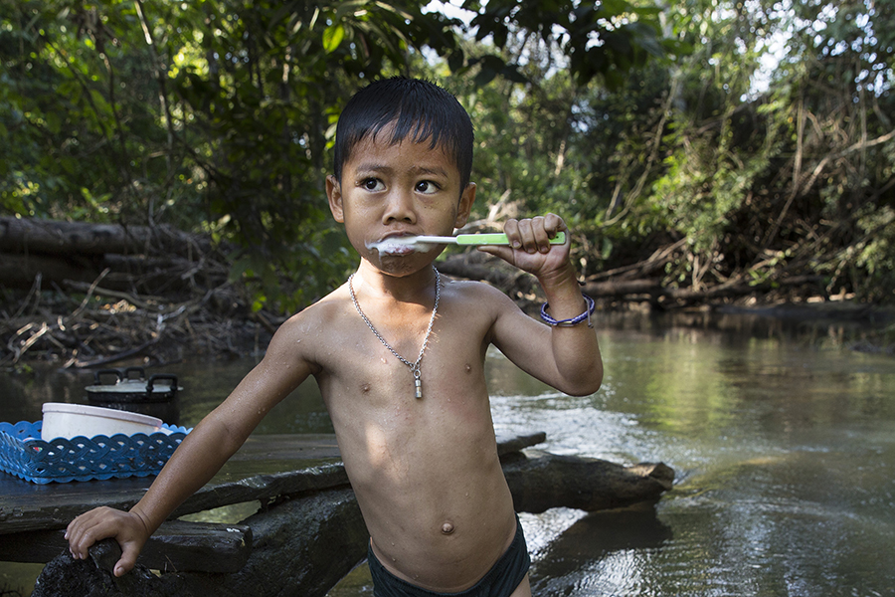
THAILAND

Slide 10
Juliane Kippenberg
Associate Director
Children’s Rights Division
Human Rights Watch
kippenj@hrw.org

