Slide 1
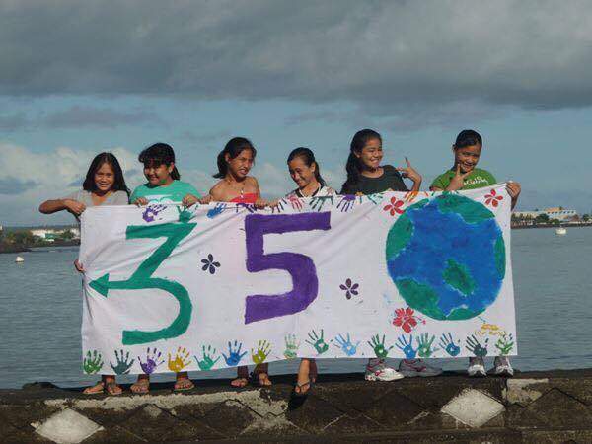
Children at the forefront of Climate Change
Brianna Fruean
Samoa (Pacific)

Slide 2
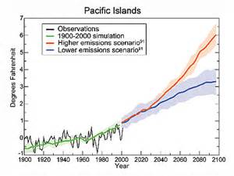
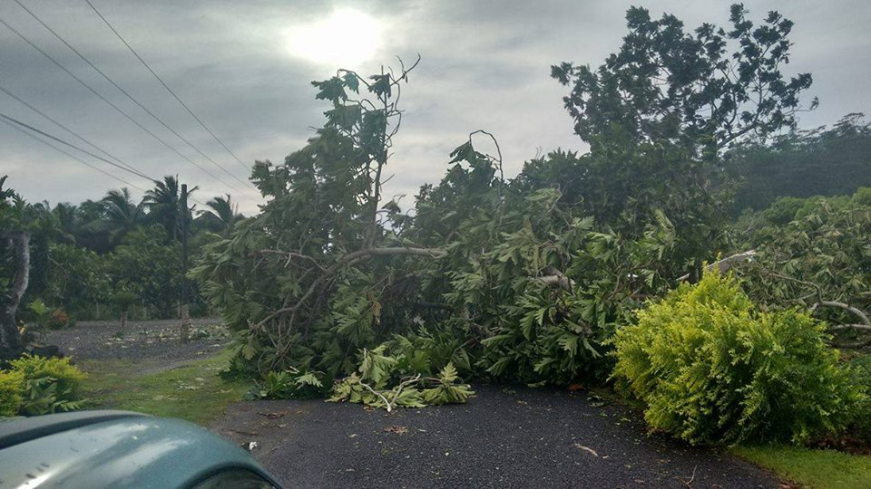
Climate change in the Pacific Region
Photo: Cyclone Amos, Samoa
This graph is excerpted from United Global States Research Program, 2009

Slide 3
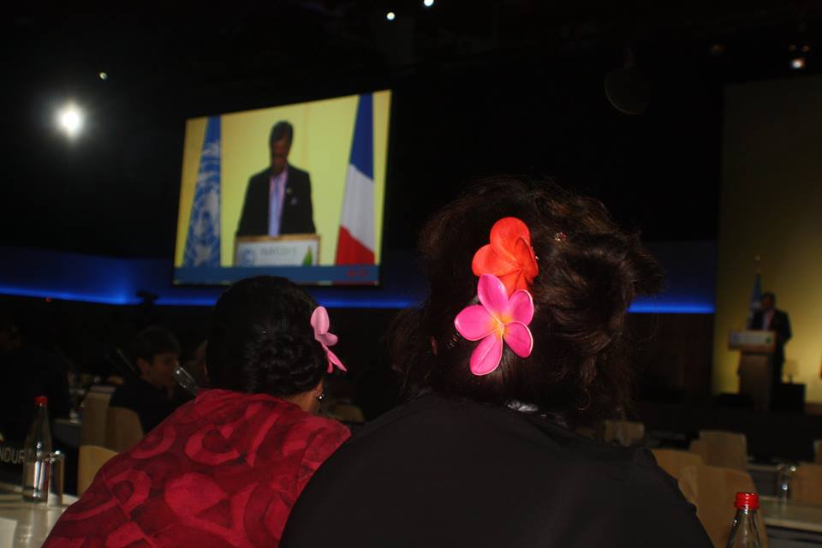
Climate facts from the Pacific
Tropical oceans warm
Increasing tropical cyclone intensity
Increasing cyclone frequency
More devastating tropical cyclones such as Cyclone Pam
Photo: Cook Is delegation during COP21 plenary (SPREP)

Slide 4
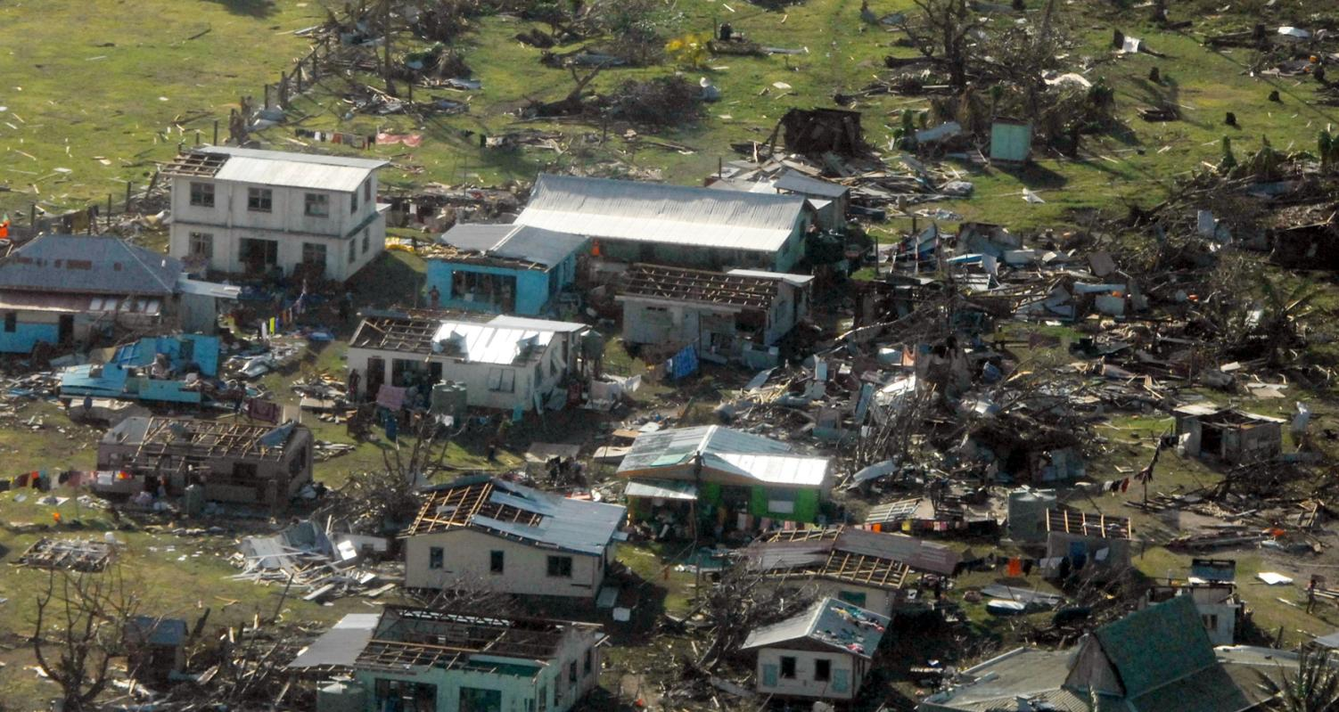
Tropical Cyclone Winston
Photo: Fiji post TC Winston (Ahmad Ali Karim)

Slide 5
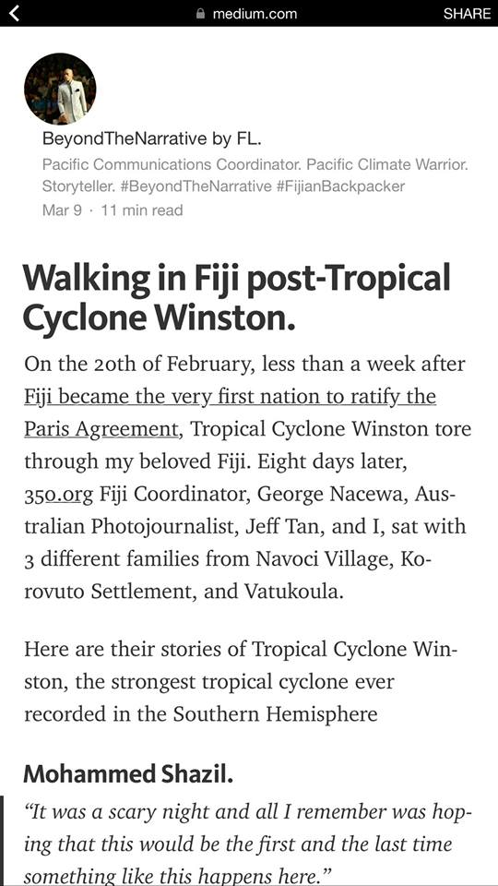
Frontline stories
Blog by: Beyond The Narrative

Slide 6
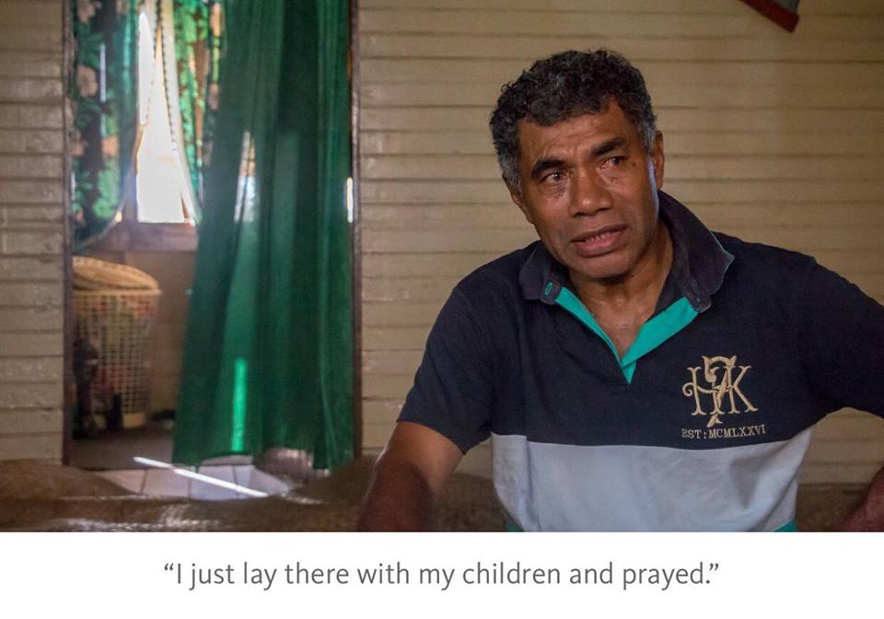
Frontline stories

Slide 7
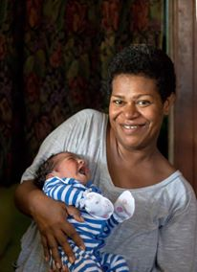
Frontline stories
Photos: Beyond The Narrative

Slide 8
Frontline stories
It is evident that the effects of climate change removes affected children's basic rights to:
Nutrition
Safety
Security
Shelter
Survival

Slide 9
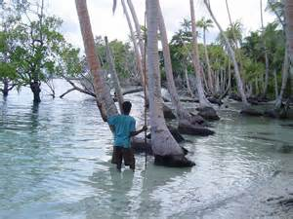
Children are living with the consequences of Climate Change today!
Photo: SPREP

Slide 10
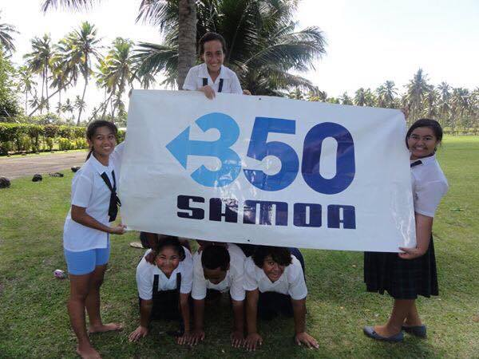
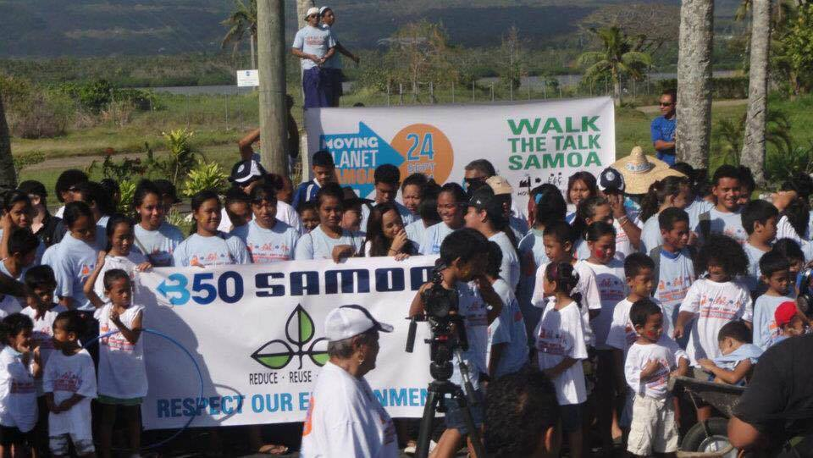
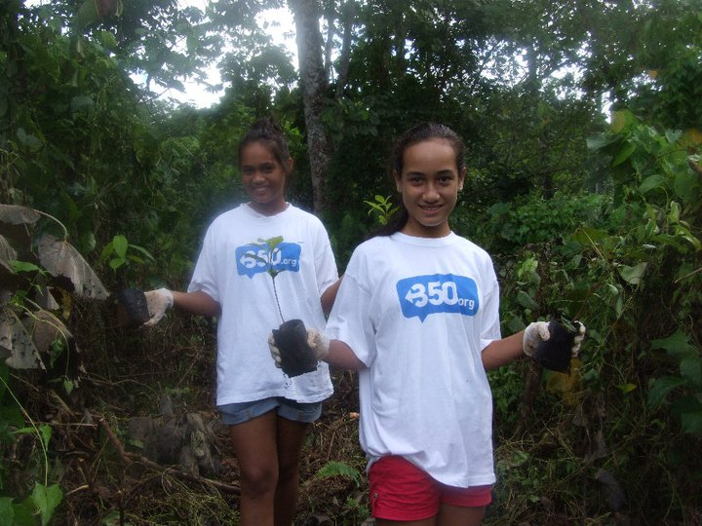
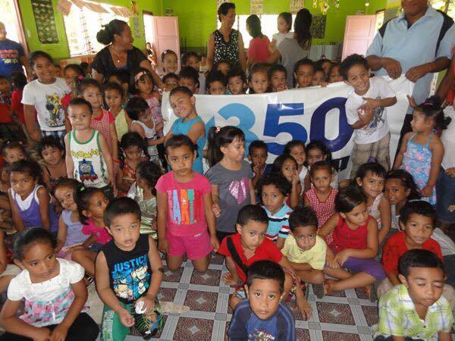
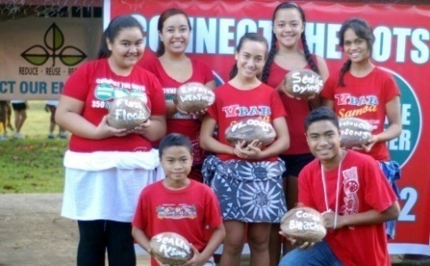
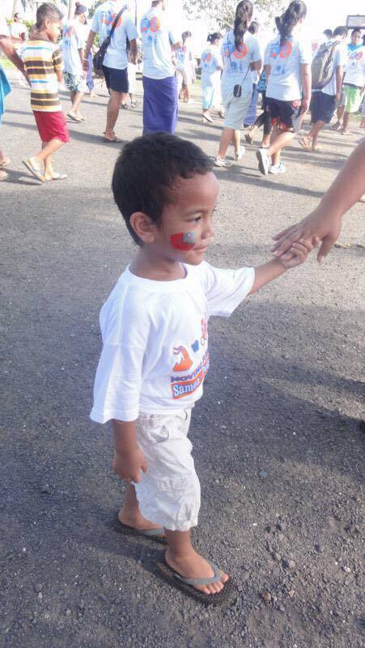
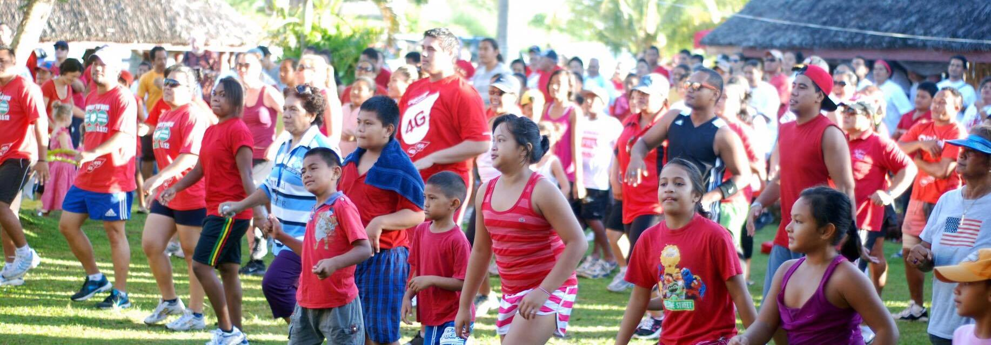
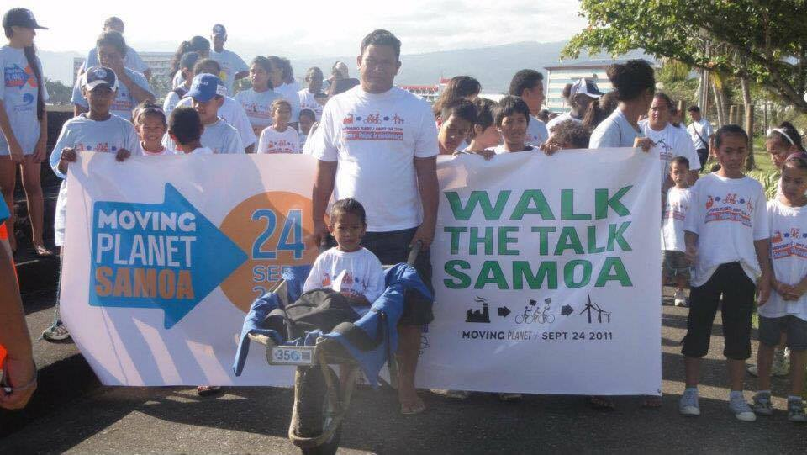
Role of Children and Youth Activists
Examples of my work and results achieved:

Slide 11
Creating agents of change
In order to create agents of change we need to.....
Have clear, comprehensive and frequently updated climate change education.
Be changing our school curriculums.
Include adaption and mitigation teachings.
Have altered information and resources based on different children's situations.
Include traditional knowledge and informal education.

Slide 12
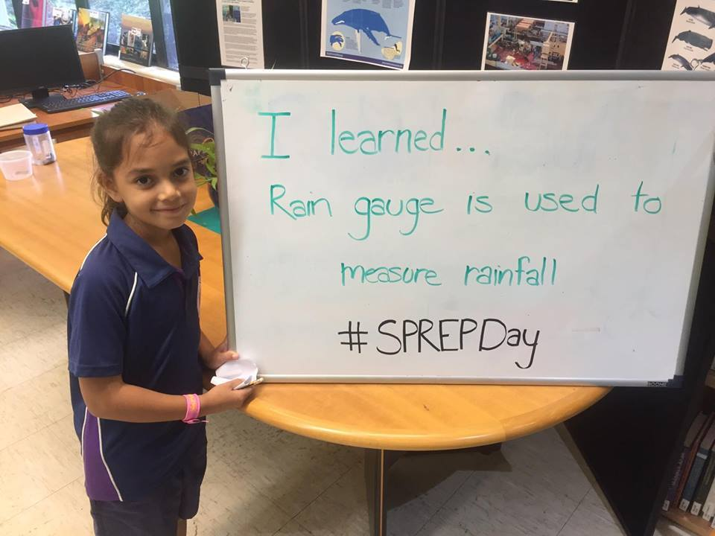

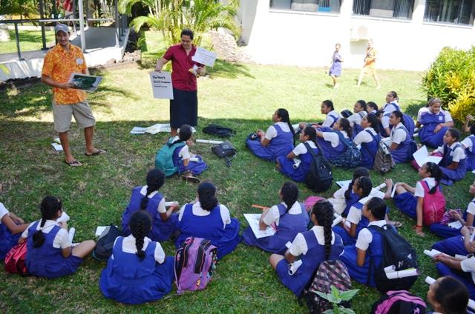
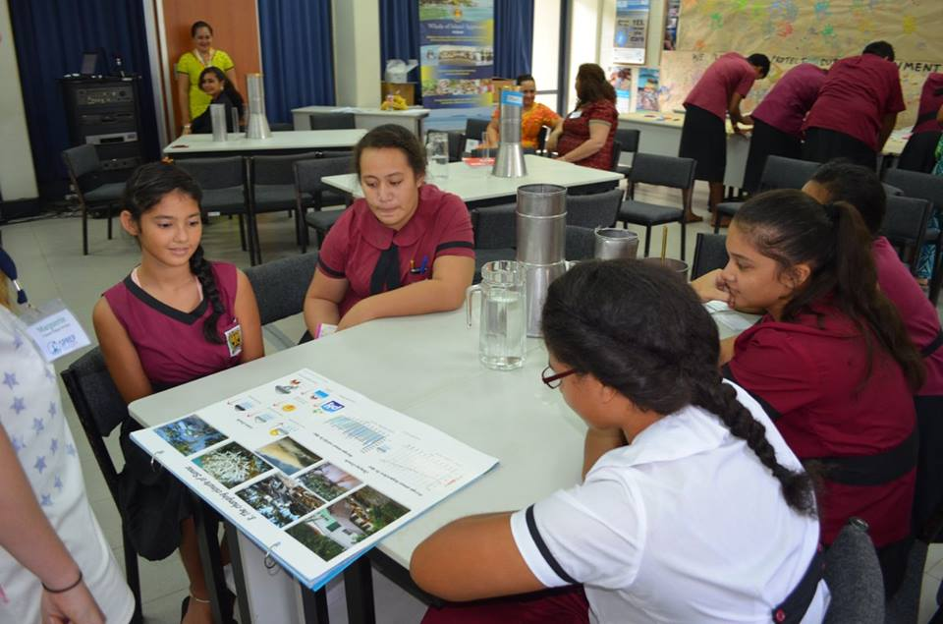
Creating agents of change
Non formal education inclusion
Practical activities
Field trips
Environmental groups
Creative writing opportunities
Establishing the translation of more child friendly UN documents
Photos: SPREP

Slide 13
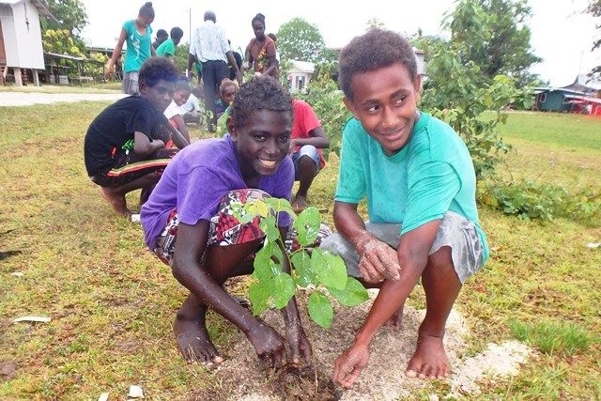
Photo: SPREP
The generation to change the world.

