Slide 1
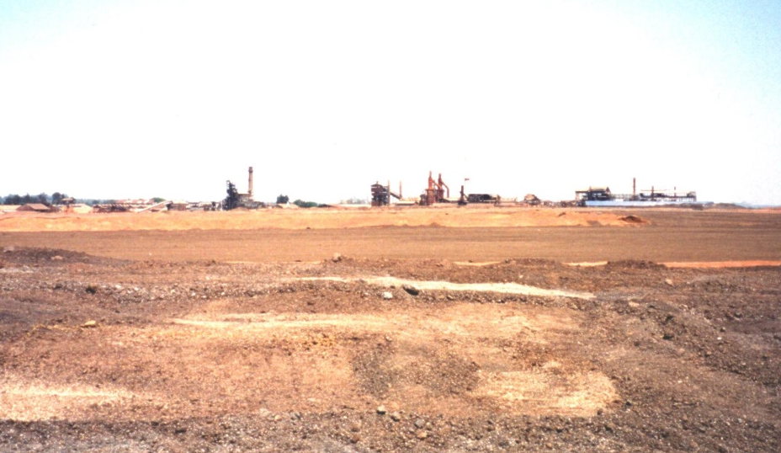
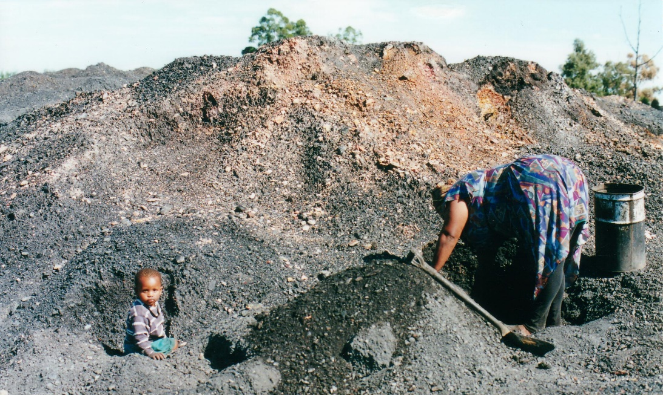
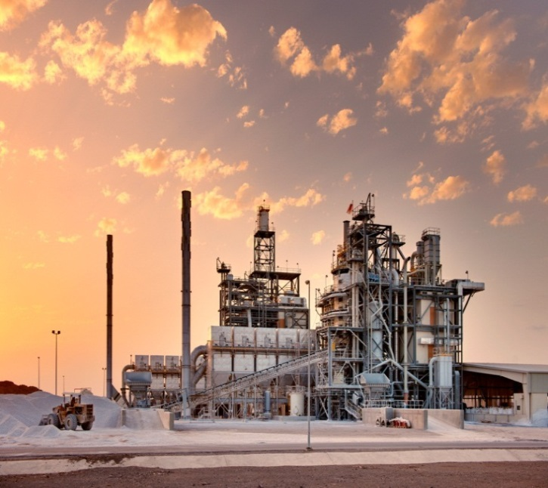
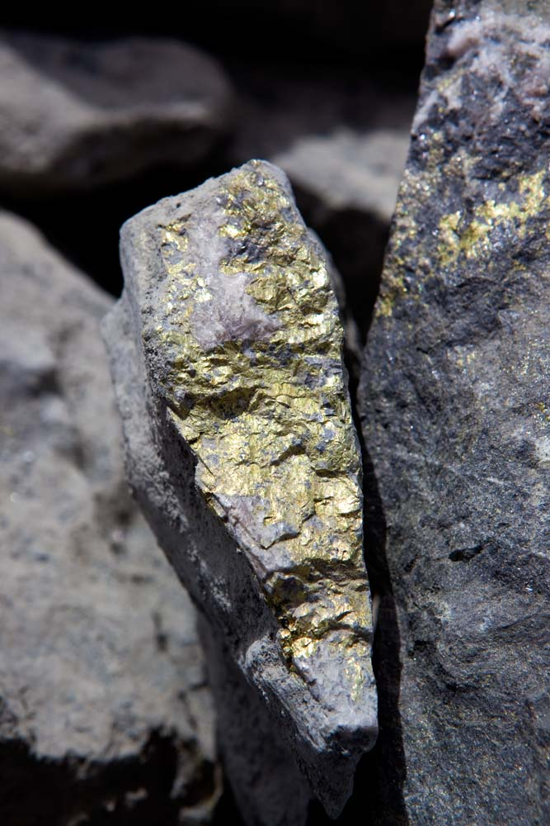
Assessing Impacts Children in the Mining Sector
Daniel Limpitlaw
Synergy Global Consulting
www.synergy-global.net
Notes:
1

Slide 2
Impacts on Children
Physical hazards
Pollution
Water shortages
Climate Change
Diseases
Livelihoods and Food Security
Notes:
The majority of health problems reported in mining regions are caused by air and water pollution and accidents at sites
Physical hazards
noise
accidents that trap and sometimes kill mineworkers. In addition to death and debilitation arising from silicosis and lung cancer, cave-ins, explosions, floods and other accidents may be fatal
Because their bodies are still growing and developing, children working in mining are at greater risk of being injured
Children may not necessarily be able to read warning signs and may not have the experience to know how to deal with hazardous conditions or falling ill than adult workers
Hg example
toxic levels of arsenic, cadmium, chromium and lead are present in coal-fuelled power plant waste
The threshold limit value (TLV) for lead corresponds to a concentration of 30 μg/dL in blood for adults and 10 for children
Women and children are potentially vulnerable to respiratory diseases as they may be more exposed to indoor pollution through cooking
air pollution affects agriculture in several ways and has the potential to reduce both the yield and the nutritional quality of crop plants
Mining uses a significant volume of water: in water stressed regions this can result in water scarcity and shortages for communities, making agriculture and livestock production difficult or impossible; drinking and cooking water become scarce. This may necessitate longer walks to water sources. Children may miss a greater proportion of the school day and may lose time for their education
Mining may cause massive deforestation and forest degradation which is a major source of greenhouse gas emissions that cause climate change. Also the impact of climate change on rehab to be considered.
Diseases
Waterborne diseases, including skin diseases and conditions that present as joint pain, were recorded at several mining sites in India
The majority of diseases are airborne: respiratory diseases (tuberculosis – TB, coughs and colds), gastric problems and eye problems (especially acute conjunctivitis). Diseases of the skin and eyes are thought to be related to the high incidence of particulate matter (PM) in mining areas
Livelihoods and food security
the loss of cropland in the drying up of water resources can lead to decreased food supply, malnutrition and cultural disruption

Slide 3
Child Vulnerability
Physiology
small body size, higher metabolism, more rapid breathing rate, less developed blood-brain barrier, developing organs
Behaviour
outdoor activity, hand to mouth habits
Extended exposure to potentially hazardous environments
many children live in environments polluted by mining rather than being exposed to those pollutants only for an eight-hour shift
Notes:
Children take in more air per-unit bodyweight – and more air pollution – at a given level of exertion than adults.
Children do not necessarily respond to air pollution in the same way as adults. Adults exposed to low levels of pollution will experience symptoms such as coughing, soreness in their chests, sore throats and sometimes headaches. Children may not feel the same symptoms or at least they do not acknowledge them when asked by researchers. Children may have losses in lung function even when they don’t cough or feel discomfort.
Children are more vulnerable to environmental stressors than adults and have less control over their environment. Although evidence indicating impacts on child’s development is growing, understanding of environmental risks to children remains limited. Environmental stressors may affect children with different vulnerability, at different stages (foetal, infancy, early childhood, adolescence) or even in the preconception period (possibly via epigenetic mechanisms).
Health impacts are mostly non-specific and non-acute. The time lag between exposure and effect may take decades and ultimate health outcomes may be modified by other factors.

Slide 4
Current Mining Sector ESIA Practice
Good international industry practice is based on the IFC Performance Standards and references the Equator Principles
The ICMM guidance on human rights due diligence requires companies to address their impacts on rights
Child Rights are implicitly rather than explicitly considered
HR focus effectively bridges the gap between the biophysical environment and the social environment
Notes:
EQP human rights due diligence shall be included in the ESIA, protection of human health, protection of human rights and community health, safety and security
IFC PS
PS 1: Social and Environmental Assessment and Management Systems - evaluates a project’s potential environmental and social risks and impacts in its area of influence,
examines project alternatives,
identifies ways of improving project selection, siting, planning, design and implementation by preventing, minimising, mitigating or compensating for adverse environmental and social impacts and enhancing positive impacts, and
includes the process of mitigating and managing adverse environmental and social impacts throughout project implementation.
PS 2 Labour and Working Conditions – particular emphasis is placed on fair treatment, health and safety of workers;
PS 3 Resource Efficiency and Pollution Prevention – provides guidance on preventing or minimising pollution risks;
PS 4 Community Health, Safety and Security – covers project-related activities such as infrastructure and equipment safety, environmental and natural resource issues and emergency preparedness and response in case of the broader community;
PS 5 Land Acquisition and Involuntary Resettlement – covers compensation and benefits for displaced persons, community consultation, grievance mechanisms, resettlement planning and implementation to ensure appropriate displacement of people where required in collaboration with governments;
PS 6 Biodiversity Conservation and Sustainable Management of Living Natural Resources – provides guidance on the avoidance of adverse impacts on biodiversity and ecosystem services. Any conversion or degradation should be mitigated with the aim of managing renewable natural resources in a sustainable manner;
PS 7 Indigenous Peoples – provides guidance on the avoidance of adverse impacts on indigenous communities and promotes effective communication; and
PS 8 Cultural Heritage – protects cultural heritage and supports its preservation.
A deficiency in the definition of environmental effect is that it focusses primarily on the implications of project developments for the physical environment, addressing human or health impacts only when these are caused by environmental changes directly due to project actions. Social, economic and other human environmental effects are examined where relevant, but their inclusion is often indirect

Slide 5
Key Findings
Environmental risks to children’s health are both complex in nature and uncertain - apply the Precautionary Principle
Notes:
necessary to identify and effectively prevent such risks, characterise uncertainties, and stimulate research and development of preventative alternatives

Slide 6
Key Findings
Pay attention to impacts of vulnerable groups – explicit measurements of the condition and trends of biodiversity associated with relevant ecosystems are required
Children should be explicitly identified as a vulnerable group (where appropriate)
Notes:
Poor and marginalised people have the least capacity to adapt to environmental, economic and social changes or to protect themselves from environmental hazards

Slide 7
Key Findings
Assessments must be built on multi-stakeholder consultation and participation
to encourage members of the community to participate in the investigative process and
to use the information to analyse environmental aspects, identify impacts and execute and evaluate potential solutions.
Notes:
Assessments must consider the extent to which proposed activities infringe on the enjoyment of human rights by others.

Slide 8
Key Findings
A broader social and community health assessment based on several determinants of health, including employment, income, education, housing, environment, lifestyle and traditional land-use activities is required to determine impacts on children
Notes:
Data collected as part of baseline surveys should be disaggregated by age and gender.

Slide 9
Key Findings
The determinants of health rather than the health impacts should be assessed – weigh the evidence for likely changes in health determinants and then outline whether the nett effect of these changes will be positive or negative for identified communities
Notes:
Human health problems from degraded ecosystems: dust, erosion, adverse effects on ecology and biodiversity, and the contamination of soil, ground and surface water by chemicals
Integrating health into ESIA requires a more inclusive consideration of both physical and social health impacts based on the recognition that human health and social and environmental well-being are inextricably linked.
The complexity of the relationships between environmental change and health make the construction of models that successfully quantify and predict the impacts of a project on human health challenging. Consequently, predicting social health impacts pose a significant challenge as the linkages between aspects, environmental change and health outcomes are often difficult to establish. There may be substantial time lags, feedback and an absence of known cause and effect relationships. One solution is to assess the determinants of health rather than the health impacts.

Slide 10
Key Findings
An ecosystem approach makes explicit links between the status of natural resource systems and ecosystem services that support human well-being
Multidisciplinary assessment teams are key to the success of this approach
Determination of the delivery of ecosystem benefits (quantity and quality) is necessary to determine the measurements required
Notes:
EA requires engagement with broad range of institutions, organisations, groups and individuals that have an interest in, understanding of, or potential influence over, the management of a given ecosystem.
In other words, we need to understand what benefits people derive from and ecosystem so that we can monitor those aspects with the correct resolution (spatial and temporal). This might mean weekly water quality sampling and seasonal fish diversity surveys, for example.
EA makes explicit links between the status of natural resource systems and ecosystem services (ES) that support human well-being The Convention on Biological Diversity (CBD) describes EA as “a strategy for the integrated management of land, water and living resources that promotes conservation and sustainable use in an equitable way”
By adopting an approach that considered the provision of ecosystem services (as would be required when adopting an ecosystems approach) indirect impacts of a project can be more easily assessed.

Slide 11
Key Findings
Understand the context of contrasting future scenarios which incorporate both the value of ecosystem services (ES) and the cost of actions affecting those ecosystems
Recognise that human health and social and environmental well-being are inextricably linked
A more inclusive definition of health to include physical, social and other cultural dimensions specific to the community in question is required
Assessments of health, ecological, social, economic and technological factors in affected communities should be combined
Notes:
This allows the impacts of alternative decisions on ES can be assessed
Ecosystem services are the advantages that community receives from healthy functioning ecosystem
EA seeks to maintain the integrity and functioning of ecosystems as a whole to avoid undesirable ecological change. EA goes beyond limiting assessment to ecosystems themselves and includes social, cultural and economic factors that are fully interdependent with biodiversity and ecosystem services. This requires open and explicit choices to be made between alternative stable ecosystem states and levels of benefits they deliver.

Slide 12
Synergy Global Consulting
www.synergy-global.net

