Slide 1

HUMAN RIGHTS AND THE 2030 AGENDA:
Human rights and SDG implementation at the national level
Date: Tuesday, 3 December 2019 Venue: Room XX, Palais des Nations, Geneva Session 3, 15:00-17:30
              BY COMMISIONER GEORGE MORARA
              VICE CHAIRPERSON
              KENYA NATIONAL COMMISSION ON HUMAN RIGHTS

Slide 2
Outline of Presentation
About the Kenya National Commission on Human Rights (KNCHR)
Memorandum of Understanding Between KNCHR and the Kenya National Bureau of Statistics (KNBS)
Impact of the Partnership in ensuring Inclusivity: The 2019 Kenya Population and Housing Census
Overview of Ongoing Work on SDG 16

Slide 3
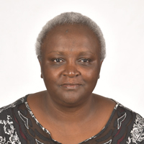

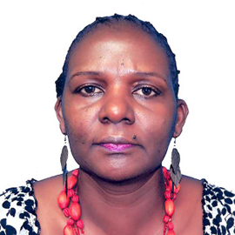
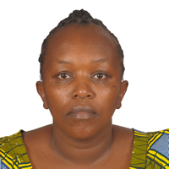
Establishment & Mandate
Kenya National Commission on Human Rights established under Article 59 of the Constitution of Kenya, 2010; Operationalised under the KNCHR Act, 2011.
Note: [Established as the Kenya National Human Rights and Equality Commission under the Constitution- KNCHR, CAJ/Ombudsman and NGEC].
As per the Act comprises five (5) Commissioners (but in reality we have four Commissioners who are fulltime).
Presence in five Regions across the country besides the HQ in Nairobi.

Slide 4
KNCHR Mandate
Mandate to promote and protect human rights
To promote the protection, and observance of human rights in public and private institutions;
Receive and process complaints; investigations; research on human rights issues, public awareness.
We are the designated principal organ of the State in ensuring state compliance with national, regional and international human rights

Slide 5
KNCHR and KNBS MOU
Background:
The adoption of ‘Transforming our World: The 2030 Agenda for Sustainable Development’ by all UN members in September 2015.
Clarion call: to leave no-one behind in the implementation of the
17 Sustainable Development Goals and 169 targets.
Kenya’s vision 2030: National blueprint for socio-economic development.
Merida Declaration on the Role of NHRIs in Implementing 2030 Agenda for Sustainable Development.
Kigali Declaration and Plan of Action on the 2030 Agenda.

Slide 6



MOU between KNCHR and KNBS (contd.)
Consultations between the Kenya National Bureau of Statistics (KNBS), the Kenyan National Commission on Human Rights (KNCHR) and the Senior Human Rights Adviser of the United Nations Office of the High Commissioner for Human Rights in Kenya: Mutual interest and willingness to pursue further dialogue on human rights and statistics and on strengthening cooperation between KNBS and KNCHR.
KNBS established under the Statistics Act, 2006 (Act No. 4 of 2006) as the principal agency of the government for collecting, analysing and disseminating statistical data in Kenya. KNBS is charged with conducting the Population and Housing Census every ten years, and such other censuses and surveys as the Board may determine.

Slide 7
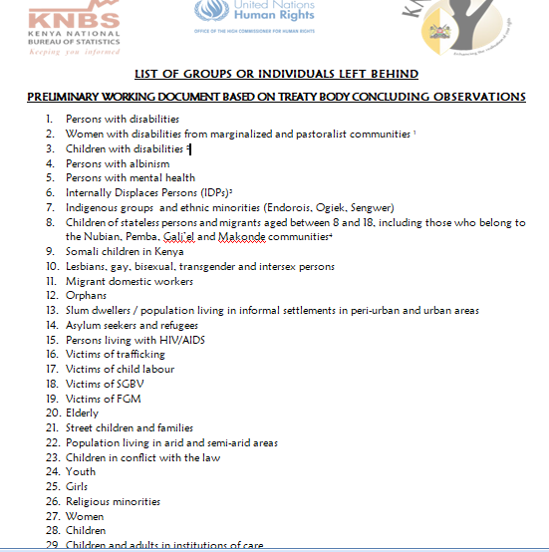
Preliminary Group of Individuals Left Behind
The consultations also resulted in the development of a preliminary list of population groups(29) who are at risk of being left behind in Kenya. The list was based on Treaty Body Concluding observations.

Slide 8
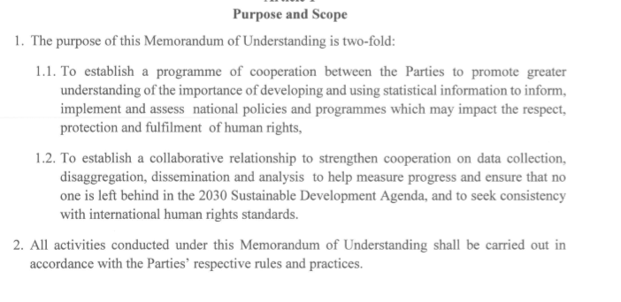
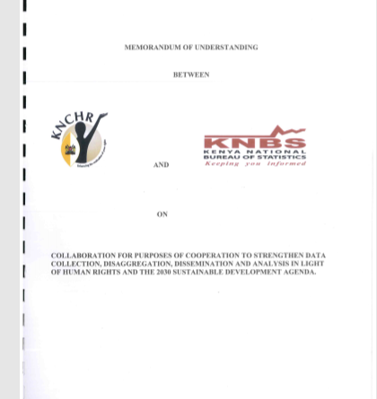
MOU between KNCHR and KNBS
Signed 26th July 2017

Slide 9

Towards inclusivity: The Census Process
Participation in Preparation of Census instruments: As member of the Technical Working Committee(TWC) on Census
Development of series of Advisories: KNCHR developed a series of advisories: To KNBS, DoJ, Ministry of Interior.
First one in March 2018 touching on
  Recognition of the marginalised communities indigenous: The Makonde; Nubians
  Self identification
  Inclusion of the Intersex Persons

Slide 10
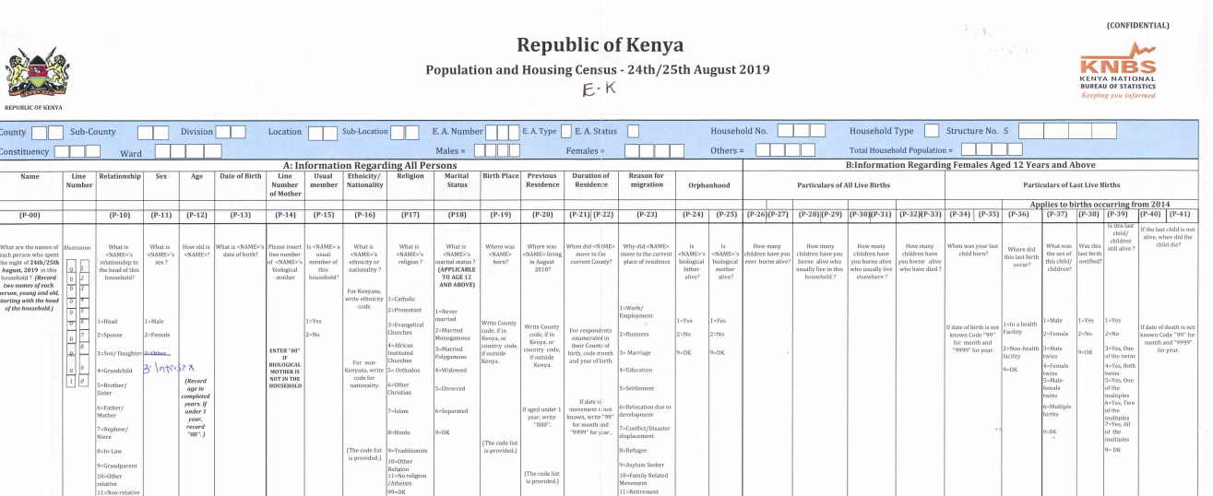
Census
Advisories:
Relied on national frameworks (principles of non-discrimination and protection of the vulnerable and marginalised groups); court judgments and concluding observations both regional and international mechanisms.
Guidance Note on Human Rights Based Approach
  Participation
  Disaggregation
  Self-identification
  Privacy; Transparency.

Slide 11
How we went about it ….
Several follow up meetings- Focal points for the institutions key
‘Insider’ engagements’ within the Statistical Committee as a member of TWC
Sharing a list of marginalised ethnic/minority groups with KNBS team
Direct involvement in the field process/Pilot Census in August 2018 (whereby we made recommendations towards the main census in August 2019)
Advocacy through other actors as well:
  Office of the Attorney General and Department of Justice- As government Adviser
  Member of Parliament Representing Special Interest Groups
  Government Taskforce- Taskforce on Policy, Legal, Institutional and Administrative Reforms in Kenya
  Media

Slide 12
Results: A census of Firsts…
Use of technology: CAPI
Both English and Kiswahili translations of questionnaires
Inclusion of ‘Intersex’ as third sex in the Census instrument
Persons with Disabilities and How the Washington set of questions was being asked ‘Persons having difficulties’
Albinism
Inclusion of ‘Makonde’ and other hitherto neglected sub-tribes; the corner tribes etc
Codes for Stateless persons; Refugee/Asylum Seekers
On ethnic coding: Even provided an option for ‘refusal’
Enumerators’ Instructions manual that is in line with HRBA:
e.g How to interview persons.
The August 2019 Census is the sixth since independence, at intervals of ten(10) years: 1969, 1979, 1989, 1999, 2009.
Earlier ones in 1948 and 1962.

Slide 13
More collaboration: Beyond Inclusive Instruments
We were as much interested in the process of data collection.
Trainings of TOTS and Supervisors [Cascaded trainings]
Preparation of training module for use by TOTs
Review of Enumerators manual (the booklet that explains to field officer how to ask each of the questions)
Participation as supervisors and coordinators: Actual feel of the challenges on the ground.
Others aspects of data such as privacy/confidentiality: Oath of Office and Secrecy.
Lobbying for Fast-Tracking of Data Privacy and Protection Laws and Policy. Shared an advisory with Ministry

Slide 14
Beyond inclusion… Information Dissemination is Key
Recognition was a great milestone
But … people needed to come out and get counted: We had just slightly over a month to the national census to inform population that a ‘stigmatised’ population could come out [How many media advocacy forums?, media briefings, infomercials, IEC materials]
Collaboration in development of content for disseminating the right information to the media: E.G About the ‘Intersex’ marker.

Slide 15
Impact of Partnership
Inclusion in the Technical Working Committee(TWC) of the KPHC Pilot Census in 2018 and TWC for main census exercise in 2019:
  The committee reviews the census instruments and makes recommendations on the best practices for preparatory activities, data collection and processing; quality assurance guidelines; and monitoring and evaluation of all the technical activities of the census at all stages.
  The committee consists of technical representatives of major stakeholders in both public and private sectors.
Invitation to join two other data statistical Committees:
  Governance, Peace and Security Statistical Committee
  Gender Statistical Committee

Slide 16
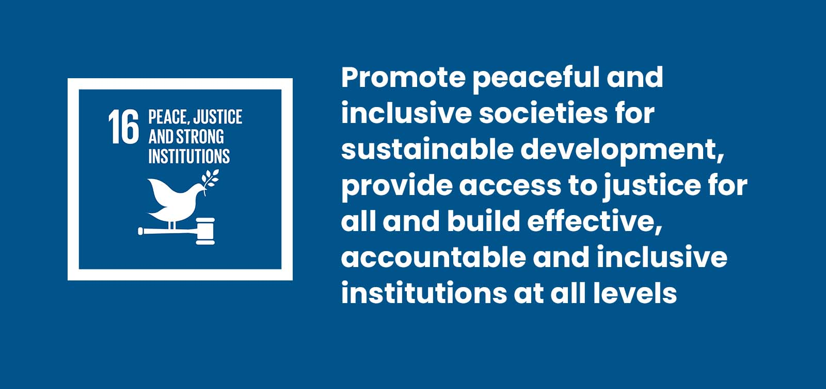

Slide 17
SDG 16 Project- some Background...
Extrajudicial Killings; HRDs, Enforced Disappearances: Various report: Error of Fighting terror with terror: Terrorism..
Discrepancies in Reporting across various institutions: Government; KNCHR and NGOs dealing in the thematic area
In the 2017 first Voluntary National Review (VNR), it was evident that there was no data available in all the priority targets and indicators under SDG 16, except SDG 16.10 as was demonstrated in the SDGs Indicator Framework for Kenya

Slide 18

SDG 16 Project
Deliverables
Three main deliverables:
1). Develop an effective methodology together with accompanying tools for data collection, disaggregation and dissemination on selected SDG 16 indicators in compliance with international statistical and human rights standards and methodologies.
A consultant was hired through a consultative process involving both the KNCHR and the OHCHR representative. A consultancy contract was issued on in March 2019 to run for 14 weeks spread in 4 months.
*Extension*

Slide 19
SDG 16 Consultancy
2). Put forward suggestions on what should be prioritized to operationalize the Office of Human Rights Commissioner OHCHR’s guidance note on Human Rights-Based Approach to Data (HRBAD), and to further data collection, disaggregation, analysis and dissemination based on the use of the list of groups being left behind in Kenya identified by the oversight team;
3). Produce a situation analysis highlighting the review of practices, methodologies and challenges by the KNCHR and KNBS to collect data on indicators 16.1.1, 16.1.3, 16.3.1, 16.10.1 and 16.b.1/10.3.1 and gaps based on the list of population groups left behind.

Slide 20
SDG 16
  Produce a situation analysis and review of practices, methodologies and challenges by the two institutions to collect data on the above-mentioned indicators16.1.1, 16.1.3, 16.3.1 and 16.10.1 and gaps based on the list of population groups left behind prepared by the KNCHR, KNBS and OHCHR. Compile a detailed report on effective and viable methodologies for filling all these gaps, furthering the implementation of the HRBAD in Kenya in the operations and products of the national statistical system.

Slide 21
FOCUS AREAS
    Number of victims of intentional homicide per 100,000 population and disaggregated by type of victims and perpetrators (16.1.1);
    Proportion of population subjected to physical, psychological or sexual violence in the previous 12 months (16.1.3);
    Proportion of victims of violence in the previous 12 months who reported their victimization to competent authorities or other officially recognized conflict resolution mechanisms(16.3.1);
    Number of verified cases of killing, kidnapping, enforced disappearance, arbitrary detention and torture of journalists, associated media personnel, trade unionists and human rights advocates in the previous 12 months (16.10.1).
The information will also capture the killings, kidnapping, enforced disappearances and torture of persons who are not necessarily HRDs.

Slide 22
Expected Impact?
The Non–State actors (Civil Society Organizations): An opportunity aimed at not only reviewing their methodologies but as a key step towards working with state actors on improving their relationship as they work towards common goal of promotion and protection of human rights.
The National Statistical Office ( KNBS)
The review and adoption of the necessary methodologies key- incorporation of data from the local levels into the official data by the national statistical office thus giving a more holistic picture.

Slide 23
The National Government
Bears primary responsibility on monitoring and reporting against the various indicators under all the SDGs including SDG 16. The project would provide the necessary methodologies and input on how the data can be mined for reporting at the international arena.
National Reporting: E.G Under the Prevention of Torture Act, 2017.
International reporting: ICCPR; CAT

Slide 24
SDGs
Status: Consultancy on SDG 16 almost at tail end(to be concluded by December)
MOU signed with the Danish Institute on Human Rights:
Currently touching on Business and Human Rights; SDGs and Human Rights Data and the Human Rights Education.

