Slide 1
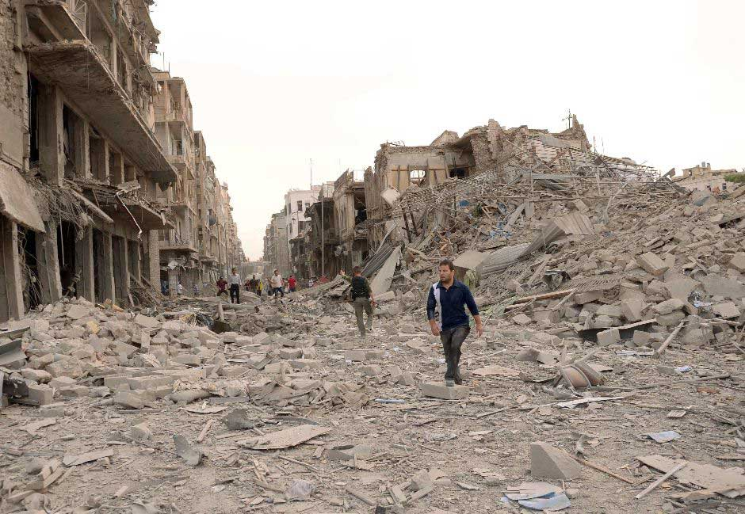
The use of barrel bombs and indiscriminate bombardment in Syria
Aleppo city

Slide 2
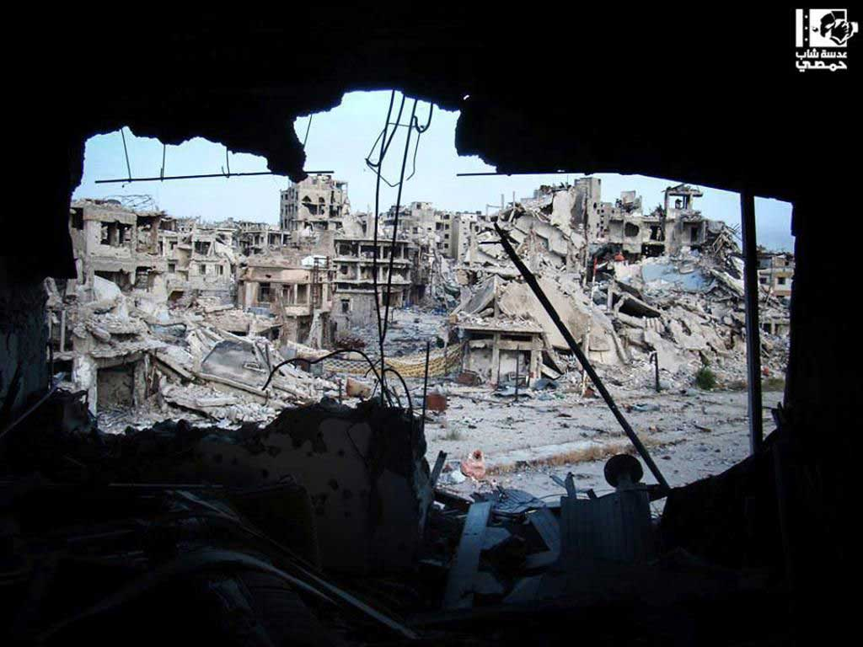
Indiscriminate bombardment
Primary cause of death, displacement and destruction
Perpetrated by all parties
But in considerably different scales
Homs city

Slide 3
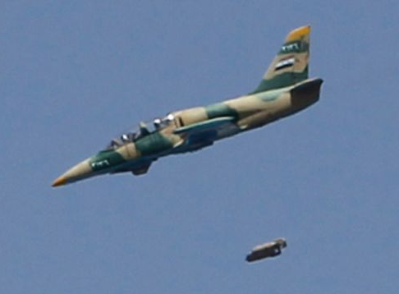
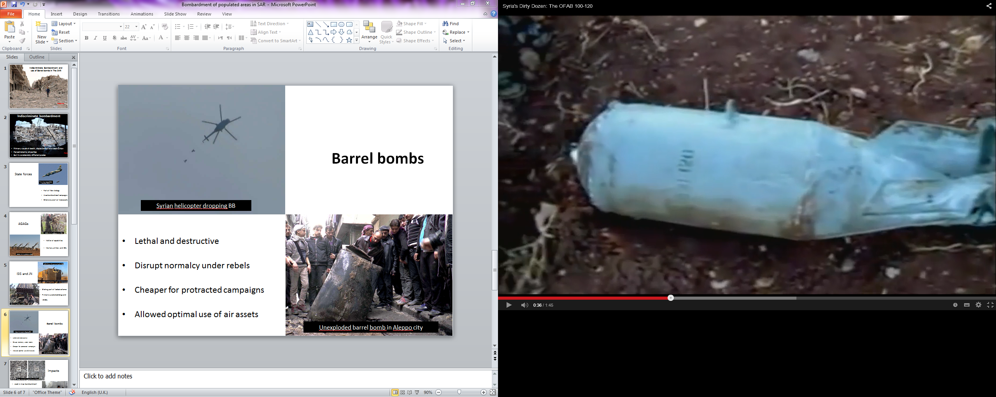
State forces
Plane fires a missile, Aleppo city, Sept 2012
Unexploded “gravity bomb” in Aleppo, OFAB 100-120
Part of their strategy
Area bombardment campaigns
Extensive use of Air Force and unguided bombs

Slide 4
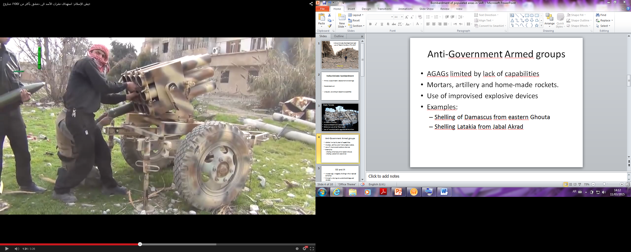
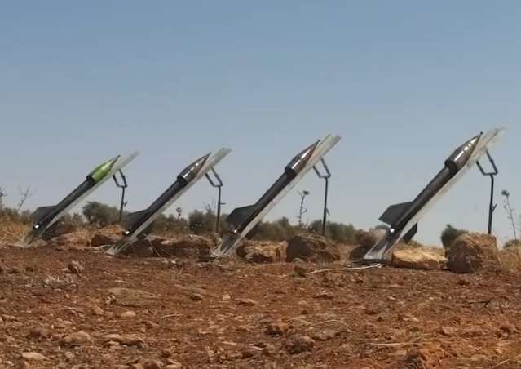
AGAGs
AGAGs shelling Damascus, Jan 2015
Matter of capabilities
Mortars, artillery and IEDs
AGAGs shelling Nubul, Jan 2015

Slide 5
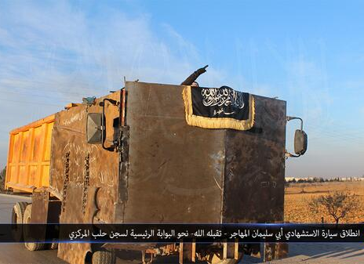
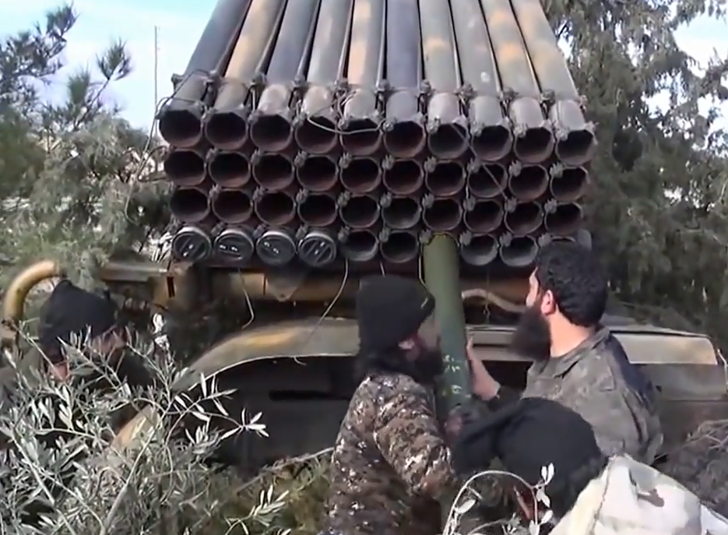
ISIS and Jabhat
Al-Nusra
Jabhat Nusra, Aleppo countryside, 2014
Shelling, part of tactical schemes
Primarily suicide bombings and VBIEDs
ISIS shelling Kobane, Jan 2015

Slide 6
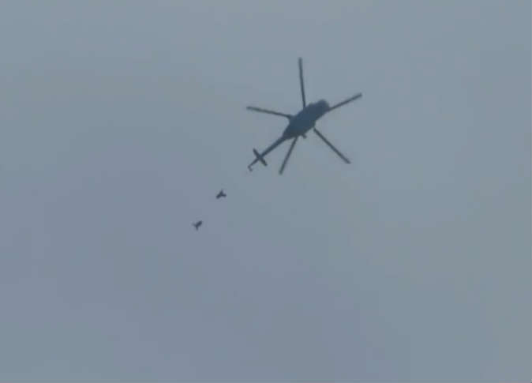
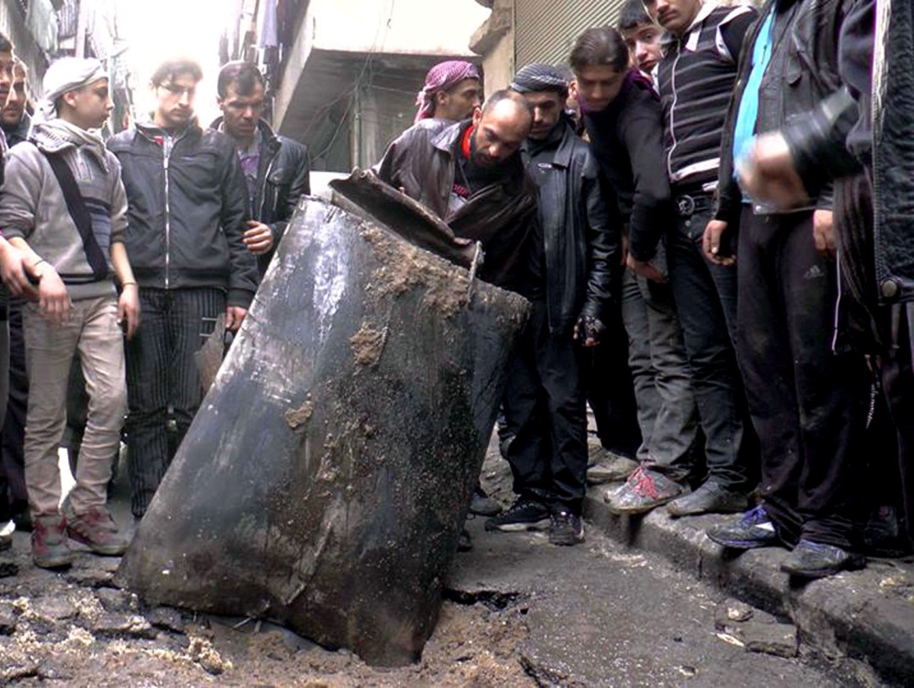
Barrel bombs
Syrian helicopter dropping BB
Lethal and destructive
Disrupt normalcy under rebels
Cheaper for protracted campaigns
Allowed optimal use of air assets
Unexploded barrel bomb in Aleppo city

Slide 7
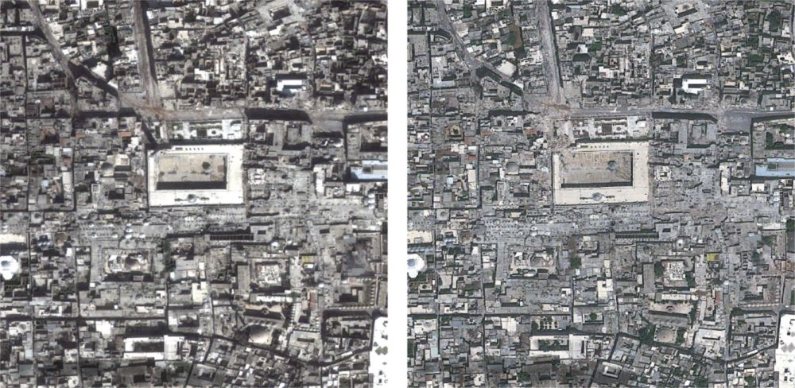
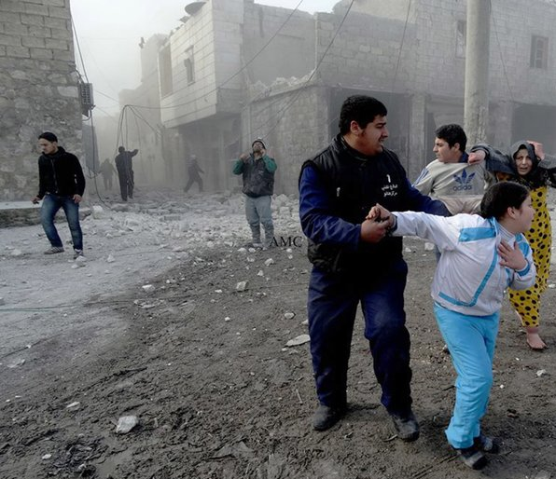
Impacts
Damage around the Great Mosque of Aleppo
Used in Area bombardment
Includes fragmentation or incendiary effect
Caused large displacements
Aerial bombardment in Aleppo city

