Slide 1
romarising
Chad Evans Wyatt/Photo
www.romarising.com

Slide 2
Most of the following individuals are
university post-graduates.
All have university training.

Slide 3
Some ignored personal risk to participate
in romarising.
I am indebted to all.

Slide 4
romarisingSK
www.romarising.com
© Chad Evans Wyatt / Photo

Slide 5
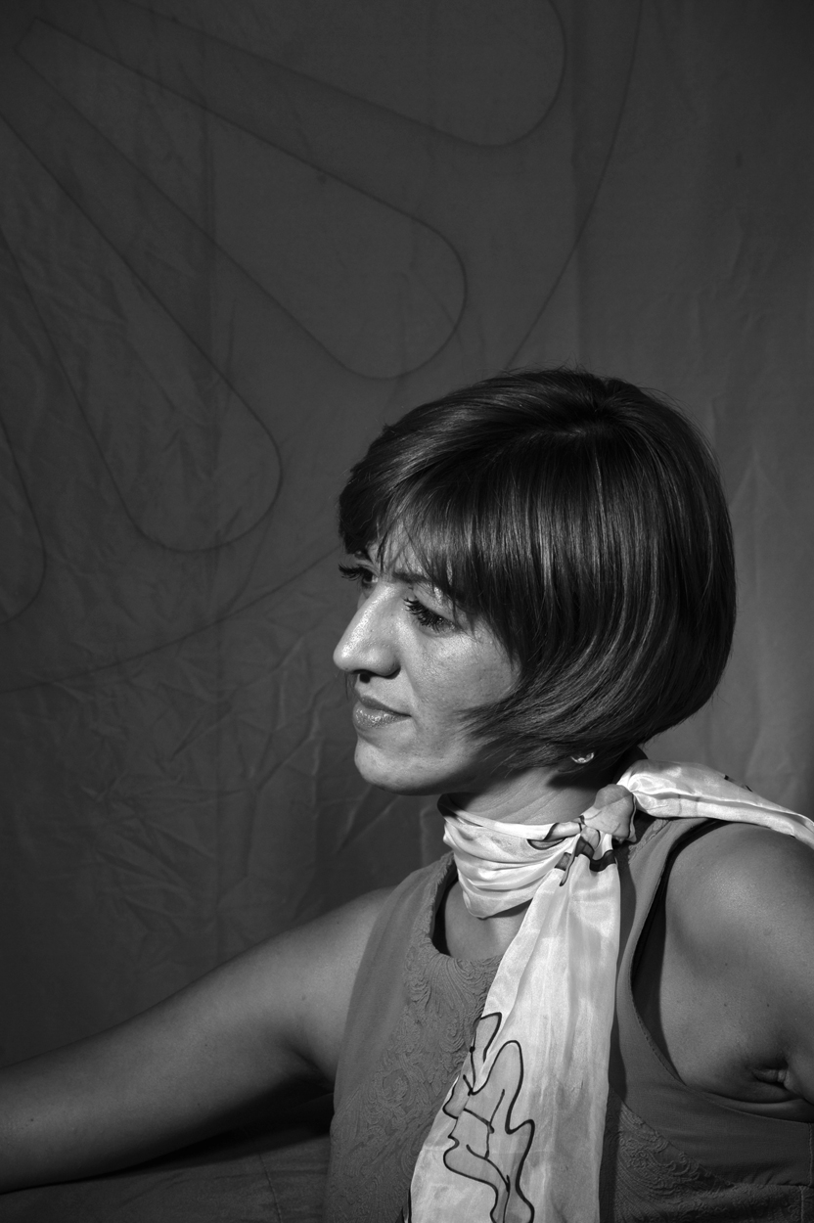
Mgr Andrea Bučková
Office of Human Rights

Slide 6
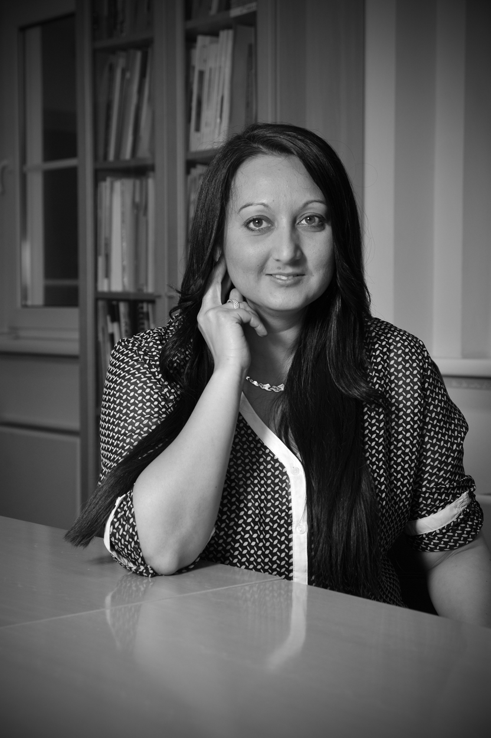
Mgr Beata Bislim Oláhová
Roma Education Fund

Slide 7
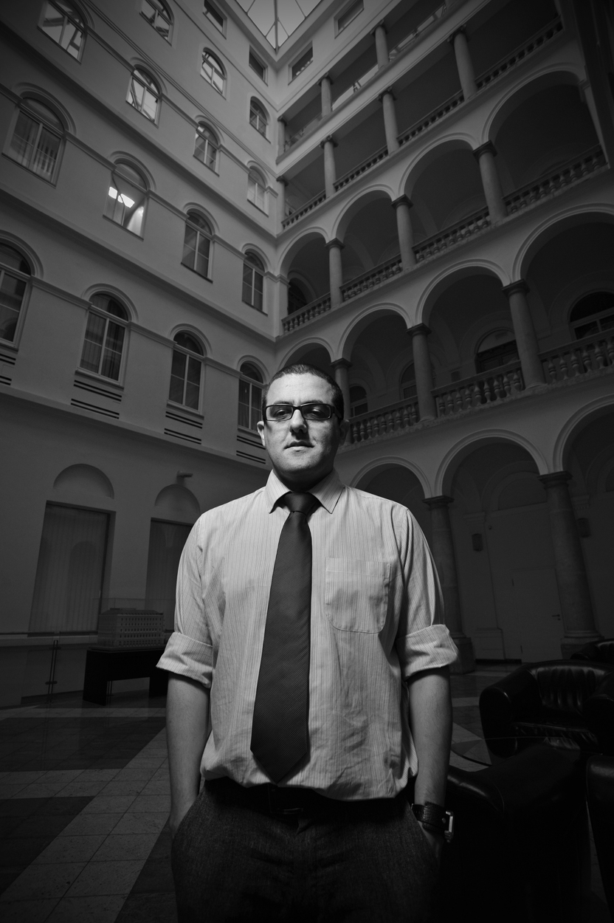
Stanislav Daniel
Roma Education Fund/Program Officer

Slide 8
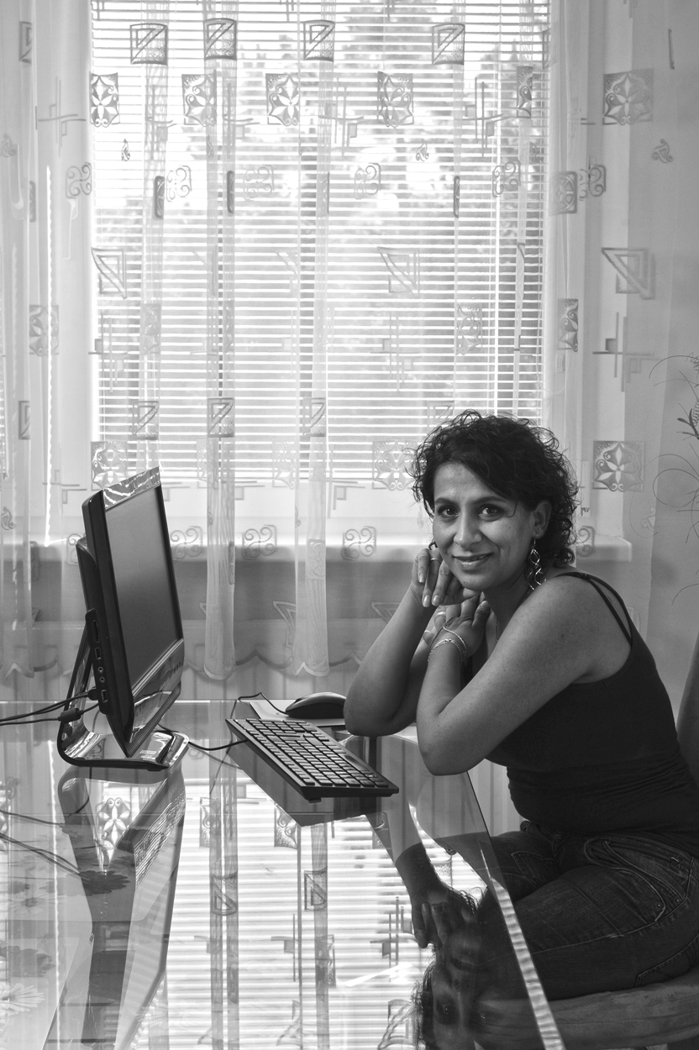
Janette Motlová
Author, Journalist

Slide 9
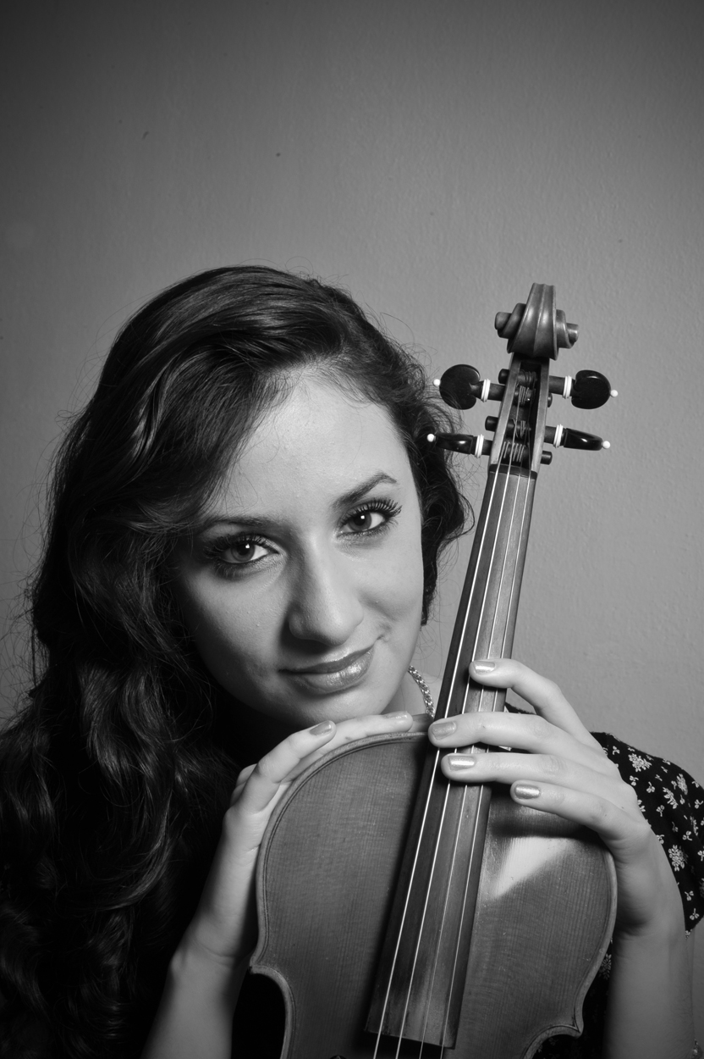
Mgr Barbora Botošová
Musician

Slide 10
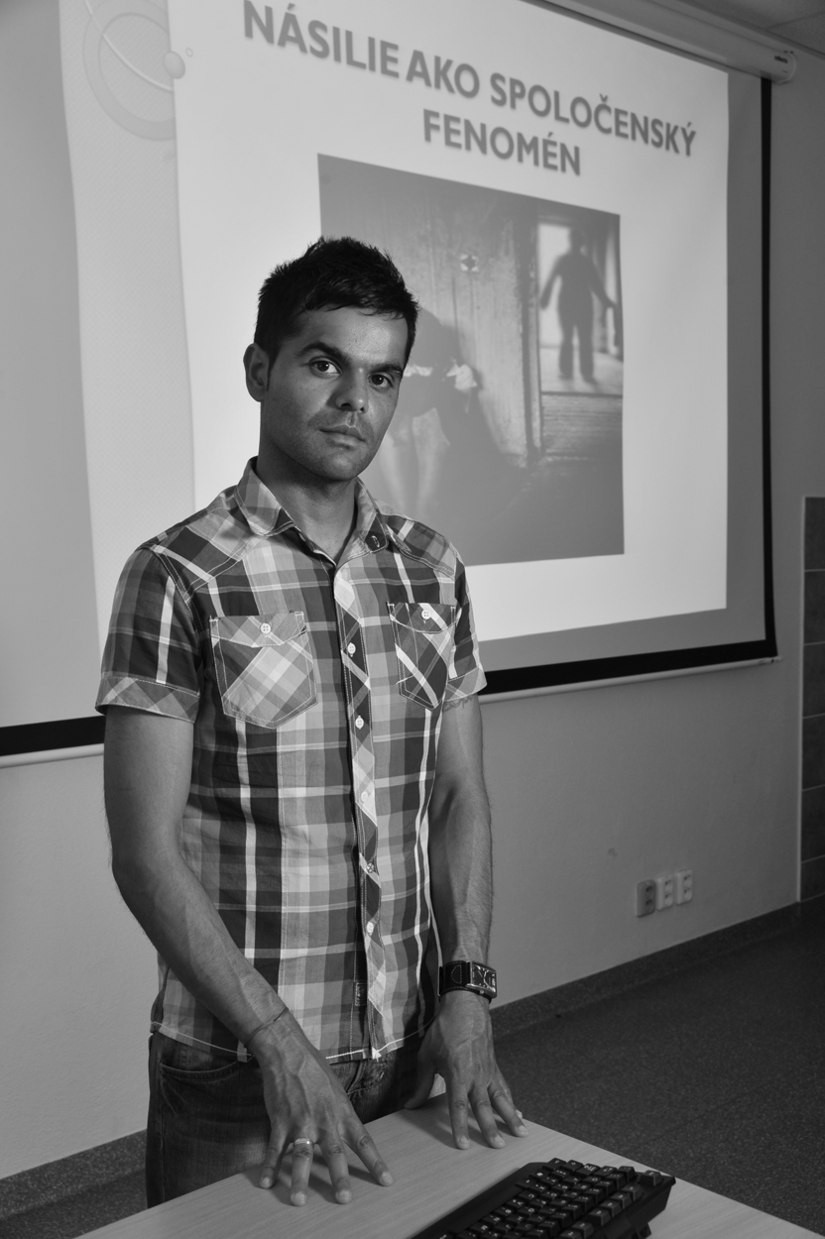
Ivan Rác, PhD
Sociologist

Slide 11
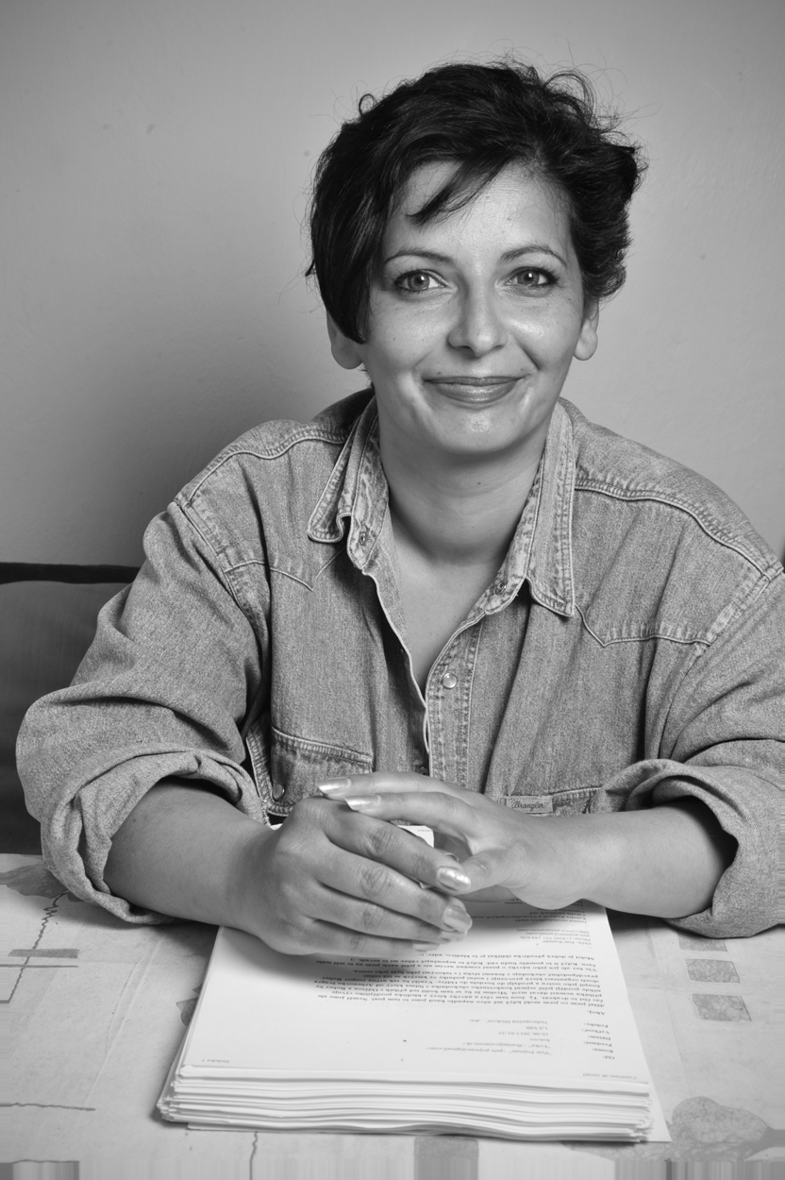
Erika Hornáková
Author

Slide 12
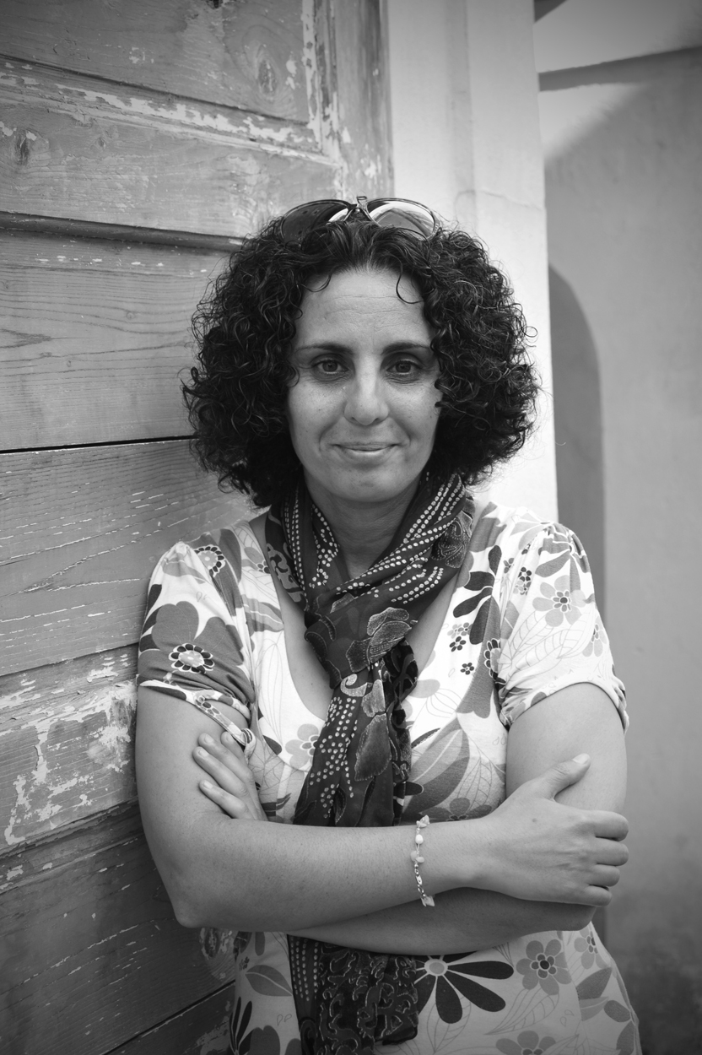
Denisa Havrľová
Journalist, Videographer

Slide 13
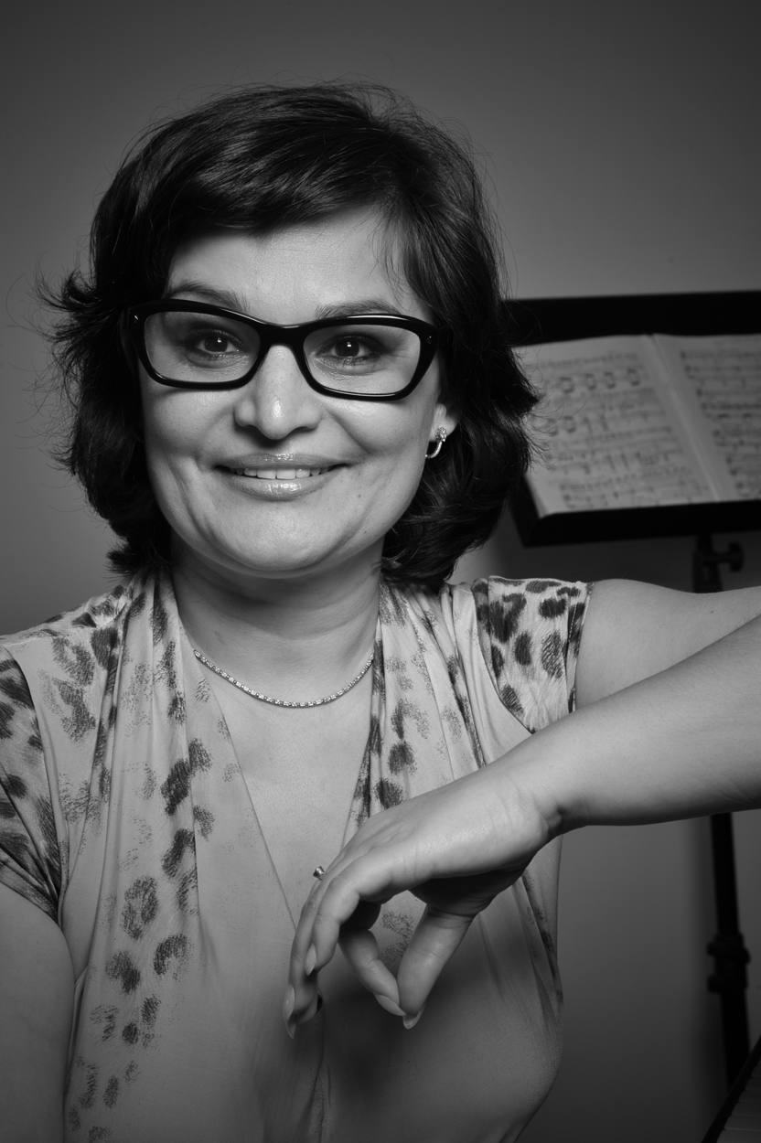
Božena Ferancová, PhD
Opera Singer, Professor

Slide 14
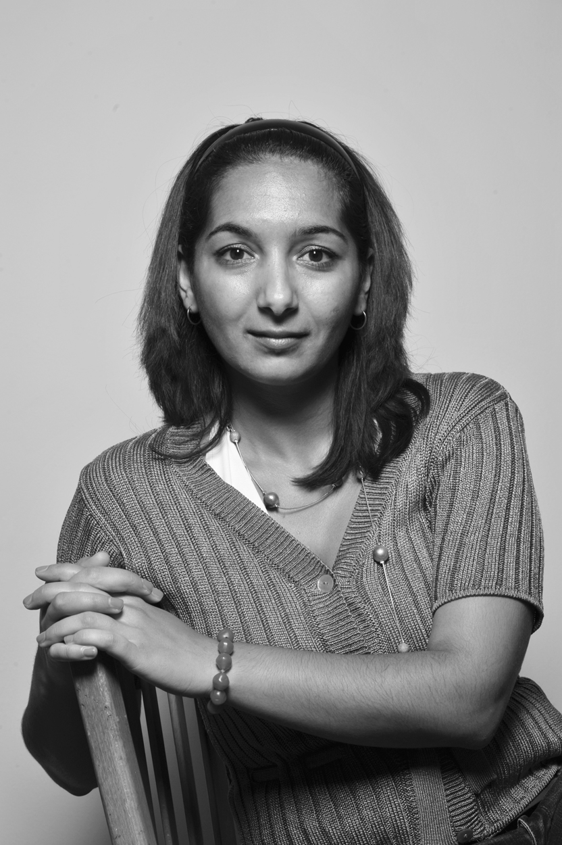
Mgr Petra Šarköziová
Broadcaster

Slide 15
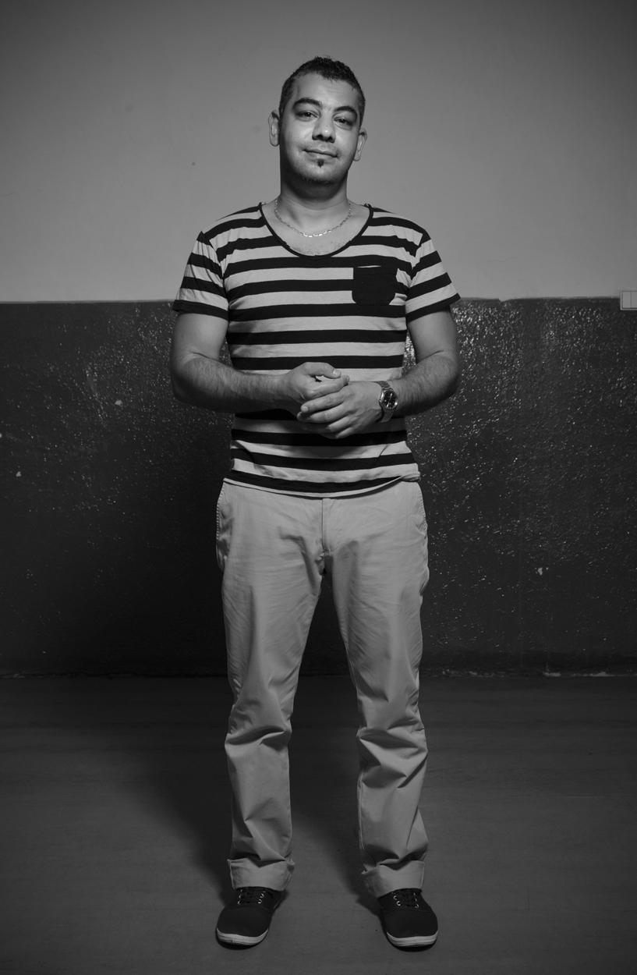
Mgr Jozef Ikri
Medical Student, Nurse

Slide 16
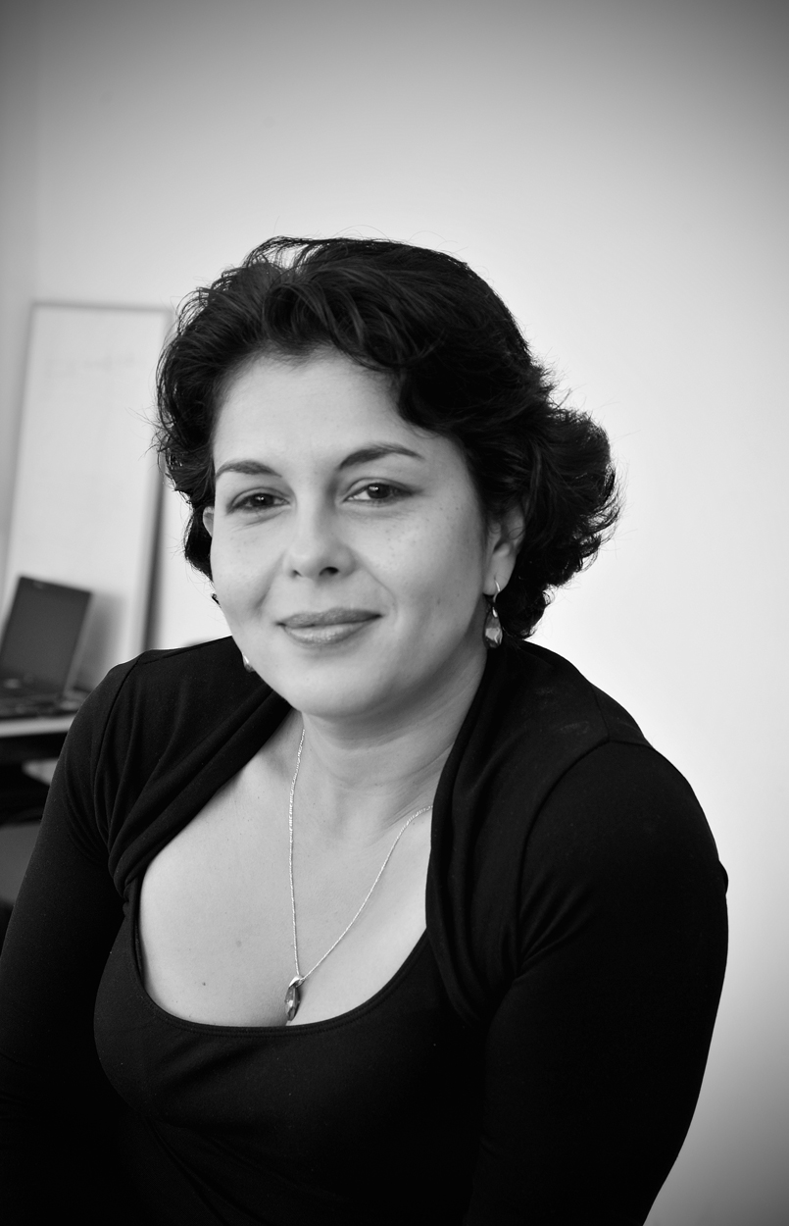
Ingrid Kosová PhD
Educator, School Owner

Slide 17
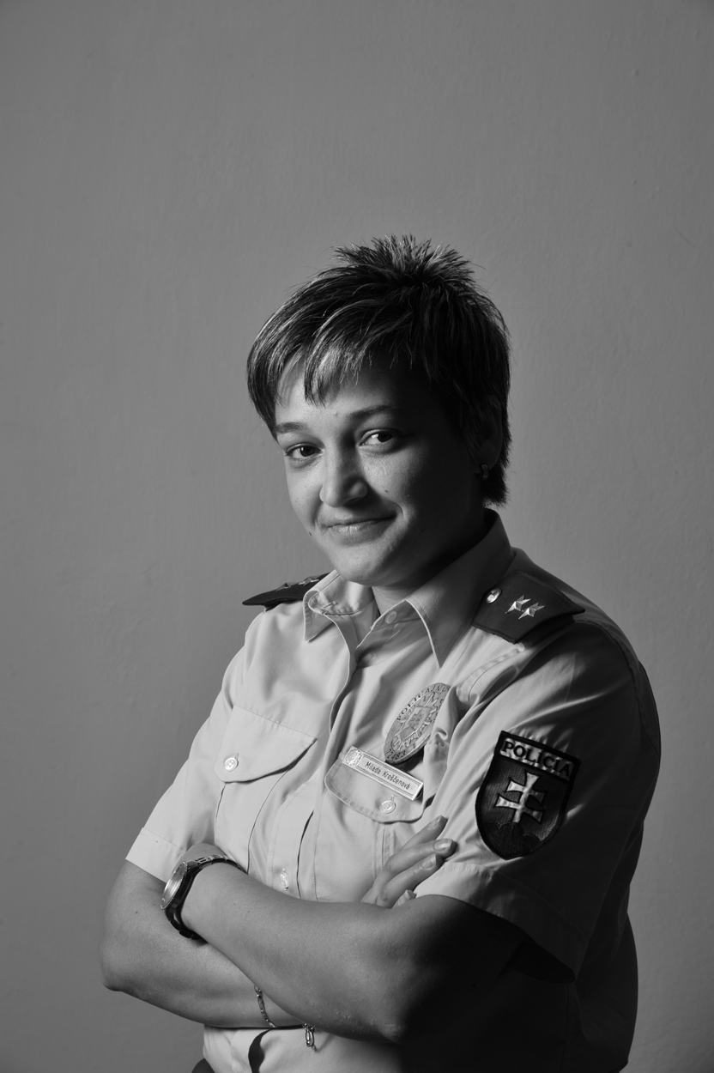
1st Lt Milada Kroščenová
Police Officer

Slide 18
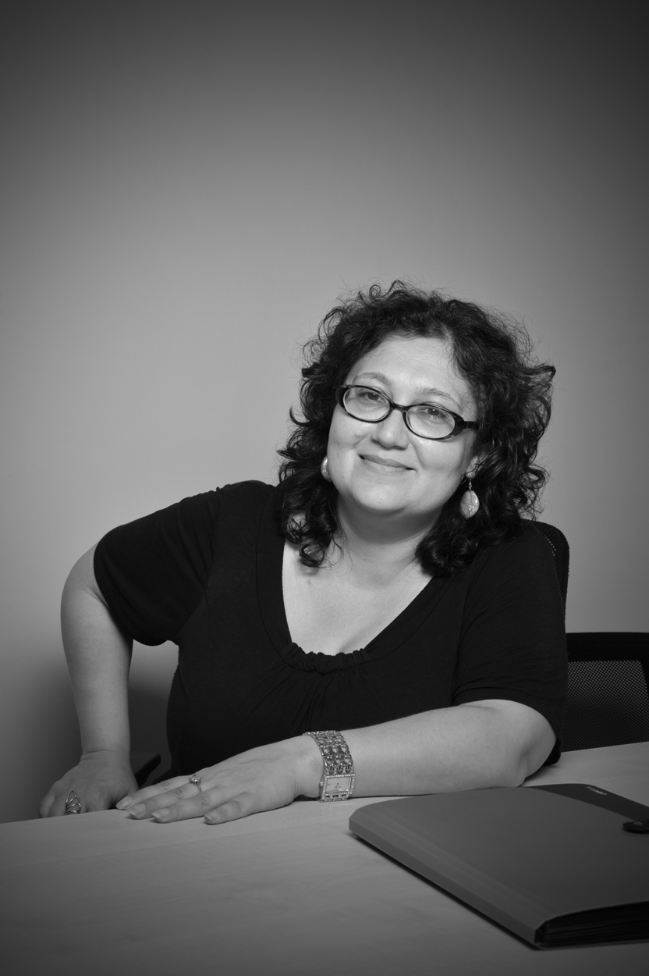
Mgr Erika Godlová
Archivist

Slide 19
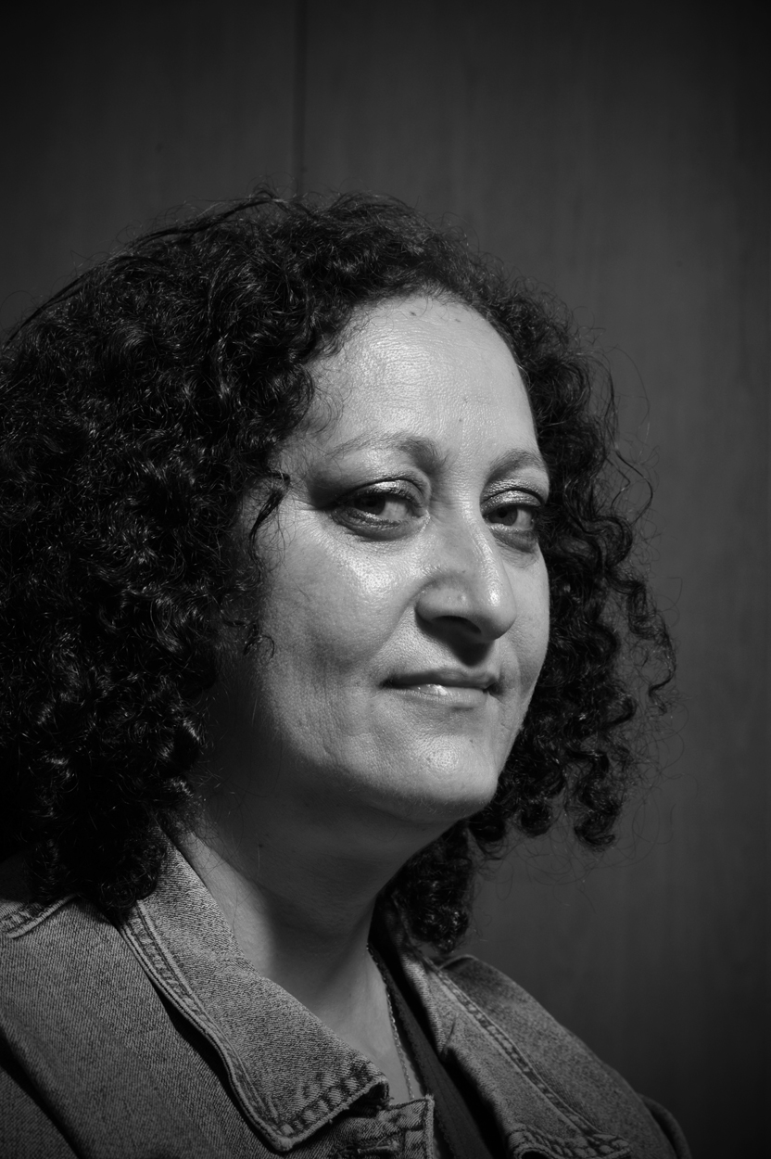
Jarmila Vaňová
Journalist

Slide 20
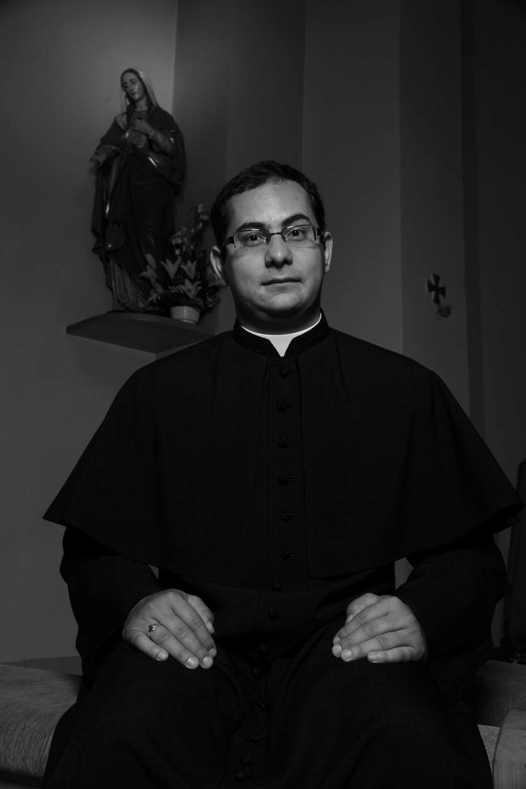
Mgr Peter Gaži
Catholic Priest

Slide 21
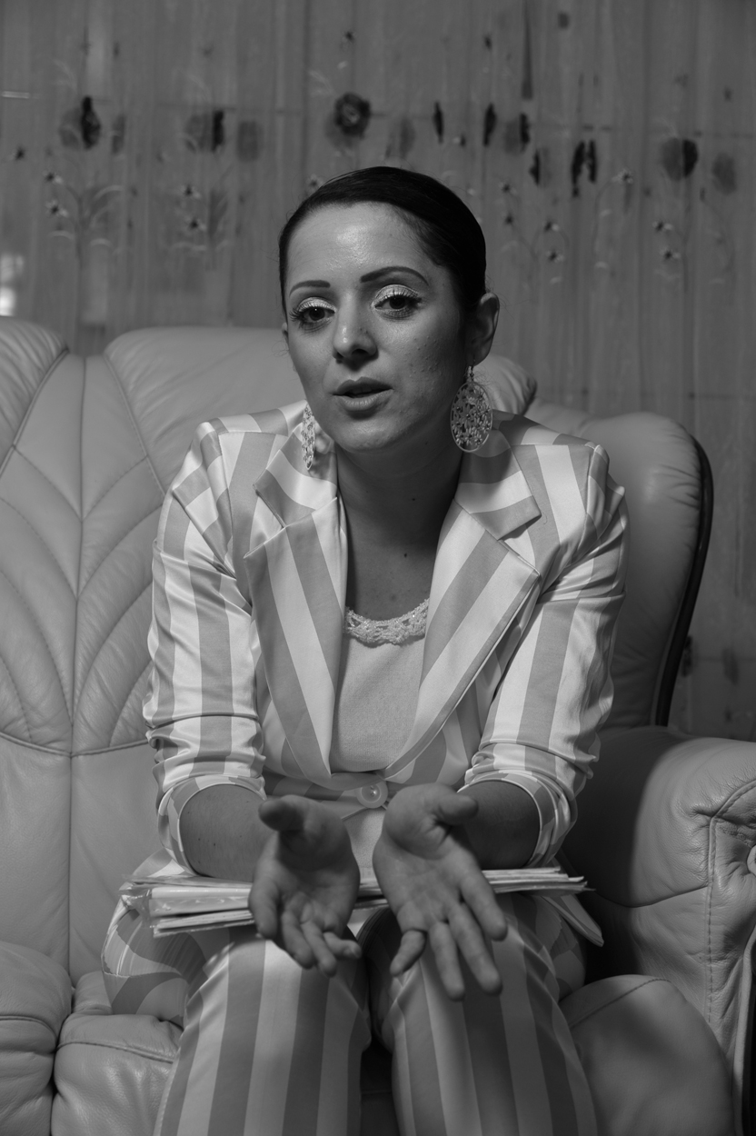
Mgr Klaudia Ferencová
Legal Advocate

Slide 22
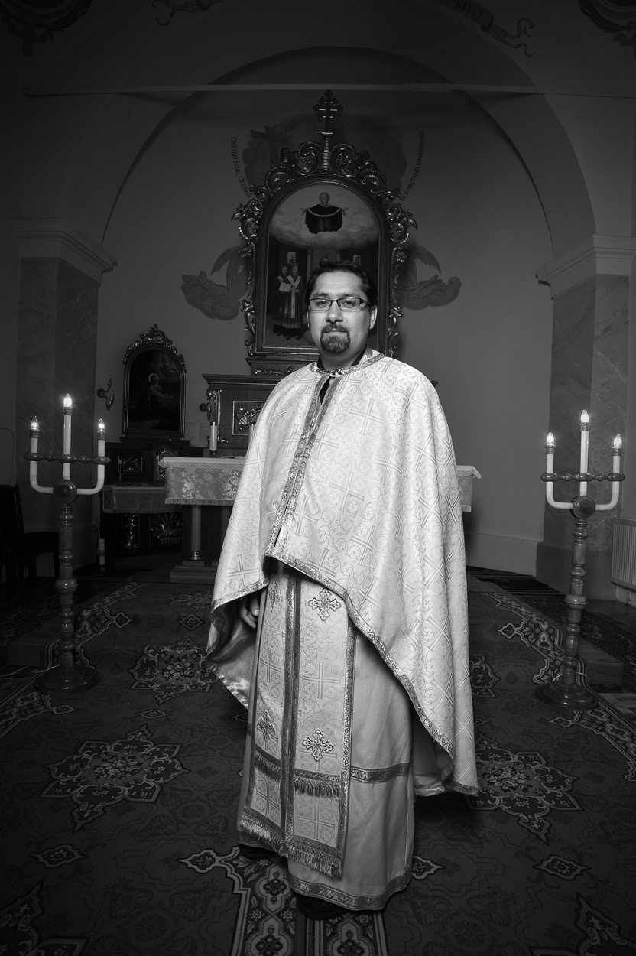
PaedDr ThLic Peter Horváth
Orthodox Priest

Slide 23
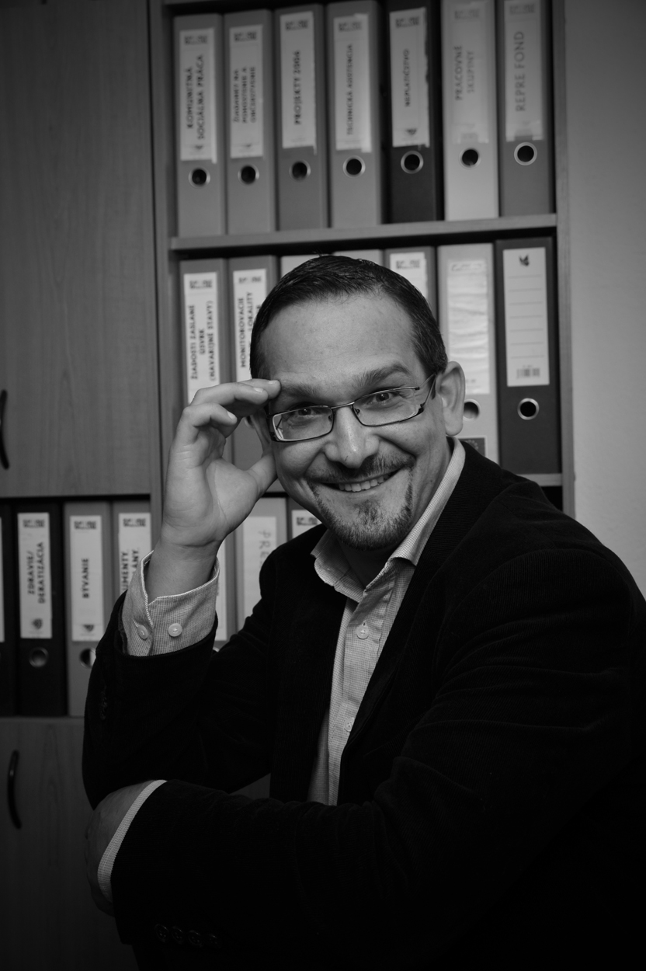
Mgr Maroš Balog
Government Official

Slide 24
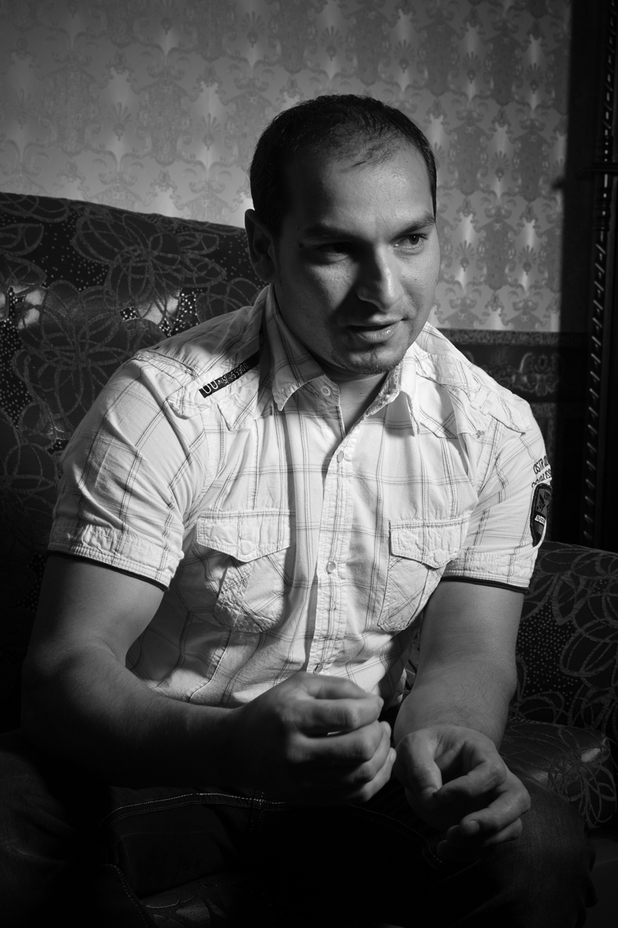
Mgr Maroš Pecha
Owner, Construction Company

Slide 25
romarisingBG
www.romarising.com
© Chad Evans Wyatt / Photo

Slide 26
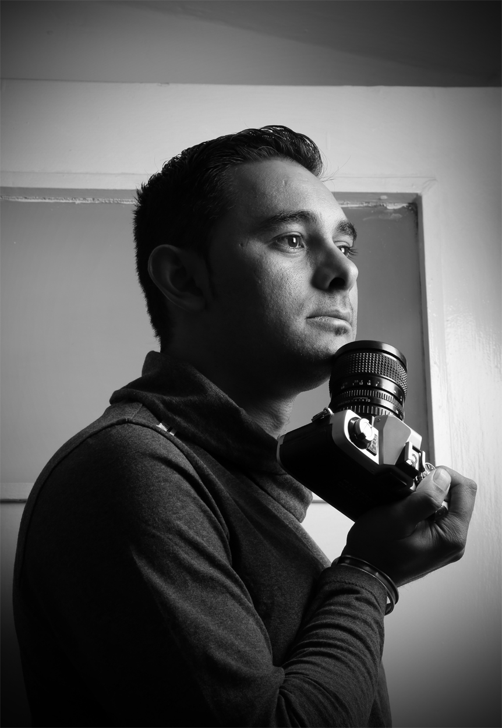
Emil Ivanov Metodiev
NGO Official

Slide 27
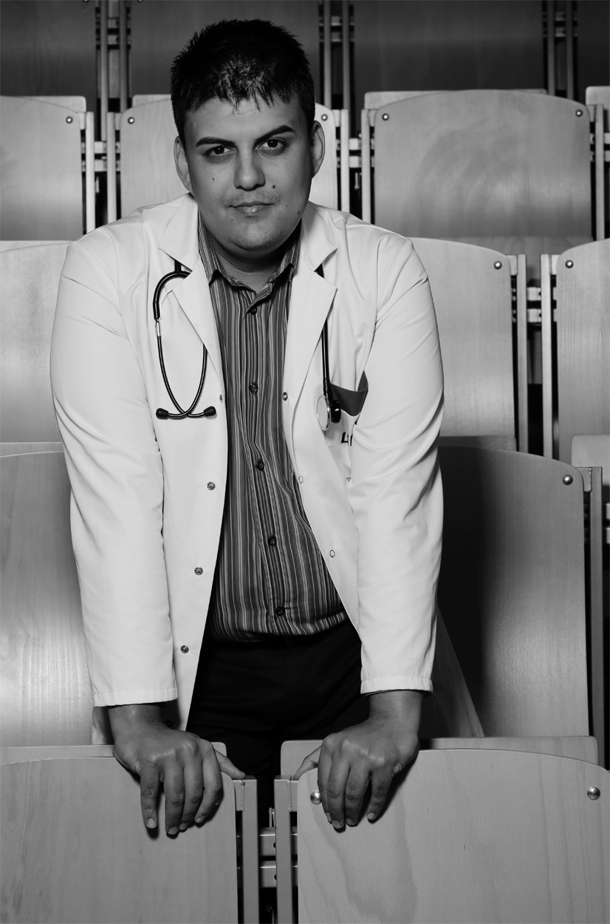
Miroslav Angelov Angelov, MD

Slide 28
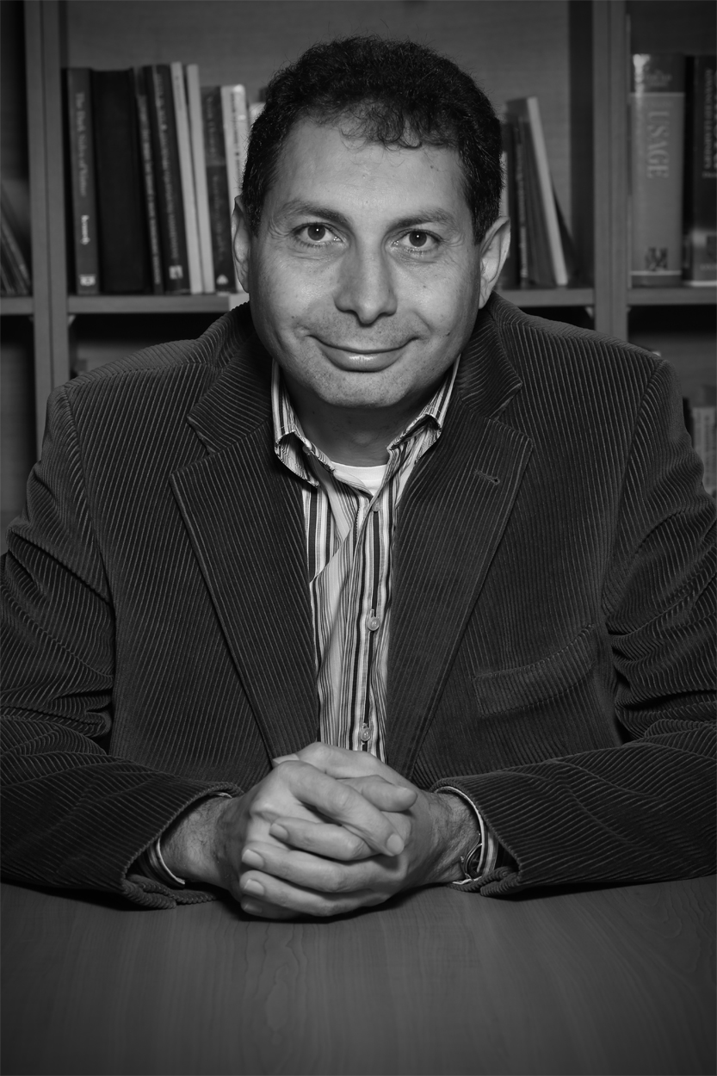
Rumian Sergiev Russinov MA
Educator, REF Official

Slide 29
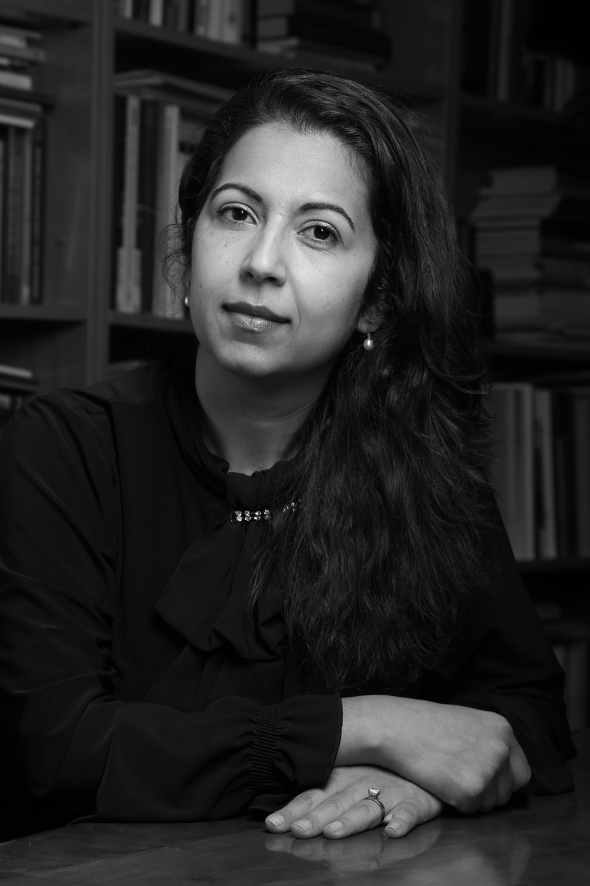
Viktoria Petrova, MA
REF Official

Slide 30
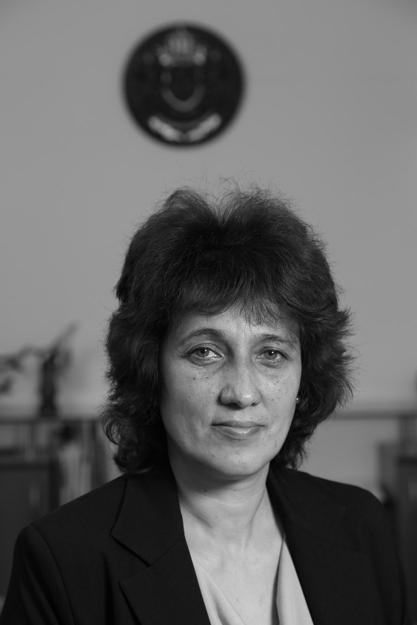
Spaska Jordanova Petrova, MA
Deputy Minister

Slide 31
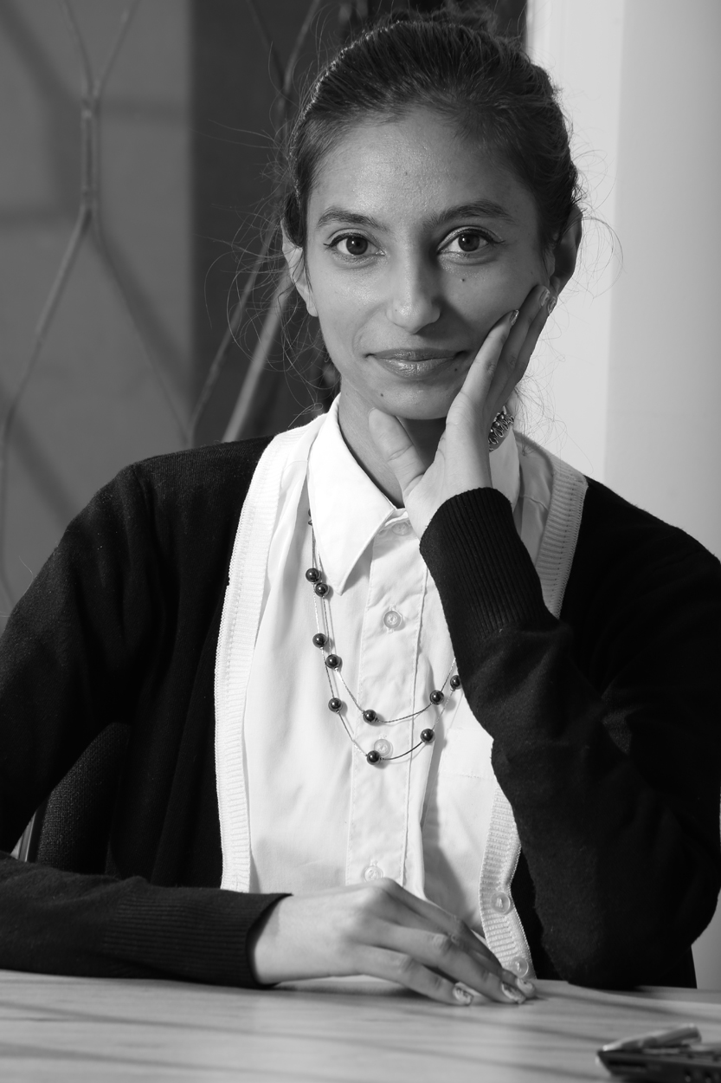
Stela Angelova, MA
Social Worker

Slide 32
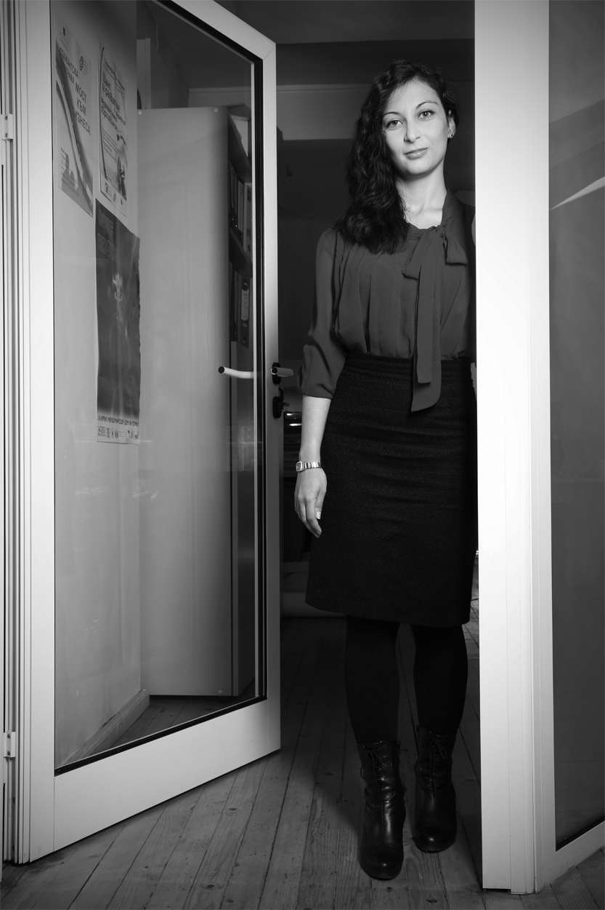
Yoana Kirilova Decheva
PhD Candidate, Public Affairs

Slide 33
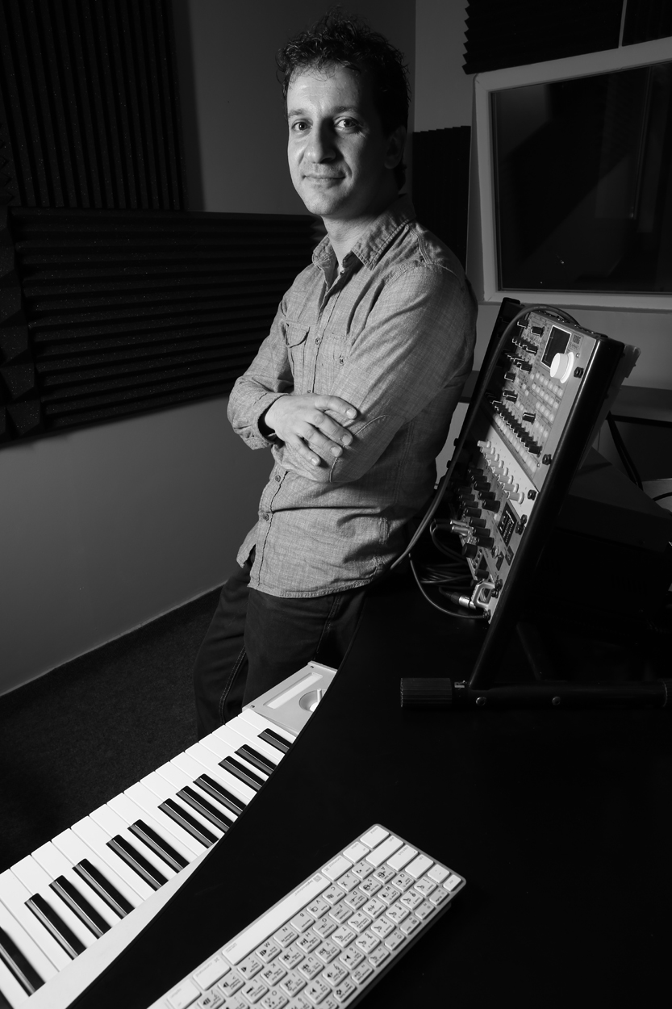
Minko Kirilov Lambov
Composer

Slide 34
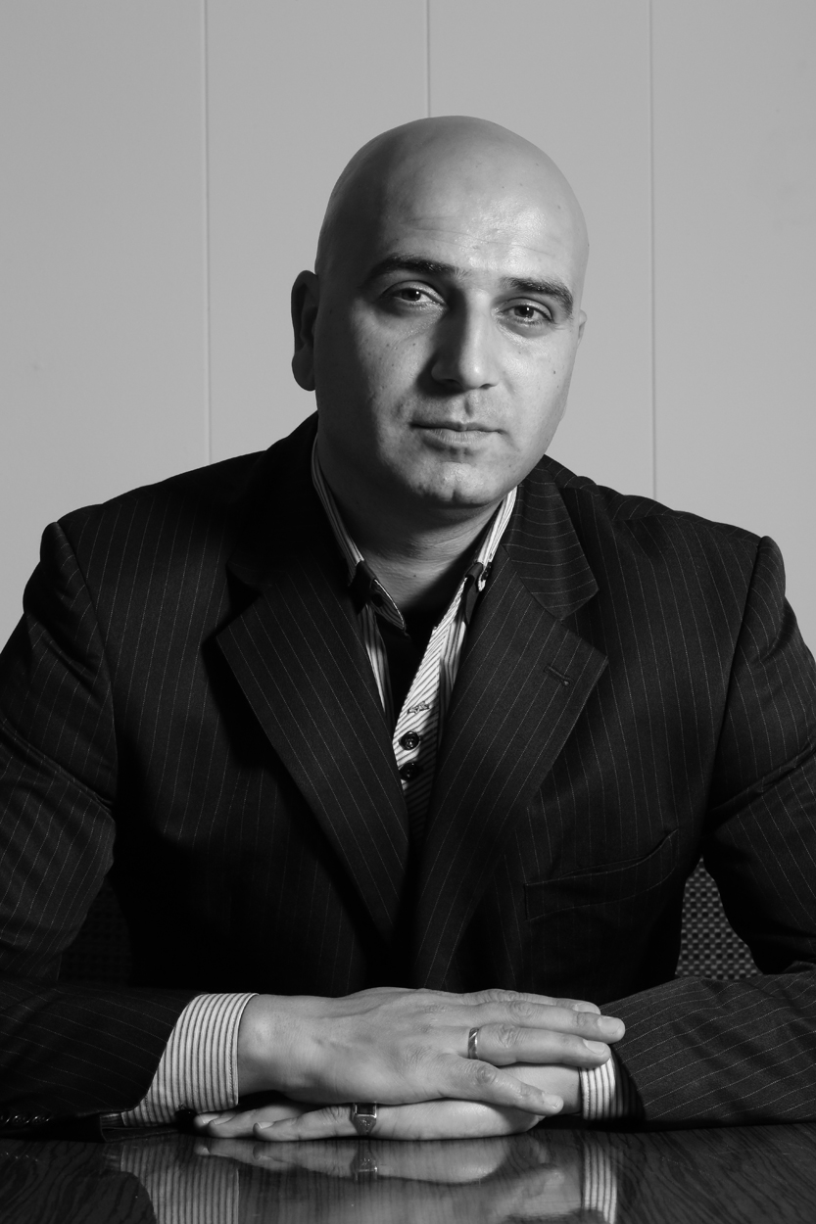
Borislav Borisov, LLD

Slide 35
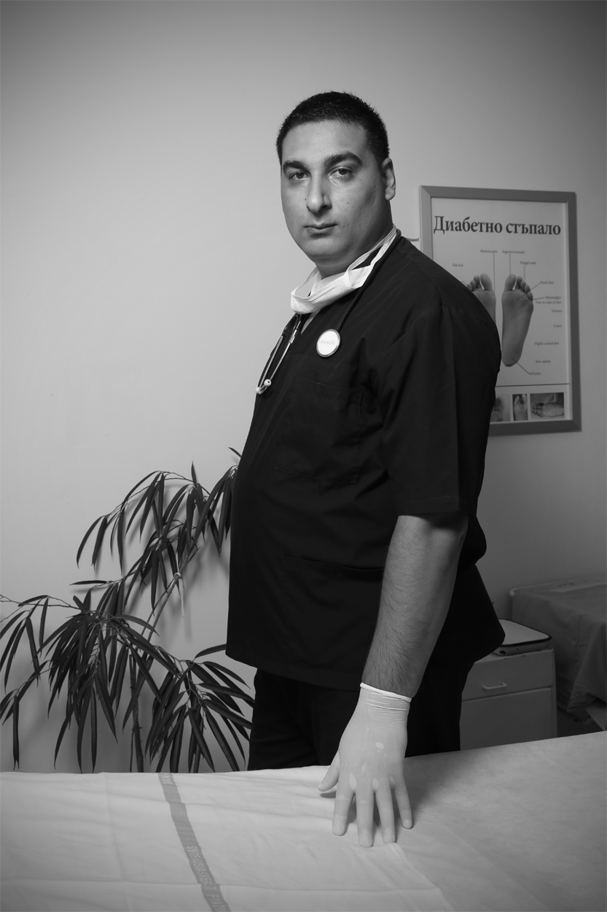
Sybi Valentinov Nikolov, MD
Podiatrist

Slide 36
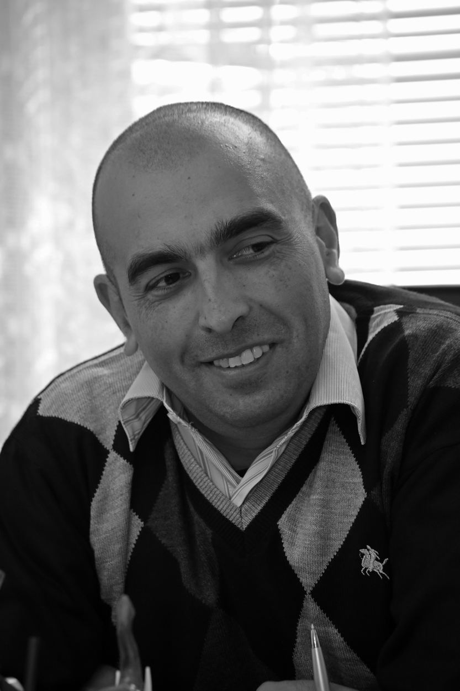
Boyan Georgiev Avramov
Deputy Mayor

Slide 37
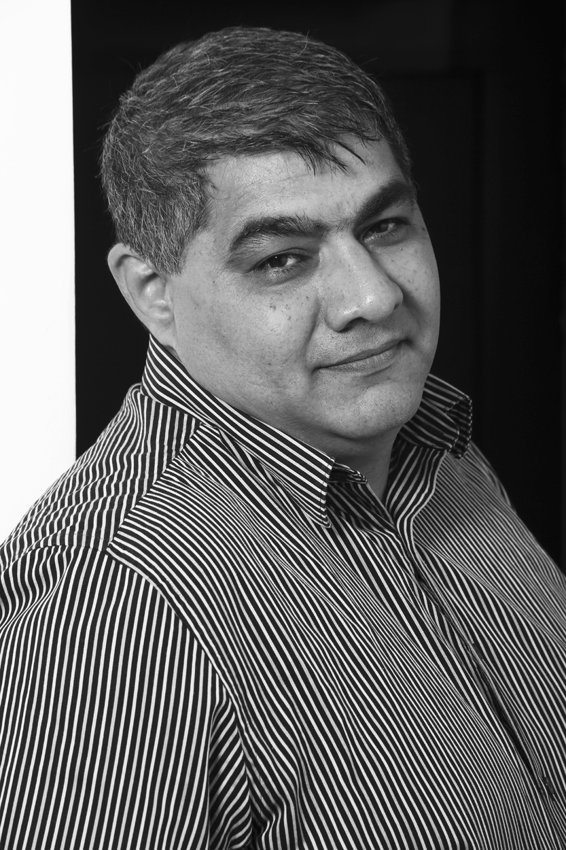
Asen Yordaninov Mitkov
Social Worker
Official, romarising Team

Slide 38
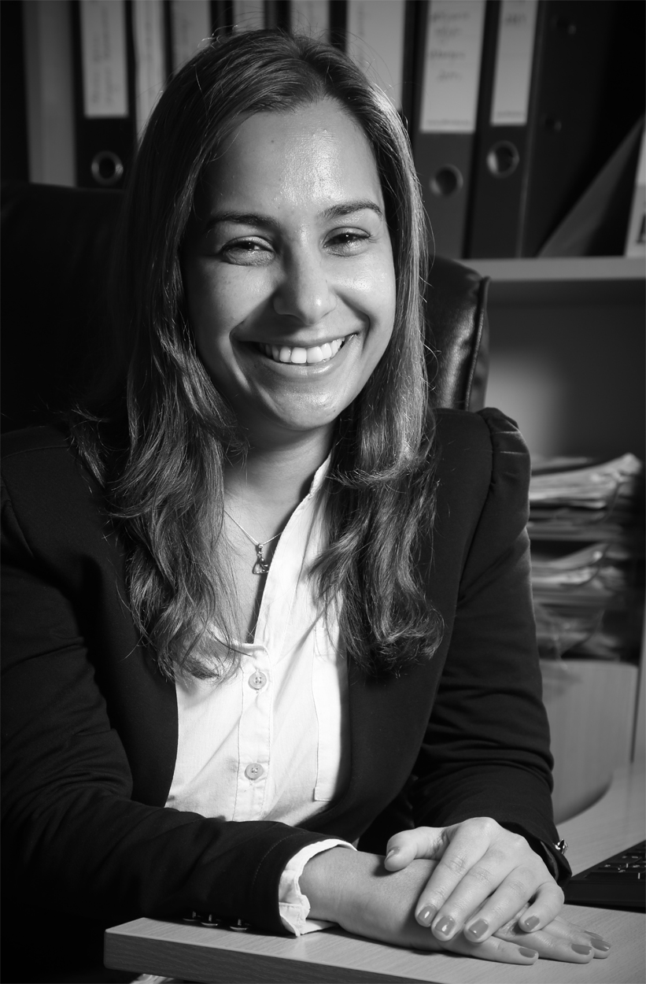
Miglena Georga Jordanova, BBA/MA
Areté Youth Foundation

Slide 39
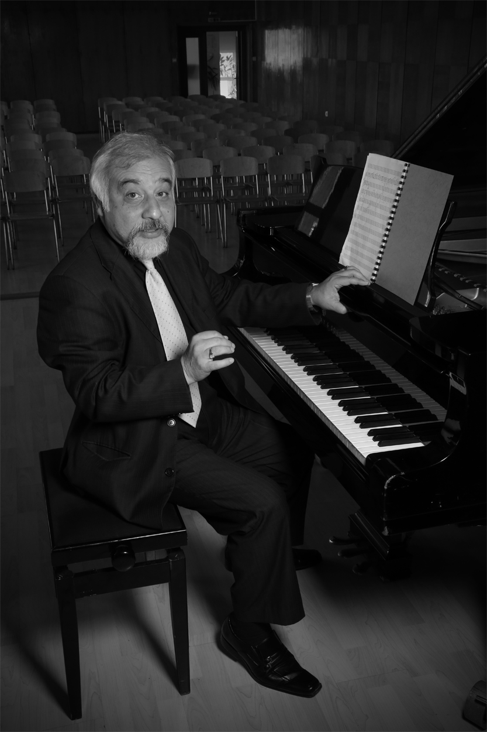
Kiril Minkov Lambov
Conductor of National Symphony

Slide 40
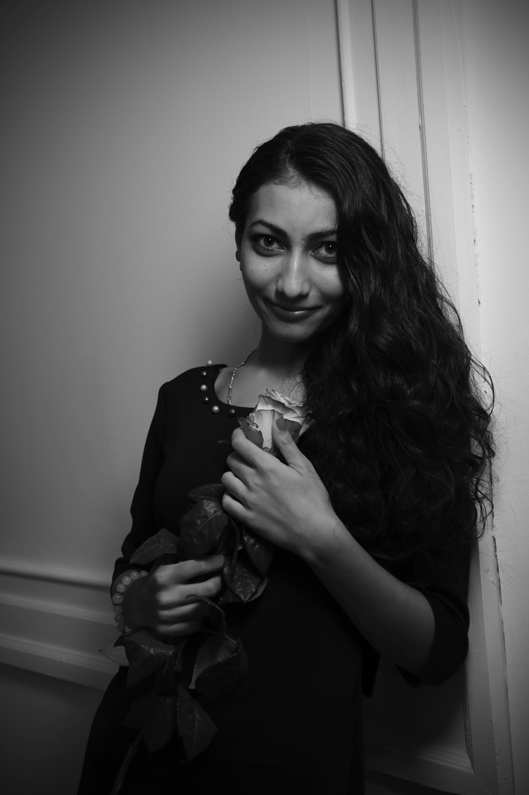
Teresa Borisova
Broadcasting

Slide 41
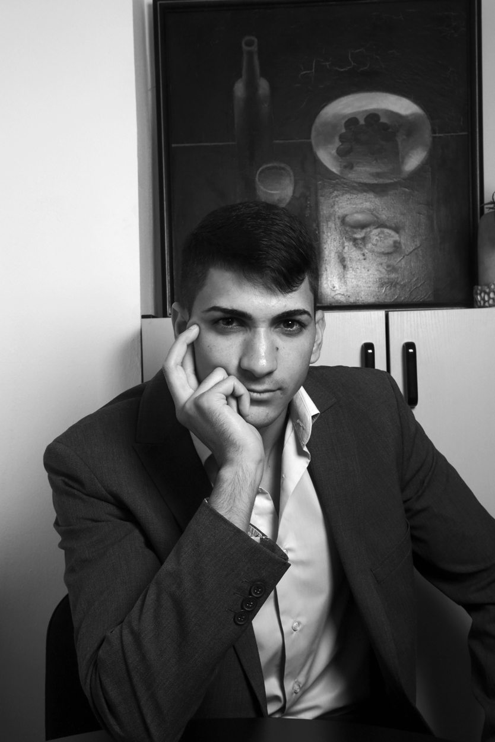
Asen Manchev Slavchev
Electrical Engineer

Slide 42
romarisingCZ
www.romarising.com
© Chad Evans Wyatt / Photo

Slide 43
Mgr David Beňak
Politician

Slide 44
Ladislav Body
Member of Parliament

Slide 46
Mgr Martín Čichy
Historian

Slide 47
Roman Dubnický, MD

Slide 48
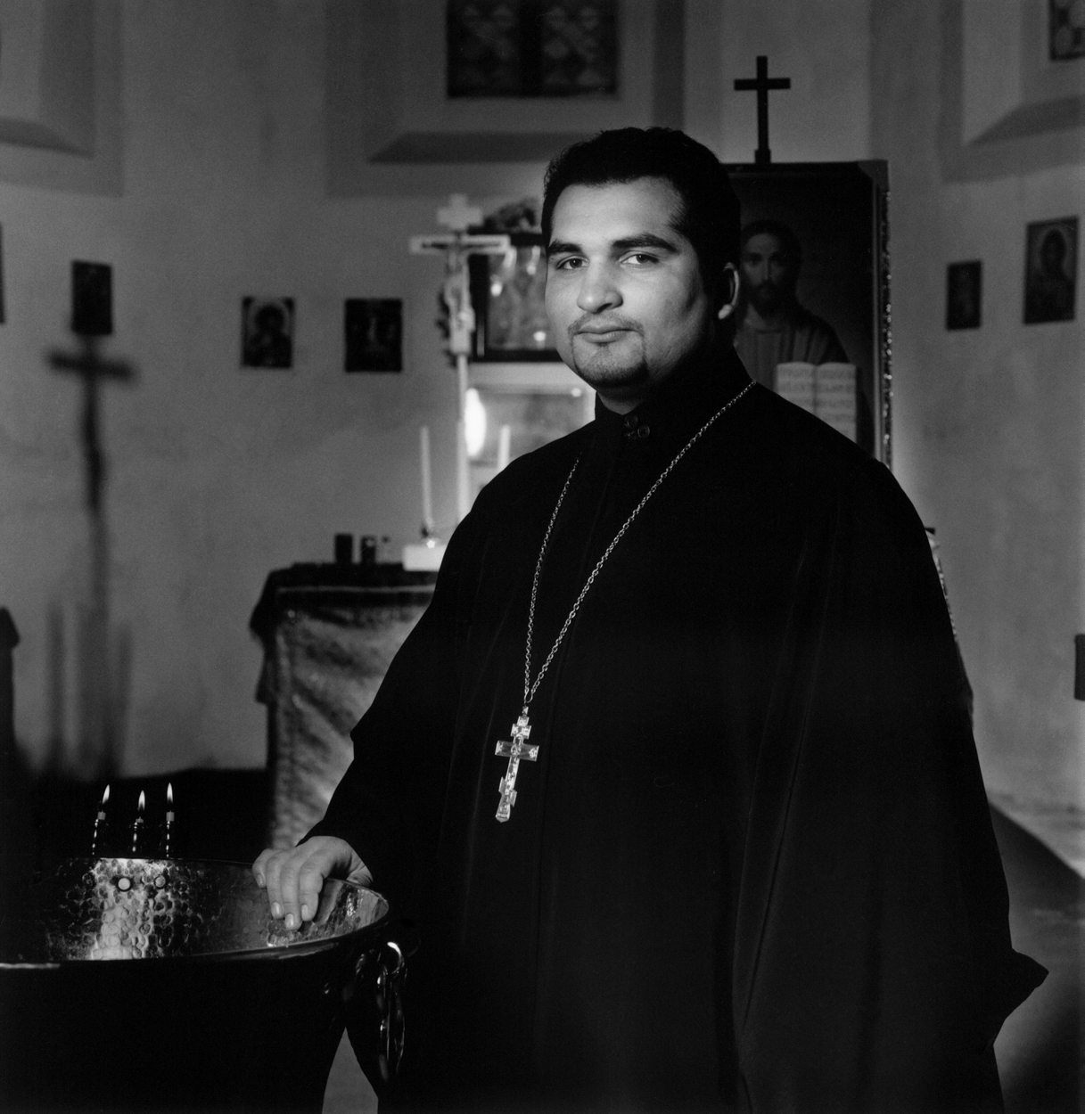
Rev David Dudaš
Orthodox Priest

Slide 49
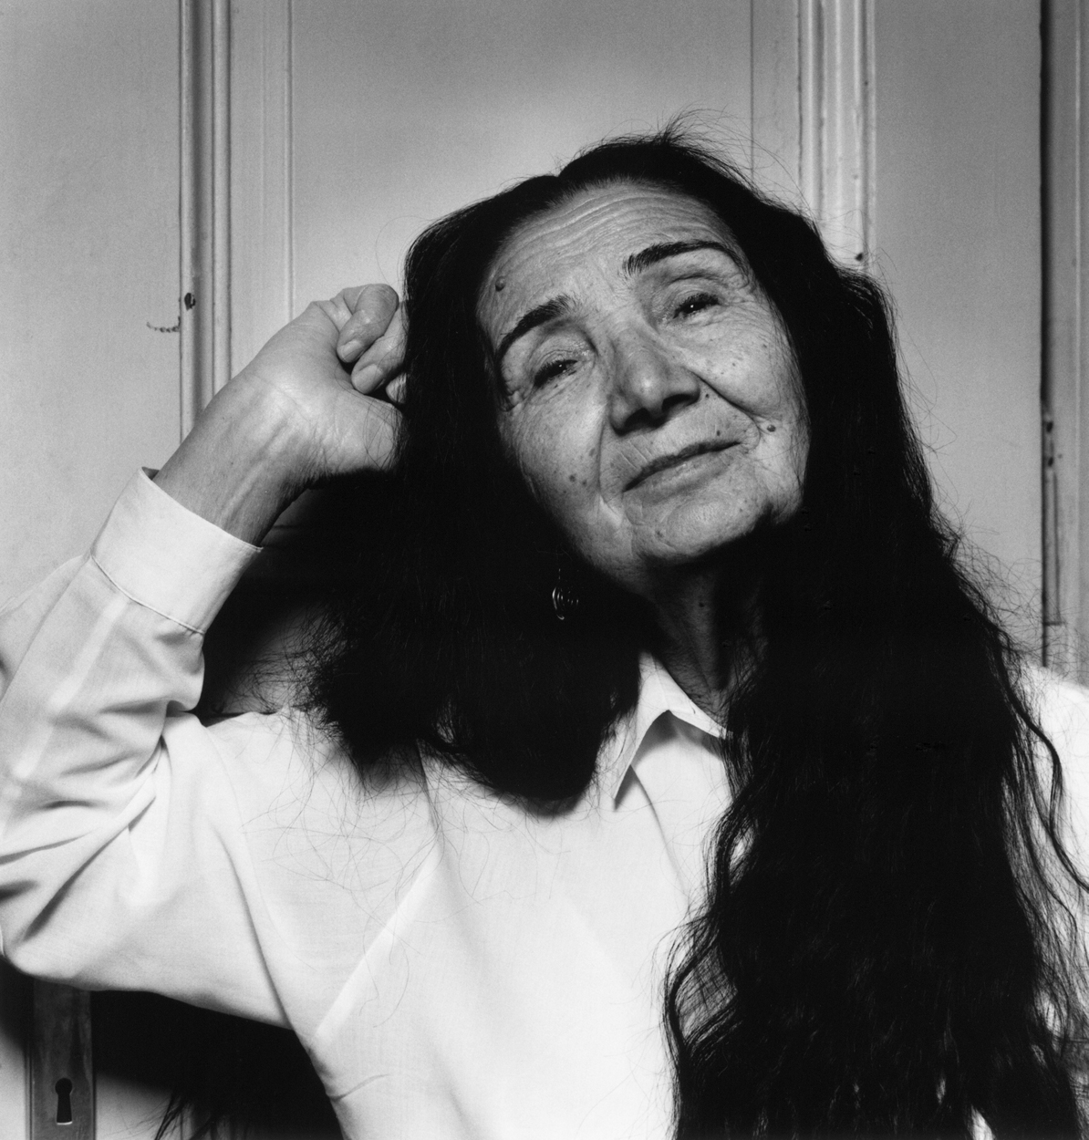
Terezia Fabiánová
Poet, Playwright, Author

Slide 50
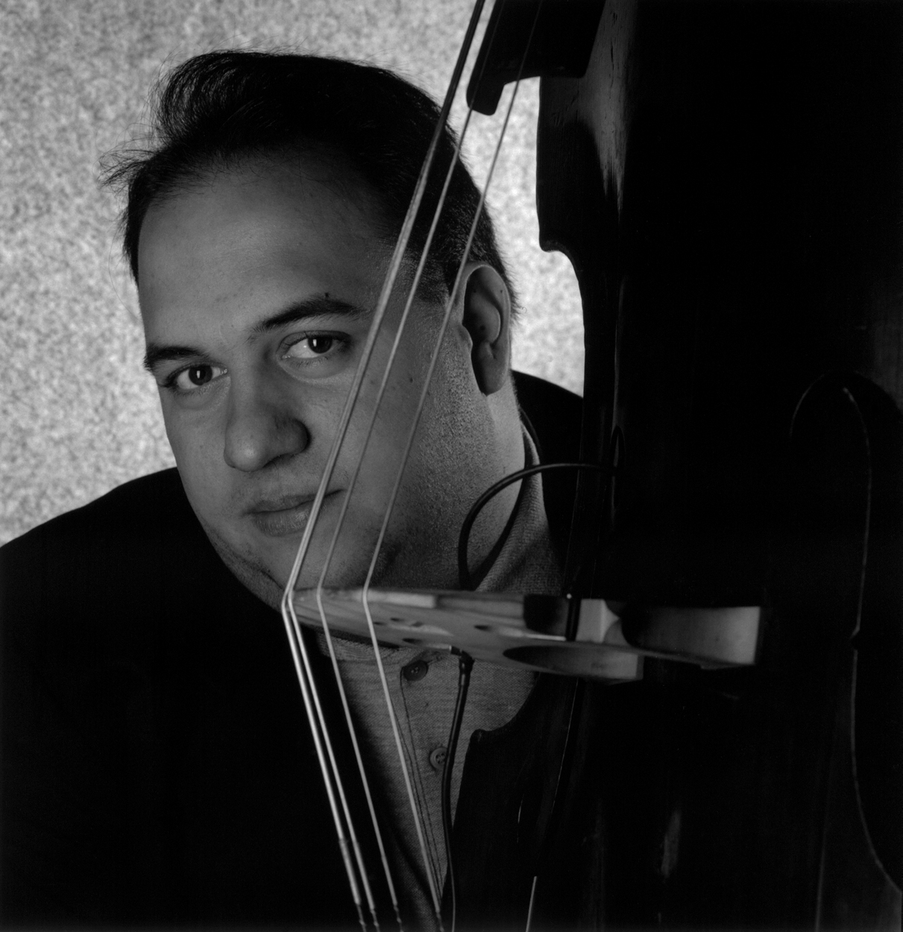
Josef Fečo
Pedagogue, Musician

Slide 51
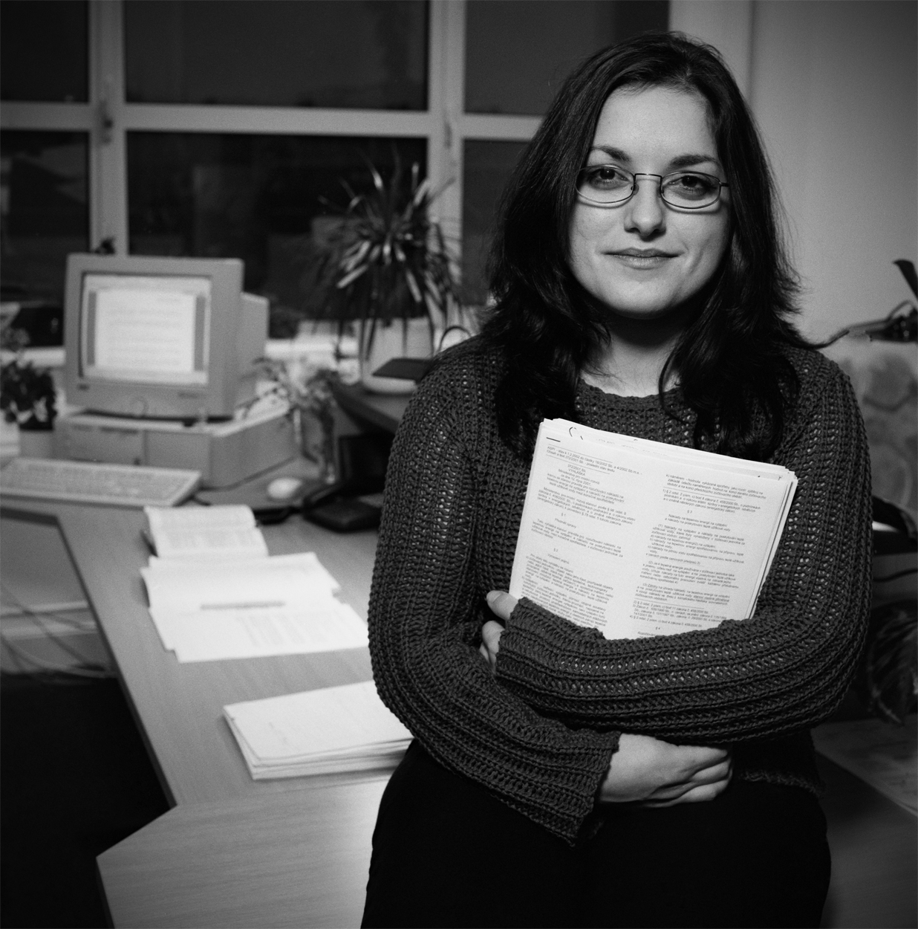
Zuzana Gáboravá, LLD

Slide 52
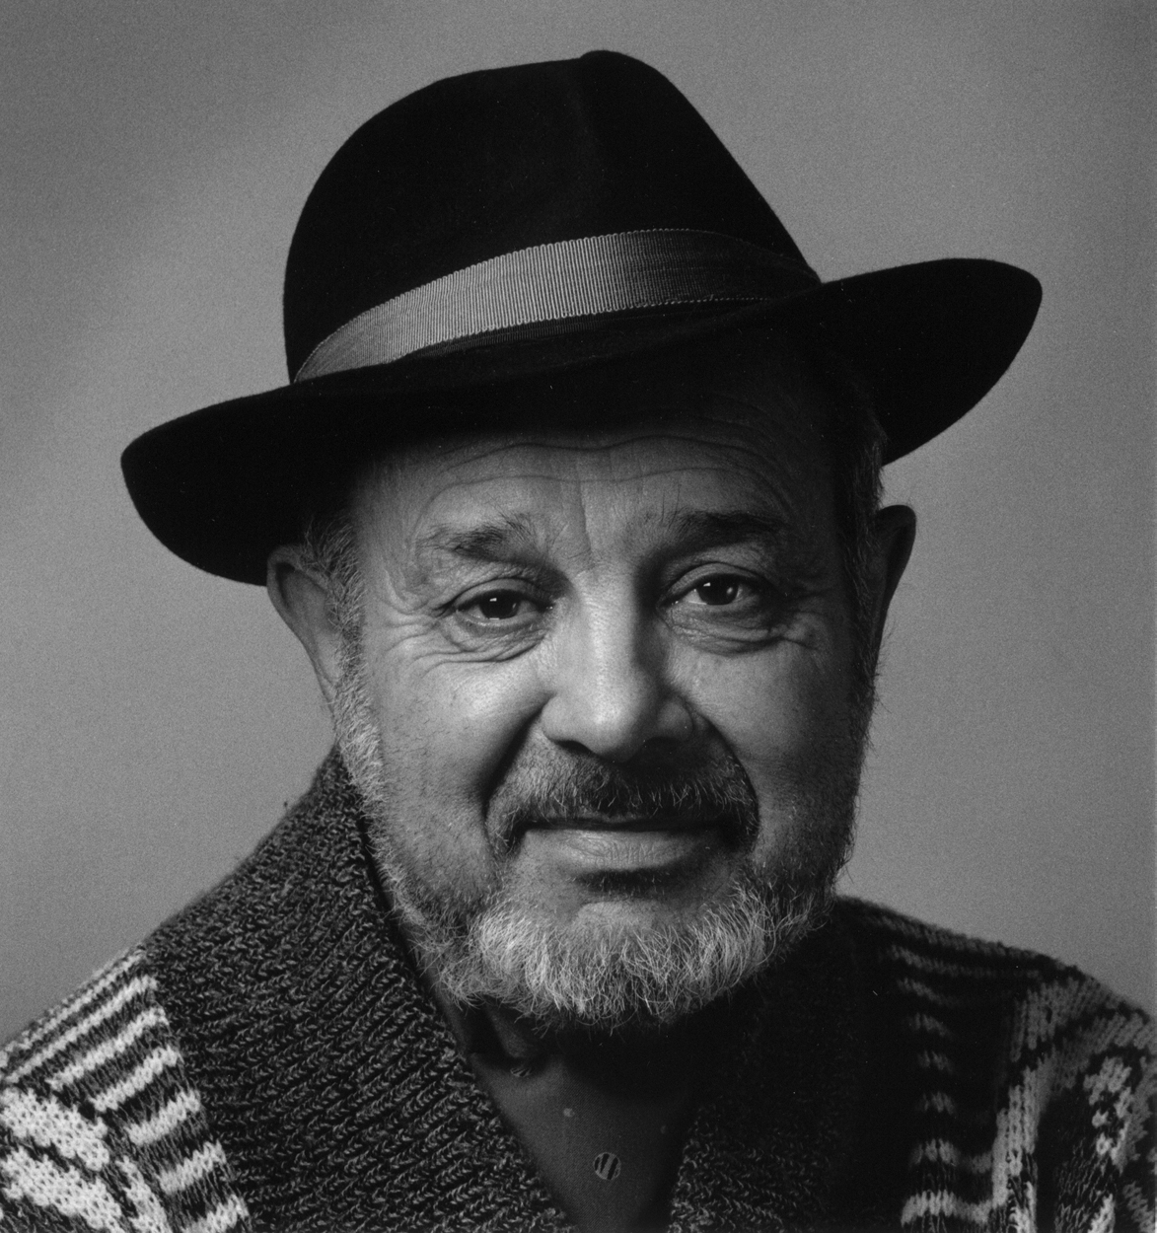
Mgr Karel Holomek
Human Rights Advocate
First romarising Portrait

Slide 53
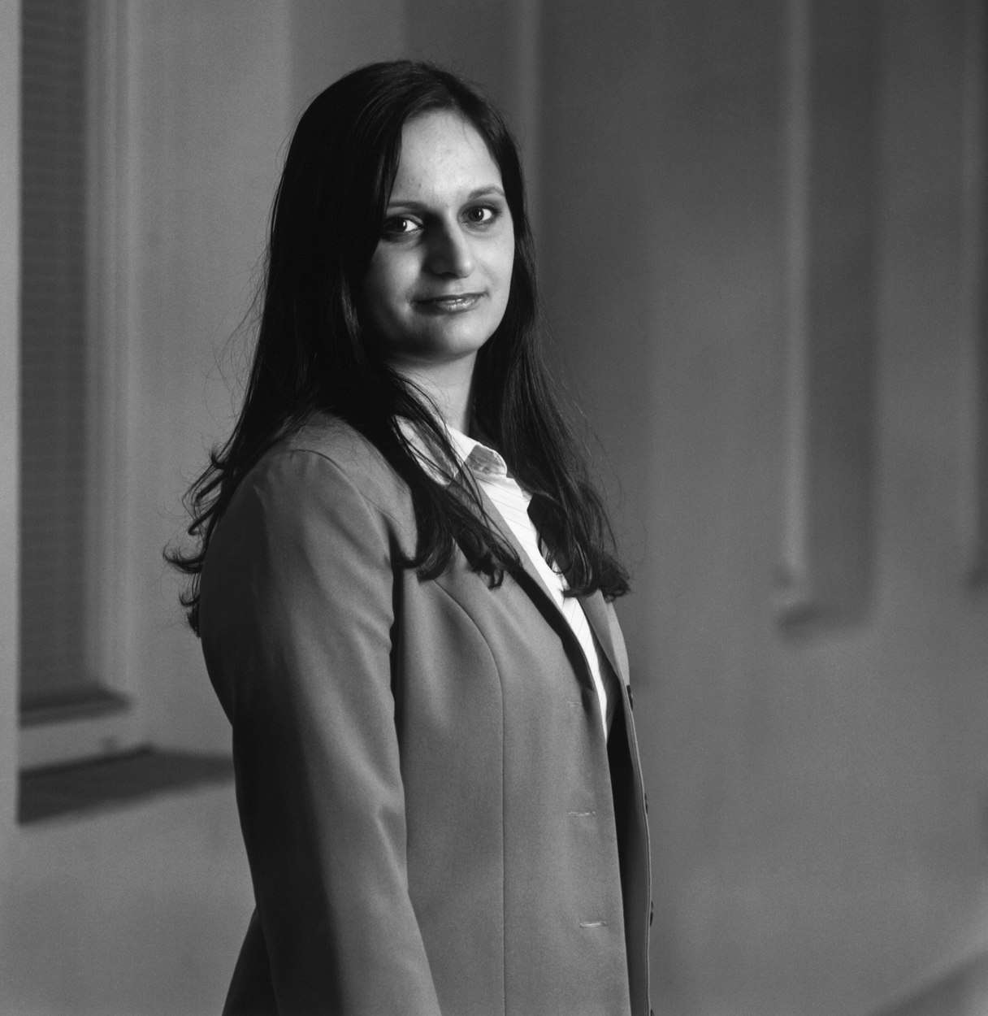
Kateřina Holubová
Insurance Underwriter

Slide 54
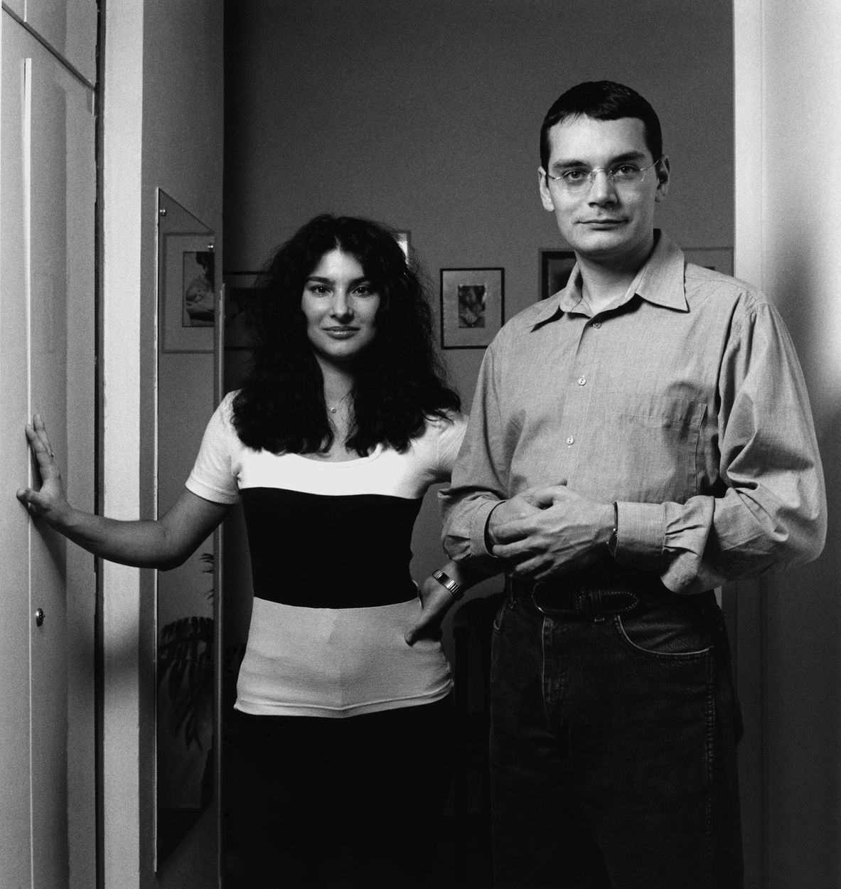
Dr Jana Horváthová
Dr Vladimír Horváth
Historian/Heart Surgeon

Slide 55
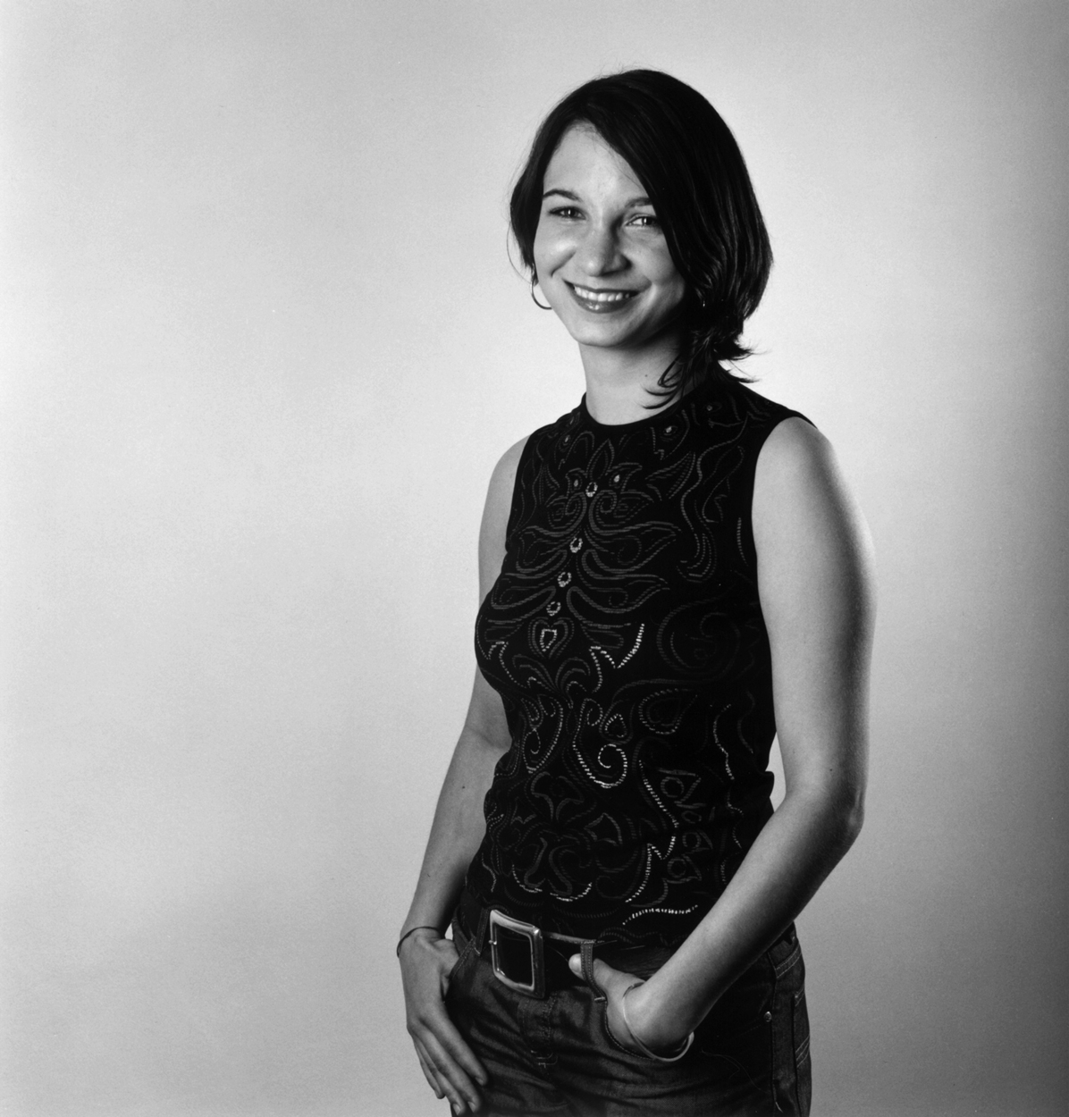
Mgr Gabriela Hrabaňová
NGO Official

Slide 56
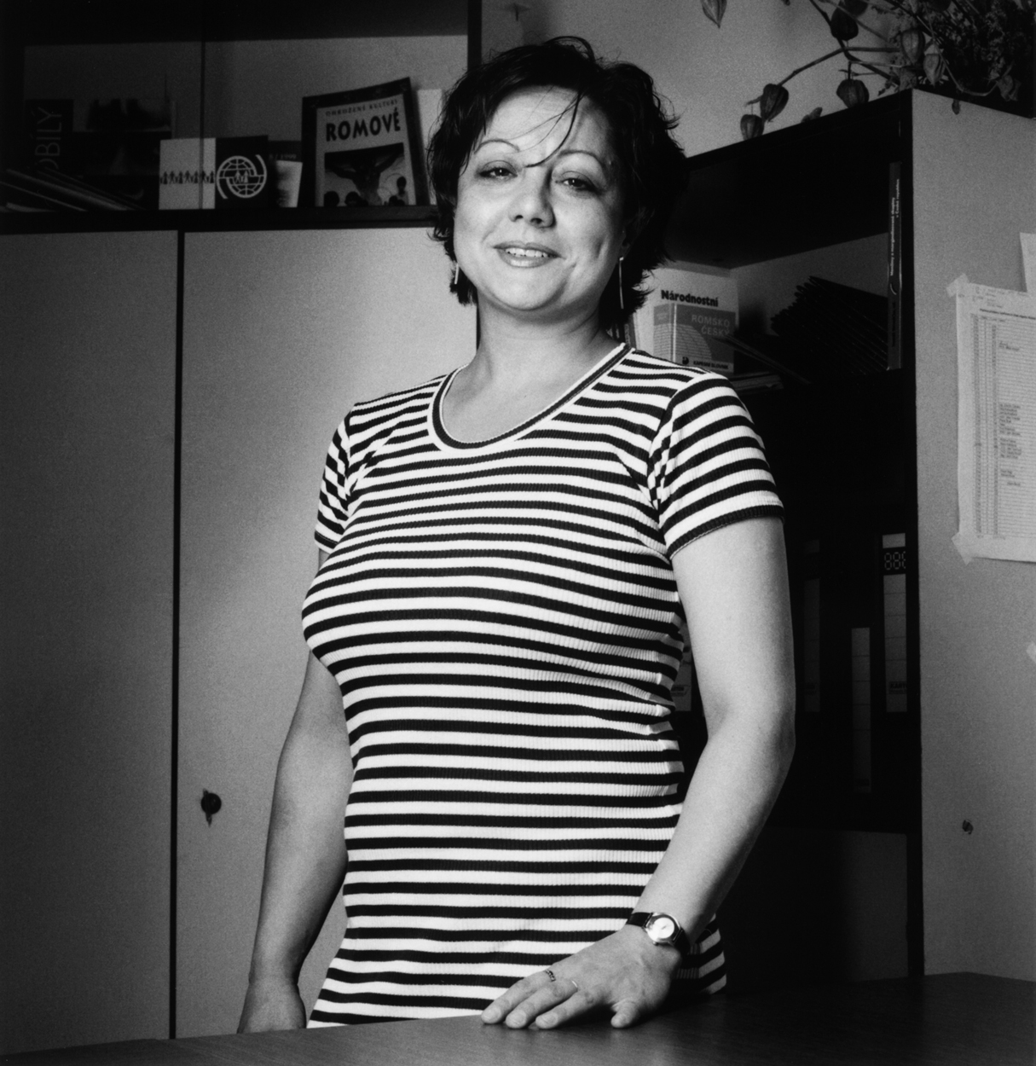
Mgr Helena Krištofová
Accountant

Slide 57
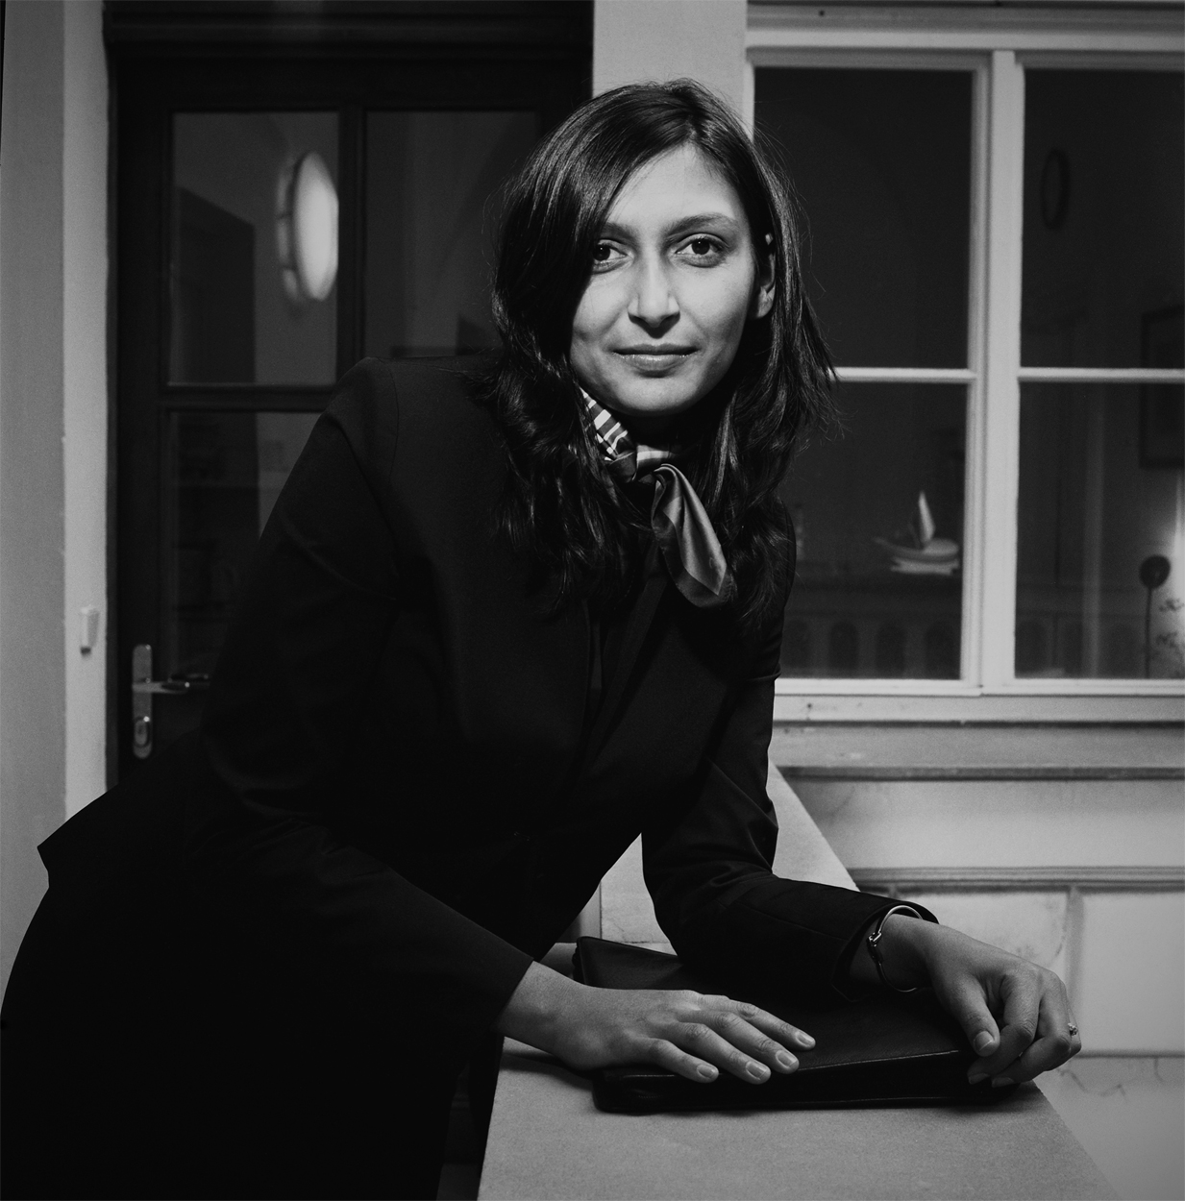
Mgr Martina Pokutová
Public Relations Account Manager

Slide 58
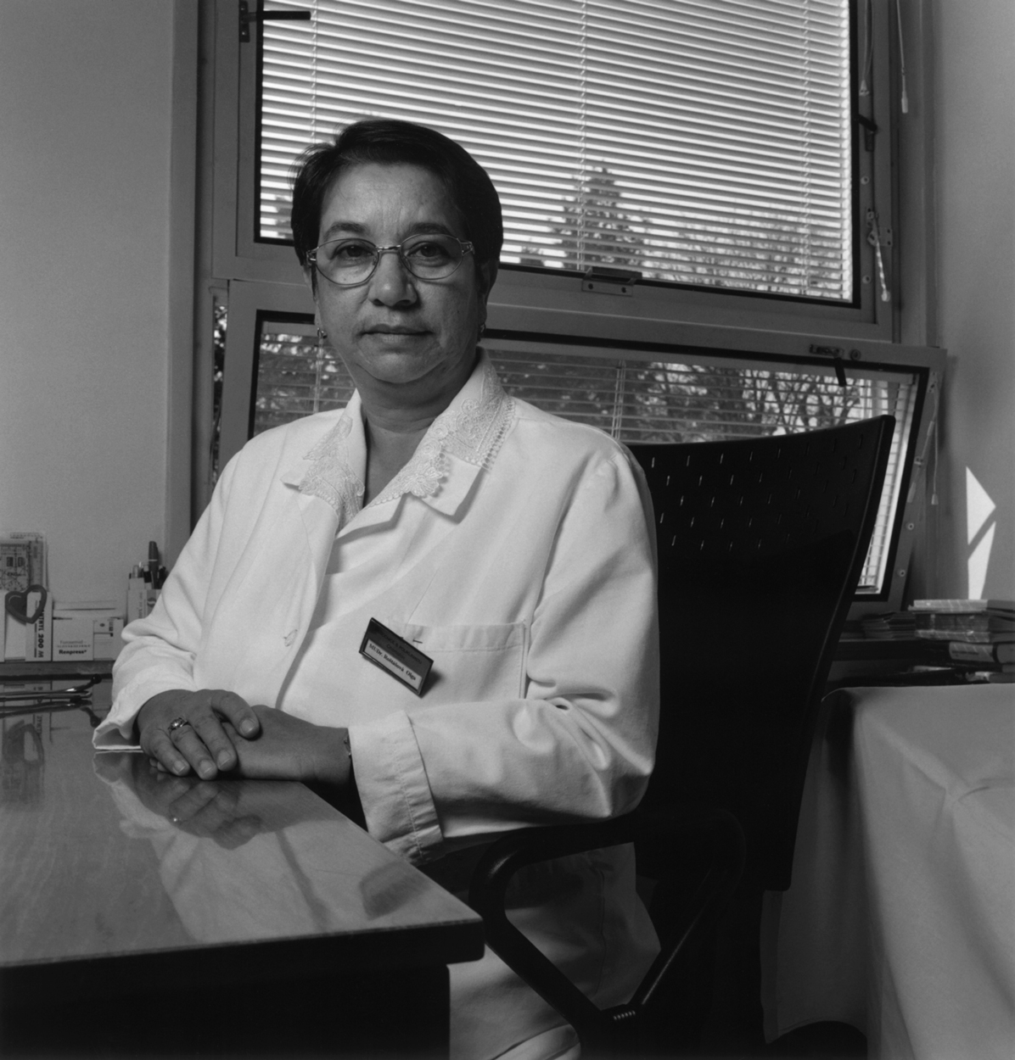
Dr Olga Rostášová
Diabetes Specialist

Slide 59
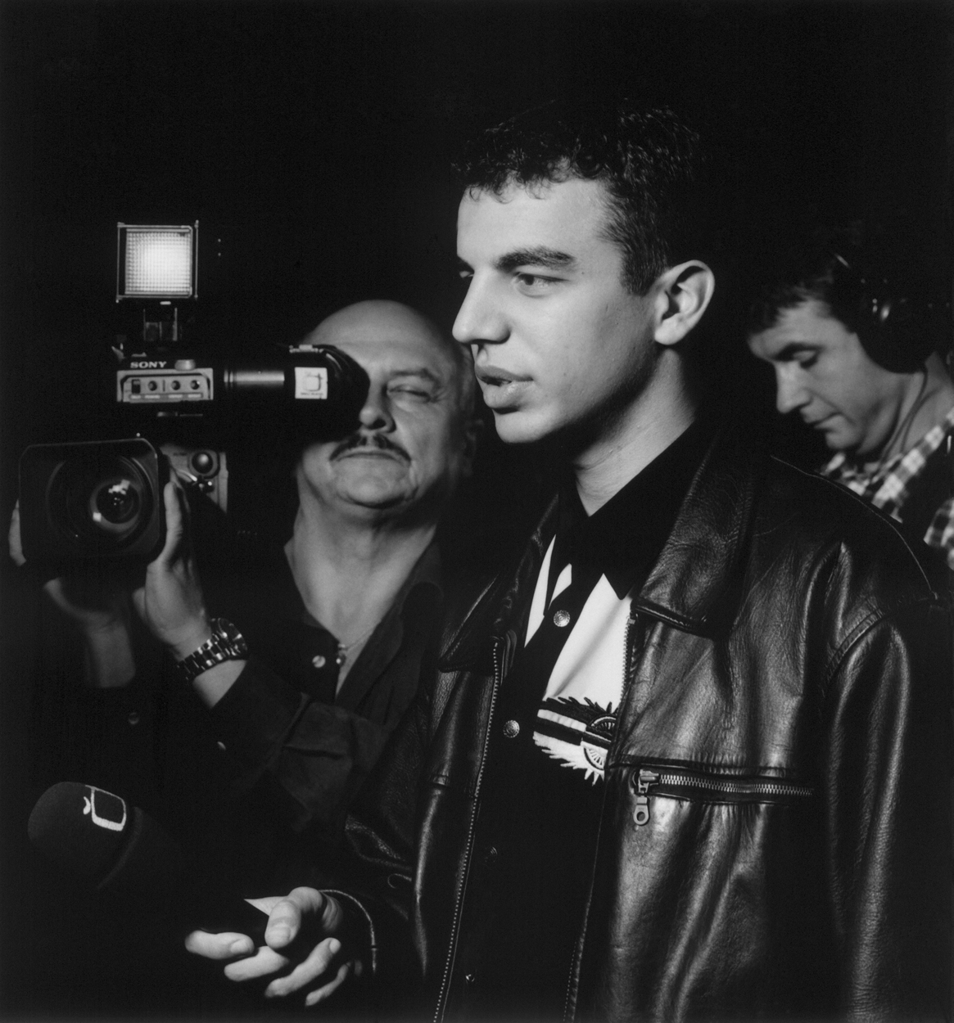
Richard Samko
Broadcaster

Slide 60
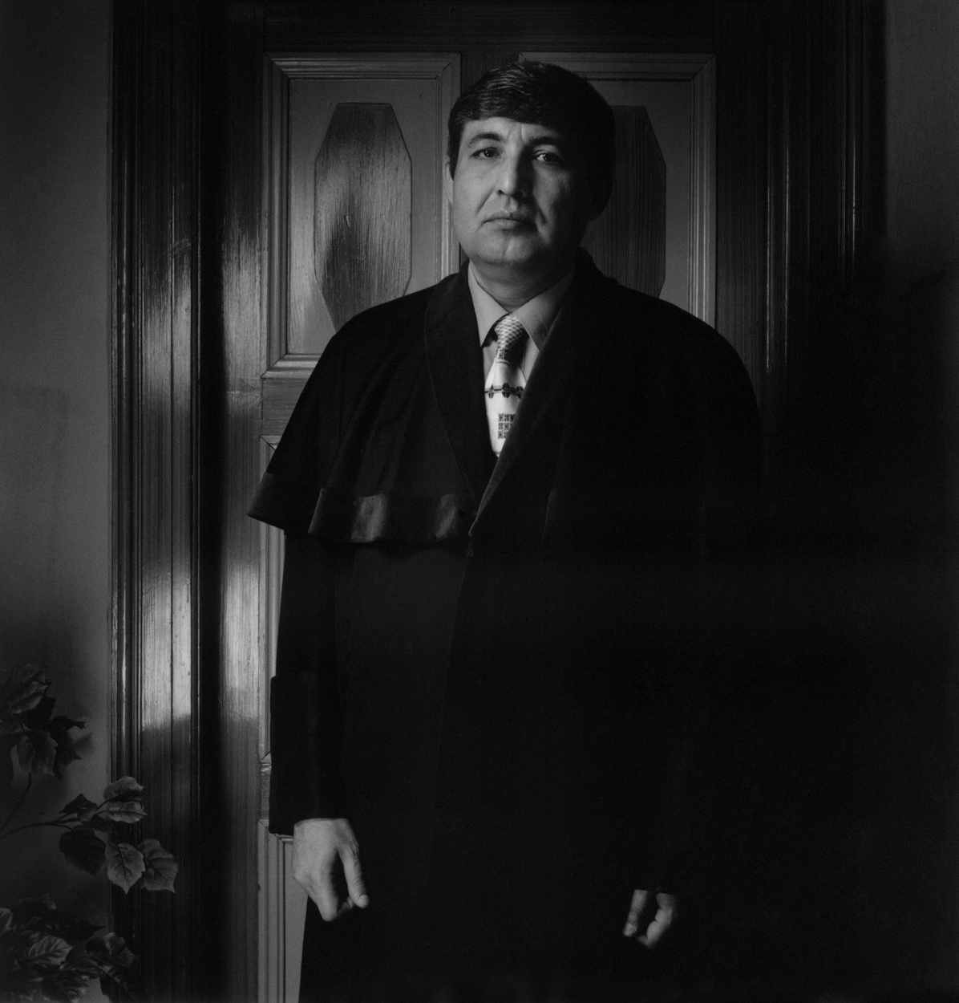
Mgr Milan Virag
Municipal Judge

Slide 61
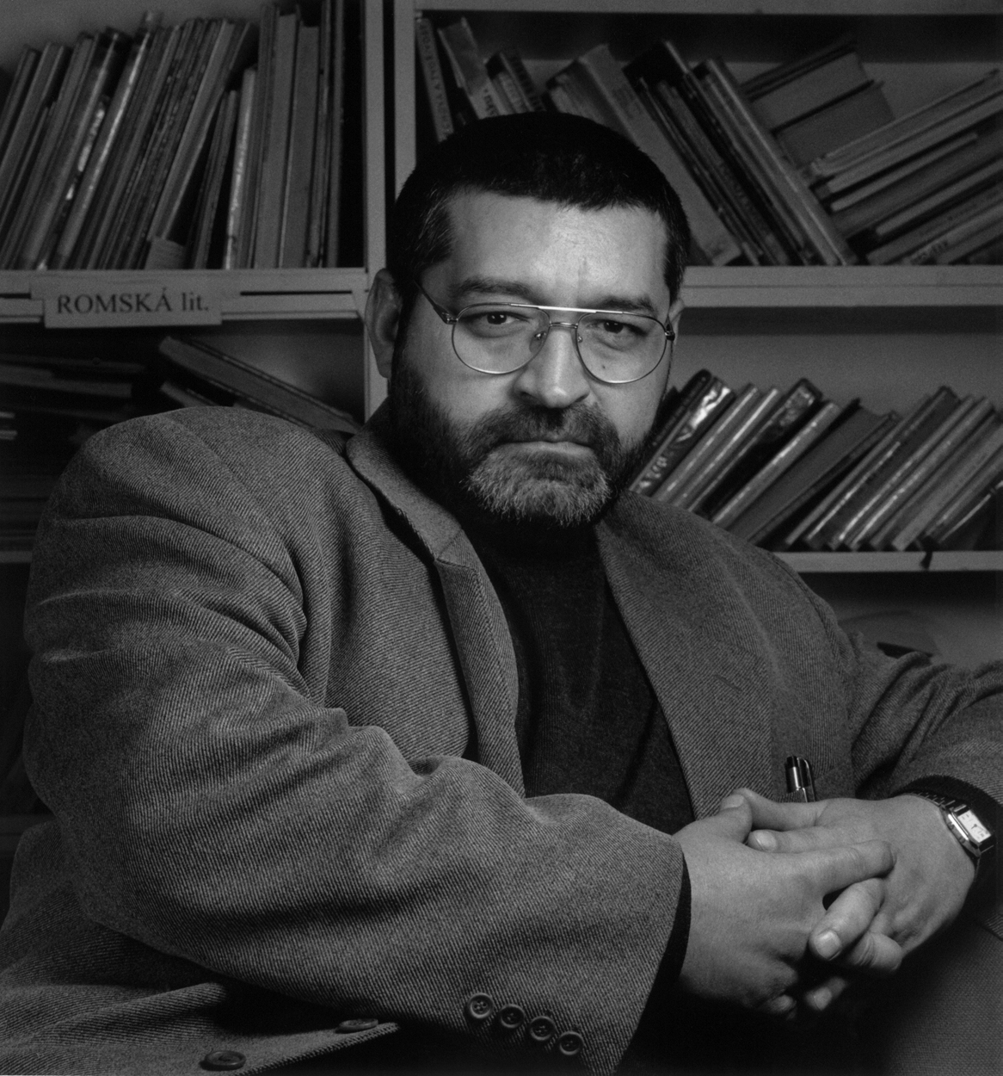
Fmr Army Major Miroslav Zima
Head of DROM, Brno

Slide 62
romarisingHU
www.romarising.com
© Chad Evans Wyatt / Photo

Slide 63

Erzsébet Gulyás, MA
Design Management

Slide 64

Dr Aladár Horváth
1st Romani Member of Parliament
Author, Pedagogue

Slide 65

Péter Kovács, MA
Ministry Official, Human Rights

Slide 66

Dr Tibor Csanya
Attorney

Slide 67

Lilla Parádi
Arts Presenter

Slide 68

Ilona Nótár
Midwife, Author, Journalist

Slide 69

Ágnes Daróczi
Scholar, Author, Advocate

Slide 70

Erika Varga
Designer
Founder and Owner
Romani Design

Slide 71

Rita Izsák, LLD
Special Rapporteur, the UN

Slide 72

Erzsébet Báder, BA
Jr Officer, Scholarships
Roma Education Fund

Slide 73

Anasztázia Nagy, MS
Programme Officer
Roma Education Fund

Slide 74

Dan Pavel Doghi, MA
(Roumania)
Higher Education Programme Mgr
Roma Education Fund

Slide 75

Szilvia Rezmuves, MA
Social Scientist

Slide 76

Ágnes Osztolykán
Member of Parliament

Slide 77

Attila Gulyás, MA
Banker

Slide 78

Zsolt Vári
Artist

Slide 79

Attila Varga, MA
UCCU

Slide 80

Anna Csilla Daróczi, MA
Project Officer,
The Tom Lantos Institute

Slide 81
romarisingPL
www.romarising.com
© Chad Evans Wyatt / Photo

Slide 82

Judyta Górniak, LLD

Slide 83

Maroń, Sylwia, BA
Teacher, Mayoral HR Asst

Slide 84

Andrasz, Ewelina, BA
Teacher, future Ed Management

Slide 85

Podczasik, Klaudia
Has own marketing company

Slide 86

Gil, Krzysztof
Awarded Artist

Slide 87

Put, Mariusz Aleksander
Concert Violinist since age 9

Slide 88

Kwatera, Elżbieta
Registered Nurse

Slide 89

Mirga-Wójtowicz, Elżbieta, MA
Voivode Proxy

Slide 90

Mirga, Jan, MA
Author, Ethnographer, Linguist

Slide 91

Mirga, Małgorzata
Artist, Instructor

Slide 92

Mirga, Stanisława
Teacher

Slide 93

Czureja, Sara
Musician

Slide 94

Markowska, Krystyna
Musician
Asst Director, Project for a Better Tomorrow

Slide 95

Głowacka, Adela
Activist, Romano Waśt

Slide 96

Kwiatkowska, Karolina
School Assistant
Editor “Rom po Drom”

Slide 97

Kwiatkowski, Karol
School Assistant
Businessman, Journalist

Slide 98

Agnieszka Caban, PhD
Editor, the Roma Quarterly

Slide 99

Mirga, Teresa
Roma School Assistant

Slide 100

Kwiek, Izolda
Poet

Slide 101

Merstein-Siwat, Jessica
Musician

Slide 102
romarisingCA
www.romarising.com
© Chad Evans Wyatt / Photo

Slide 103

Ronald Lee, LLD
Writer, Historian, Musician

Slide 104

Lynn Hutchison Lee
Artist, Teacher

Slide 105

Monica Bodirsky, BDes
Artist, University Professor

Slide 106

Gina Csanya-Robah
Former Executive Director
Toronto Roma Community Ctr

Slide 107

Michael T Butch
Leader, Toronto Roma Community

Slide 108

Jennifer Danch, LLD

Slide 109

Robi Botos
Musician

Slide 110

Sarah Barbieux
Performance Artist

Slide 111

Dafina Savić, BA
Founder, Romanipe

Slide 112

Lela Savić, BA
Co-Founder Romanipe

Slide 113

Kristin Molnár, MA
Musician, Teacher

Slide 114

Nazik Deniz, MA
Exec Dir RCC, Theatre Professor

Slide 115

Emilian Niculae, LLD

Slide 116

Alfonso Mejia-Arias, PhD
Legal Services, Musician

Slide 117

Valerie Packota, MA
University Professor

Slide 118

Robert Horvath
Concert Pianist

Slide 119

John Huculiak, BA
Museum Services Coordinator

