Slide 1
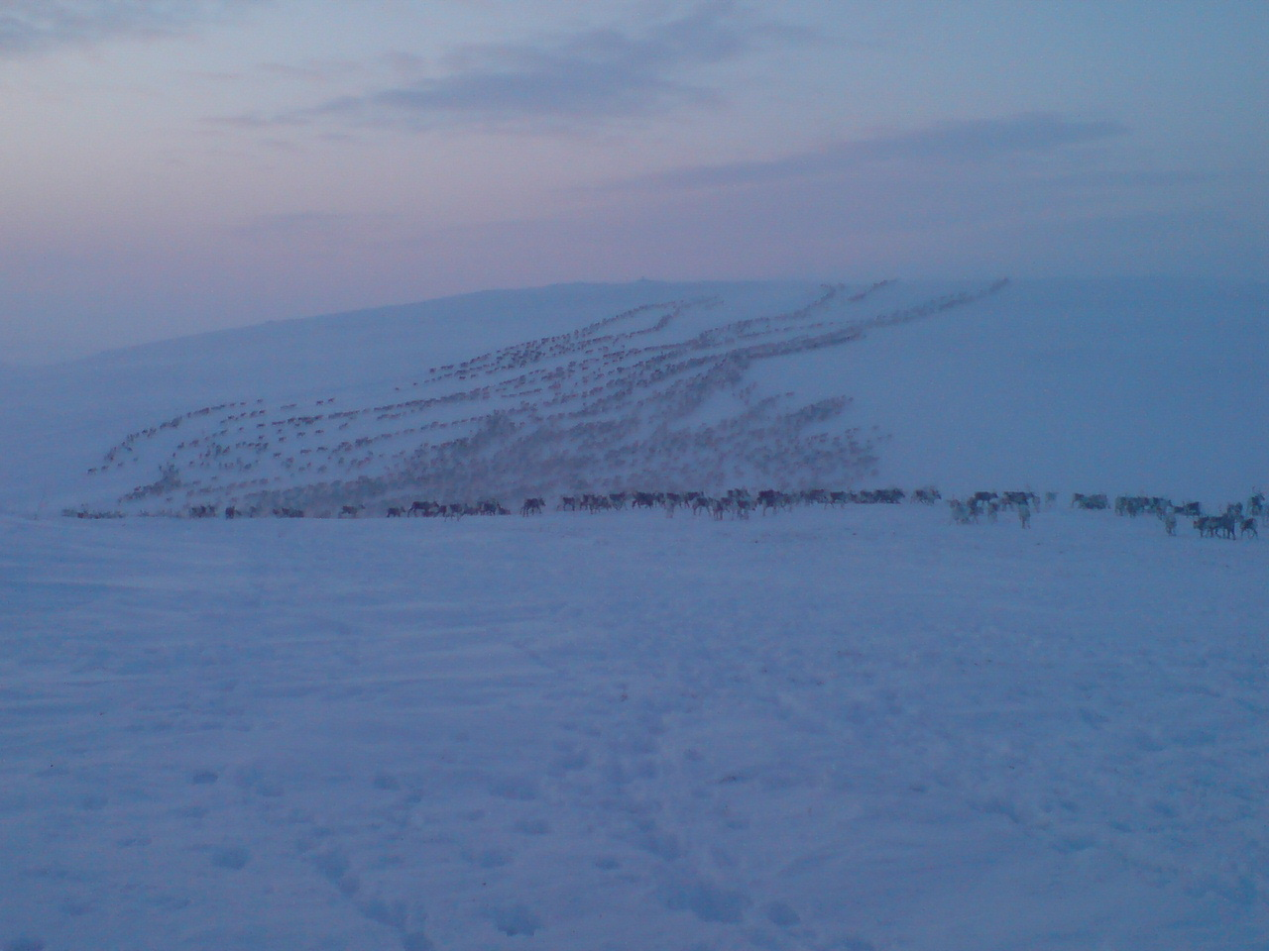
FISHING LITIGATION
By Anne Nuorgam

Slide 2
National Court Decisions and UNDRIP
The Supreme Court of Belize invoked the UNDRIP when interpreting the Constitution to protect the rights of the Mayan people to their traditional lands in 2007
Botswana 2004, the draft form of UNDRIP to rule in favour of Basarwa (San) people peoples who were evicted from their ancestral lands
The Constitutional Court of Indonesia: in the customary forests Indigenous peoples’ collective rights to their territories were recognized
Malaysia
Australian High Court 2019
Ecuador 2019

Slide 3
Background
The Saami are the only indigenous people in the European Union
Saami people live in Norway, Sweden, Russia and Finland
The total Saami population is estimated to be over 75 000. There are 10 Saami languages in total, and three of them are spoken in Finland
North Saami, over 2500 speakers
Inari Saami, approximately 350 speakers (language is only spoken in Finland)
Skolt Saami, approximately 350 speakers

Slide 4
Background
The Saami are recognized in the constitution
Finland: The Sami, as an indigenous people, have the right to maintain and develop their own language and culture (Art 17.3).
Norway: The authorities of the state shall create conditions enabling the Sami population to preserve and develop its language, culture and way of life. (Art 108).
Sweden: The opportunities of the Sami people and ethnic, linguistic and religious minorities to preserve and develop a cultural and social life of their own shall be promoted (Art 2.7).
The States implement the constitutional clauses by drafting legislation on Saami
Separate acts: Saami Parliament, Saami language, in Norway and Sweden reindeer herding acts
Sections on Saami (rights) merged into national legislation: education, social and health, mining acts, environmental, etc. acts

Slide 6
Traditional Saami livelihoods
Reindeer herding, fishing, hunting, gathering and handicrafts (Sámi Duodji)
Livelihoods have an important role in preserving and maintaining Saami culture and languages
Livelihoods are based on sustainable use of nature
Livelihoods support Saami language
Both men and women practice Saami livelihoods

Slide 7
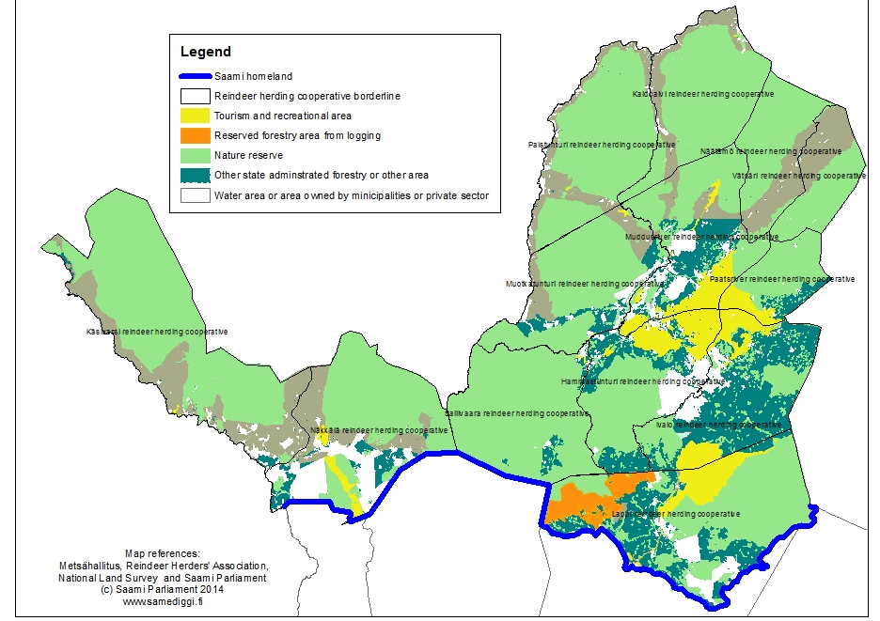
Saami homeland and land use

Slide 8
Fishing case
In Finland the Sámi have just usufruct rights to their lands
So called State owned land covers about 95 % of the Sámi homeland
Sámi fishing rights were criminalized by new Fishing Act 2015 in so called State waters when fishing salmon
Had to compete with other people for the fishing licenses
https://www.facebook.com/pg/samihumanrights/videos/?ref=page_internal

Slide 9
Judgement
District Court on 6 March 2019 acquitted the Sámi of all criminal charges
We resorted to the constitution of Finland: the Sámi have a right to their own culture of which fishing is an important part. The Court confirmed that the accused did not commit a violation when they fished according to their customary law.
“The restriction of basic rights must be based on acceptable criteria. In this case, no acceptable reasons for restricting basic rights have been found.”
The UNDRIP was referred: Articles 8, 14, 20, 26, 34, 40, 43
Fishing is collective and part of Sámi culture

Slide 10
Today
State Prosecutor had on 2 April 2019 filed an appeal against the judgment,
We are still under criminal charges, now before the Supreme Court where the Prosecutor is asking for a criminal conviction through a precedent issued by the Supreme Court in order to guide the future application of the law
The Supreme Court granted certiorari last Friday

Slide 11
Giitu beroštumis
Thank you for interest
Giitu!

