Slide 1
Stigma, Human Rights, and HIV
Measurement and Interventions
Stefan Baral, MD MPH FRCPC
Key Populations Program
Center for Public Health and Human Rights, Johns Hopkins University

Slide 2
Outline
Stigma as a Barrier to the HIV Response
Patterns of Stigma across Regions among Key Populations
Integrated Stigma Mitigation Interventions
Moving Forward

Slide 3
Why Measure Stigma?
Stigma, Rights Violations, and HIV Risks are intricately linked
  Limits Coverage of HIV Prevention and Treatment Programs
    Challenges Provision of Services
    Challenges Uptake of Services
  Data Paradox
    Least data in the most stigmatizing settings

Slide 4
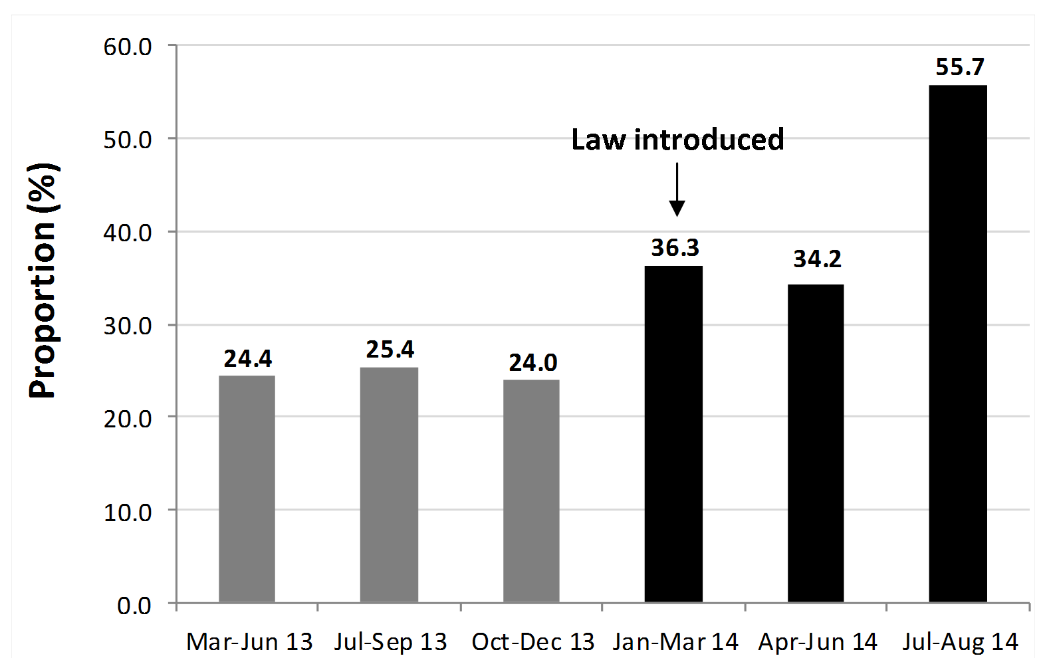
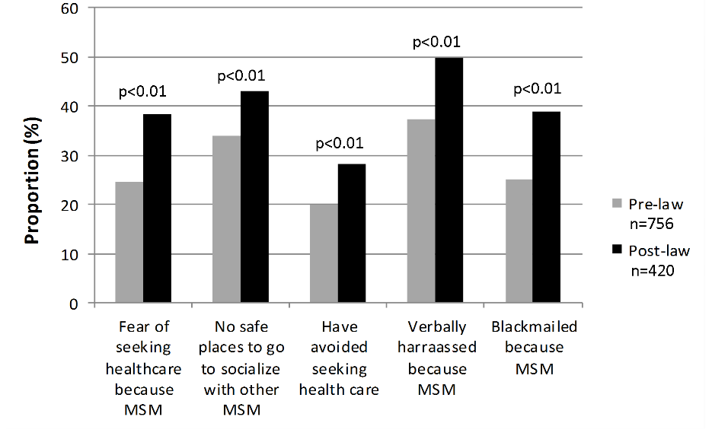
Legislation and HIV Risks among MSM in Nigeria
Reporting of Discrimination and Stigma During Study Visits Pre and Post Legislation
Cumulative lifetime experiences of reported fear of seeking health care services across study visits (n=1,175 visits).
HIV Prevalence ~45%, HIV Incidence ~14%
Sources: Schwartz, Nowak, Orazulike, Blattner, Charurat, Baral, TRUST Study Group (UMD, MHRP, ICARH, JHU). The immediate HIV-related impact of enacted legislation that further criminalizes same-sex practices in Nigeria. Lancet HIV

Slide 5
Stigma affecting Disclosure among MSM in the Gambia
Disclosure of Sexual Orientation to
  Family Member
    3.9% (8/205)
  Health Care Worker
    15.4% (32/205)
 | Fear of Seeking Care | Denial of Care
Variable | aOR | aOR
Disclosure of Sexual Orientation to Family or HCW | 2.61 (1.08-2.61) | 9.74 (1.96-48.45)
Source: Baral, Mason, Diouf, Ceesaay, Drame. A cross-sectional analysis of population demographics, HIV knowledge and risk behaviors, and prevalence and associations of HIV among men who have sex with men in the Gambia. AIDS Research and Human Retroviruses. 2014

Slide 6
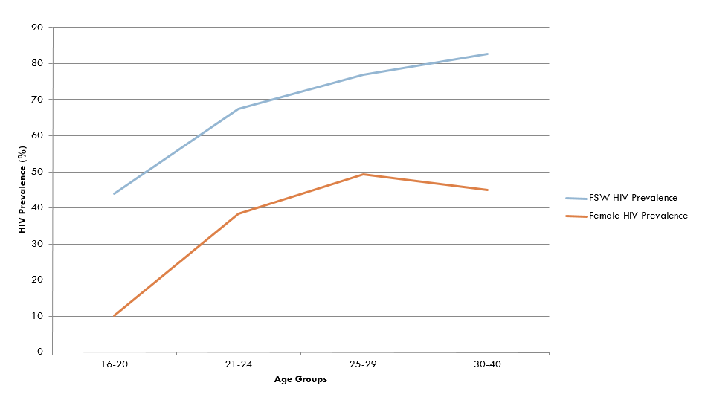
Disclosure of Sex Work Status in eSwatini
Disclosure of Sex Work to
  Family Member
    30.3% (98/325)
  Health Care Worker
    25.9% (84/325)
Afraid to Seek Health Care
  aOR 3.5 (95% CI 1.3-5.6) disclosed sex work to HCW
  aOR 2.0 (95% CI 1.12-3.7) being treated for HIV

Slide 7
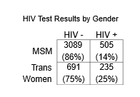
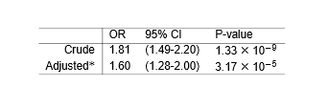
HIV of Trans Women vs CisMSM in Eight Countries Across Sub-Saharan Africa
Overall Proportion of Trans Women
4586 participants
  20.4% trans women
  79.6% cisgender MSM
Poteat, Ackerman et al, Baral, PloS Medicine, 2017

Slide 8

Stigma among transgender women vs cisgender MSM across Sub-Saharan Africa
* p < 0.05
** p < 0.001
** p < 0.001
Poteat, Ackerman et al, Baral, PloS Medicine, 2017

Slide 9
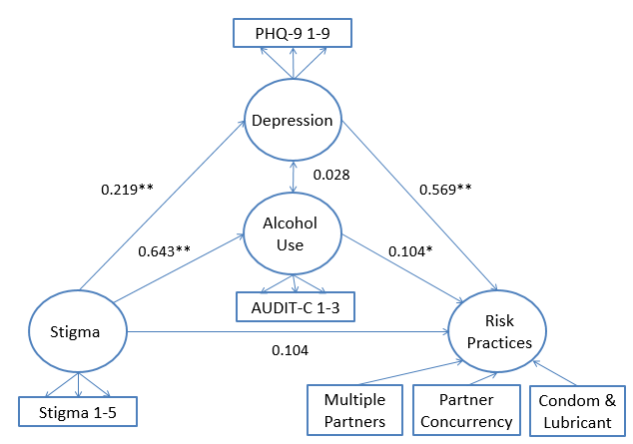
Stigma and Depression among MSM
Structural Equation Model
Indirect effect of stigma in health system on sexual risk practices
527 MSM from Lesotho
*p=0.072; **p<0.01
Da, W, Stahlman, and Baral, S. Depressive symptoms and Alcohol use as Mediators of HIV-related risk practices and stigma affecting men who have sex with men in Lesotho : a Structural Equation Modelling Approach, Annals of Epidemiology, 2016

Slide 10
Stigma and Mental Health among Trans Women in Cote D’Ivoire
Decomposition of effects of transgender female identity on depression, mediated by sexual behavior stigma (n=1301)*
 | Excess relative risk | (95% CI) | P-value
Total | 0.72 | (0.31, 1.12) | <0.001
Natural direct effect (NDE)ª | 0.26 | (-0.08, 0.60) | 0.139
Pure indirect effect (PIE)^{b} | 0.47 | (0.34, 0.60) | <0.001
Mediated interaction (IMD)^{c} | -0.01 | (-0.07, 0.04) | 0.659
 | Proportion mediated | (95% CI)
Proportion of effect mediated by sexual behavior stigma | 63.9 | (34.9, 92.9) | <0.001
*Adjusted for age, study site, and HIV-positive serostatus
ª Effect of transgender female identity if transgender women experienced the same level of sexual behavior stigma as cisgender MSM.
^{b} Effect of transgender female identity due to mediation by stigma, but not interaction.
^{c} Effect of transgender female identity due to mediation by, and interaction with, stigma.
Scheim, Liestman, Diouf, et al, Baral, Annals of Epidemiology, In Press

Slide 11
Stigma and Suicidal Ideation among MSM in West Africa
 |  | OR | 95% CI | aORª | 95% CI
Family exclusion |  | 2.28*** | 1.52, 3.42 | 2.22*** | 1.43, 3.43
Family gossip |  | 2.68*** | 1.99, 3.64 | 2.50*** | 1.79, 3.50
Friend rejection |  | 2.38*** | 1.73, 3.26 | 2.17*** | 1.53, 3.07
Treated poorly in healthcare setting |  | 2.51** | 1.41, 4.45 | 1.99* | 1.07, 3.71
Healthcare worker gossiped |  | 1.54 | 0.91, 2.59 | 1.41 | 0.81, 2.43
Physically hurt |  | 3.83*** | 2.57, 5.72 | 2.94** | 1.91, 4.52
Tortured |  | 3.84*** | 2.24, 6.60 | 3.86*** | 2.17, 6.86
Raped |  | 3.36*** | 2.30, 4.89 | 3.07*** | 2.05, 4.60
Social cohesion |  | 0.97** | 0.94, 0.99 | 0.98 | 0.95, 1.00
Social participation |  | 0.92* | 0.86, 0.98 | 0.91* | 0.85, 0.99
*p<0.05; **p<0.01; ***p<0.001
ªAdjusts for age, gender identity, study site, marital status, self-reported HIV status, and disclosure of sexual identity to family members or healthcare workers
Source: Stahlman, Diouf, Ceesay, Abo, Ezouatchi, Thiam, Drame, Baral, International Journal of Psychiatry, 2016

Slide 12
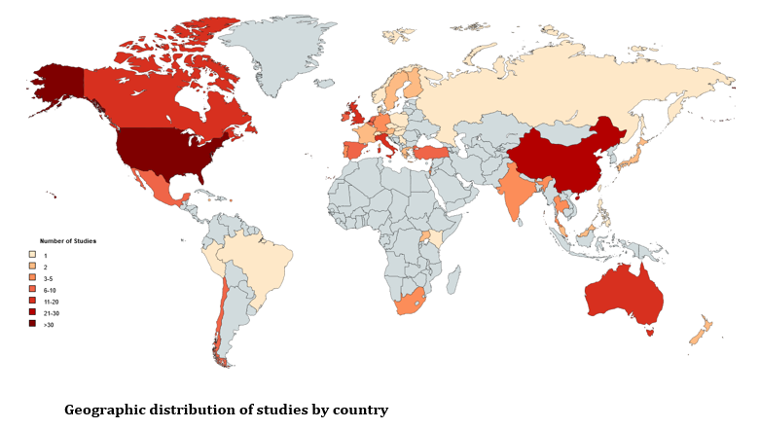
Where Stigma Data Are Available for Key Populations from 2000-2016
Source: Fitzgerald-Husek, Grosso, Van Wert, Ewing, Baral, Systematic Review of Stigma Metrics for Key Populations. PLoS One, 2018

Slide 13
Prevalence of Community Level Stigma Affecting Men who have Sex with Men across the US and Sub-Saharan Africa
Source: Stahlman, Sanchez, Sullivan, Baral, The Prevalence of Sexual Behavior Stigma Affecting Gay Men and Other Men Who Have Sex with Men Across Sub-Saharan Africa and in the United States, JMIR PH&S, 2016

Slide 14
Measurement of Stigma Across Populations
Validated Stigma Metrics Used
 | MSM only | SW and MSM | SW only | PWID | Total
Validated | 221 | 1 | 4 | 0 | 226
Partly Validated | 28 | 1 | 0 | 0 | 29
Not validated | 279 | 6 | 9 | 0 | 294
Total | 528 | 8 | 13 | 0 | 549
Source: Fitzgerald-Husek, Grosso, Van Wert, Ewing, Baral, Systematic Review of Stigma Metrics for Key Populations. PLoS One, 2017

Slide 15
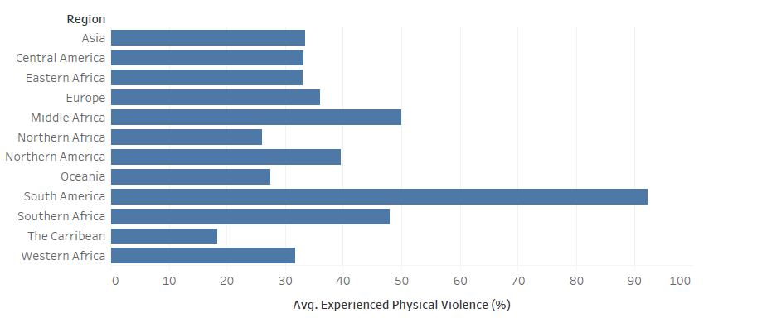
Average Percentage of Female Sex Workers Reporting Experiences of Physical Violence, 2006-2017

Slide 16
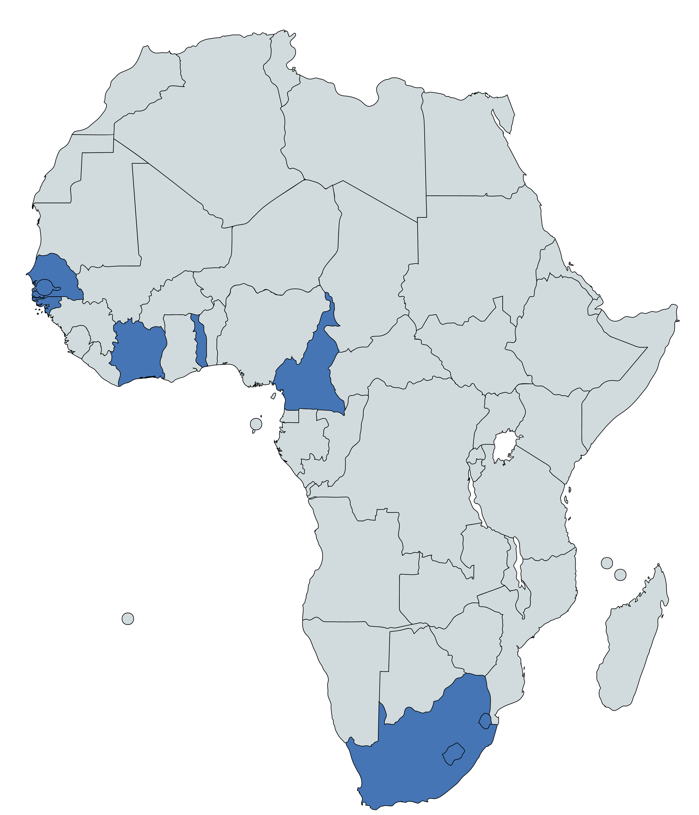
Stigma among female sex workers in 10 countries in sub Saharan Africa
Lyons CE, Baral SD. The Role of Stigma in Potentiating HIV Risks among Female Sex Workers Across Sub-Saharan Africa: A Meta-Analysis of Ten Countries. 2019.

Slide 17
Relationship between legal status of sex work and HIV
 | Living with HIV
 | n/N | % | X² p value | OR | P value | 95% CI | aOR* | P value | 95% CI
Legal status of sex work |  |  | <0.01
Legal mechanism for sex work in place | 219/1908 | 11.56 |  | Ref | Ref | Ref | Ref | Ref | Ref
Selling sex not legally specified | 248/1266 | 19.59 |  | 1.86 | 0.103 | 0.88,3,94 | 3.49 | 0.022 | 1.13,5.48
Criminalized | 1605/3985 | 40.44 |  | 7.40 | 0.009 | 1.52,17.76 | 7.99 | 0.001 | 2.28, 27.93
*Adjusted for age, education level, clustered by country
Lyons CE, Baral SD. The Role of Stigma in Potentiating HIV Risks among Female Sex Workers Across Sub-Saharan Africa: A Meta-Analysis of Ten Countries. 2019.

Slide 18
Stigma reduction among cisgender MSM, transgender women, and people living with HIV over 24 months
Results
Among participants in the cohort over 24 months:
Fear of seeking health services reduced (p<0.001).
Avoidance of seeking health services reduced (p<0.001).
Feeling mistreated in the health center reduced months (p=0.086).
No significant reductions in enacted stigma.
Significant decreases in stigma observed, with differences in stigma patterns by HIV status and gender identity.
Need for specific strategies to address multiple intersecting forms of stigma as a means of improving HIV-related outcomes.
Remains a need to better understand how to reduce enacted stigma in the health care setting.
Table 1: Odds of stigma over 24 months by gender and HIV status¹
 | Fear of seeking health services |  | Avoiding seeking health services |  | Mistreated in the health center
 | aOR* | 95% CI | aOR* | 95% CI | aOR* | 95% CI
Living with HIV | 3.4 | 1.6, 7.2 | 3.2 | 1.2, 5.8 | 6.7 | 1.6, 27.5
Transgender women | 1.5 | 0.7, 3.3 | 2.7 | 1.4, 7.3 | 1.2 | 0.3, 4.5
Other gender minority | 5.9 | 1.5, 24.1 | 3.5 | 0.6, 19.0 | 8.6 | 2.8, 26.5
**reference category cisgender. Other gender minority included reported gender as other, or don’t know.
*adjusted for age, education level
¹C E Lyons, O Olawore, S Murray, B Liestman, D Castor, F Yang, S Ketende, D Diouf, FM Drame, K Coly, A Cheng, C Ndour, G Turpin, S Mboup, C Toure-Kane, NLeye-Diouf, H Diop, S Baral.

Slide 19
Moving Forward
Despite rhetoric, stigma and rights violations are understudied social determinants of health in HIV epidemiologic and prevention studies
Stigma and human rights are quantitatively measurable and represents actionable risk factors for HIV acquisition and transmission
Stigma limits coverage of effective HIV prevention and treatment interventions among communities at highest risk of acquisition and transmission sustaining the HIV pandemic

Slide 20
Acknowledgements
The people across the world who participate in studies given significant risks and limited personal benefits
The community groups that make great personal and professional sacrifices to serve the unmet health and advocacy needs of those most marginalized in the HIV response

