Slide 1
Presentation for the Group of Independent Eminent Experts on the Implementation of the Durban Declaration and Programme of Action Outreach activities
Laurent Sauveur
Chief of External Relations

Slide 2
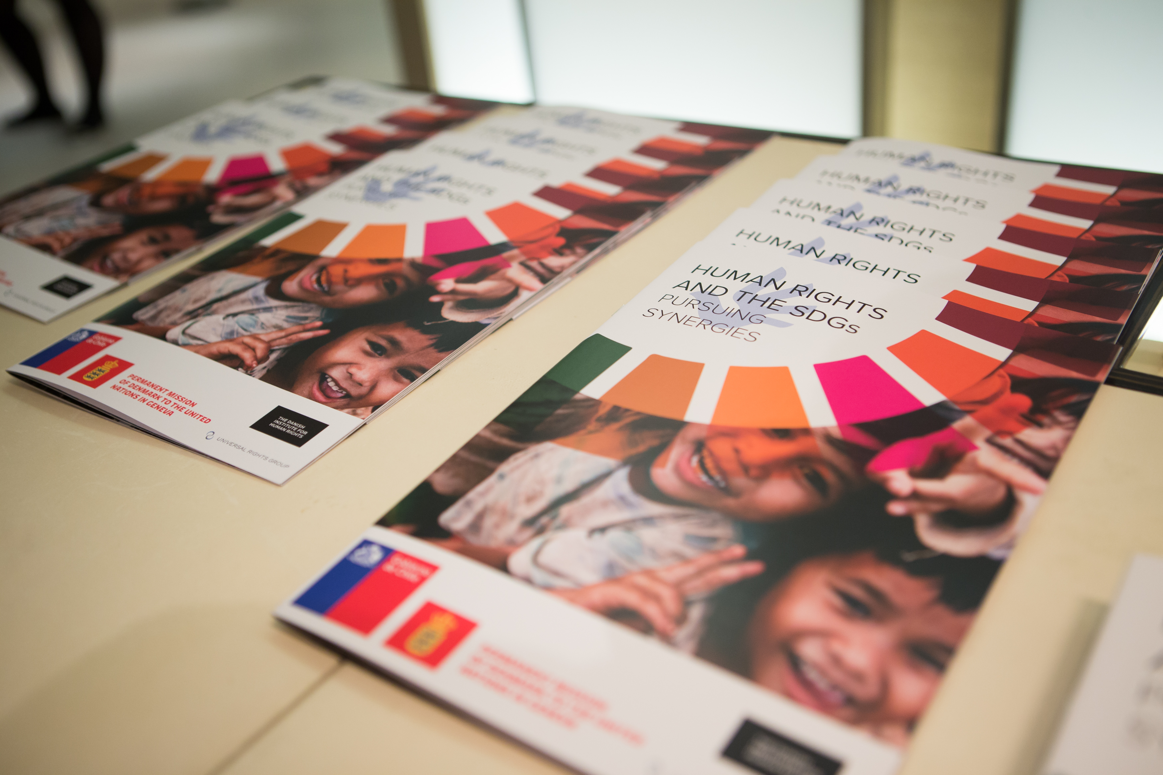
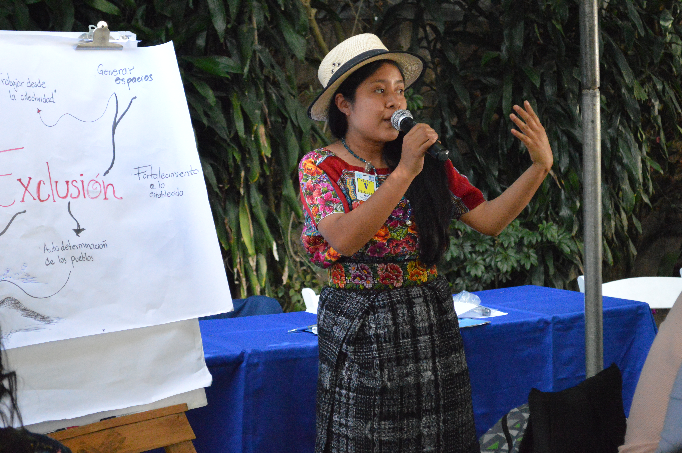
Our mission
Objectives: visibility, advocacy, mobilization, and education
Build a global constituency for human rights
Who we are:
Communications
Media and Public Positioning
Donors and External Relations
Meetings, Documents and Publications
How we do it: storytelling, digital, videos, campaigns, influencers, media
Notes:
OHCHR considers civic space a threshold issue for the advancement of all other human rights. When there is space for civil society to voice opinions and shed light on concerns, all other human rights can be pursued more effectively.
While new technologies and interconnectedness have greatly facilitated the expansion of civil society networks, including across borders, they have also created new avenues and excuses for control of civil society movements and speech, often under security pretexts. They have also shifted large parts of the participation space on-line – and, at least partially, under the control of private platforms, which challenges our traditional human rights methodology.
The tide against civil society is strong: Restrictions, including on registration and funding for civil society are growing, and counter-terrorism, security and public morality concerns are invoked as justifications for legal and policy constraints. Attacks (physical and other) on civil society – by state and non-state actors -- are on the rise, including against women human rights defenders and defenders working for gender equality.
Another challenge is that members of the public often do not fully appreciate the critical role of civil society in preserving public freedoms, defending diversity, and ensuring state accountability.

Slide 3
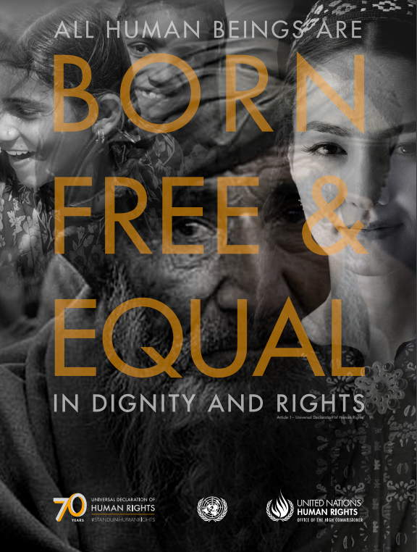
Awareness campaigns (2017-2019)
70 years of the Universal Declaration of Human Rights (UDHR70)
Women’s Day / #I Stand With Her
#FightRacism
16-days of activism against gender-based violence (November)
Flagship days (World Press Freedom Day, World Albinism Day,etc)
30 years of the Convention for the Rights of the Child (November 2019)

Slide 4
Durban Declaration and Programme of Action
DDPA is at the forefront of OHCHR anti-racial discrimination efforts
DDPA and ICERD constitute the OHCHR framework to prevent and combat racism & racial discrimination.

Slide 5
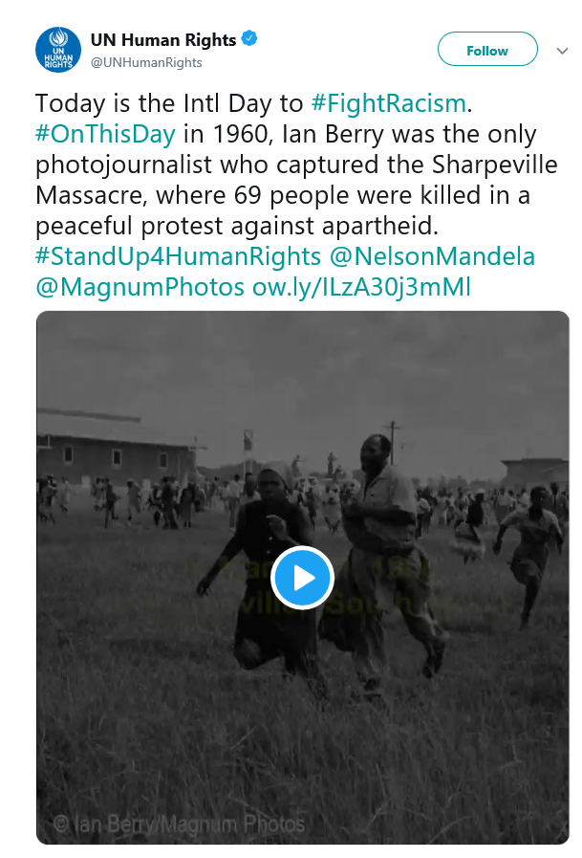
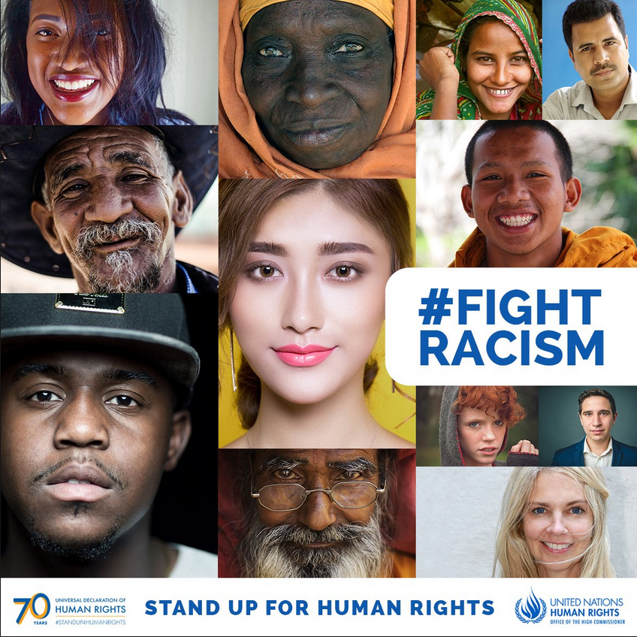
#FightRacism 2018 campaign
Yearly campaign to mark the International Day for the elimination of racial discrimination (21 March)
Focus on the Sharpeville massacre & collaboration with Magnum Photos
Links to the UDHR70 campaign

Slide 6
#FightRacism 2019 campaign - overview
Global social media campaign #FightRacism (17-21 March):
Iconic quotes from famous writers and artists against racism (Paulo Coelho, Gabriel García Marquez, Audre Lorde or Tahar Ben Jelloun)
High Commissioner Bachelet & 6 influencers’ video messages against hate
Call to action: #FightRacism through the power of poetry
Multilingualism: EN, SP, FR,PT

Slide 7
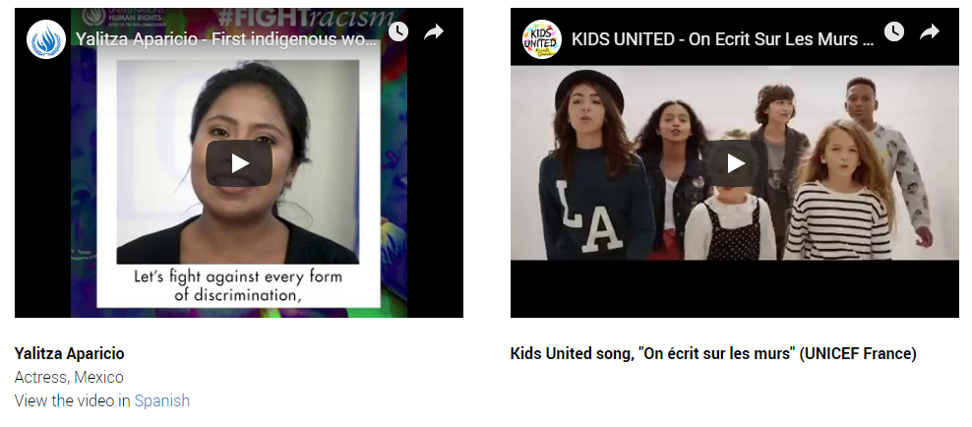
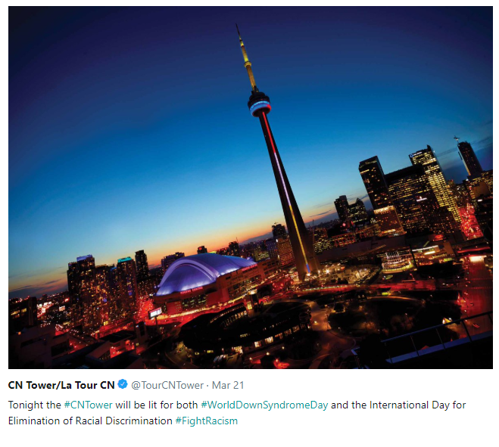
#FightRacism 2019 campaign - results
Successful pick up on social media by a large number of Member States,organizations, field offices, UNICs and UN agencies.
Reach to a broader audience thanks to
multilingual posts & influencers sharing our
stories.

Slide 8
Considerations for future campaigns
Need for resources
UDHR70: 2 fully-dedicated staff + 840K budget
Strategy & planning
Clear definition of objectives
Teamwork with substantive colleagues
Notes:
At a global level, the voice and leadership of the High Commissioner is critical for the defence of civic space and protection of human rights defenders.
In terms of UN support to civil society/civic space, our advocacy has two objectives:
(1) widening the space for civil society engagement within UN entities and forums (the recent HC report on civil society engagement within the UN advocates for clearer rules on accreditation and predictable channels for exchange and access to information that are actionable in case of disagreements; diversity of engagement and conscious out-reach to different NGOs; better protection, including from reprisals for cooperation with the UN);
(2) ensuring that the UN protects and promotes civic space in its work with member states.

Slide 9
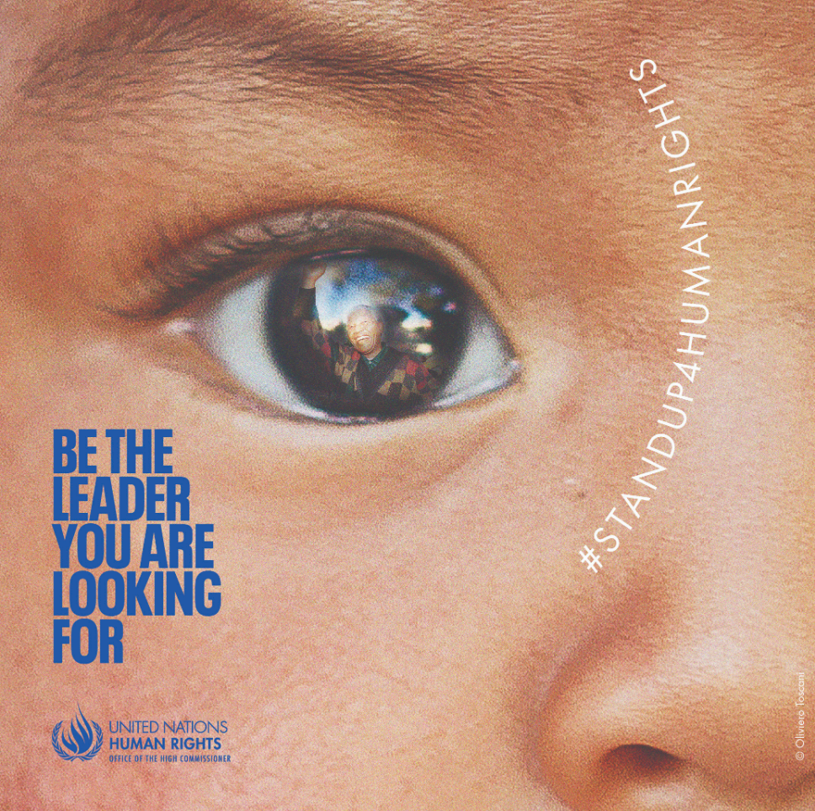
Questions?
Contact lsauveur@ohchr.org

