Slide 1
Foundations – Promoting the Rights of Persons with Disabilities through the Sustainable Development Goals A Resource Package
Online Training Module – Session 2
Presenter's name
Event or meeting title Platform, (Date)
© United Nations, 2022 – These presentation slides form part of the OHCHR Promoting the Rights of Persons with Disabilities through the Sustainable Development Goals: A Resource Package.

Slide 2
Teams tech help slides
(Templates by Training for Change)

Slide 3
Set-up
Click Unmute and Start Video to say hello
Raise your hand
Click Participants
and Chat

Slide 4
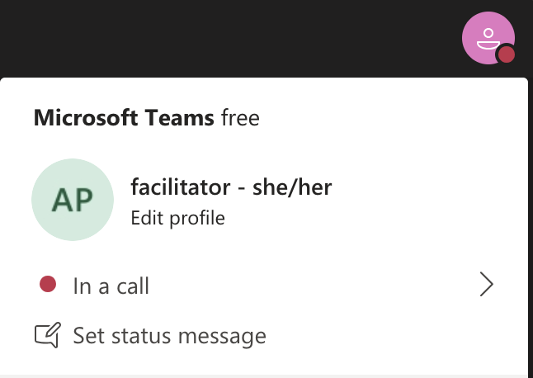
Rename yourself: Click the icon on the top right corner, click “Edit profile” to change your name and add your pronouns. Click “Set status message” to write your organization and location.

Slide 5
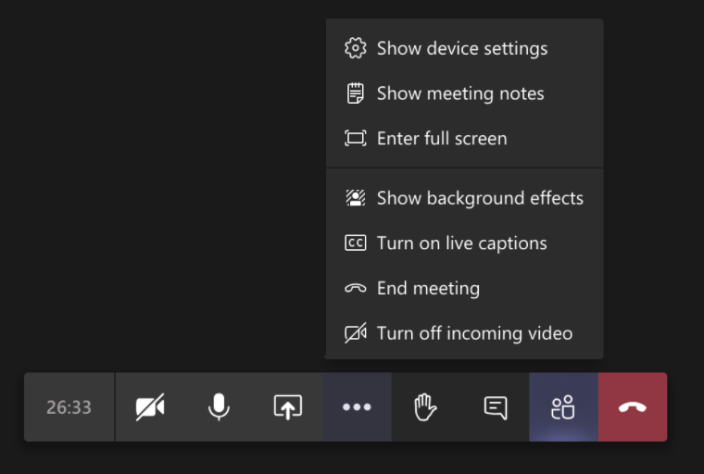
Closed Captions

Slide 6
Zoom tech help slides
(Templates by Training for Change)

Slide 7
Set-up
Click Unmute and Start Video to say hello
Click Participants
and Chat

Slide 8
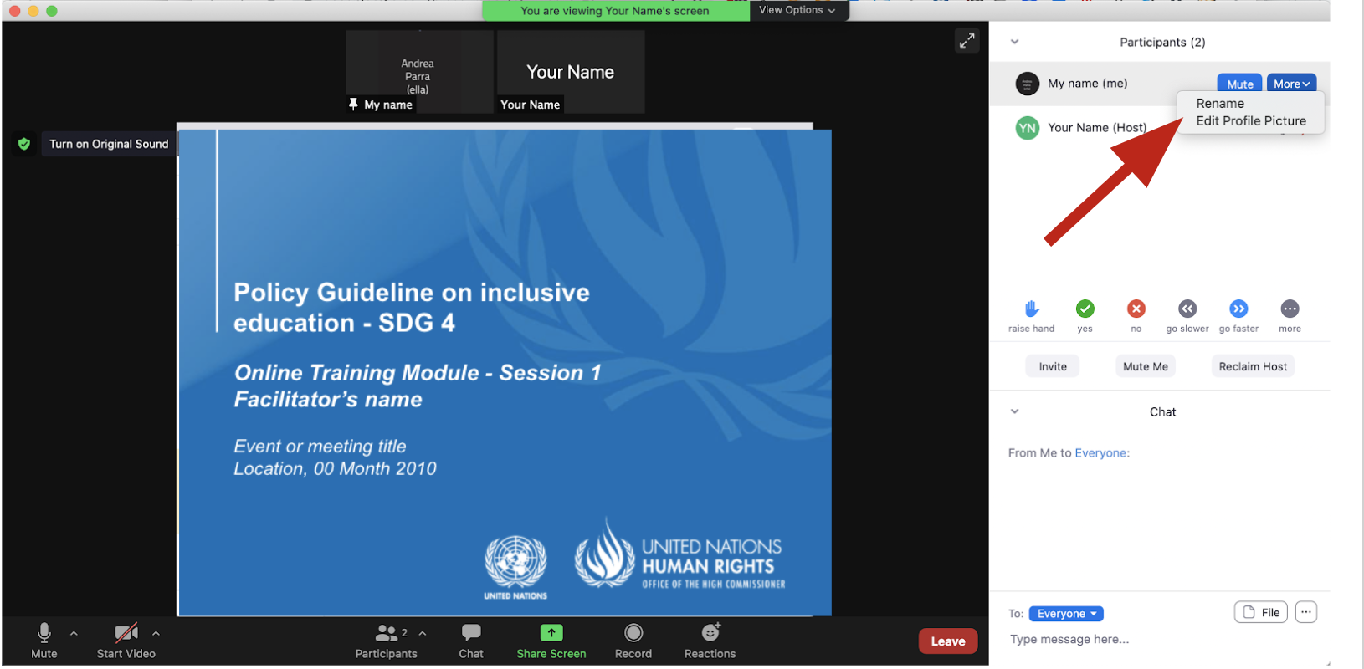
Rename yourself: Find your name at the top of the Participants list, click “More” then “Rename”. Add your pronouns & location.

Slide 9
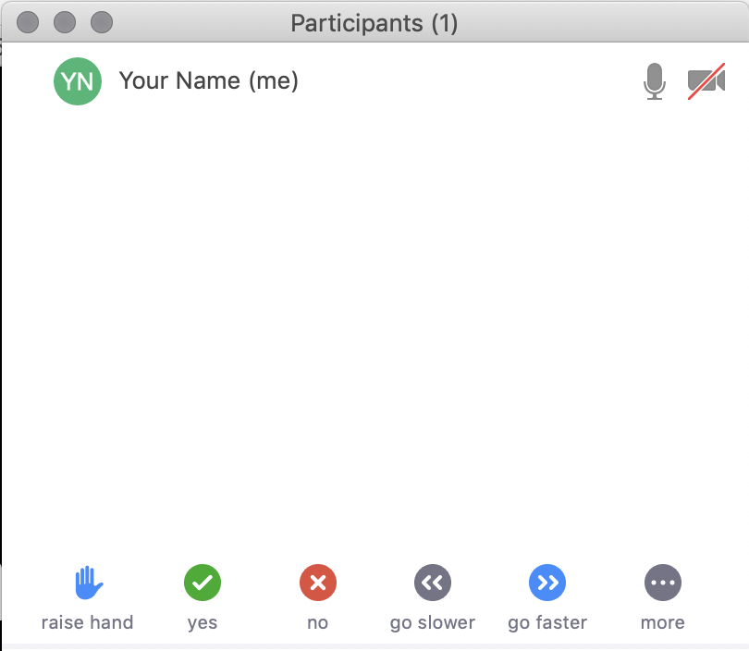
Raise your hand
Use the participants menu tool --or--
Type * in chat
*9 on phone
Alt+Y on keyboard

Slide 10
Closed Captioning
Click arrow next to “Closed Caption” and click “Show Subtitle”
Notes:
Template by Training for Change • www.trainingforchange.org
Visual guide for how to turn on closed captioning is very important when you have a live captioner in your online meeting. It is recommended to also paste in chat:
==========
Live closed captioning available. Click “Closed Caption” in the toolbar and “Show Subtitle” to view the captions. Click “Subtitle Settings…” for more options.
==========

Slide 12
Be present
Remove distractions
Get a beverage
Get note-taking materials
Center yourself

Slide 13
Welcome!
Please share in chat or out loud something that stuck with you from the previous session.
Notes:
Template by Training for Change • www.trainingforchange.org

Slide 14
Objectives of the module
Become familiar with the various components of the Office of the United Nations High Commissioner for Human Rights’ Resource Package on Promoting the Rights of Persons with Disabilities through the Sustainable Development Goals
Gain an understanding of key human rights concepts that underpin a rights-based approach to disability-inclusive development.
Gain an understanding of the structural requirements that enable the implementation of all the Sustainable Development Goals with a disability rights lens.
Identify concrete steps that policymakers can take to implement general requirements and foundations for the inclusion of persons with disabilities.

Slide 15
Agenda
Start time: 00:00
Core pillars
Structural requirements for enabling environments
Closing time:

Slide 16
Instructions
Take a moment to review the Core Pillars Infocard
We will spin the wheel of pillars and the wheel of stories.
We will read the story of the character and you will write in the corresponding slide examples of how that pillar would look like if it were applied to the situation.

Slide 17
Non-Discrimination. Character:
Double-click a note to edit
Template by Training for Change
Notes:
Template by Training for Change • www.trainingforchange.org
HOW TO USE THIS SLIDE
Insert your brainstorm prompt at the top
Invite participants to type their own answers onto the sticky notes, resizing the notes or adding new notes (copy and paste) as needed
Options and variations:
People can share in chat or out loud and one person can scribe on the slide for them. This is especially helpful with groups over 35 so the Google doc doesn’t experience lag.
Right click on the slide in the sidebar and choose “Duplicate slide” to make more room for people to add, so that you don’t have to make the font smaller.
To make this activity anonymous, set the slide settings in Google Slides to anyone with the link can edit and don’t share it directly with people’s email addresses.
After making a list, drag and drop the sticky notes to create categories, a timeline, priorities, etc.
Find and delete the white shape at the bottom right corner. Drag and drop the shapes that were hidden there to “dot vote” on the stickies.

Slide 18
Accessibility. Character:
Double-click a note to edit
Template by Training for Change
Notes:
Template by Training for Change • www.trainingforchange.org
HOW TO USE THIS SLIDE
Insert your brainstorm prompt at the top
Invite participants to type their own answers onto the sticky notes, resizing the notes or adding new notes (copy and paste) as needed
Options and variations:
People can share in chat or out loud and one person can scribe on the slide for them. This is especially helpful with groups over 35 so the Google doc doesn’t experience lag.
Right click on the slide in the sidebar and choose “Duplicate slide” to make more room for people to add, so that you don’t have to make the font smaller.
To make this activity anonymous, set the slide settings in Google Slides to anyone with the link can edit and don’t share it directly with people’s email addresses.
After making a list, drag and drop the sticky notes to create categories, a timeline, priorities, etc.
Find and delete the white shape at the bottom right corner. Drag and drop the shapes that were hidden there to “dot vote” on the stickies.

Slide 19
Supports and Assistive Technology. Character:
Double-click a note to edit
Template by Training for Change
Notes:
Template by Training for Change • www.trainingforchange.org
HOW TO USE THIS SLIDE
Insert your brainstorm prompt at the top
Invite participants to type their own answers onto the sticky notes, resizing the notes or adding new notes (copy and paste) as needed
Options and variations:
People can share in chat or out loud and one person can scribe on the slide for them. This is especially helpful with groups over 35 so the Google doc doesn’t experience lag.
Right click on the slide in the sidebar and choose “Duplicate slide” to make more room for people to add, so that you don’t have to make the font smaller.
To make this activity anonymous, set the slide settings in Google Slides to anyone with the link can edit and don’t share it directly with people’s email addresses.
After making a list, drag and drop the sticky notes to create categories, a timeline, priorities, etc.
Find and delete the white shape at the bottom right corner. Drag and drop the shapes that were hidden there to “dot vote” on the stickies.

Slide 20
Participation. Character:
Double-click a note to edit
Template by Training for Change
Notes:
Template by Training for Change • www.trainingforchange.org
HOW TO USE THIS SLIDE
Insert your brainstorm prompt at the top
Invite participants to type their own answers onto the sticky notes, resizing the notes or adding new notes (copy and paste) as needed
Options and variations:
People can share in chat or out loud and one person can scribe on the slide for them. This is especially helpful with groups over 35 so the Google doc doesn’t experience lag.
Right click on the slide in the sidebar and choose “Duplicate slide” to make more room for people to add, so that you don’t have to make the font smaller.
To make this activity anonymous, set the slide settings in Google Slides to anyone with the link can edit and don’t share it directly with people’s email addresses.
After making a list, drag and drop the sticky notes to create categories, a timeline, priorities, etc.
Find and delete the white shape at the bottom right corner. Drag and drop the shapes that were hidden there to “dot vote” on the stickies.

Slide 21
Awareness-raising. Character:
Double-click a note to edit
Template by Training for Change
Notes:
Template by Training for Change • www.trainingforchange.org
HOW TO USE THIS SLIDE
Insert your brainstorm prompt at the top
Invite participants to type their own answers onto the sticky notes, resizing the notes or adding new notes (copy and paste) as needed
Options and variations:
People can share in chat or out loud and one person can scribe on the slide for them. This is especially helpful with groups over 35 so the Google doc doesn’t experience lag.
Right click on the slide in the sidebar and choose “Duplicate slide” to make more room for people to add, so that you don’t have to make the font smaller.
To make this activity anonymous, set the slide settings in Google Slides to anyone with the link can edit and don’t share it directly with people’s email addresses.
After making a list, drag and drop the sticky notes to create categories, a timeline, priorities, etc.
Find and delete the white shape at the bottom right corner. Drag and drop the shapes that were hidden there to “dot vote” on the stickies.

Slide 22
Break! Come back at :00

Slide 23
Foundations video

Slide 24
Six structural requirements to create enable legal, policy and programming environments
Governance
Participation
Legislation
Accountability & Monitoring
Capacity Building
International Cooperation

Slide 25
Governance
Good governance that promotes the effective inclusion of people with disabilities includes the following eight components:
Institutional design
Twin-track approach
Assessment
Partnerships
Budget
Disability Markers
Procurement
Data Collection

Slide 26
Governance - Breakout Groups
In trios pick two of these elements to talk about.
Review the Governance Infocard handout
Answer:
How does this element exist currently in your country or context?
What is missing so that element can support good governance and inclusive policies?
How do you find out information about this element in your context?

Slide 27
Participation

Slide 28
Legislation

Slide 29
Capacity-building

Slide 30
Accountability and Monitoring

Slide 31
International cooperation

Slide 32
Breakout Groups – Structural requirements
Open the Structural Requirements Handout.
Open the expanded character story and discuss the question underneath the story.

Slide 33
Participation

Slide 34
Legislation

Slide 35
Capacity-building

Slide 36
Accountability and Monitoring

Slide 37
International cooperation

Slide 38
Wrap-up and Next Steps
(Add dates of next trainings and any follow-up information here)
(Contact information for questions)

Slide 39
Closing
Share in chat or out loud – One takeaway from this module.

Slide 40
Resources
Resource package link
Policy Guidance
Human Rights Indicators
Data Sources Guidance
Training Materials
Videos
(Add other relevant resources)

Slide 41
Thank you! For further information, please contact:

