Slide 1
Policy Guidance on No Poverty – Sustainable Development Goal 1: Promoting the Rights of Persons with Disabilities through the Sustainable Development Goals
A Resource Package
Online Training Module – Session 1
Presenter's name
Event or meeting title
Platform, (Date)
© United Nations, 2022 – These presentation slides form part of the OHCHR Promoting the Rights of Persons with Disabilities through the Sustainable Development Goals: A Resource Package.

Slide 2
Teams tech help slides
(Templates by Training for Change)

Slide 3
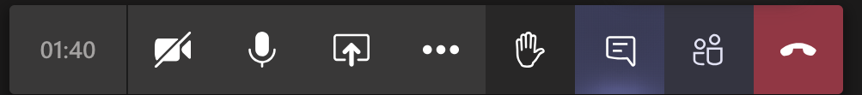
Set-up
Click Unmute and Start Video to say hello
Raise your hand
Click Participants
and Chat

Slide 4
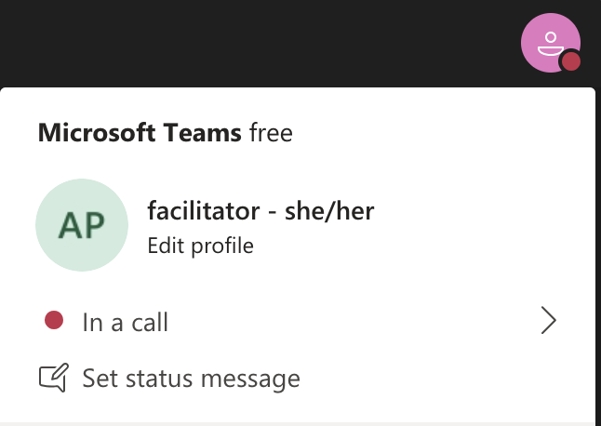
Rename yourself: Click the icon on the top right corner, click “Edit profile” to change your name and add your pronouns. Click “Set status message” to write your organization and location.

Slide 5
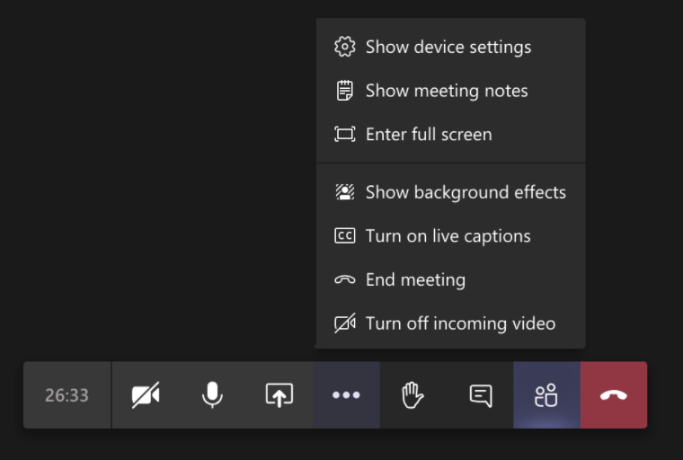
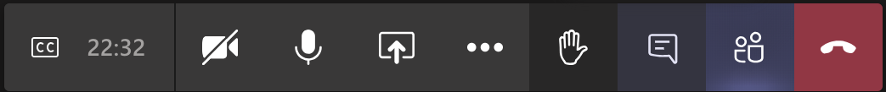
Closed Captions

Slide 6
Zoom tech help slides
(Templates by Training for Change)

Slide 7
Set-up
Click Unmute and Start Video to say hello
Click Participants
and Chat

Slide 8
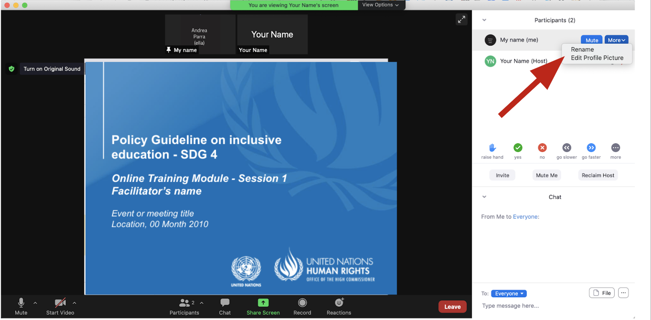
Rename yourself: Find your name at the top of the Participants list, click “More” then “Rename”. Add your pronouns & location.

Slide 9
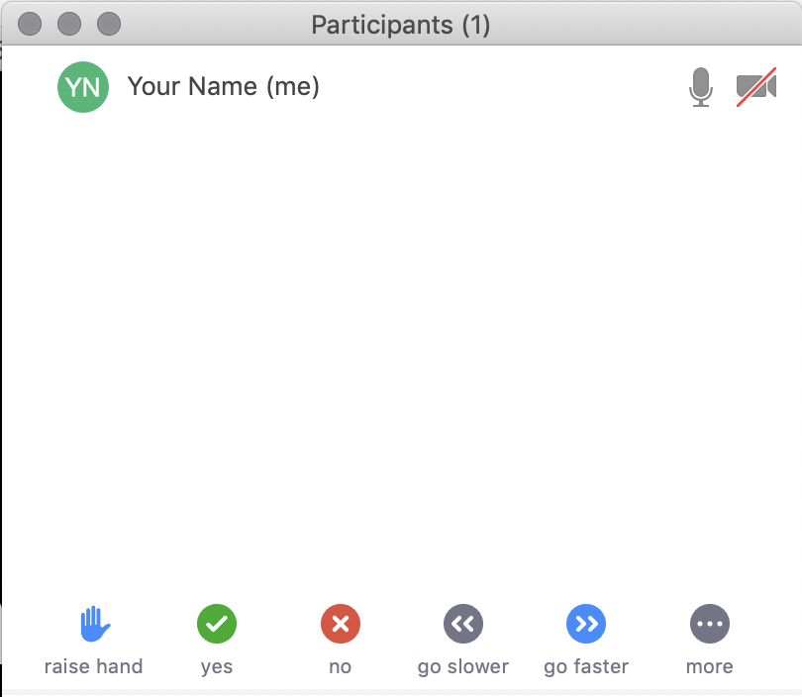
Raise your hand
Use the participants
menu tool
--or--
Type * in chat
*9 on phone
Alt+Y on keyboard

Slide 10
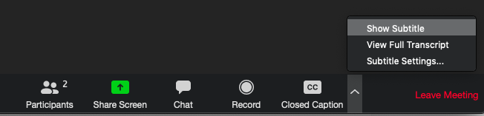
Closed Captioning
Click arrow next to “Closed Caption” and click “Show Subtitle”
Notes:
Template by Training for Change • www.trainingforchange.org
Visual guide for how to turn on closed captioning is very important when you have a live captioner in your online meeting. It is recommended to also paste in chat:
==========
Live closed captioning available. Click “Closed Caption” in the toolbar and “Show Subtitle” to view the captions. Click “Subtitle Settings…” for more options.
==========

Slide 12
Be present
Remove distractions
Get a beverage
Get note-taking materials
Center yourself

Slide 13
Welcome!
Please raise your hand and say your name, affiliation and share an occasion when you or your family struggled.
Notes:
Template by Training for Change • www.trainingforchange.org

Slide 14
Objectives of the module
Identify and use the various components of the Office of the United Nations High Commissioner for Human Rights’ Resource Package on Promoting the Rights of Persons with Disabilities through the Sustainable Development Goals
Implement tools to support policy makers to understand the situation of persons with disabilities.
Gain an understanding of the current situation in terms of how poverty and lack of access to adequate social protection impacts persons with disabilities.
Identify concrete steps that policymakers can take to guarantee adequate measures to end poverty and provide adequate social protection in the process of implementing Sustainable Development Goal 1 with a disability rights lens.
Learn how to obtain additional information to support implementation of social protection and poverty reduction measures in their context.

Slide 15
What’s in the Resource Package?
Policy Guidance
Human Rights Indicators for the Convention on the Rights of Persons with Disabilities
Data Sources Guidance
Training Materials
Videos

Slide 16
Agenda
Start time: 00:00
Disability & Ableism (if applicable)
Data Discovery Challenge
Closing time:

Slide 17
Disability and Ableism:
What did you think about disability when you were 8-12 years old?

Slide 18
Understanding Ableism and Disability

Slide 19
Understanding Ableism and Disability

Slide 20
Models of disability
Charity Model of Disability
People with impairments perceived as objects of benevolence who cannot take care of themselves.
Conditions participation to receiving “help” or charity.
Having impairments is seen as a curse or punishment.
Medical Model of Disability
People with impairments seen throughout history as persons who are sick or subjects of rehabilitation.
Reduces persons to their impairment and conditions participation to being rehabilitated or “fixed” to meet societal norms and to fit back into society.

Slide 21
Ableism
“[A] value system that considers certain typical characteristics of body and mind as essential for living a life of value. Based on strict standards of appearance, functioning and behaviour, ableist ways of thinking consider the disability experience as a misfortune that leads to suffering and disadvantage and invariably devalues human life”.
Special Rapporteur on the rights of persons with disabilities, Report on the impact of ableism in medical and scientific practice, A/HRC/43/41, 2019

Slide 22
Break! Come back at :00

Slide 23
Data discovery challenge – Consolidated results

Slide 24
Breakout Groups
Please discuss:
How was it to answer the survey for you?
What did you learn?
Share something about your own context

Slide 25
Debrief
Please share in chat or out loud a highlight from your group discussion.

Slide 26
Video SDG 1
https://www.ohchr.org/EN/Issues/Disability/Pages/SDG-CRPD-Resource.aspx

Slide 27
Wrap-up and Next Steps
(Add dates of next trainings and any follow-up information here)
(Contact information for questions)

Slide 28
Closing
Name
Name
Name
Name
Name one thing you would like to do to become more aware of ableism in your daily life.
Name
Name
Name
Name
Name
Name
Name
Template by Training for Change
Notes:
Template by Training for Change • www.trainingforchange.org

Slide 29
Resources
Resource package link
  Policy Guidance
  Human Rights Indicators
  Data Sources Guidance
  Training Materials
  Videos
(Add other relevant resources)

Slide 30
Thank you!
For further information, please contact:

