Slide 1
Policy Guidance on No Poverty – Sustainable Development Goal 1: Promoting the Rights of Persons with Disabilities through the Sustainable Development Goals A Resource Package
Online Training Module – Session 2
Presenter's name
Event or meeting title Platform, (Date)
© United Nations, 2022 – These presentation slides form part of the OHCHR Promoting the Rights of Persons with Disabilities through the Sustainable Development Goals: A Resource Package.

Slide 2
Teams tech help slides
(Templates by Training for Change)

Slide 3
Set-up
Click Unmute and Start Video to say hello
Raise your hand
Click Participants
and Chat

Slide 4
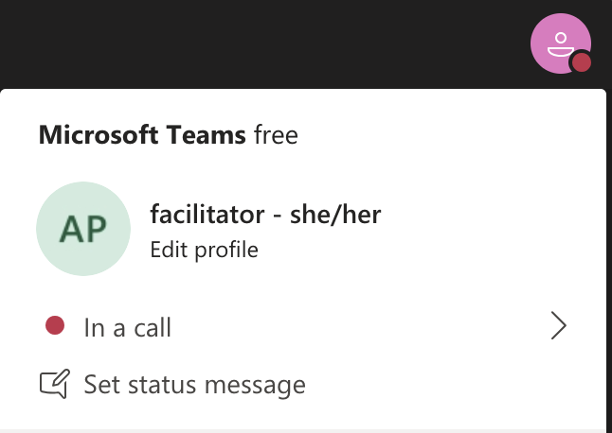
Rename yourself: Click the icon on the top right corner, click “Edit profile” to change your name and add your pronouns. Click “Set status message” to write your organization and location.

Slide 5
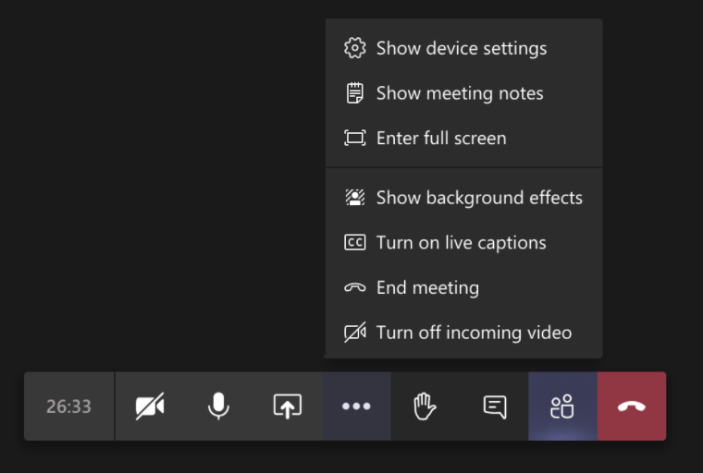
Closed Captions

Slide 6
Zoom tech help slides
(Templates by Training for Change)

Slide 7
Set-up
Click Unmute and Start Video to say hello
Click Participants
and Chat

Slide 8
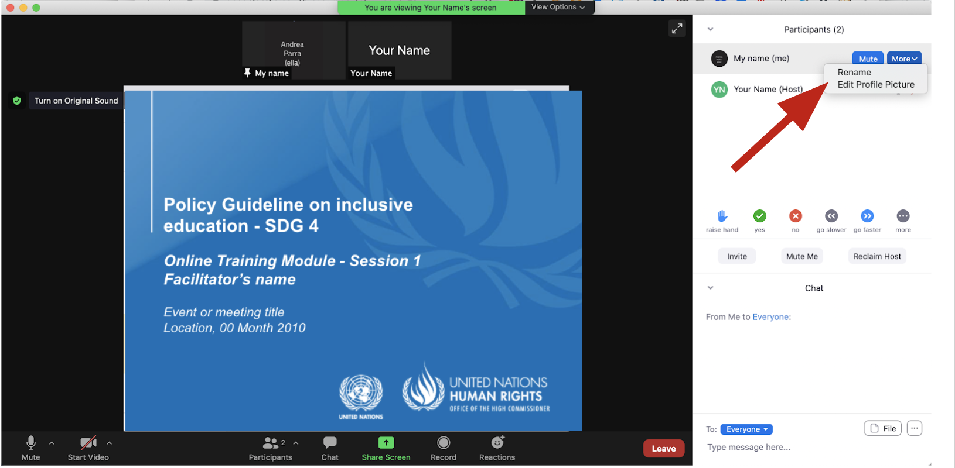
Rename yourself: Find your name at the top of the Participants list, click “More” then “Rename”. Add your pronouns & location.

Slide 9
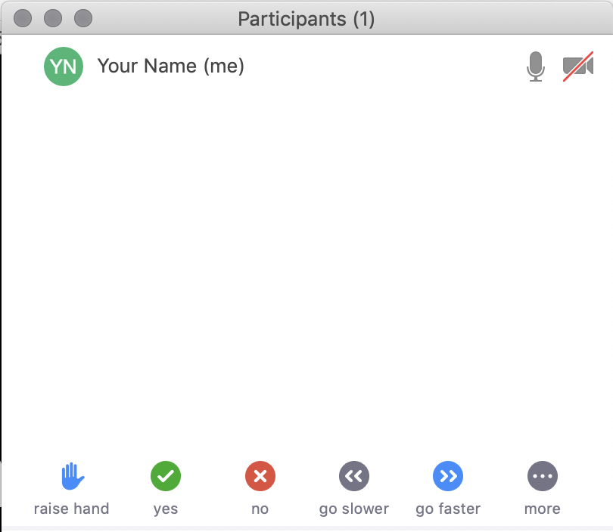
Raise your hand
Use the participants menu tool --or--
Type * in chat
*9 on phone
Alt+Y on keyboard

Slide 10
Closed Captioning
Click arrow next to “Closed Caption” and click “Show Subtitle”
Notes:
Template by Training for Change • www.trainingforchange.org
Visual guide for how to turn on closed captioning is very important when you have a live captioner in your online meeting. It is recommended to also paste in chat:
==========
Live closed captioning available. Click “Closed Caption” in the toolbar and “Show Subtitle” to view the captions. Click “Subtitle Settings…” for more options.
==========

Slide 12
Be present
Remove distractions
Get a beverage
Get note-taking materials
Center yourself

Slide 13
Welcome!
Please share in chat one thing that stuck with you from the last session.
Notes:
Template by Training for Change • www.trainingforchange.org

Slide 14
Objectives of the module
Identify and use the various components of the Office of the United Nations High Commissioner for Human Rights’ Resource Package on Promoting the Rights of Persons with Disabilities through the Sustainable Development Goals
Implement tools to support policy makers to understand the situation of persons with disabilities.
Gain an understanding of the current situation in terms of how poverty and lack of access to adequate social protection impacts persons with disabilities.
Identify concrete steps that policymakers can take to guarantee adequate measures to end poverty and provide adequate social protection in the process of implementing Sustainable Development Goal 1 with a disability rights lens.
Learn how to obtain additional information to support implementation of social protection and poverty reduction measures in their context.

Slide 15
Breakout Groups
Discuss:
Is your monthly budget enough to cover your needs? Why?
What else would you need?
When an event happens, discuss:
How would you adjust your budget?
What would you need to meet your needs?

Slide 16
Welcome back!
Please share in chat or out loud some of the highlights from your discussions.
Notes:
Template by Training for Change • www.trainingforchange.org

Slide 17
Break! Come back at :00

Slide 18
Group 1 – Aaron – Review the Do and Do not table and discuss: What are social protection schemes that could support Aaron’s increased participation in society? Write them in the slide.

Slide 19
Group 2 – Eva – Review the Do and Do not table and discuss: What are social protection schemes that could support Eva’s increased participation in society? Write them in the slide.

Slide 20
Group 3 – Benjamin – Review the Do and Do not table and discuss: What are social protection schemes that could support Benjamin’s increased participation in society? Write them in the slide.

Slide 21
Group 4 – Zhang – Review the Do and Do not table and discuss: What are social protection schemes that could support Zhang’s increased participation in society? Write them in the slide.

Slide 22
Welcome back!
Each group please share two ideas that came up in their groups.
Notes:
Template by Training for Change • www.trainingforchange.org

Slide 23
Structural elements of an inclusive social protection system
Twin-track approach
A human rights-based approach
Disability assessment and determination focus on support requirements, rather than impairment
Moving away from a focus on “incapacity to work”
Tailoring benefits to the diversity of persons with disabilities
Access to basic general services and disability-specific services to ensure full and effective participation in the community
Consultation with organizations of persons with disabilities
Awareness-raising
Finance and budget

Slide 24
Videos – Center for Inclusive Policy
Understanding disability extra costs:–
https://www.youtube.com/watch?v=W6PADO7y1JQ&t=18s
Addressing disability extra costs:
https://www.youtube.com/watch?v=BAI1oCmVGn4&t=14s

Slide 25
Videos – Center for Inclusive Policy
Reflect:
What disability extra-costs do Aaron, Eva, Benjamin and Zhang have to undertake?
From the various options shown in the videos, which would support each of the characters?

Slide 26
Breakout Groups
In your breakout groups please choose two actions that you think are possible to do in their country/region.
Then discuss how you could begin to materialize them.
Pick one action that would be difficult and discuss why.

Slide 27
Possible actions

Slide 28
Next Steps
(Add any follow-up information here such as upcoming training dates, information they will receive after the training, etc)
(Contact information for questions)
(evaluations)

Slide 29
Closing
Name
Name
Name
Name
One learning you have from this module and something you’ll do to bring it to your context.
Name
Name
Name
Name
Name
Name
Name
Template by Training for Change
Notes:
Template by Training for Change • www.trainingforchange.org

Slide 30
Resources
Resource package link
Policy Guidance
Human Rights Indicators
Data Sources Guidance
Training Materials
Videos
(Add other relevant resources)

Slide 31
Thank you! For further information, please contact:

