Slide 1
Policy Guidance on Sustainable Cities and Communities – Sustainable Development Goal 11: Promoting the Rights of Persons with Disabilities through the Sustainable Development Goals A Resource Package
Online Training Module – Session 1
Presenter's name
Event or meeting title Platform, (Date)
© United Nations, 2022 – These presentation slides form part of the OHCHR Promoting the Rights of Persons with Disabilities through the Sustainable Development Goals: A Resource Package.

Slide 2
Teams tech help slides
(Templates by Training for Change)

Slide 3
Set-up
Click Unmute and Start Video to say hello
Raise your hand
Click Participants
and Chat

Slide 4
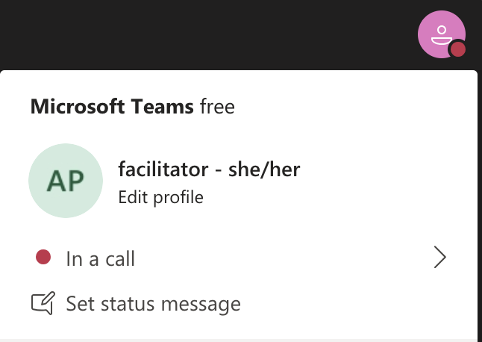
Rename yourself: Click the icon on the top right corner, click “Edit profile” to change your name and add your pronouns. Click “Set status message” to write your organization and location.

Slide 5
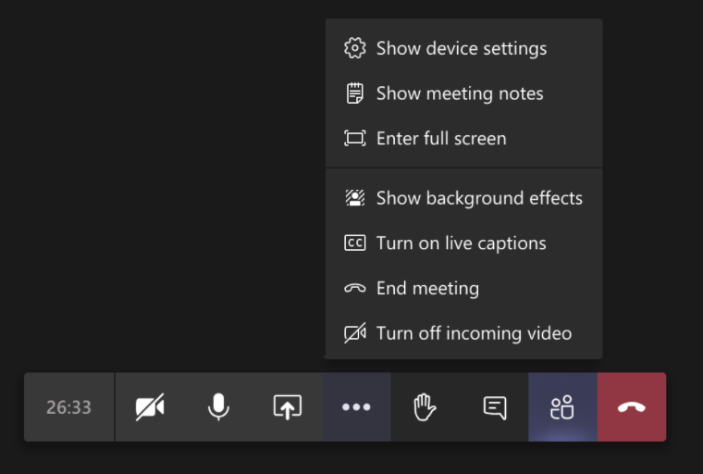
Closed Captions

Slide 6
Zoom tech help slides
(Templates by Training for Change)

Slide 7
Set-up
Click Unmute and Start Video to say hello
Click Participants
and Chat

Slide 8
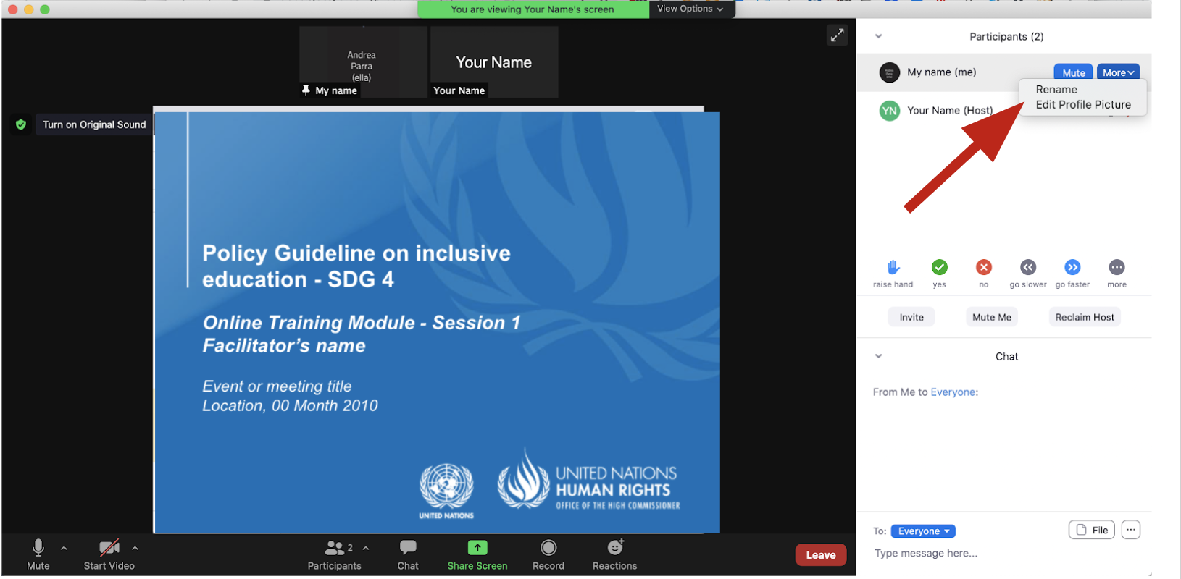
Rename yourself: Find your name at the top of the Participants list, click “More” then “Rename”. Add your pronouns & location.

Slide 9
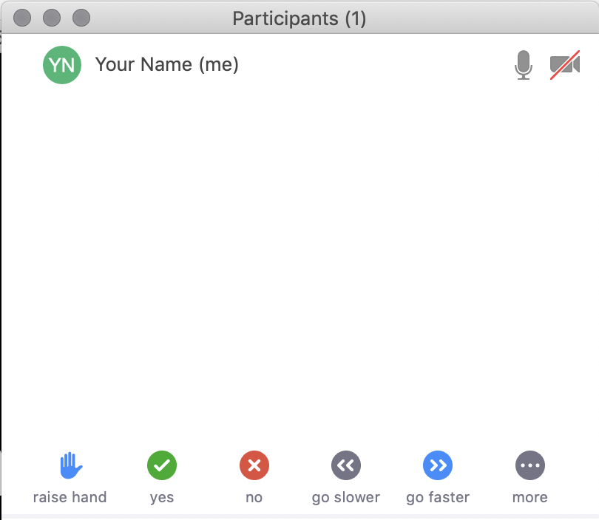
Raise your hand
Use the participants menu tool --or--
Type * in chat
*9 on phone
Alt+Y on keyboard

Slide 10
Closed Captioning
Click arrow next to “Closed Caption” and click “Show Subtitle”
Notes:
Template by Training for Change • www.trainingforchange.org
Visual guide for how to turn on closed captioning is very important when you have a live captioner in your online meeting. It is recommended to also paste in chat:
==========
Live closed captioning available. Click “Closed Caption” in the toolbar and “Show Subtitle” to view the captions. Click “Subtitle Settings…” for more options.
==========

Slide 12
Be present
Remove distractions
Get a beverage
Get note-taking materials
Center yourself

Slide 13
Welcome!
Please raise your hand and say your name, affiliation and something you really like about the place where you live.
Notes:
Template by Training for Change • www.trainingforchange.org

Slide 14
Objectives of the module
Become familiar with the various components of the Office of the United Nations High Commissioner for Human Rights’ Resource Package on Promoting the Rights of Persons with Disabilities through the Sustainable Development Goals.
Gain an understanding of the current situation in terms of the barriers persons with disabilities face in cities and urban settlements.
Identify concrete steps that policymakers can take to guarantee inclusive cities and communities in the process of implementing Sustainable Development Goal 11 with a disability rights lens.
Obtain additional information to support the implementation of measures to ensure inclusive cities and communities in their own context.

Slide 15
What’s in the Resource Package?
Policy Guidance
Human Rights Indicators for the Convention on the Rights of Persons with Disabilities
Data Sources Guidance
Training Materials
Videos

Slide 16
Agenda
Start time: 00:00
Disability & Ableism (if applicable)
Creating Our Cities
Closing time:

Slide 17
Disability and Ableism:
What did you think about disability when you were 8-12 years old?

Slide 18
Understanding Ableism and Disability

Slide 19
Understanding Ableism and Disability

Slide 20
Models of disability
Charity Model of Disability
People with impairments perceived as objects of benevolence who cannot take care of themselves.
Conditions participation to receiving “help” or charity.
Having impairments is seen as a curse or punishment.
Medical Model of Disability
People with impairments seen throughout history as persons who are sick or subjects of rehabilitation.
Reduces persons to their impairment and conditions participation to being rehabilitated or “fixed” to meet societal norms and to fit back into society.

Slide 21
Ableism
“[A] value system that considers certain typical characteristics of body and mind as essential for living a life of value. Based on strict standards of appearance, functioning and behaviour, ableist ways of thinking consider the disability experience as a misfortune that leads to suffering and disadvantage and invariably devalues human life”.
Special Rapporteur on the rights of persons with disabilities, Report on the impact of ableism in medical and scientific practice, A/HRC/43/41, 2019

Slide 22
DATA DISCOVERY CHALLENGE RESULTS

Slide 23
In trios, discuss:
How was it to answer the survey for you, what did you learn and share something about your own context.

Slide 24
Break! Come back at :00

Slide 25
Group 1 – What does the ideal accessible city looks like?
Create a collage on this slide from images you find on the internet and that represent the elements that an ideally accessible city would have. Copy and paste the images on the slide.

Slide 26
Group 2 – What does the ideal accessible city looks like?
Create a collage on this slide from images you find on the internet and that represent the elements that an ideally accessible city would have. Copy and paste the images on the slide.

Slide 27
Group 3 – What does the ideal accessible city looks like?
Create a collage on this slide from images you find on the internet and that represent the elements that an ideally accessible city would have. Copy and paste the images on the slide.

Slide 28
Group 4 – What does the ideal accessible city looks like?
Create a collage on this slide from images you find on the internet and that represent the elements that an ideally accessible city would have. Copy and paste the images on the slide.

Slide 29
Group 5 – What does the ideal accessible city looks like?
Create a collage on this slide from images you find on the internet and that represent the elements that an ideally accessible city would have. Copy and paste the images on the slide.

Slide 30
Group 6 – What does the ideal accessible city looks like?
Create a collage on this slide from images you find on the internet and that represent the elements that an ideally accessible city would have. Copy and paste the images on the slide.

Slide 31
Welcome back!
Please now visit the creations of the other groups.

Slide 32
Debrief
How was it to create your ideal city?
What did you include or think about?
What makes it ideal?

Slide 33
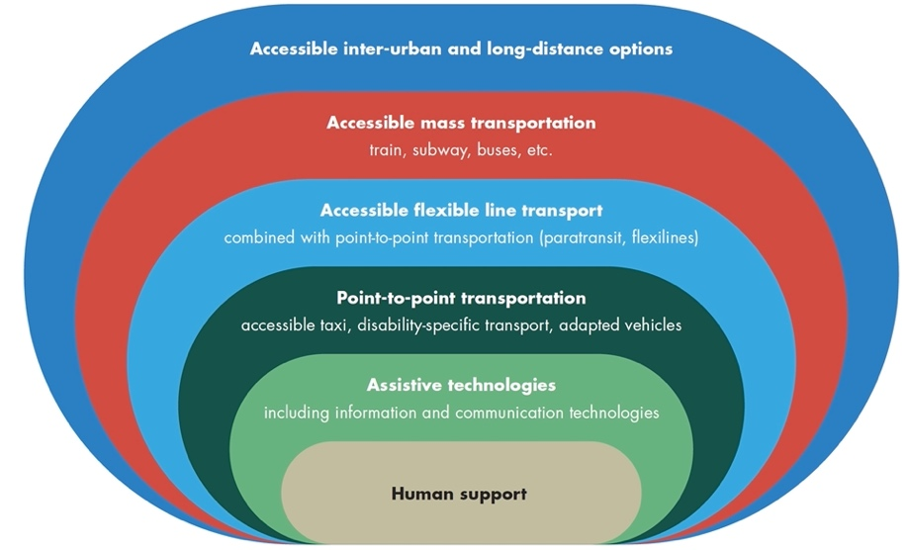
The progression of supports

Slide 34
Wrap-up and Next Steps
Before the next session, please make a list of the ways in which your current city is accessible or inaccessible for persons with disabilities.
Before the next session, please watch the video on SDG 11 of the resource package
(Information about session 2)
(Any follow-up information)
(Evaluation)

Slide 35
Closing
Name
Name
Name
Name
Name
Name one question you have after today’s session.
Name
Name
Name
Name
Name
Name
Template by Training for Change
Notes:
Template by Training for Change • www.trainingforchange.org

Slide 36
Resources
Resource package link
Policy Guidance
Human Rights Indicators
Data Sources Guidance
Training Materials
Videos
(Add other relevant resources)

Slide 37
Thank you! For further information, please contact:

