Slide 1
Policy Guidance on Sustainable Cities and Communities – Sustainable Development Goal 11: Promoting the Rights of Persons with Disabilities through the Sustainable Development Goals
A Resource Package
Online Training Module – Session 2
Presenter's name
Event or meeting title
Platform, (Date)
© United Nations, 2022 – These presentation slides form part of the OHCHR Promoting the Rights of Persons with Disabilities through the Sustainable Development Goals: A Resource Package.

Slide 2
Teams tech help slides
(Templates by Training for Change)

Slide 3
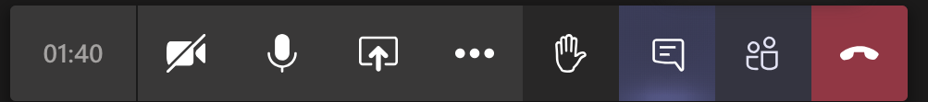
Set-up
Click Unmute and Start Video to say hello
Raise your hand
Click Participants
and Chat

Slide 4
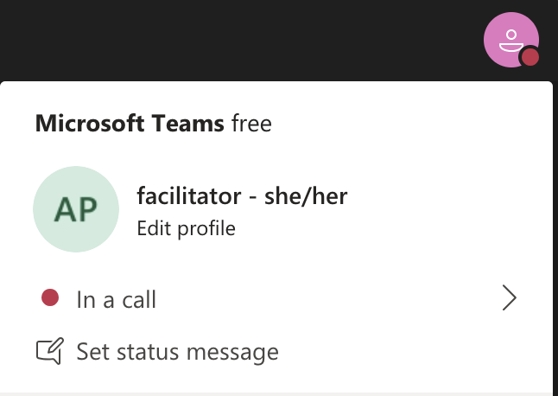
Rename yourself: Click the icon on the top right corner, click “Edit profile” to change your name and add your pronouns. Click “Set status message” to write your organization and location.

Slide 5
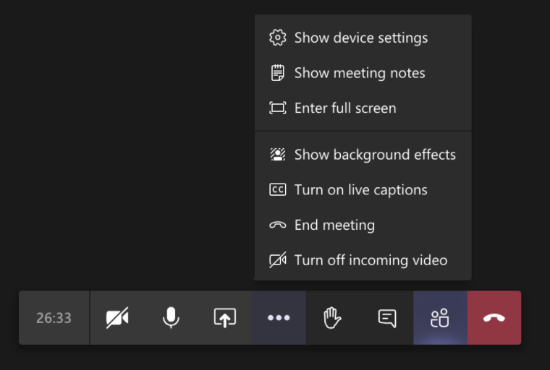
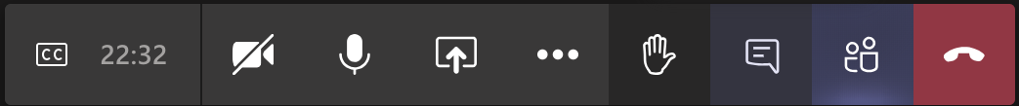
Closed Captions

Slide 6
Zoom tech help slides
(Templates by Training for Change)

Slide 7
Set-up
Click Unmute and Start Video to say hello
Click Participants
and Chat

Slide 8
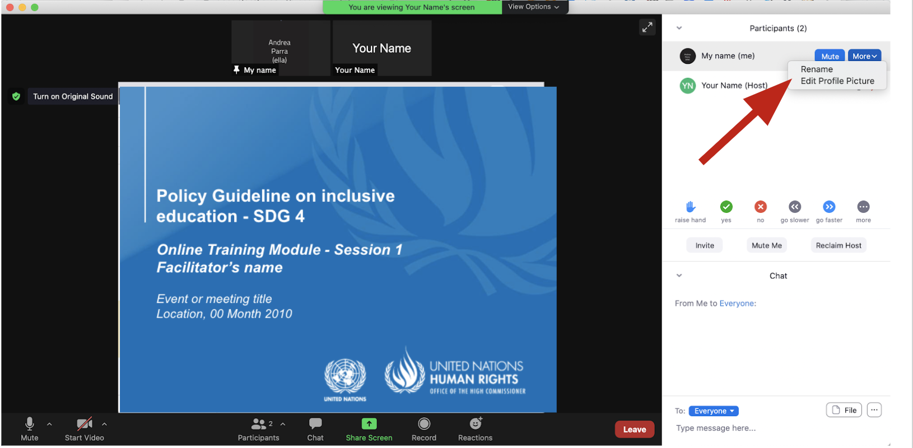
Rename yourself: Find your name at the top of the Participants list, click “More” then “Rename”. Add your pronouns & location.

Slide 9
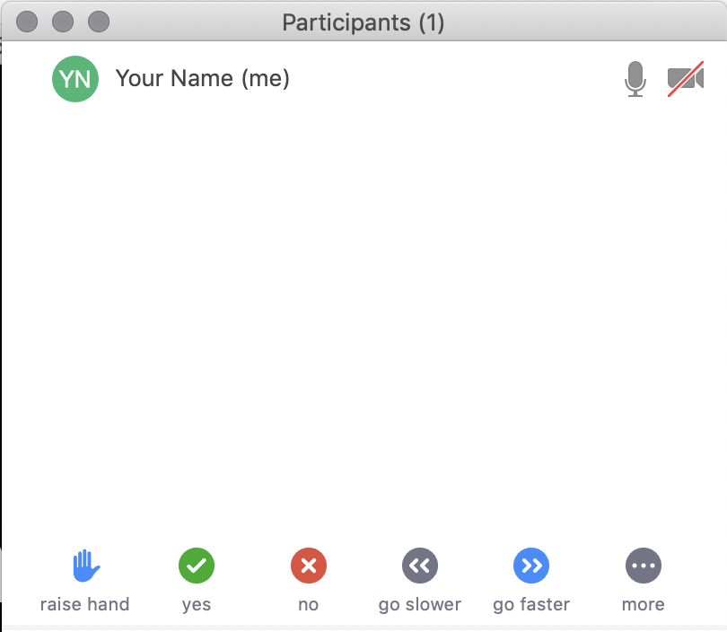
Raise your hand
Use the participants
menu tool
--or--
Type * in chat
*9 on phone
Alt+Y on keyboard

Slide 10
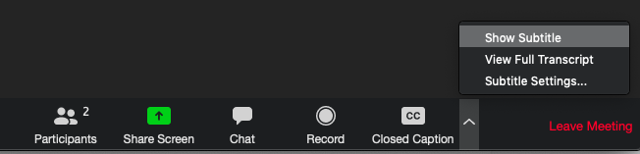
Closed Captioning
Click arrow next to “Closed Caption” and click “Show Subtitle”
Notes:
Template by Training for Change • www.trainingforchange.org
Visual guide for how to turn on closed captioning is very important when you have a live captioner in your online meeting. It is recommended to also paste in chat:
==========
Live closed captioning available. Click “Closed Caption” in the toolbar and “Show Subtitle” to view the captions. Click “Subtitle Settings…” for more options.
==========

Slide 12
Be present
Remove distractions
Get a beverage
Get note-taking materials
Center yourself

Slide 13
Welcome!
Please share in chat one thing that stuck with you from last session.
Notes:
Template by Training for Change • www.trainingforchange.org

Slide 14
Objectives of the module
Become familiar with the various components of the Office of the United Nations High Commissioner for Human Rights’ Resource Package on Promoting the Rights of Persons with Disabilities through the Sustainable Development Goals.
Gain an understanding of the current situation in terms of the barriers persons with disabilities face in cities and urban settlements.
Identify concrete steps that policymakers can take to guarantee inclusive cities and communities in the process of implementing Sustainable Development Goal 11 with a disability rights lens.
Obtain additional information to support the implementation of measures to ensure inclusive cities and communities in their own context.

Slide 15
Short Video
As you watch and listen, pay attention to the different stories highlighted and the issues shared and proposed.
Please share in chat any reactions to the video.

Slide 16
What are some ways in which your current cities or towns are accessible or inaccessible for people with disabilities?
Accessible
Inaccessible

Slide 17
Breakout groups
Each group has a character assigned
Review the handout: A day in the life of…
Discuss the questions about their situation

Slide 18
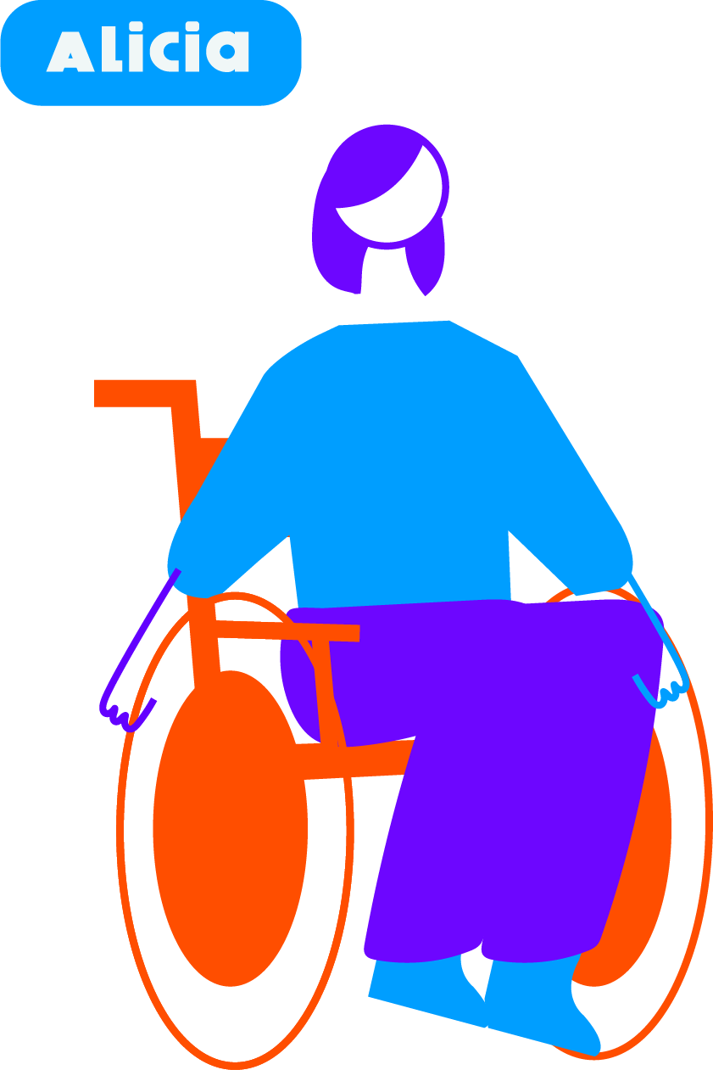
Group 1 – Alicia Discuss: What are Alicia’s needs? Is your city accessible or inaccessible to her? What’s needed to improve her situation in terms of accessibility and urban planning?

Slide 19
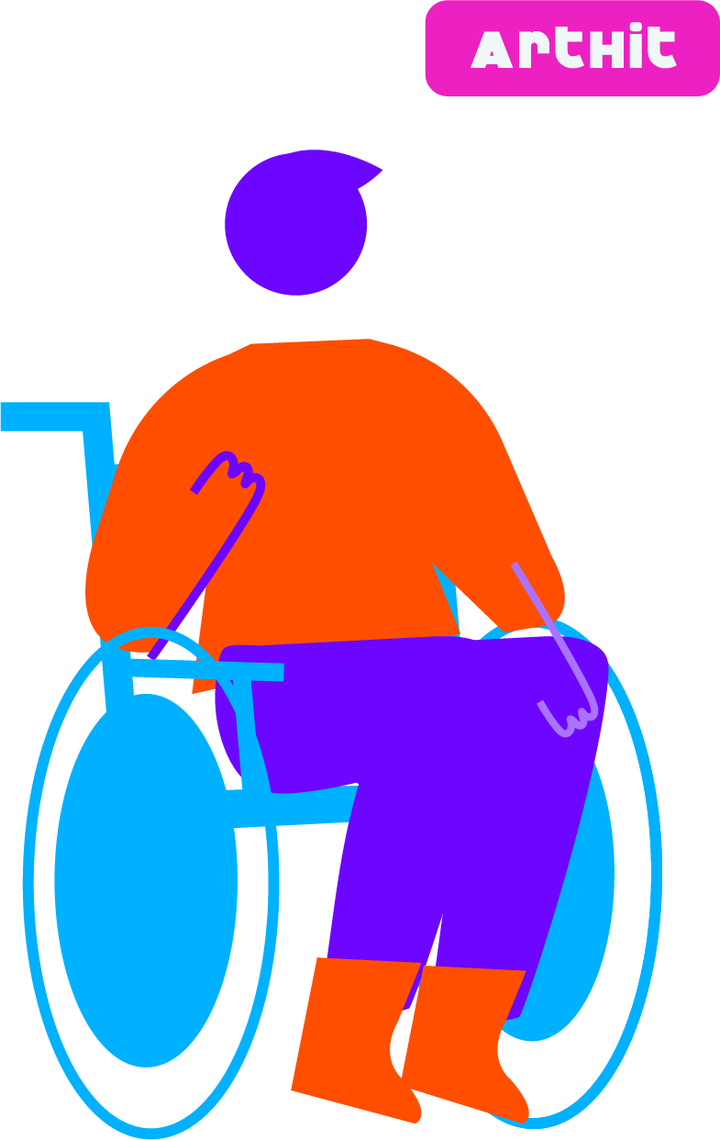
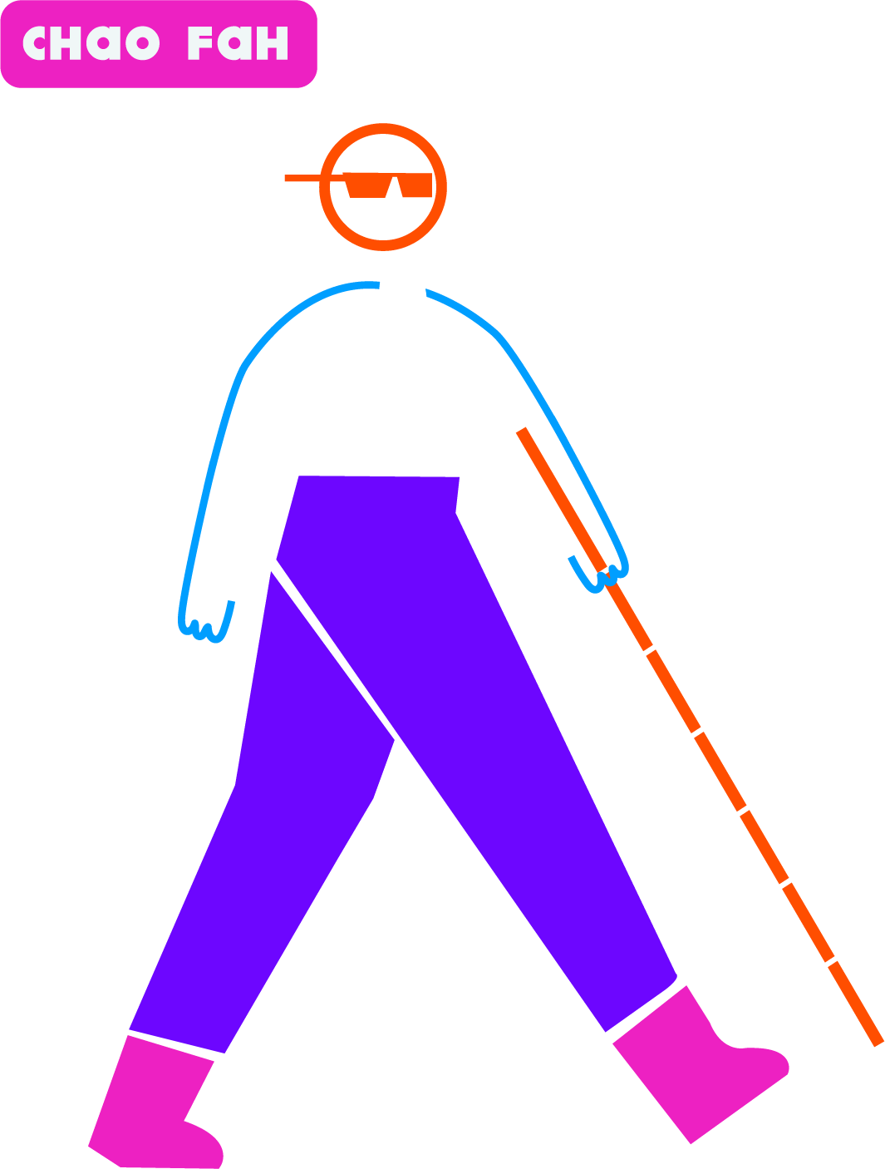
Group 2 – Chao Fah & Artit Discuss: What are Chao Fah & Arthit’s needs? Is your city accessible or inaccessible to them? What’s needed to improve their situation in terms of accessibility and urban planning?

Slide 20
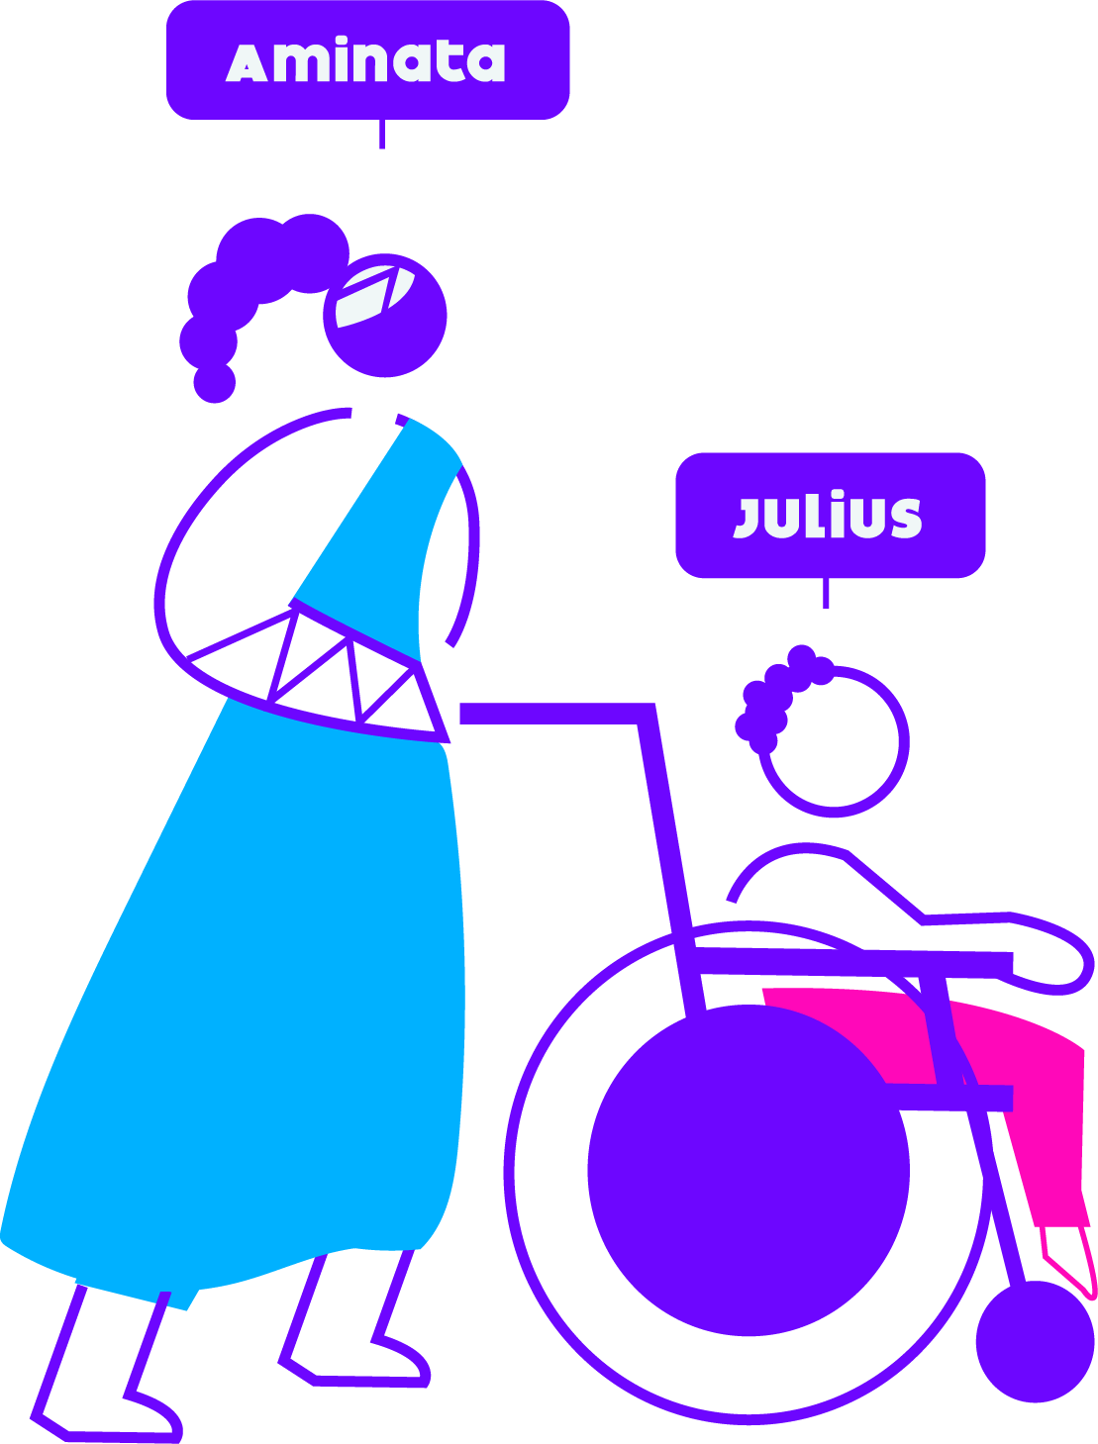
Group 3 – Aminata & Julius Discuss: What are Aminata & Julius’ needs? Is your city accessible or inaccessible to them? What’s needed to improve their situation in terms of accessibility and urban planning?

Slide 21
Group 4 – Alicia Discuss: What are Alicia’s needs? Is your city accessible or inaccessible to her? What’s needed to improve her situation in terms of accessibility and urban planning?

Slide 22
Group 5 – Chao Fah & Artit Discuss: What are Chao Fah & Arthit’s needs? Is your city accessible or inaccessible to them? What’s needed to improve their situation in terms of accessibility and urban planning?

Slide 23
Group 6 – Aminata & Julius Discuss: What are Aminata & Julius’ needs? Is your city accessible or inaccessible to them? What’s needed to improve their situation in terms of accessibility and urban planning?

Slide 24
Welcome back!
Please share in chat or out loud some of the insights you had in this activity

Slide 25
Break! Come back at :00

Slide 26
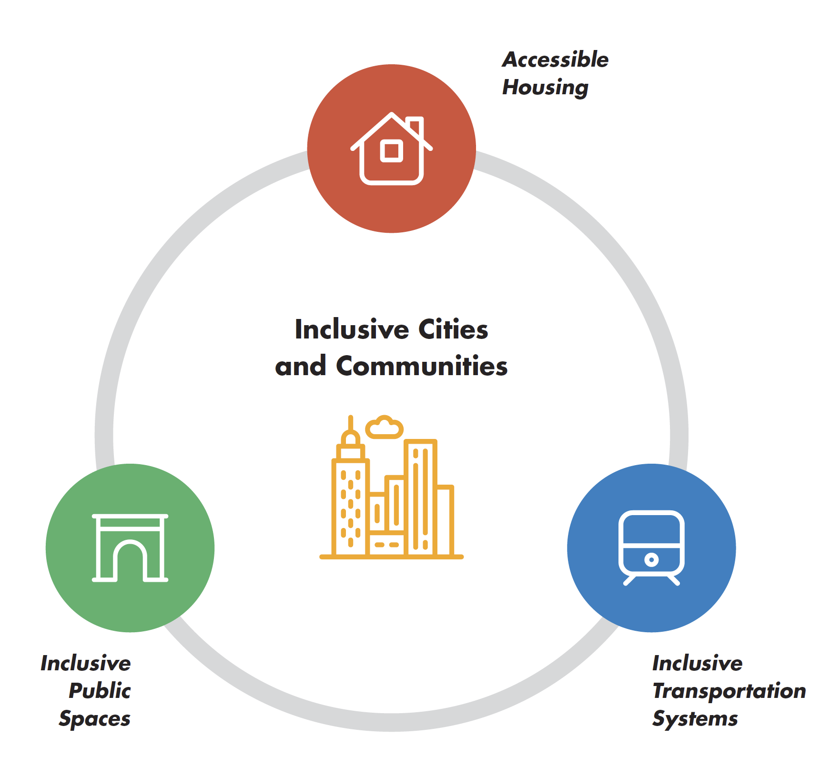
Implementation Challenge: What do our cities need?

Slide 27
Group 1 – What actions could ensure inclusive cities under each category? After listing the actions pick one or two and discuss what would it take to implement it in your contexts.
Accessible housing
Accessible transportation
Accessible public spaces

Slide 28
Group 2 – What actions could ensure inclusive cities under each category? After listing the actions pick one or two and discuss what would it take to implement it in your contexts.
Accessible housing
Accessible transportation
Accessible public spaces

Slide 29
Group 3 – What actions could ensure inclusive cities under each category? After listing the actions pick one or two and discuss what would it take to implement it in your contexts.
Accessible housing
Accessible transportation
Accessible public spaces

Slide 30
Group 4 – What actions could ensure inclusive cities under each category? After listing the actions pick one or two and discuss what would it take to implement it in your contexts.
Accessible housing
Accessible transportation
Accessible public spaces

Slide 31
Group 5 – What actions could ensure inclusive cities under each category? After listing the actions pick one or two and discuss what would it take to implement it in your contexts.
Accessible housing
Accessible transportation
Accessible public spaces

Slide 32
Group 6 – What actions could ensure inclusive cities under each category? After listing the actions pick one or two and discuss what would it take to implement it in your contexts.
Accessible housing
Accessible transportation
Accessible public spaces

Slide 33
Welcome back!
Please share in chat or out loud what are some ideas you came up in your groups about how to implement actions to ensure inclusive cities.

Slide 34
Closing
Name
Name
Name
One commitment you are making to make your cities and communities for inclusive? Who in your context can hold you accountable to it?
Name
Name
Name
Name
Name
Name
Name
Name
Template by Training for Change
Notes:
Template by Training for Change • www.trainingforchange.org

Slide 35
Resources
Resource package link
  Policy Guidance
  Human Rights Indicators
  Data Sources Guidance
  Training Materials
  Videos
(Add other relevant resources)

Slide 36
Thank you!
For further information, please contact:

