Slide 1
Policy Guidance on Good Health – Sustainable Development Goal 3: Promoting the Rights of Persons with Disabilities through the Sustainable Development Goals A Resource Package
Online Training Module – Session 2
Presenter's name
Event or meeting title Platform, (Date)
© United Nations, 2022 – These presentation slides form part of the OHCHR Promoting the Rights of Persons with Disabilities through the Sustainable Development Goals: A Resource Package.

Slide 2
Teams tech help slides
(Templates by Training for Change)

Slide 3
Set-up
Click Unmute and Start Video to say hello
Raise your hand
Click Participants
and Chat

Slide 4
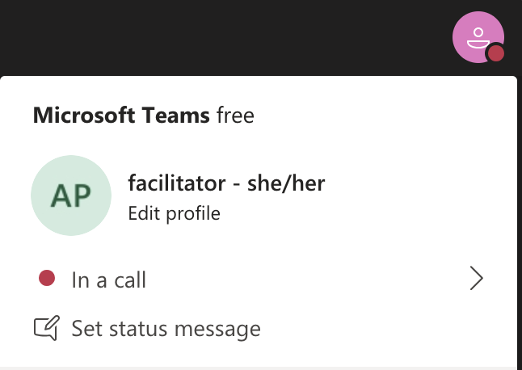
Rename yourself: Click the icon on the top right corner, click “Edit profile” to change your name and add your pronouns. Click “Set status message” to write your organization and location.

Slide 5
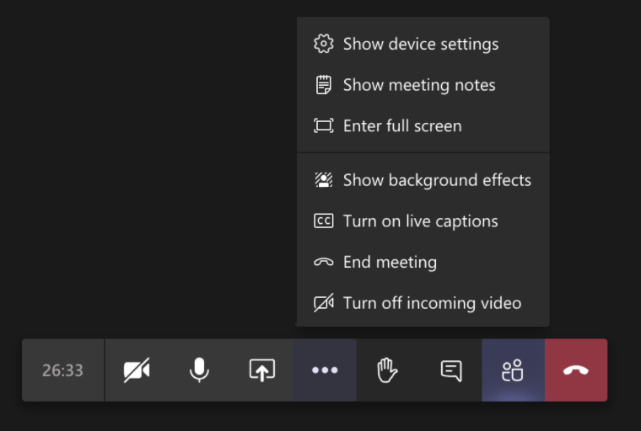
Closed Captions

Slide 6
Zoom tech help slides
(Templates by Training for Change)

Slide 7
Set-up
Click Unmute and Start Video to say hello
Click Participants
and Chat

Slide 8
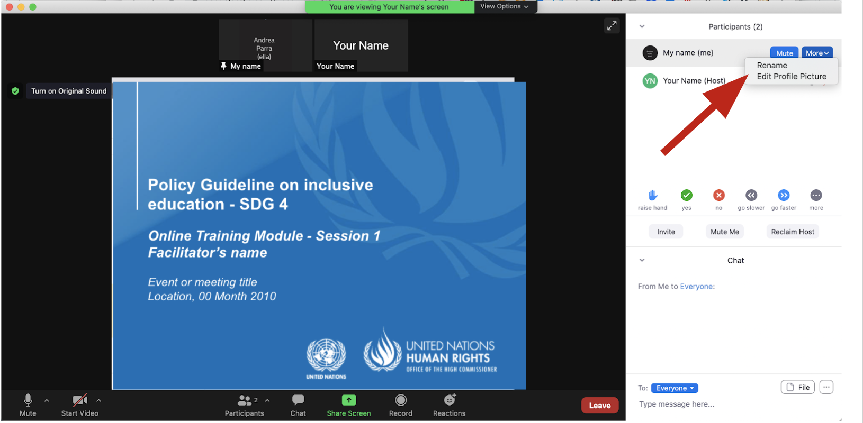
Rename yourself: Find your name at the top of the Participants list, click “More” then “Rename”. Add your pronouns & location.

Slide 9
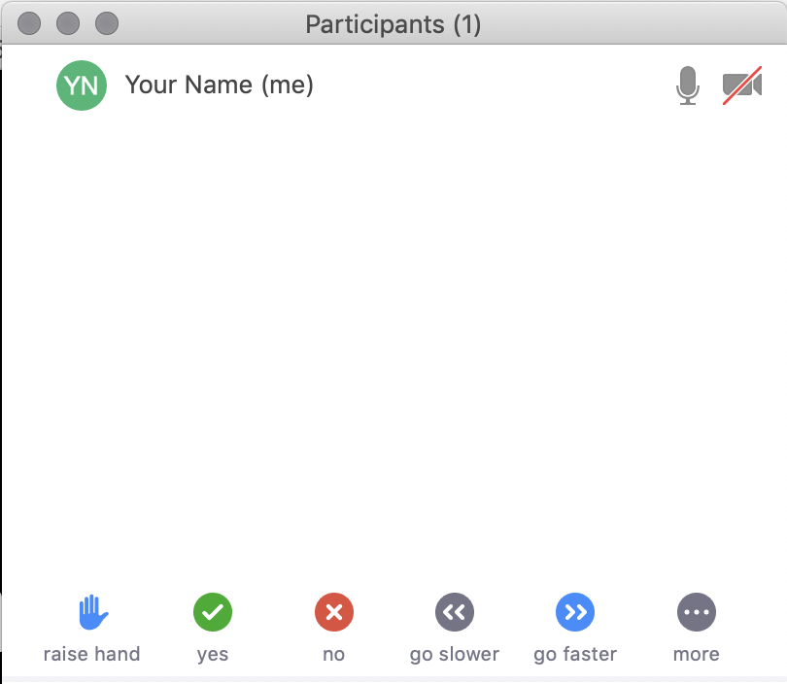
Raise your hand
Use the participants menu tool --or--
Type * in chat
*9 on phone
Alt+Y on keyboard

Slide 10
Closed Captioning
Click arrow next to “Closed Caption” and click “Show Subtitle”
Notes:
Template by Training for Change • www.trainingforchange.org
Visual guide for how to turn on closed captioning is very important when you have a live captioner in your online meeting. It is recommended to also paste in chat:
==========
Live closed captioning available. Click “Closed Caption” in the toolbar and “Show Subtitle” to view the captions. Click “Subtitle Settings…” for more options.
==========

Slide 12
Be present
Remove distractions
Get a beverage
Get note-taking materials
Center yourself

Slide 13
Welcome!
Please raise your hand and say your name, affiliation and share an occasion when you or your family struggled.
Notes:
Template by Training for Change • www.trainingforchange.org

Slide 14
Objectives of the module
Become familiar with the Office of the United Nations High Commissioner for Human Rights’ Resource Package on Promoting the Rights of Persons with Disabilities through the Sustainable Development Goals
Gain an understanding of the current situation in terms of access to health for people with disabilities.
Identify concrete steps that policymakers can take to guarantee inclusive health care services in the process of implementing Sustainable Development Goal 3 with a disability-rights lens.
Learn how to obtain additional information to support implementation of access to health in your own context.

Slide 15
Short video
In the next activities we will go deeper into the information shared in this video. As you watch/listen pay attention to the different stories highlighted and the issues shared and proposed.
Please share in chat any reactions to the video.

Slide 16
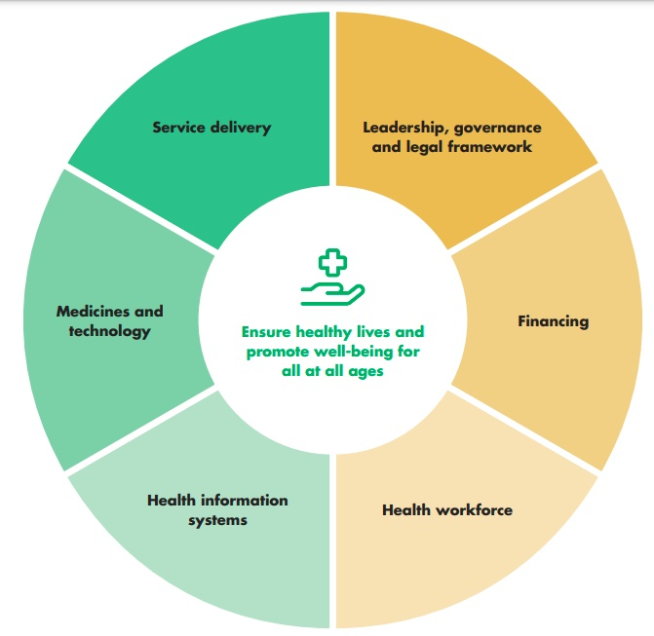
Implementation Challenge – Setup

Slide 17
Implementation Challenge – Part 1: Actions
In small groups come up with actions to advance the health and well-being of the character assigned to you under each of the stations categories. You will have 10 minutes at each station assigned.

Slide 18
Station 1: Health Information Systems
SAMUEL
AKARI
AMARA
IAN

Slide 19
Station 2: Medicines and technology
SAMUEL
AKARI
AMARA
IAN

Slide 20
Station 3: Health Workforce
SAMUEL
AKARI
AMARA
IAN

Slide 21
Station 4: Service Delivery
SAMUEL
AKARI
AMARA
IAN

Slide 22
Station 5: Financing
SAMUEL
AKARI
AMARA
IAN

Slide 23
Station 6: Leadership, Governance and Legal Framework
SAMUEL
AKARI
AMARA
IAN

Slide 24
Break! Come back at :00

Slide 25
Implementation Challenge: Actions
Group 1
Group 4
Group 2
Group 5
Group 3
Group 6

Slide 26
Implementation Challenge Debrief – Journal:
How does this relate to your own context?

Slide 27
Closing
Name
Name
Name
Name
Name one commitment you are making to advance health policies in your country in benefit of persons with disabilities. Who in your specific context can hold you accountable for it?
Name
Name
Name
Name
Name
Name
Name
Template by Training for Change
Notes:
Template by Training for Change • www.trainingforchange.org

Slide 28
Resources
Resource package link
Policy Guidance
Human Rights Indicators
Data Sources Guidance
Training Materials
Videos
(Add other relevant resources)

Slide 29
Thank you! For further information, please contact:

