Slide 1
Policy Guidance on Quality Education – Sustainable Development Goal 4: Promoting the Rights of Persons with Disabilities through the Sustainable Development Goals
A Resource Package
Online Training Module – Session 1
Presenter's name
Event or meeting title
Platform, (Date)
© United Nations, 2022 – These presentation slides form part of the OHCHR Promoting the Rights of Persons with Disabilities through the Sustainable Development Goals: A Resource Package.

Slide 2
Teams tech help slides
(Templates by Training for Change)

Slide 3
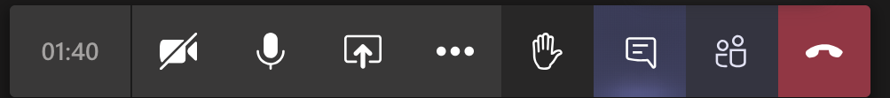
Set-up
Click Unmute and Start Video to say hello
Raise your hand
Click Participants
and Chat

Slide 4
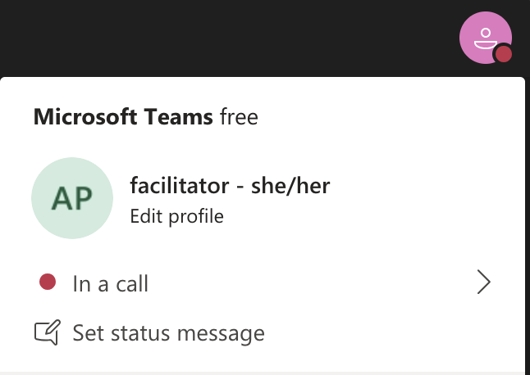
Rename yourself: Click the icon on the top right corner, click “Edit profile” to change your name and add your pronouns. Click “Set status message” to write your organization and location.

Slide 5
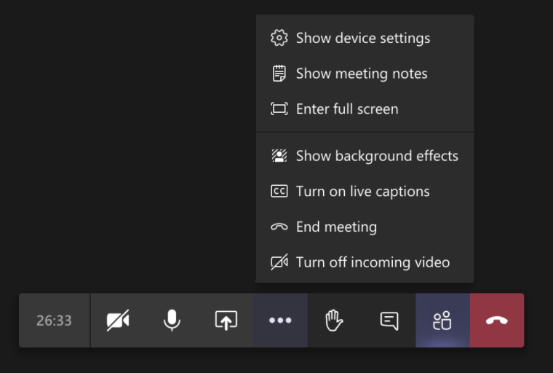
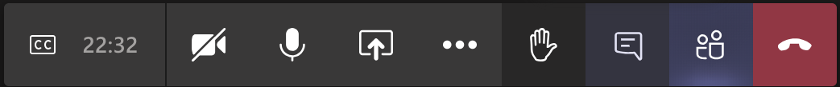
Closed Captions

Slide 6
Zoom tech help slides
(Templates by Training for Change)

Slide 7
Set-up
Click Unmute and Start Video to say hello
Click Participants
and Chat

Slide 8
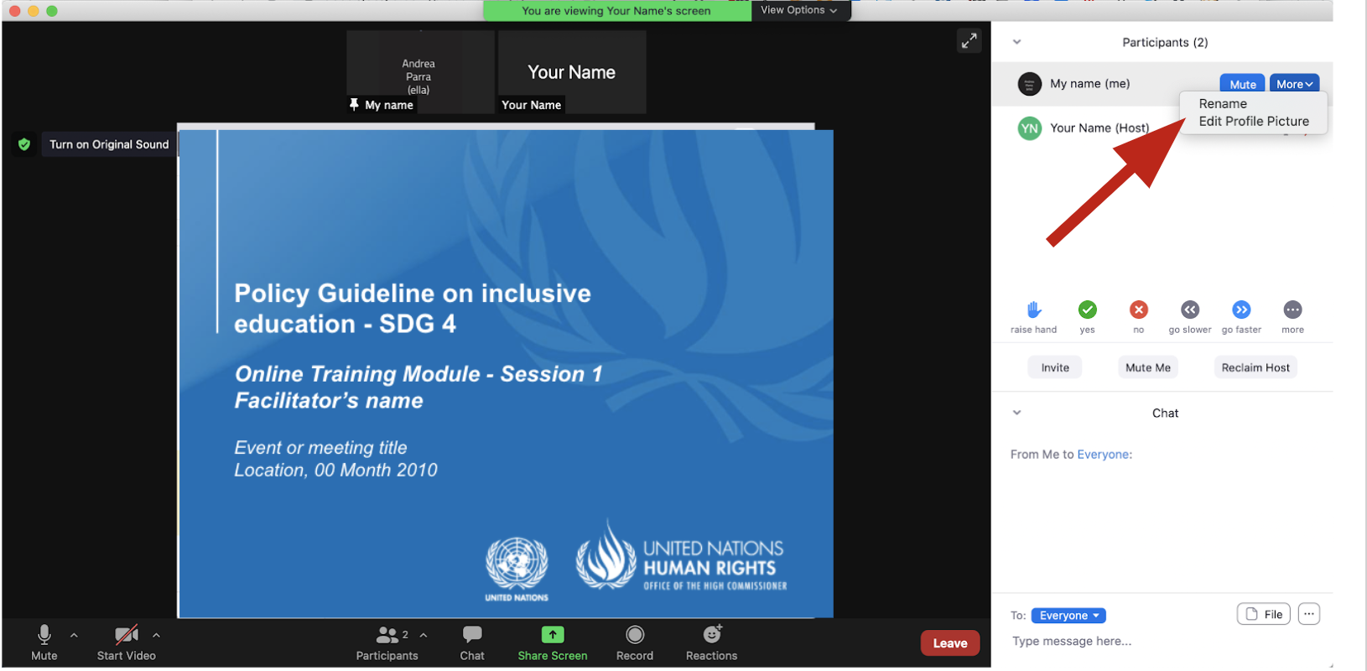
Rename yourself: Find your name at the top of the Participants list, click “More” then “Rename”. Add your pronouns & location.

Slide 9
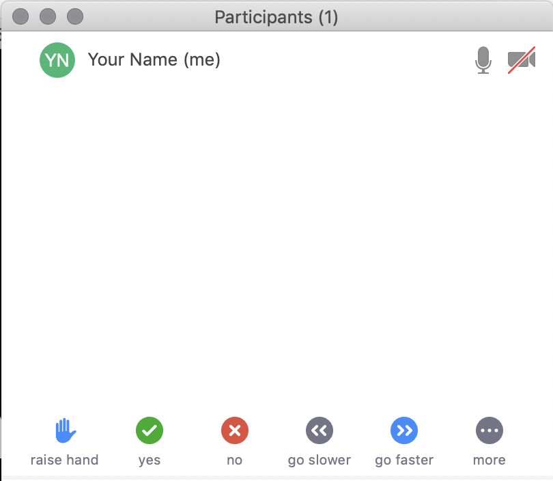
Raise your hand
Use the participants
menu tool
--or--
Type * in chat
*9 on phone
Alt+Y on keyboard

Slide 10
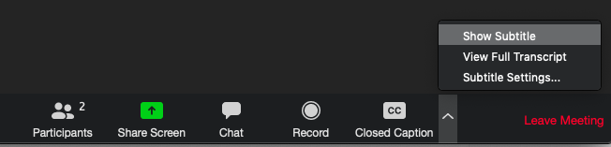
Closed Captioning
Click arrow next to “Closed Caption” and click “Show Subtitle”
Notes:
Template by Training for Change • www.trainingforchange.org
Visual guide for how to turn on closed captioning is very important when you have a live captioner in your online meeting. It is recommended to also paste in chat:
==========
Live closed captioning available. Click “Closed Caption” in the toolbar and “Show Subtitle” to view the captions. Click “Subtitle Settings…” for more options.
==========

Slide 12
Be present
Remove distractions
Get a beverage
Get note-taking materials
Center yourself

Slide 13
Welcome!
Please raise your hand and one thing that motivates you to do the work you do.
Notes:
Template by Training for Change • www.trainingforchange.org

Slide 14
Objectives of the module
Learn about the various components of the Office of the United Nations High Commissioner for Human Rights’ Resource Package on Promoting the Rights of Persons with Disabilities through the Sustainable Development Goals
Better understand the current situation in terms of access to the various levels of education for persons with disabilities
Identify concrete steps that policymakers can take to guarantee inclusive education in the process of implementing Sustainable Development Goal 4 with a disability rights lens.
Learn how to obtain additional information for implementation of inclusive education in their context.

Slide 15
What’s in the Resource Package?
Policy Guidance
Human Rights Indicators for the Convention on the Rights of Persons with Disabilities
Data Sources Guidance
Training Materials
Videos

Slide 16
Agenda
Start time: 00:00
Disability & Ableism (if applicable)
Our own experiences with schooling
Data contest!
Closing time:

Slide 17
Disability and Ableism:
What did you think about disability when you were 8-12 years old?

Slide 18
Understanding Ableism and Disability

Slide 19
Understanding Ableism and Disability

Slide 20
Models of disability
Charity Model of Disability
People with impairments perceived as objects of benevolence who cannot take care of themselves.
Conditions participation to receiving “help” or charity.
Having impairments is seen as a curse or punishment.
Medical Model of Disability
People with impairments seen throughout history as persons who are sick or subjects of rehabilitation.
Reduces persons to their impairment and conditions participation to being rehabilitated or “fixed” to meet societal norms and to fit back into society.

Slide 21
Ableism
“[A] value system that considers certain typical characteristics of body and mind as essential for living a life of value. Based on strict standards of appearance, functioning and behaviour, ableist ways of thinking consider the disability experience as a misfortune that leads to suffering and disadvantage and invariably devalues human life”.
Special Rapporteur on the rights of persons with disabilities, Report on the impact of ableism in medical and scientific practice, A/HRC/43/41, 2019

Slide 22
What memories do you have from when you attended this level?

Slide 23
Memories of Schooling – Elementary

Slide 24
Memories of Schooling – Secondary

Slide 25
Memories of Schooling – Technical and Vocational

Slide 26
Memories of Schooling – Higher education

Slide 27
Break! Come back at :00

Slide 28
Discuss:
Something you learned or that surprised you in this activity.

Slide 29
Short video
As you watch and listen, pay attention to the different students highlighted and the issues shared and proposed.
Please share in chat any reactions to the video.

Slide 30
Inclusive Education:
“The result of a process of continuing and proactive commitment to eliminating barriers impeding the right to education, together with changes to culture, policy and practice of regular schools to accommodate and effectively include all students (…) Inclusion involves a process of systemic reform embodying changes and modifications in content, teaching methods, approaches, structures and strategies in education to overcome barriers with a vision serving to provide all students of the relevant age range with an equitable and participatory learning experience and the environment that best corresponds to their requirements and preferences.”
Source: United Nations, Committee on the Rights of Persons with Disabilities. General comment No.4 (2016) Article 24: Right to Inclusive Education. 2 September 2016. CRPD/C/GC/4. para. 11

Slide 31
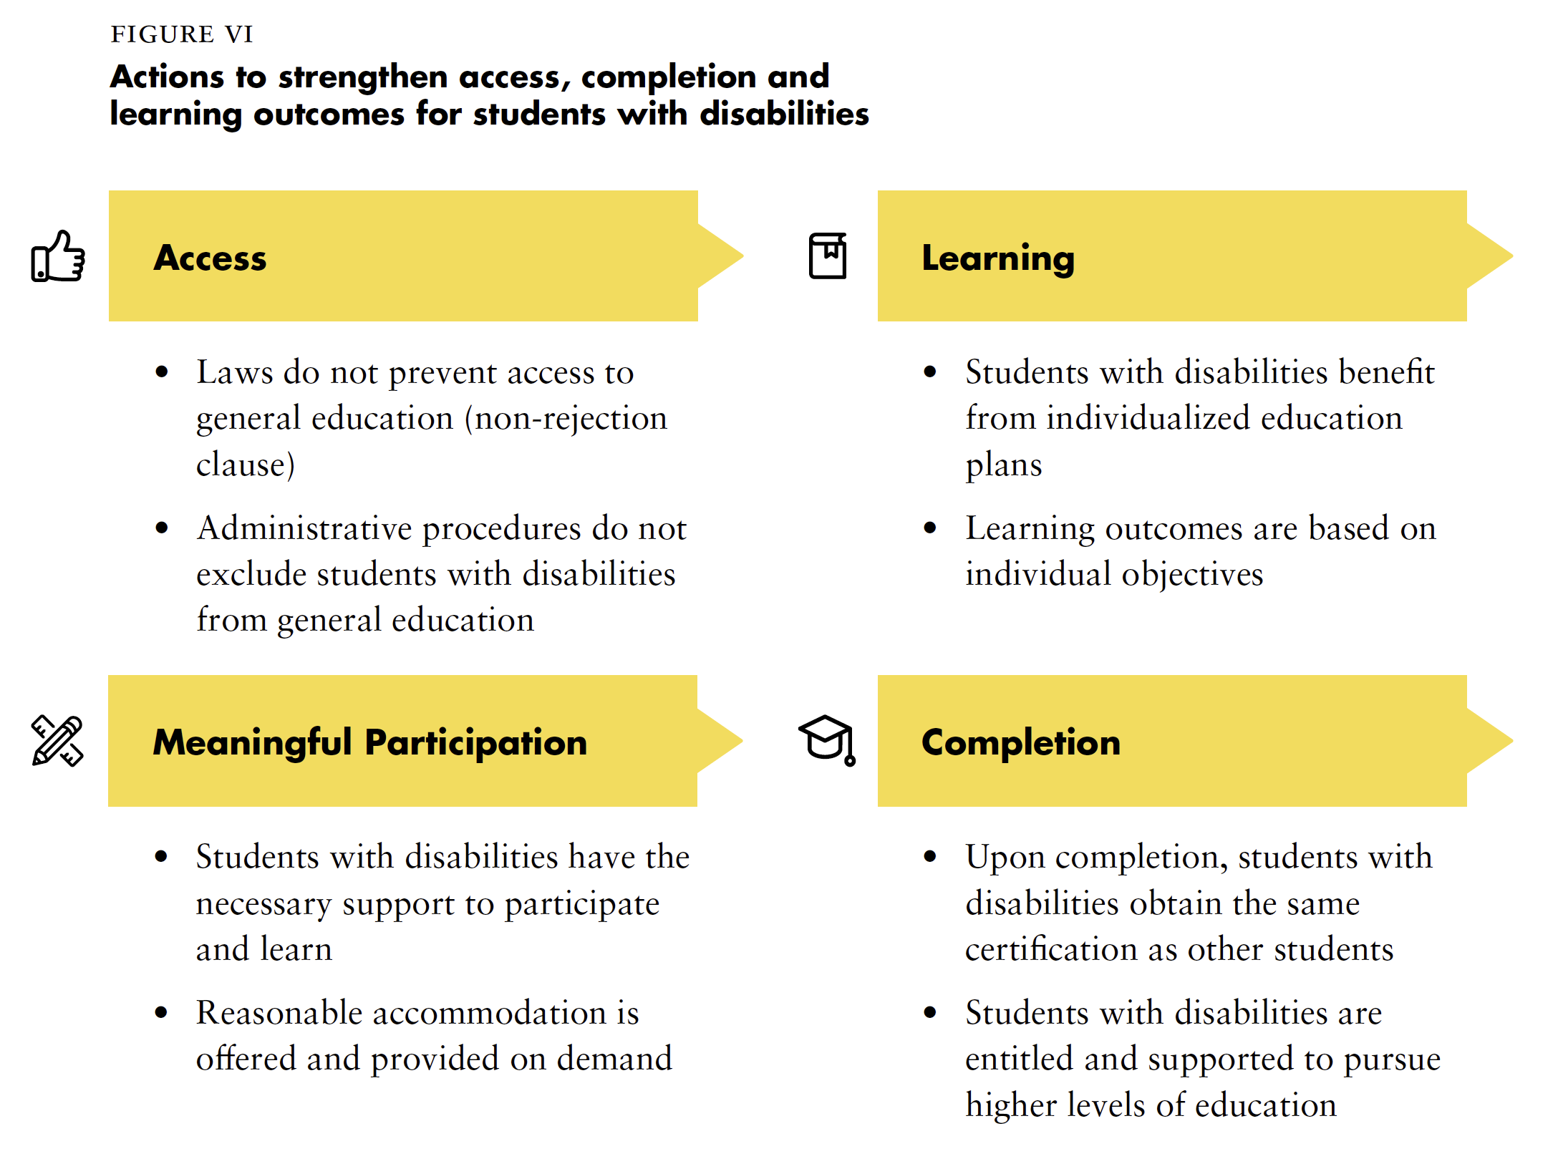

Slide 32
Closing
Name
Name
Name
Name
Name
Name one question you have after today’s session.
Name
Name
Name
Name
Name
Name
Template by Training for Change
Notes:
Template by Training for Change • www.trainingforchange.org

Slide 33
Resources
Resource package link
  Policy Guidance
  Human Rights Indicators
  Data Sources Guidance
  Training Materials
  Videos
(Add other relevant resources)

Slide 34
Thank you!
For further information, please contact:

