Slide 1
Policy Guidance on Quality Education – Sustainable Development Goal 4: Promoting the Rights of Persons with Disabilities through the Sustainable Development Goals A Resource Package
Online Training Module – Session 2
Presenter's name
Event or meeting title Platform, (Date)
© United Nations, 2022 – These presentation slides form part of the OHCHR Promoting the Rights of Persons with Disabilities through the Sustainable Development Goals: A Resource Package.

Slide 2
Teams tech help slides
(Templates by Training for Change)

Slide 3
Set-up
Click Unmute and Start Video to say hello
Raise your hand
Click Participants
and Chat

Slide 4
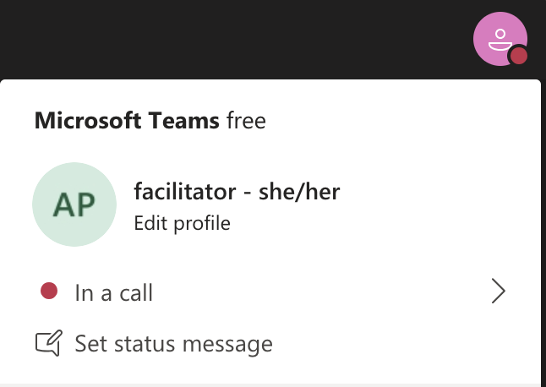
Rename yourself: Click the icon on the top right corner, click “Edit profile” to change your name and add your pronouns. Click “Set status message” to write your organization and location.

Slide 5
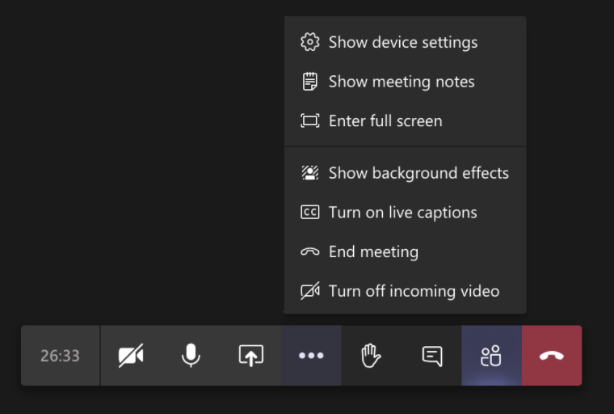
Closed Captions

Slide 6
Zoom tech help slides
(Templates by Training for Change)

Slide 7
Set-up
Click Unmute and Start Video to say hello
Click Participants
and Chat

Slide 8
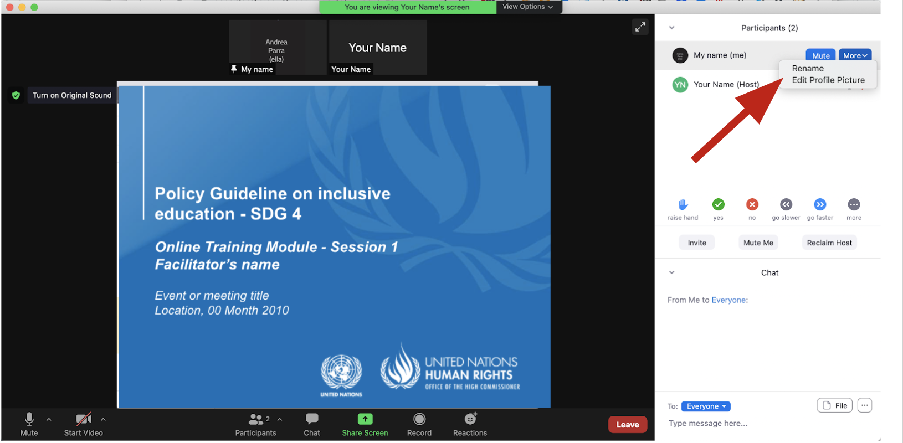
Rename yourself: Find your name at the top of the Participants list, click “More” then “Rename”. Add your pronouns & location.

Slide 9
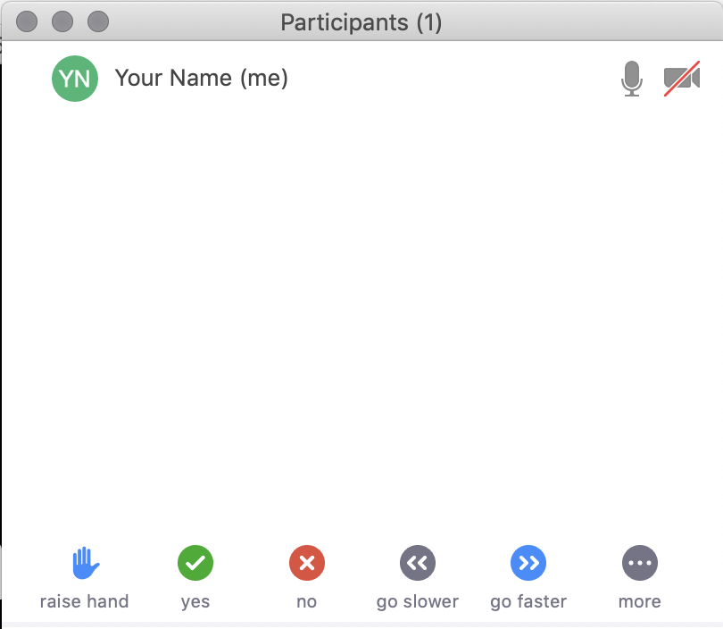
Raise your hand
Use the participants menu tool --or--
Type * in chat
*9 on phone
Alt+Y on keyboard

Slide 10
Closed Captioning
Click arrow next to “Closed Caption” and click “Show Subtitle”
Notes:
Template by Training for Change • www.trainingforchange.org
Visual guide for how to turn on closed captioning is very important when you have a live captioner in your online meeting. It is recommended to also paste in chat:
==========
Live closed captioning available. Click “Closed Caption” in the toolbar and “Show Subtitle” to view the captions. Click “Subtitle Settings…” for more options.
==========

Slide 12
Be present
Remove distractions
Get a beverage
Get note-taking materials
Center yourself

Slide 13
Welcome!
Please share in chat one thing that stuck with you from last session.
Notes:
Template by Training for Change • www.trainingforchange.org

Slide 14
Objectives of the module
Learn about the various components of the Office of the United Nations High Commissioner for Human Rights’ Resource Package on Promoting the Rights of Persons with Disabilities through the Sustainable Development Goals
Better understand the current situation in terms of access to the various levels of education for persons with disabilities
Identify concrete steps that policymakers can take to guarantee inclusive education in the process of implementing Sustainable Development Goal 4 with a disability rights lens.
Learn how to obtain additional information for implementation of inclusive education in their context.

Slide 15
What barriers do these students face?

Slide 16
Station 1: Implementation Challenge – Access
IVAN
AYDIN
Out of Regular School
AVA
RAJID

Slide 17
Station 2: Implementation Challenge – Policy
IVAN
AYDIN
Out of Regular School
AVA
RAJID

Slide 18
Station 3: Implementation Challenge – Capacity-building
IVAN
AYDIN
Out of Regular School
AVA
RAJID

Slide 19
Station 4: Implementation Challenge – Awareness-raising
IVAN
AYDIN
Out of Regular School
AVA
RAJID

Slide 20
Station 5: Implementation Challenge – Budget allocation
IVAN
AYDIN
Out of Regular School
AVA
RAJID

Slide 21
Station 6: Implementation Challenge – Data collection process
IVAN
AYDIN
Out of Regular School
AVA
RAJID

Slide 22
Station 7: Implementation Challenge – Accountability
IVAN
AYDIN
Out of Regular School
AVA
RAJID

Slide 23
What new thing did you learn? What’s one thing that grabbed your attention? What feels doable in your country? What might be most difficult?

Slide 24
Name one commitment you are making to advance inclusive education after today’s session and who in your specific context can hold you accountable for it?

Slide 25
Closing
Name
Name
Name
Name one commitment you are making to advance inclusive education after today’s session and who in your specific context can hold you accountable for it?
Name
Name
Name
Name
Name
Name
Name
Name
Template by Training for Change
Notes:
Template by Training for Change • www.trainingforchange.org

Slide 26
Resources
Resource package link
Policy Guidance
Human Rights Indicators
Data Sources Guidance
Training Materials
Videos
(Add other relevant resources)

Slide 27
Thank you! For further information, please contact:

