Slide 1
Policy Guidance on Gender Equality – Sustainable Development Goal 5: Promoting the Rights of Persons with Disabilities through the Sustainable Development Goals A Resource Package
Online Training Module – Session 1
Presenter's name
Event or meeting title Platform, (Date)
© United Nations, 2022 – These presentation slides form part of the OHCHR Promoting the Rights of Persons with Disabilities through the Sustainable Development Goals: A Resource Package.

Slide 2
Teams tech help slides
(Templates by Training for Change)

Slide 3
Set-up
Click Unmute and Start Video to say hello
Raise your hand
Click Participants
and Chat

Slide 4
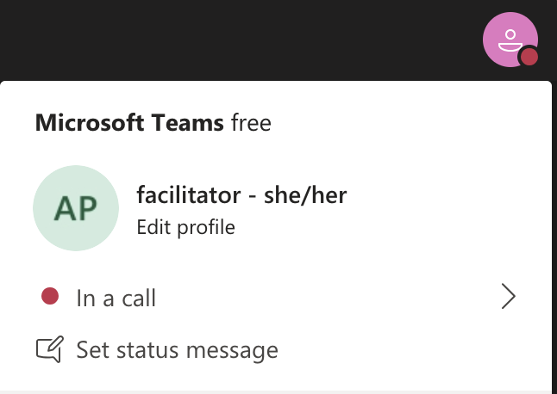
Rename yourself: Click the icon on the top right corner, click “Edit profile” to change your name and add your pronouns. Click “Set status message” to write your organization and location.

Slide 5
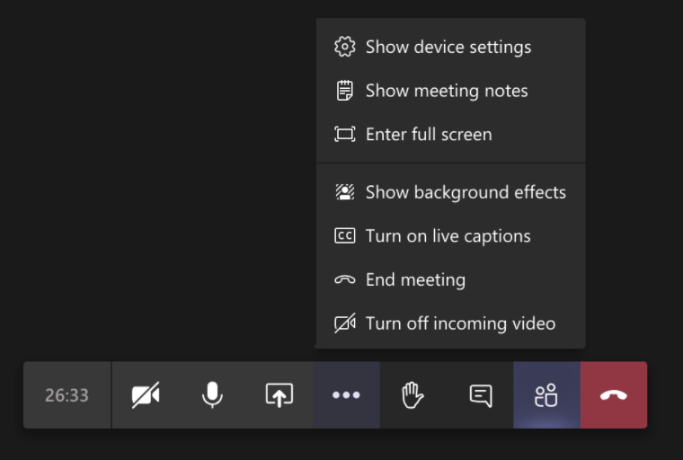
Closed Captions

Slide 6
Zoom tech help slides
(Templates by Training for Change)

Slide 7
Set-up
Click Unmute and Start Video to say hello
Click Participants
and Chat

Slide 8
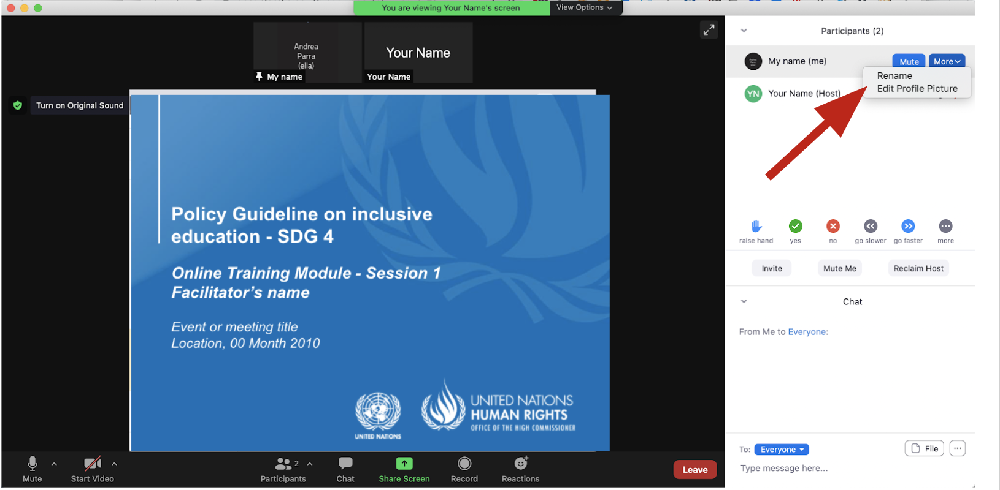
Rename yourself: Find your name at the top of the Participants list, click “More” then “Rename”. Add your pronouns & location.

Slide 9
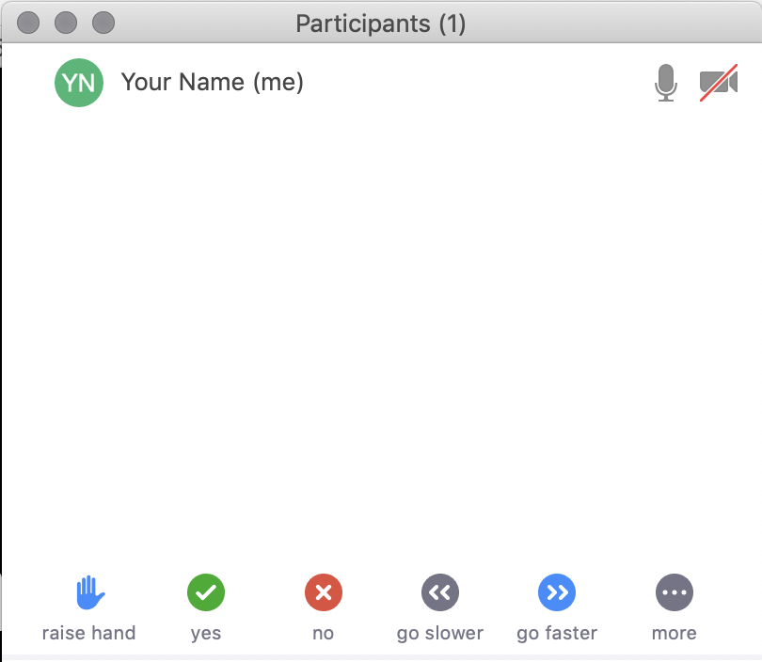
Raise your hand
Use the participants menu tool --or--
Type * in chat
*9 on phone
Alt+Y on keyboard

Slide 10
Closed Captioning
Click arrow next to “Closed Caption” and click “Show Subtitle”
Notes:
Template by Training for Change • www.trainingforchange.org
Visual guide for how to turn on closed captioning is very important when you have a live captioner in your online meeting. It is recommended to also paste in chat:
==========
Live closed captioning available. Click “Closed Caption” in the toolbar and “Show Subtitle” to view the captions. Click “Subtitle Settings…” for more options.
==========

Slide 12
Be present
Remove distractions
Get a beverage
Get note-taking materials
Center yourself

Slide 13
Welcome!
Please raise your hand and say your name, affiliation and one thing you have been told you had to do or be, just because of your gender?
Notes:
Template by Training for Change • www.trainingforchange.org

Slide 14
Objectives of the module
Become familiar with the various components of the Office of the United Nations High Commissioner for Human Rights’ Resource Package on Promoting the Rights of Persons with Disabilities through the Sustainable Development Goals.
Gain a better understanding of the situation of women and girls with disabilities.
Identify concrete actions that policymakers can take to implement Sustainable Development Goal 5 on gender equality in their own contexts.
Learn how to obtain additional information for supporting the process of implementation of Sustainable Development Goal 5.

Slide 15
What’s in the Resource Package?
Policy Guidance
Human Rights Indicators for the Convention on the Rights of Persons with Disabilities
Data Sources Guidance
Training Materials
Videos

Slide 16
Agenda
Start time: 00:00
Disability & Ableism (if applicable)
Data Discovery Challenge
Laws and Policies
Closing time:

Slide 17
Disability and Ableism:
What did you think about disability when you were 8-12 years old?

Slide 18
Understanding Ableism and Disability

Slide 19
Understanding Ableism and Disability

Slide 20
Models of disability
Charity Model of Disability
People with impairments perceived as objects of benevolence who cannot take care of themselves.
Conditions participation to receiving “help” or charity.
Having impairments is seen as a curse or punishment.
Medical Model of Disability
People with impairments seen throughout history as persons who are sick or subjects of rehabilitation.
Reduces persons to their impairment and conditions participation to being rehabilitated or “fixed” to meet societal norms and to fit back into society.

Slide 21
Ableism
“[A] value system that considers certain typical characteristics of body and mind as essential for living a life of value. Based on strict standards of appearance, functioning and behaviour, ableist ways of thinking consider the disability experience as a misfortune that leads to suffering and disadvantage and invariably devalues human life”.
Special Rapporteur on the rights of persons with disabilities, Report on the impact of ableism in medical and scientific practice, A/HRC/43/41, 2019

Slide 22
Break! Come back at :00

Slide 23
DATA DISCOVERY CHALLENGE RESULTS

Slide 24
In trios, discuss:
How was it to answer the survey for you, what did you learn and share something about your own context.

Slide 25
Laws and Policies: in groups
Write out a list of laws or policies that relate to gender or women in your country.
Discuss how these laws or policies do or do not include women with disabilities.

Slide 26
Laws and Policies: What laws and policies did you identify? How do these laws and policies relate to women with disabilities?

Slide 27
Laws and Policies: The Four Areas
Economic empowerment:
Violence and harmful practices:
Political participation:
Sexual and reproductive health and rights:

Slide 28
Laws and Policies: What needs to be done?
Impact-Assessment
Twin-Track Approach
Coordination
Access to Justice
Active Consultation
Awareness Raising
Budget
Data
International Cooperation

Slide 29
Closing
Name
Name
Name
Name
Name
Name one question you have after today’s session.
Name
Name
Name
Name
Name
Name
Template by Training for Change
Notes:
Template by Training for Change • www.trainingforchange.org

Slide 30
Resources
Resource package link
Policy Guidance
Human Rights Indicators
Data Sources Guidance
Training Materials
Videos
(Add other relevant resources)

Slide 31
Thank you! For further information, please contact:

