Slide 1
Policy Guidance on Gender Equality – Sustainable Development Goal 5: Promoting the Rights of Persons with Disabilities through the Sustainable Development Goals
A Resource Package
Online Training Module – Session 2
Presenter's name
Event or meeting title
Platform, (Date)
© United Nations, 2022 – These presentation slides form part of the OHCHR Promoting the Rights of Persons with Disabilities through the Sustainable Development Goals: A Resource Package.

Slide 2
Teams tech help slides
(Templates by Training for Change)

Slide 3
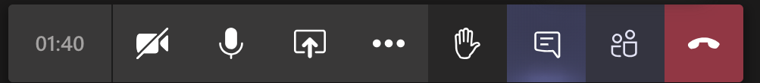
Set-up
Click Unmute and Start Video to say hello
Raise your hand
Click Participants
and Chat

Slide 4
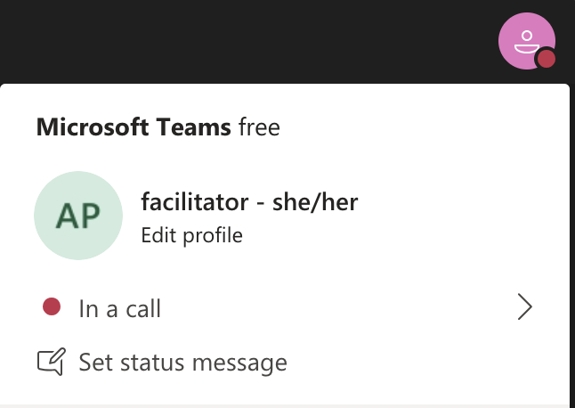
Rename yourself: Click the icon on the top right corner, click “Edit profile” to change your name and add your pronouns. Click “Set status message” to write your organization and location.

Slide 5
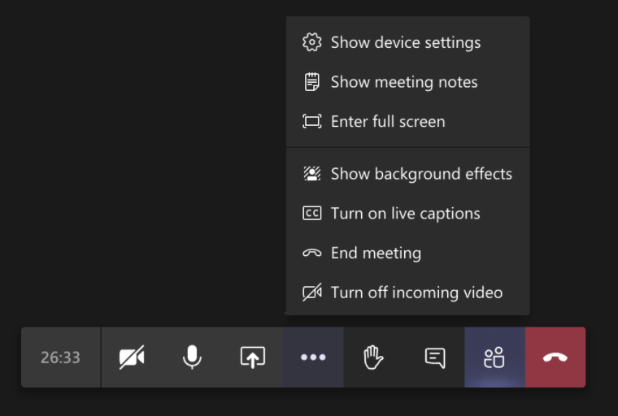
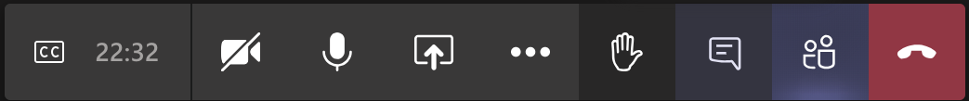
Closed Captions

Slide 6
Zoom tech help slides
(Templates by Training for Change)

Slide 7
Set-up
Click Unmute and Start Video to say hello
Click Participants
and Chat

Slide 8
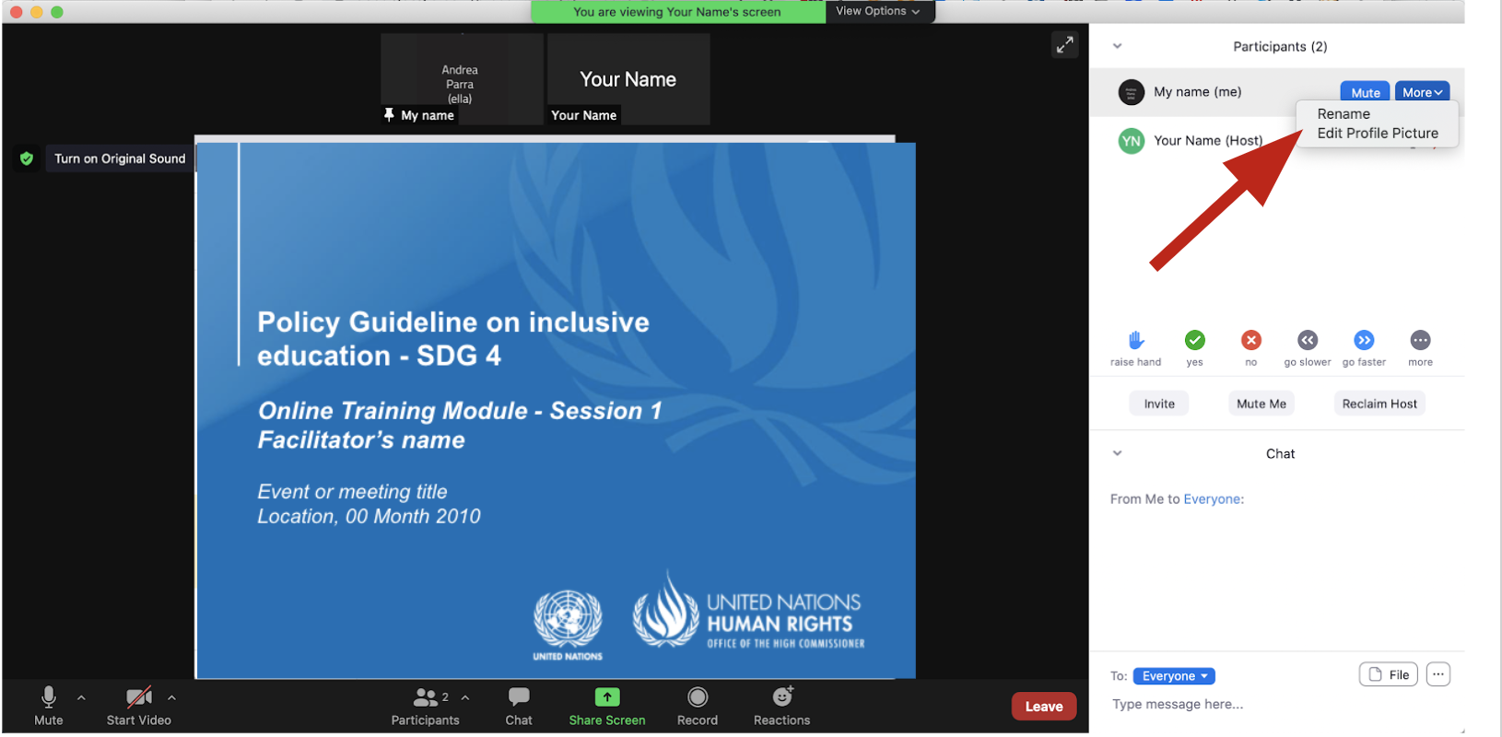
Rename yourself: Find your name at the top of the Participants list, click “More” then “Rename”. Add your pronouns & location.

Slide 9
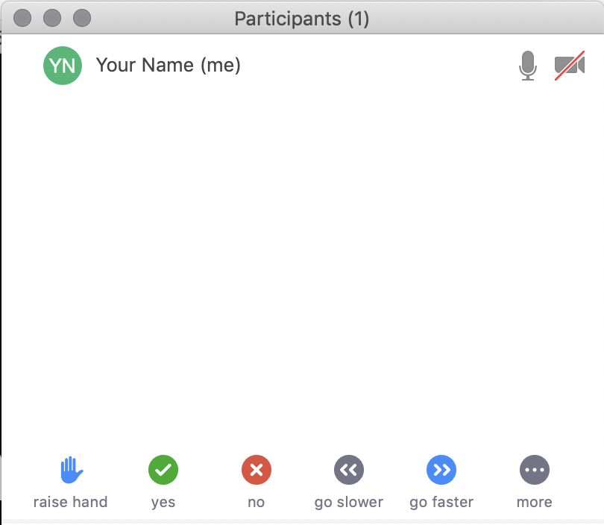
Raise your hand
Use the participants
menu tool
--or--
Type * in chat
*9 on phone
Alt+Y on keyboard

Slide 10
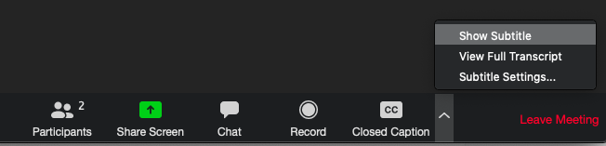
Closed Captioning
Click arrow next to “Closed Caption” and click “Show Subtitle”
Notes:
Template by Training for Change • www.trainingforchange.org
Visual guide for how to turn on closed captioning is very important when you have a live captioner in your online meeting. It is recommended to also paste in chat:
==========
Live closed captioning available. Click “Closed Caption” in the toolbar and “Show Subtitle” to view the captions. Click “Subtitle Settings…” for more options.
==========

Slide 12
Be present
Remove distractions
Get a beverage
Get note-taking materials
Center yourself

Slide 13
Welcome!
Please share in chat one thing that stuck with you from last session.
Notes:
Template by Training for Change • www.trainingforchange.org

Slide 14
Objectives of the module
Become familiar with the various components of the Office of the United Nations High Commissioner for Human Rights’ Resource Package on Promoting the Rights of Persons with Disabilities through the Sustainable Development Goals.
Gain a better understanding of the situation of women and girls with disabilities.
Identify concrete actions that policymakers can take to implement Sustainable Development Goal 5 on gender equality in their own contexts.
Learn how to obtain additional information for supporting the process of implementation of Sustainable Development Goal 5.

Slide 15
Short Video
As you watch and listen, pay attention to the different stories highlighted and the issues shared and proposed.

Slide 16
Breakout groups
Write in your slide what barriers does this character face?

Slide 17
Group 1 – What Barriers does Achen face?

Slide 18
Group 2 – What Barriers does Nadia face?

Slide 19
Group 3 – What Barriers does Makeba face?

Slide 20
Group 4 – What Barriers does Kanda face?

Slide 21
Welcome back!
Please share some of the barriers you identified.

Slide 22
Breakout Groups – Actions to take
In the same groups review the corresponding section of the Policy Guidance Excerpt.
Come up with three actions to address your character’s situation under the corresponding section of the excerpt.
Discuss who would be responsible in your own contexts for implementing those actions.

Slide 23
Group 1 – Achen (economic empowerment) – section 5.4 Write three actions you could take to address her situation and discuss who would be in charge of implementing them in your own contexts.
Actions
Who would be in charge?

Slide 24
Group 2 – Nadia (violence and harmful practices) – section 5.3 Write three actions you could take to address her situation and discuss who would be in charge of implementing them in your own contexts.
Actions
Who would be in charge?

Slide 25
Group 3 – Makeba (political participation) – section 5.5 Write three actions you could take to address her situation and discuss who would be in charge of implementing them in your own contexts.
Actions
Who would be in charge?

Slide 26
Group 1 – Kanda (sexual and reproductive health and rights) – section 5.6 Write three actions you could take to address her situation and discuss who would be in charge of implementing them in your own contexts.
Actions
Who would be in charge?

Slide 27
Break! Come back at :00

Slide 28
Welcome back! Gallery Round
Individually, browse through the slides groups wrote in the previous activity.
If you have suggestions, write them in the corresponding slide.

Slide 29
Debrief
Please share in chat or out loud some of the highlights of your group discussion:
How did you use the excerpt?
What connections do you see with actions written by other groups?
Other things you noticed?

Slide 30
Breakout groups by country/region
Pick two actions that you think are possible to implement in your context and discuss what you would need to bring them to reality.
Pick one action that would be difficult to implement in your context and discuss why.

Slide 31
Wrap-up and Next Steps
(Add dates of next trainings and any follow-up information here)
(Contact information for questions)

Slide 32
Closing
Name
Name
Name
Name one thing you will share with your colleagues about what needs to be done to advance gender equality for women with disabilities in your context.
Name
Name
Name
Name
Name
Name
Name
Name
Template by Training for Change
Notes:
Template by Training for Change • www.trainingforchange.org

Slide 33
Resources
Resource package link
  Policy Guidance
  Human Rights Indicators
  Data Sources Guidance
  Training Materials
  Videos
(Add other relevant resources)

Slide 34
Thank you!
For further information, please contact:

