Slide 1
Policy Guidance on Decent Work and Economic Growth – Sustainable Development Goal 8: Promoting the Rights of Persons with Disabilities through the Sustainable Development Goals
A Resource Package
Online Training Module – Session 1
Presenter's name
Event or meeting title
Platform, (Date)
© United Nations, 2022 – These presentation slides form part of the OHCHR Promoting the Rights of Persons with Disabilities through the Sustainable Development Goals: A Resource Package.

Slide 2
Teams tech help slides
(Templates by Training for Change)

Slide 3
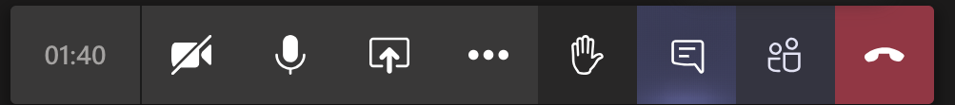
Set-up
Click Unmute and Start Video to say hello
Raise your hand
Click Participants
and Chat

Slide 4
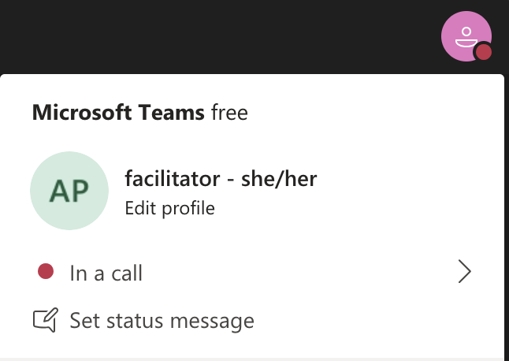
Rename yourself: Click the icon on the top right corner, click “Edit profile” to change your name and add your pronouns. Click “Set status message” to write your organization and location.

Slide 5
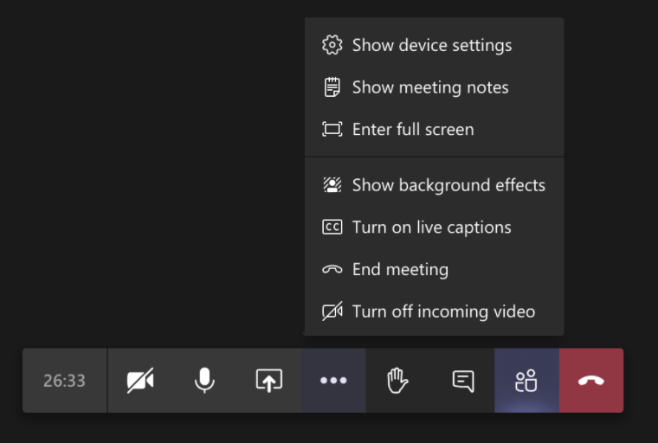
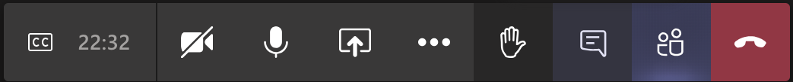
Closed Captions

Slide 6
Zoom tech help slides
(Templates by Training for Change)

Slide 7
Set-up
Click Unmute and Start Video to say hello
Click Participants
and Chat

Slide 8
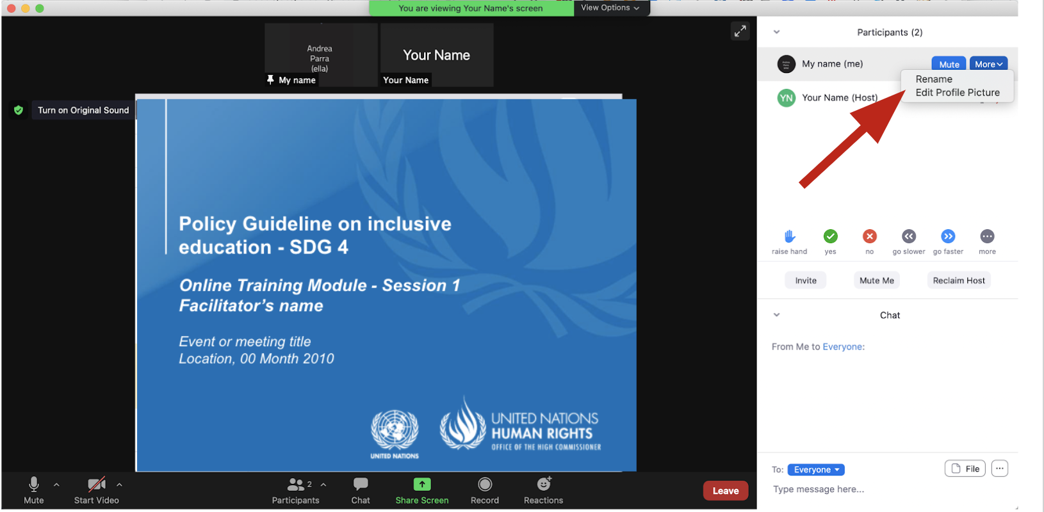
Rename yourself: Find your name at the top of the Participants list, click “More” then “Rename”. Add your pronouns & location.

Slide 9
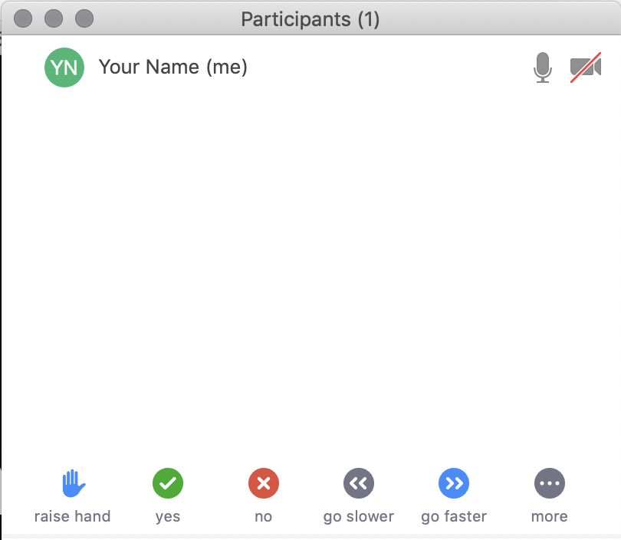
Raise your hand
Use the participants
menu tool
--or--
Type * in chat
*9 on phone
Alt+Y on keyboard

Slide 10
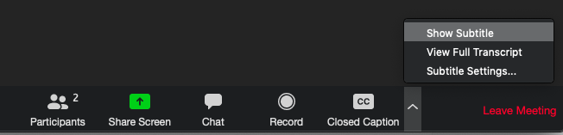
Closed Captioning
Click arrow next to “Closed Caption” and click “Show Subtitle”
Notes:
Template by Training for Change • www.trainingforchange.org
Visual guide for how to turn on closed captioning is very important when you have a live captioner in your online meeting. It is recommended to also paste in chat:
==========
Live closed captioning available. Click “Closed Caption” in the toolbar and “Show Subtitle” to view the captions. Click “Subtitle Settings…” for more options.
==========

Slide 11


Slide 12
Be present
Remove distractions
Get a beverage
Get note-taking materials
Center yourself

Slide 13
Welcome!
Please raise your hand and say your name, affiliation and one thing you are good at.
Notes:
Template by Training for Change • www.trainingforchange.org

Slide 14
Objectives of the module
Become familiar with the various components of the Office of the United Nations High Commissioner for Human Rights’ Resource Package on Promoting the Rights of Persons with Disabilities through the Sustainable Development Goals.
Gain a better understanding of the situation of persons with disabilities with regards to employment.
Identify concrete actions that policymakers can take to implement Sustainable Development Goal 8 in their own contexts.
Learn how to obtain additional information for supporting the process of implementation of Sustainable Development Goal 8.

Slide 15
What’s in the Resource Package?
Policy Guidance
Human Rights Indicators for the Convention on the Rights of Persons with Disabilities
Data Sources Guidance
Training Materials
Videos

Slide 16
Agenda
Start time: 00:00
Disability & Ableism (if applicable)
Data Discovery Challenge
Stereotypes
Video Showing
Closing time:

Slide 17
Disability and Ableism:
What did you think about disability when you were 8-12 years old?

Slide 18
Understanding Ableism and Disability

Slide 19
Understanding Ableism and Disability

Slide 20
Models of disability
Charity Model of Disability
People with impairments perceived as objects of benevolence who cannot take care of themselves.
Conditions participation to receiving “help” or charity.
Having impairments is seen as a curse or punishment.
Medical Model of Disability
People with impairments seen throughout history as persons who are sick or subjects of rehabilitation.
Reduces persons to their impairment and conditions participation to being rehabilitated or “fixed” to meet societal norms and to fit back into society.

Slide 21
Ableism
“[A] value system that considers certain typical characteristics of body and mind as essential for living a life of value. Based on strict standards of appearance, functioning and behaviour, ableist ways of thinking consider the disability experience as a misfortune that leads to suffering and disadvantage and invariably devalues human life”.
Special Rapporteur on the rights of persons with disabilities, Report on the impact of ableism in medical and scientific practice, A/HRC/43/41, 2019

Slide 22
DATA DISCOVERY CHALLENGE RESULTS

Slide 23
In trios, discuss:
How was it to answer the survey for you, what did you learn and share something about your own context.

Slide 24
Break! Come back at :00

Slide 25
Stereotypes – In trios
List the stereotypes you know, have heard, or believe about persons with disabilities and employment.
When thinking about these stereotypes also consider the type of employment or if someone is self-employed.

Slide 26
Stereotypes – Do nots – Mini Lecture
Decent work:
Limit the provisions on disability rights to a disability-specific law. This would undermine the visibility of persons with disabilities across sector-specific legislation, including employment law
Refer to reasonable accommodation only in general clauses in legislation. Instead, explain it further in detailed regulations and guidance
Promote early retirement or pension based on acquiring an impairment, unless all measures for retaining the person in the workforce are exhausted

Slide 27
Stereotypes – Do nots – Mini Lecture
Decent work, continued:
Establish reserved employment that:
  prevents career advancement,
  restricts the number of hours that a person with disability can work, or
  mandates absolute protection against the dismissal of persons with disabilities, as they operate as disincentives for persons with disabilities to seek employment or for employers to hire persons with disabilities.
Establish requirements that go beyond the core functions of the job and/or processes that disregard the provision reasonable accommodation disqualifying persons with disabilities who would require it.

Slide 28
Stereotypes – Do nots – Mini Lecture
Decent work, continued:
Disclose disability-related information beyond what might be required for the provision of support and reasonable accommodation.
Create segregated employment settings for persons with disabilities, regardless of their impairment (for example, sheltered employment/workshops, protected employment)
Allow salaries for persons with disabilities to be below minimum wage or market standards, nor allow that persons with disabilities do not receive any salary or remuneration for their work.
Create capacity-building schemes for persons with disabilities that are disconnected from economic reality and from accessing employment positions

Slide 29
Stereotypes – Do nots – Mini Lecture
Self Employment:
Limit the access of persons with disabilities to general credit lines, based on stereotypes or legal capacity status.
Data Collection and Accountability:
Overlook the importance of collecting data on the employment and economic activities of persons with disabilities through labor force surveys and other instruments, nor limit data collection to disability-specific surveys
Limit the possibility of bringing complaints about non-inclusive labor policies and practices to the judiciary, including on disability-based discrimination

Slide 30
Short Video
As you watch and listen, pay attention to the different people highlighted and the issues shared and proposed.

Slide 31
Map the actors in your country:
Individually: draft a map of actors in the employment system for your country. Keep it with you.

Slide 32
Closing
Name
Name
Name
Name
Name
Name one question you have after today’s session.
Name
Name
Name
Name
Name
Name
Template by Training for Change
Notes:
Template by Training for Change • www.trainingforchange.org

Slide 33
Resources
Resource package link
  Policy Guidance
  Human Rights Indicators
  Data Sources Guidance
  Training Materials
  Videos
(Add other relevant resources)

Slide 34
Thank you!
For further information, please contact:

