Slide 1
Foundations – Promoting the Rights of Persons with Disabilities through the Sustainable Development Goals A Resource Package
In-Person Training Module
Presenter's name
Event or meeting title Location, (Date)
© United Nations, 2022 – These presentation slides form part of the OHCHR Promoting the Rights of Persons with Disabilities through the Sustainable Development Goals: A Resource Package.

Slide 2
Welcome!
We welcome the full diversity of this group and are glad you are here today.

Slide 3
Objectives of the module
Become familiar with the various components of the Office of the United Nations High Commissioner for Human Rights’ Resource Package on Promoting the Rights of Persons with Disabilities through the Sustainable Development Goals
Gain an understanding of key human rights concepts that underpin a rights-based approach to disability-inclusive development.
Gain an understanding of the structural requirements that enable the implementation of all the Sustainable Development Goals with a disability rights lens.
Identify concrete steps that policymakers can take to implement general requirements and foundations for the inclusion of persons with disabilities.

Slide 4
What’s in the Resource Package?
Policy Guidance
Human Rights Indicators for the Convention on the Rights of Persons with Disabilities
Data Sources Guidance
Training Materials
Videos

Slide 5
Agenda
Start time: 00:00
Foundational concepts
Core Pillars for inclusive policies
Structural requirements for enabling environments Part 1
Meal time: 00:00
Structural requirements for enabling environments Part 2
Final thoughts
Next Steps
Closing time:

Slide 6
Disability and Ableism:
What did you think about disability when you were 8-12 years old?

Slide 7
In trios:
Share what you remembered
What do you notice in common between the stories?
Come up with a list of words that you associated with disability during that time of your life.

Slide 8
Models of disability
Charity Model of Disability
People with impairments perceived as objects of benevolence who cannot take care of themselves.
Conditions participation to receiving “help” or charity.
Having impairments is seen as a curse or punishment.
Medical Model of Disability
People with impairments seen throughout history as persons who are sick or subjects of rehabilitation.
Reduces persons to their impairment and conditions participation to being rehabilitated or “fixed” to meet societal norms and to fit back into society.

Slide 9
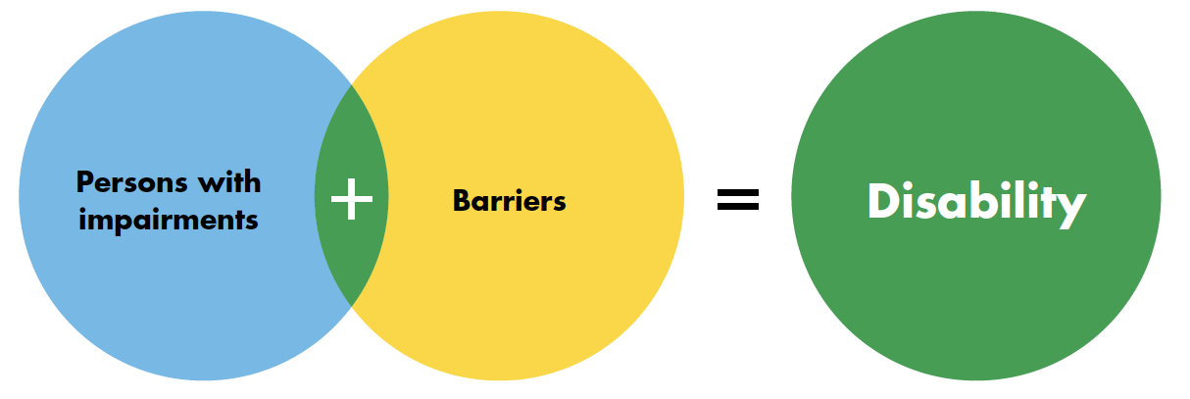
Human Rights Model of Disability

Slide 10
Barriers
Environmental:
Physical
Communication
Policy
Attitudinal

Slide 11
Privilege Road
How do I benefit from abled or able-bodied privilege?
In groups of four go through
Autistic Hoya’s Abled Privilege Checklist; and
Melissa Graham’s “The Invisible Backpack of Able-Bodied Privilege Checklist”
Each person marks some of the statements which is true for themselves.
Discuss: What surprised you? What hadn’t you thought about before? What are you curious about?

Slide 12
Ableism
“[A] value system that considers certain typical characteristics of body and mind as essential for living a life of value. Based on strict standards of appearance, functioning and behaviour, ableist ways of thinking consider the disability experience as a misfortune that leads to suffering and disadvantage and invariably devalues human life”.
Special Rapporteur on the rights of persons with disabilities, Report on the impact of ableism in medical and scientific practice, A/HRC/43/41, 2019

Slide 13
Break! Come back at :00

Slide 14
Five pillars of inclusive policies
non-discrimination
accessibility
supports and assistive technology
participation
awareness-raising
In groups:
Pick a story and write in the post-its two examples of how the selected pillar would apply to the story you picked from the basket. Place the post-its in the corresponding flipchart.

Slide 15
Gallery Round
Find a person who was not in your group and review the examples under each pillar.
Share ways in which these pillars exist or are missing in your specific context.

Slide 16
Video – Foundations

Slide 17
Six structural requirements to create enable legal, policy and programming environments
Governance
Participation
Legislation
Accountability and Monitoring
Capacity Building
International Cooperation

Slide 18
Governance
Good governance that promotes the effective inclusion of people with disabilities includes the following eight components:
Institutional design
Twin-track approach
Assessment
Partnerships
Budget
Disability Markers
Procurement
Data Collection

Slide 19
Governance – Work in Groups
In trios, pick three of these elements to talk about.
Review the Governance Infocard handout
Answer:
How does this element exist currently in your country or context?
What’s missing so that element can support good governance and inclusive policies?
How do you find out information about this element in your context?

Slide 20
Lunch Break! Come back at :00

Slide 21
Structural Requirements Part 2
Five stations – one group in each station
In each group station there is an expanded character story with a question.
You have 15 minutes in each station to discuss the question and write your ideas in the flipchart and when the time is up you will move to the station to your right.
**Don’t take the handouts with you!

Slide 22
Gallery Round
With your group visit the other three stations for 10 minutes.
Form a pair with someone who was not in your group and who you don’t know very well and share how these requirements relate to your context.

Slide 23
Break! Come back at :00

Slide 24
Final Thoughts
Individually, journal for 10 minutes about what you learned today, what questions you still have, what you are taking back home or any other reflections you may have about today’s session.
Open share in the large group

Slide 25
Next Steps
(Add any follow-up information here)

Slide 26
Closing Circle
Please share one thing from today that you feel energized about working on in your context.

Slide 27
Thank you! For further information, please contact:

