Slide 1
Policy Guidance on No Poverty – Promoting the Rights of Persons with Disabilities through the Sustainable Development Goals A Resource Package
In-Person Training Module
Presenter's name
Event or meeting title Location, (Date)
© United Nations, 2022 – These presentation slides form part of the OHCHR Promoting the Rights of Persons with Disabilities through the Sustainable Development Goals: A Resource Package.

Slide 2
Welcome!
You each have one minute to come to the front of the room, introduce yourself and share one occasion when you or your family struggled.

Slide 3
Objectives of the module
Become familiar with the various components of the Office of the United Nations High Commissioner for Human Rights’ Resource Package on Promoting the Rights of Persons with Disabilities through the Sustainable Development Goals
Gain an understanding of the current situation regarding how poverty and lack of access to adequate social protection impacts persons with disabilities.
Identify concrete steps that policymakers can take to guarantee adequate measures to end poverty and provide adequate social protection, in the process of implementing Sustainable Development Goal 1 with a disability-rights lens.
Learn how to obtain additional information to support implementation of social protection and poverty reduction measures in your context.

Slide 4
What’s in the Resource Package?
Policy Guidance
Human Rights Indicators for the Convention on the Rights of Persons with Disabilities
Data Sources Guidance
Training Materials
Videos

Slide 5
Agenda
Start time: 00:00
Disability & Ableism (if applicable)
Data contest!
Video Showing
Budget adjustments per family
Meal time: 00:00
Social Protection Scheme
Bringing social protection to your own context
Next Steps
Closing time:

Slide 6
What did you think about disability when you were 8-12 years old?

Slide 7
In trios:
Share what you remembered
What do you notice in common between the stories?
Come up with a list of words that you associated with disability during that time of your life.

Slide 8
Ableism
“a value system that considers certain typical characteristics of body and mind as essential for living a life of value. Based on strict standards of appearance, functioning and behaviour, ableist ways of thinking consider the disability experience as a misfortune that leads to suffering and disadvantage and invariably devalues human life”.
Special Rapporteur on the rights of persons with disabilities, Report on the impact of ableism in medical and scientific practice, A/HRC/43/41, 2019

Slide 9
BREAK! Come back at :00

Slide 10
WELCOME TO THE DATA CONTEST!
The team with most points will win a prize!

Slide 11
Question 1: When looking at six countries from North America, Asia and Eastern Europe, what was the average percentage of persons with disabilities living under the poverty line in comparison to persons without disabilities? (5 points)
13% of persons without disabilities and 24% of persons with disabilities
12% of persons without disabilities and 17% of persons with disabilities.
8% of persons without disabilities and 36% of persons with disabilities

Slide 12
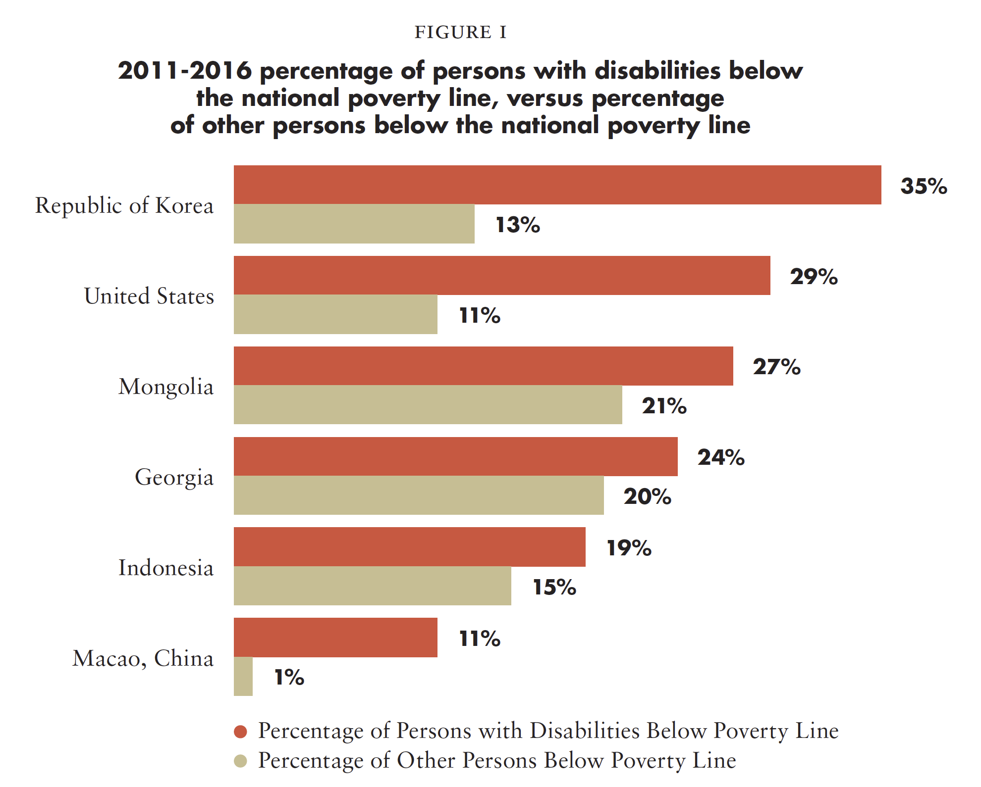
Question 1: When looking at six countries from North America, Asia and Eastern Europe, what was the average percentage of persons with disabilities living under the poverty line in comparison to persons without disabilities? (5 points)
Source: United Nations Department of Economic and Social Affairs, Disability and Development Report, 2019. Figure II.2, p. 34.

Slide 13
Question 2 - What is the percentage of persons with disabilities with high support requirements accessing social protection disability cash benefits? (5 points)

Slide 14
Question 2 - What is the percentage of persons with disabilities with high support requirements accessing social protection disability cash benefits? (5 points)
Recent estimations indicate that worldwide only 27,8% of persons with disabilities with high support requirements access social protection disability-specific cash benefits. This average falls to only 9.4% in Asia and the Pacific. Available information shows that more than half of all countries provide disability benefits only through contributory schemes. Persons with disabilities outside the formal economy, including children, are often not be eligible for disability benefits.

Slide 15
Question 3 - What is the percentage of average income for extra-costs associated with ‘severe’ disability? (7 points)
A. 20%
B. 65%
C. 40%
D. None of the above

Slide 16
Question 3 - What is the percentage of average income for extra-costs associated with ‘severe’ disability? (7 points)
UNDESA, Disability and Development Report, 2019. pp. 37-38.

Slide 17
Question 4: True/False - In low- and middle-income countries, only 5% to 15% of people who require assistive technology and products have access to them.

Slide 18
Question 4: True/False - In low- and middle-income countries, only 5% to 15% of people who require assistive technology and products have access to them.
There is a global estimation that only between 5 and 15% of persons with disabilities who require a wheelchair have access to it. Additionally, only 5% of the 40 million amputees have access to any form of prosthetic care.
Data from five developing countries indicate that between 8% and 64% of persons with disabilities consider banks inaccessible. Other data, mostly from developed countries, indicate that, in 2017, 28% of banks and 12% of ATMs were not accessible. In many countries, restrictions to the legal capacity of persons with disabilities prevent them from opening and managing bank accounts autonomously. In this sense, blind people might be directly rejected, or have to comply with more requirements than others (e.g. witnesses). Persons with intellectual disabilities might be required to have a guardian appointed to open an account, even if not foreseen in regulations, as the person is perceived as ‘incapable’.

Slide 19
Question 5: Challenge! (10 points)
Two members of your team share policies or practices in their countries that are aimed at ensuring social protection inclusive of persons with disabilities.

Slide 20
In pairs, discuss:
Something you learned or that surprised you in this activity.

Slide 21
Short Video
As you watch and listen, pay attention to the different students highlighted and the issues shared and proposed.

Slide 22
Work in groups
You each belong to the family group of each of the characters.
Choose a role within the family
Review your story and monthly budget
Reflect:
Is your monthly budget enough to cover your needs? Why? What else would you need?

Slide 23
Event # 1
Given this event, in your groups discuss:
How would you adjust your budget?
What would you need to meet your needs?

Slide 24
Event # 2
Given this event, in your groups discuss:
How does this new event impact your family’s budget?
How would a social protection system support you?

Slide 25
Lunch Break! Come back at :00

Slide 26
Social Protection Scheme
What are actions governments should take to ensure proper social protection and income stability for this person?
Which agencies should be responsible for implementation?

Slide 27
Inclusive Social Protection Systems: structural elements (Policy Guidance on Sustainable Development Goal 1, section 4)
Twin-track approach
A human rights-based approach
Disability assessment and determination focus on support requirements, rather than impairment
Moving away from a focus on “incapacity to work”
Tailoring benefits to the diversity of persons with disabilities
Access to basic general services and disability-specific services to ensure full and effective participation in the community
Consultation with organizations of persons with disabilities
Awareness-raising
Finance and budget

Slide 28
BREAK! Come back at :00

Slide 29
Application
In groups by country or region:
Choose two actions that are possible
Discuss how could you begin to materialize them
Pick one action that would be difficult and discuss why

Slide 30
Next Steps
(Add any follow-up information here)

Slide 31
Closing Circle
Please share one learning from today that you are bringing to your work. You choose who goes next.

Slide 32
Thank you! For further information, please contact:
OHCHR

