Slide 1
Policy Guidance on Quality Education: Sustainable Development Goal 4 – Promoting the Rights of Persons with Disabilities through the Sustainable Development Goals A Resource Package
In-Person Training Module
Presenter's name
Event or meeting title Location, (Date)
© United Nations, 2022 – These presentation slides form part of the OHCHR Promoting the Rights of Persons with Disabilities through the Sustainable Development Goals: A Resource Package.

Slide 2
Welcome!
You each have one minute to come to the front of the room, introduce yourself and share: what motivates you to do the work you do?

Slide 3
Objectives of the module
Become familiar with the various components of the Office of the United Nations High Commissioner for Human Rights’ Resource Package on Promoting the Rights of Persons with Disabilities through the Sustainable Development Goals and how to use it.
Gain an understanding of the current situation in terms of access to the various levels of education for people with disabilities
Identify concrete steps that policymakers can take to guarantee inclusive education in the process of implementing Sustainable Development Goal 4 with a disability rights lens.
Learn how to obtain additional information for implementation of inclusive education in their context.

Slide 4
What’s in the Resource Package?
Policy Guidance
Human Rights Indicators for the Convention on the Rights of Persons with Disabilities
Data Sources Guidance
Training Materials
Videos

Slide 5
Agenda
Start time: 00:00
Disability & Ableism (if applicable)
Our own experiences with schooling
Data contest!
Meal time: 00:00
Inclusive Education Stations
Next Steps
Closing time:

Slide 6
What did you think about disability when you were 8-12 years old?

Slide 7
In trios:
Share what you remember
What do you notice in common between the stories?
Come up with a list of words that you associated with disability during that time of your life.

Slide 8
Ableism
“a value system that considers certain typical characteristics of body and mind as essential for living a life of value. Based on strict standards of appearance, functioning and behaviour, ableist ways of thinking consider the disability experience as a misfortune that leads to suffering and disadvantage and invariably devalues human life”.
Special Rapporteur on the rights of persons with disabilities, Report on the impact of ableism in medical and scientific practice, A/HRC/43/41, 2019

Slide 9
Memories of Schooling
In each flipchart answer the question:
“What memories do you have from when you attended this level of schooling?”
(Elementary, Secondary, Technical/Vocational, Higher Education).

Slide 10
In trios, discuss:
How did your experience with schooling shape you?
And how might your experience with schooling be linked to what you do today?

Slide 11
BREAK! Come back at :00

Slide 12
WELCOME TO THE DATA CONTEST!
The team with most points will win a prize!

Slide 13
Question 1: What proportion of children in the world are children with disabilities? (5 points)
10 per cent
25 per cent
C. 5 per cent

Slide 14
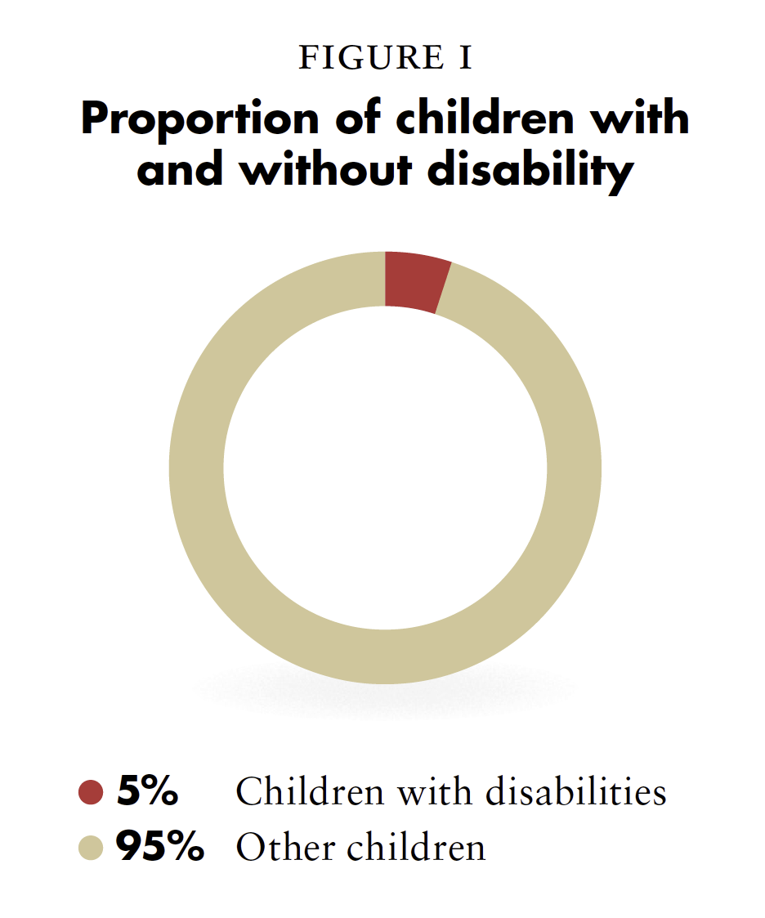
Question 1: What proportion of children in the world are children with disabilities? (5 points)
Source: United Nations Children’s Fund, The state of the world’s children: Children with disabilities (2013), p. 3

Slide 15
Question 2: What proportion of children out of school are children with disabilities? (5 points)
10 per cent
15 per cent
C. 5 per cent

Slide 16
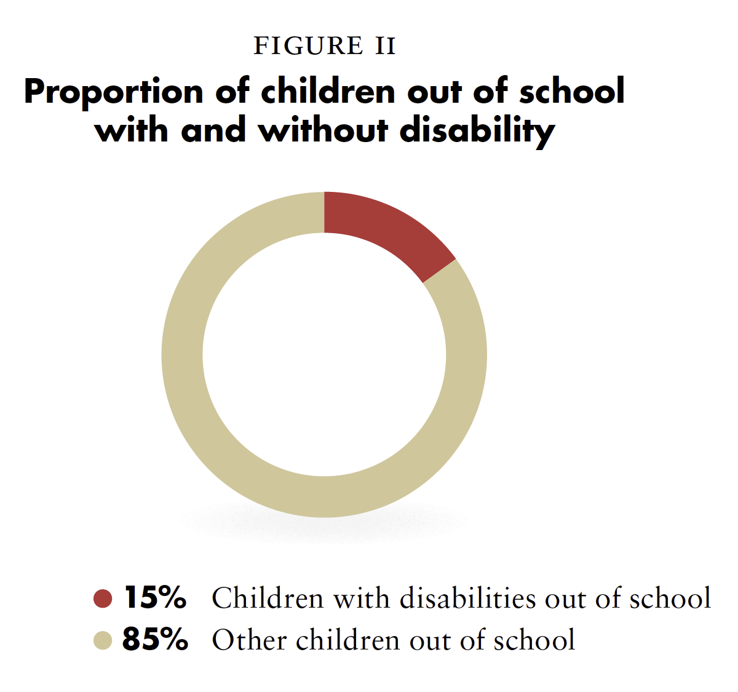
Question 2: What proportion of children out of school are children with disabilities? (5 points)
Source: Global Education Monitoring Report Team, Global education monitoring report, 2020: Inclusion and education: all means all (Paris: United Nations Educational, Scientific and Cultural Organization, 2020), p. 72, fig. 3.4)

Slide 17
Question 3: What are the literacy rates of persons with disabilities in comparison to those of persons without disabilities? (5 points)
3 in 10 persons with disabilities are literate vs. 7 in 10 persons without disabilities
5 in 10 persons with disabilities are literate vs. 8 in 10 persons without disabilities
6 in 10 persons with disabilities are literate vs. 9 in 10 persons without disabilities
None of the above

Slide 18
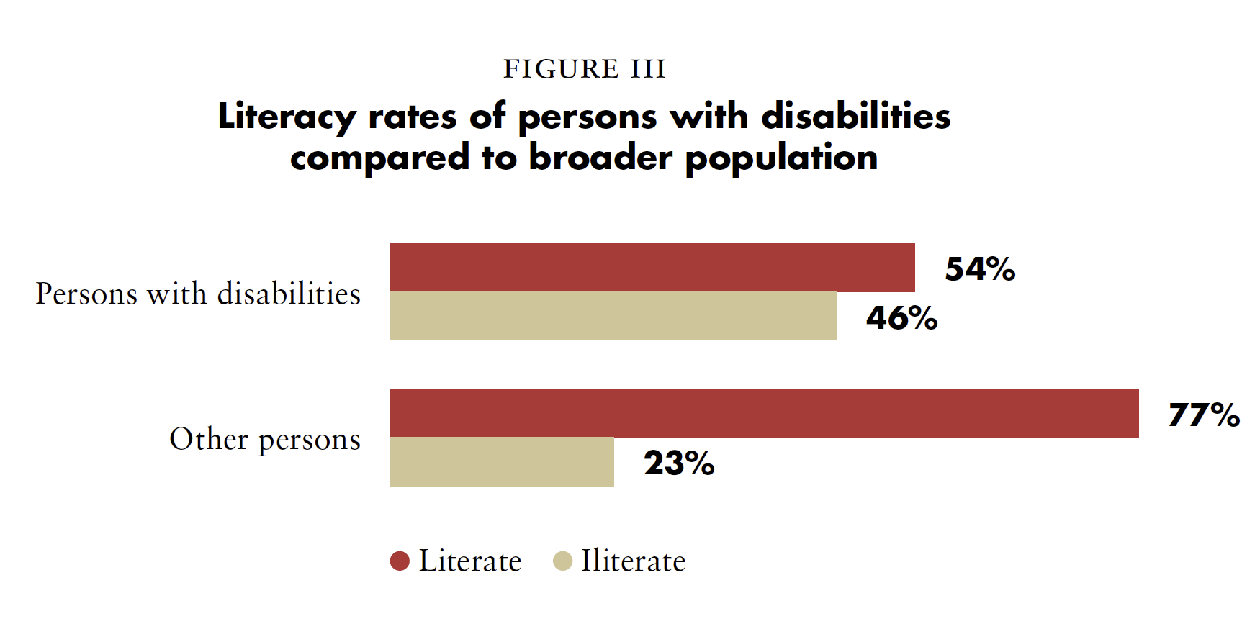
Question 3: What are the literacy rates of persons with disabilities in comparison to those of persons without disabilities? (5 points)
Source: UNDESA, Disability and Development Report, 2019, p. 83, fig. II.33

Slide 19
Question 4: How many years of schooling do women with disabilities in developing countries complete in comparison to men and other women? (7 points)
4.98 years compared to 5.96 years for men and 6.26 for other women.
2.76 years compared to 7.15 years for men and 6.54 for other women.
7.32 years compared to 8.21 years for men and 8.43 for other women.

Slide 20
Question 4: How many years of schooling do women with disabilities in developing countries complete in comparison to men and other women? (7 points)
Correct Answer: 4.98 years compared to 5.96 years for men and 6.26 for other women.

Slide 21
Question 5: Challenge! (10 points)
Two members of your team have to share policies or practices in their countries that are aimed at including students with disabilities in regular schools.

Slide 22
In pairs, discuss:
Something you learned or that surprised you in this activity.

Slide 23
Short Video
As you watch and listen, pay attention to the different students highlighted and the issues shared and proposed.

Slide 24
Inclusive Education:
“The result of a process of continuing and proactive commitment to eliminating barriers impeding the right to education, together with changes to culture, policy and practice of regular schools to accommodate and effectively include all students (…) Inclusion involves a process of systemic reform embodying changes and modifications in content, teaching methods, approaches, structures and strategies in education to overcome barriers with a vision serving to provide all students of the relevant age range with an equitable and participatory learning experience and the environment that best corresponds to their requirements and preferences.”
Source: United Nations, Committee on the Rights of Persons with Disabilities. General comment No.4 (2016) Article 24: Right to Inclusive Education. 2 September 2016. CRPD/C/GC/4. para. 11

Slide 25
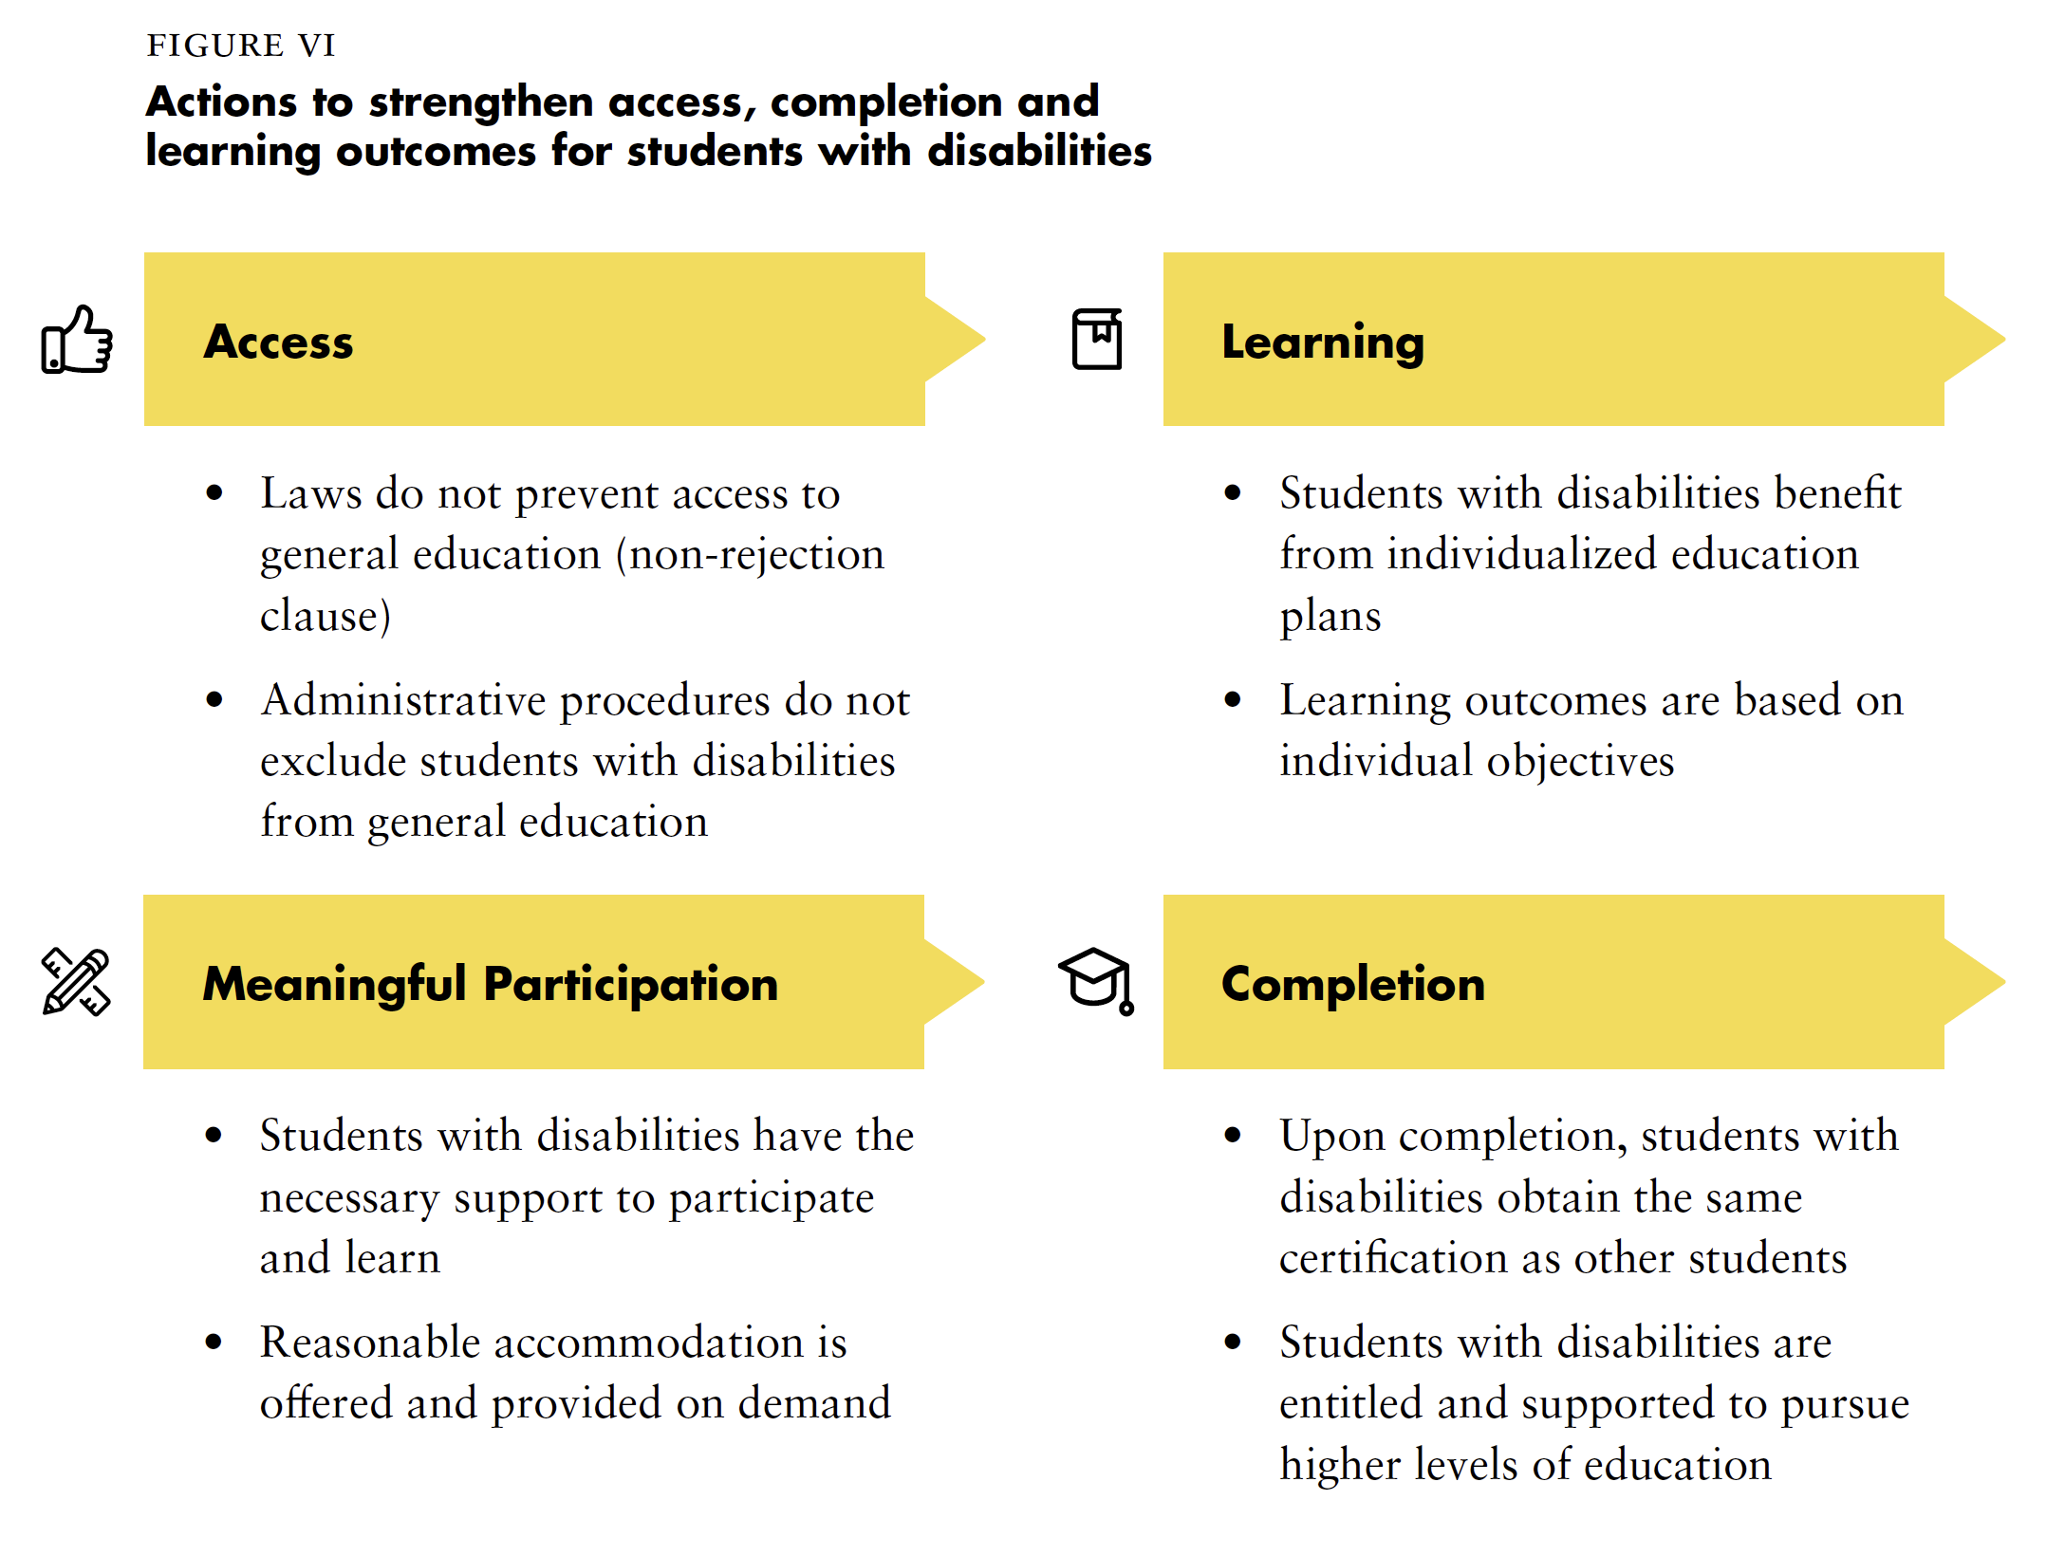

Slide 26
Barriers to inclusive education
Take a moment to read through the stories of Ivan, Aydin, Ava and Rajid.
What barriers are they facing?

Slide 27
Lunch Break! Come back at :00

Slide 28
Team work: Key aspects to ensure inclusive education
Access
Policy
Capacity building
Awareness-Raising
Budget Allocation
Data Collection Process
Accountability
Visit each station, read through the info card and write down specific actions that should be taken for each character and for students who are out of regular schools.

Slide 29
Gallery round in pairs
Find one other person from a different team, go around the room and review the flipcharts.
Share:
What did you learn new?
What’s one thing that called for your attention?
What do you feel can be done in your country?
What might be most difficult to accomplish?

Slide 30
Journal
Individually, write down:
What are specific steps that you can take within the next three months to advance inclusive education in your country?
What and who do you need to bring them to reality?

Slide 31
Next Steps
(Add any information for follow-up after the training here)

Slide 32
Closing Circle
Name one commitment you are making to advance inclusive education in your country.
Who - in your specific context - can hold you accountable for it?

Slide 33
Thank you! For further information, please contact:

