Slide 1
Policy Guidance on Gender Equality: Sustainable Development Goal 5 – Promoting the Rights of Persons with Disabilities through the Sustainable Development Goals A Resource Package
In-Person Training Module
Presenter's name
Event or meeting title Location, (Date)
© United Nations, 2022 – These presentation slides form part of the OHCHR Promoting the Rights of Persons with Disabilities through the Sustainable Development Goals: A Resource Package.

Slide 2
Welcome!
You each have one minute to come to the front of the room, introduce yourself and share:
What motivates you to do the work you do?

Slide 3
Objectives of the module
Become familiar with the various components of the Office of the United Nations High Commissioner for Human Rights’ Resource Package on Promoting the Rights of Persons with Disabilities through the Sustainable Development Goals.
Gain a better understanding of the situation of women and girls with disabilities.
Identify concrete actions that policymakers can take to implement Sustainable Development Goal 5 in their own contexts.
Learn how to obtain additional information for supporting the process of implementation of Sustainable Development Goal 5.

Slide 4
What’s in the Resource Package?
Policy Guidance
Human Rights Indicators for the Convention on the Rights of Persons with Disabilities
Data Sources Guidance
Training Materials
Videos

Slide 5
Agenda
Start time: 00:00
Disability & Ableism (if applicable)
Data contest!
Laws and policies
Meal time: 00:00
Video viewing
Implementation challenge
Next steps
Closing time: 00:00

Slide 6
What did you think about disability when you were 8-12 years old?
Disability and Ableism

Slide 7
In trios:
Share what you remember
What do you notice in common between the stories?
Come up with a list of words that you associated with disability during that time of your life.

Slide 8
Ableism
“a value system that considers certain typical characteristics of body and mind as essential for living a life of value. Based on strict standards of appearance, functioning and behaviour, ableist ways of thinking consider the disability experience as a misfortune that leads to suffering and disadvantage and invariably devalues human life”.
Special Rapporteur on the rights of persons with disabilities, Report on the impact of ableism in medical and scientific practice, A/HRC/43/41, 2019

Slide 9
WELCOME TO THE DATA CONTEST!
The team with most points will win a prize!

Slide 10
Question 1 - In developing countries, what percentage of persons with disabilities are women? (5 points)
12 per cent
75 per cent
C. 19 per cent

Slide 11
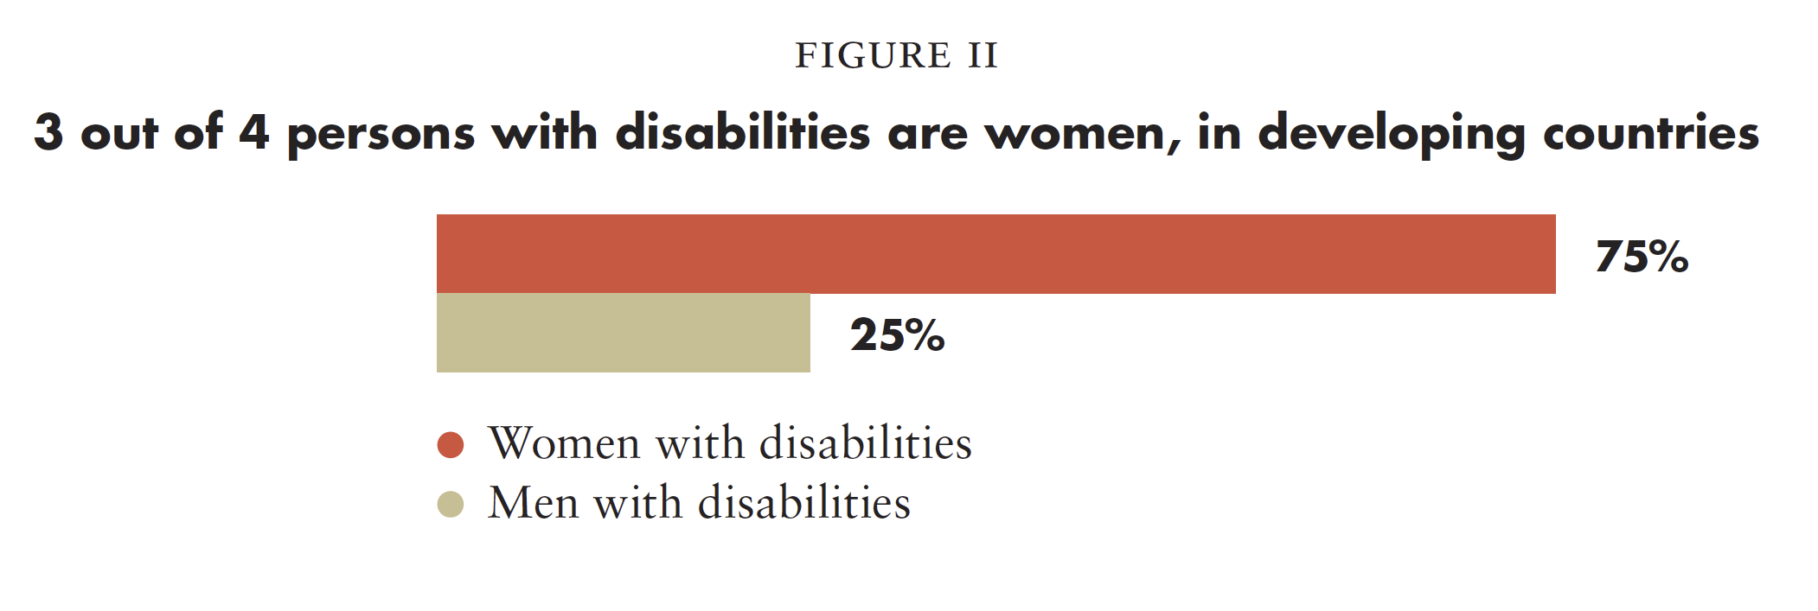
Question 1 - In developing countries, what percentage of persons with disabilities are women? (5 points)
Source: Plan International (2011) as cited in UN Women, Issue brief: Making the SDGs count for women and girls with disabilities, 2017.

Slide 12
Question 2: True or False - Women and girls with intellectual and/or psychosocial disabilities are more likely to be denied their right to legal capacity. (5 points)

Slide 13
Question 3 - Based on data from 28 European countries, what percentage of women with disabilities have experienced physical or sexual violence by an intimate partner in comparison to other women? (5 points)
34 per cent compared to 19 per cent
7 per cent compared to 5 per cent
49 per cent compared to 20 per cent
None of the above

Slide 14
Question 3 - Based on data from 28 European countries, what percentage of women with disabilities have experienced physical or sexual violence by an intimate partner in comparison to other women? (5 points)
Source: European Union Agency for Fundamental Rights, Violence against women: an EU-wide survey: Main results, 2015. p. 187, table A3.2.

Slide 15
Question 4 - True/False - Lack of access to sexual education of persons with disabilities expose them to higher risk of sexually transmitted infections. (7 points)

Slide 16
Question 5: Challenge! (10 points)
Two members of your team have to share policies or practices in their countries that promote gender equality for women with disabilities.

Slide 17
BREAK! Come back at :00

Slide 18
Journal
Write out a list of laws or policies that relate to gender or women in your country.

Slide 19
In groups
Discuss how these laws or policies do or do not include women with disabilities.

Slide 20
Lunch Break! Come back at :00

Slide 21
Short Video
As you watch and listen, pay attention to your character and the barriers highlighted.

Slide 22
In groups
Create a list with barriers your character faces.
Come up with five actions to address your character’s situation and write them in a flipchart.
Identify who would be responsible in your context for implementing these actions.

Slide 23
Break! Come back at :00

Slide 24
Implementation Challenge: Application
Choose two actions that are possible to do in your country/region.
Pick one action that would be difficult to implement and discuss why.

Slide 25
Please share one thing you will commit to do to advance gender equality for women with disabilities in your context.

Slide 26
Resources
Resource package link
Policy Guidance
Human Rights Indicators
Data Sources Guidance
Training Modules
Videos
(Add other relevant resources)

Slide 27
Thank you! (Add dates of next trainings here)
(Contact information for questions)

