Slide 1
Keeping the focus on racism in education
Professor Kehinde Andrews

Slide 2
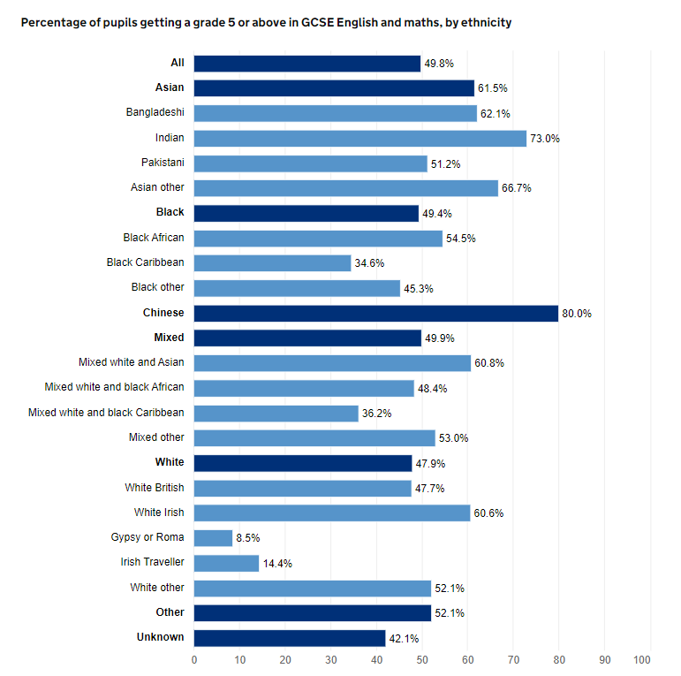
Racism, not disparities

Slide 3
New Racial Science
‘Instituional racism does not exist (Sewell Report, 2021)
‘Forgotten’ White working-class pupils let down by decades of neglect, MPs say (2021)
‘Whilst working-class white boys had been the least likely to make it to university since 2007’ (2022)
(Andrews, 2023)

Slide 4
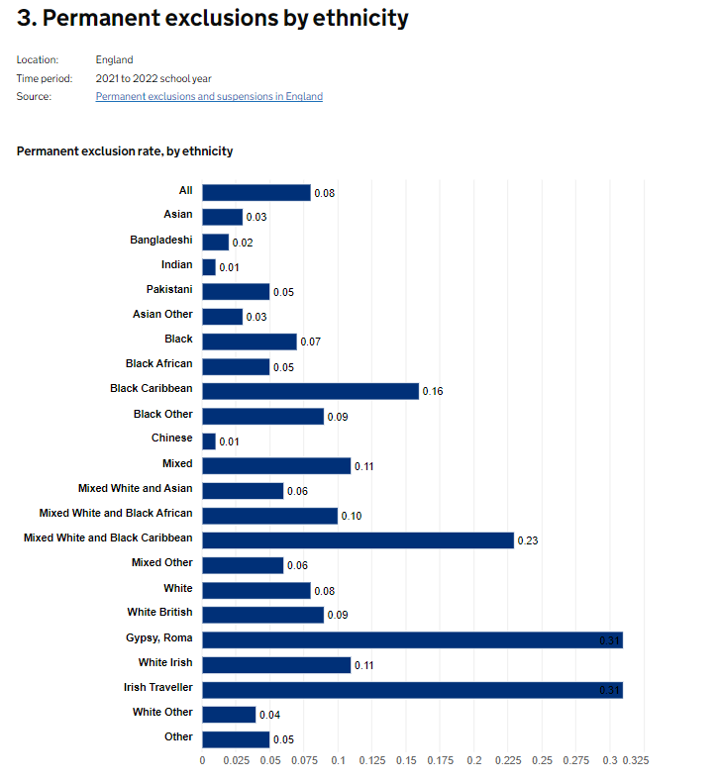
Exclusion by ethhcnity

Slide 5
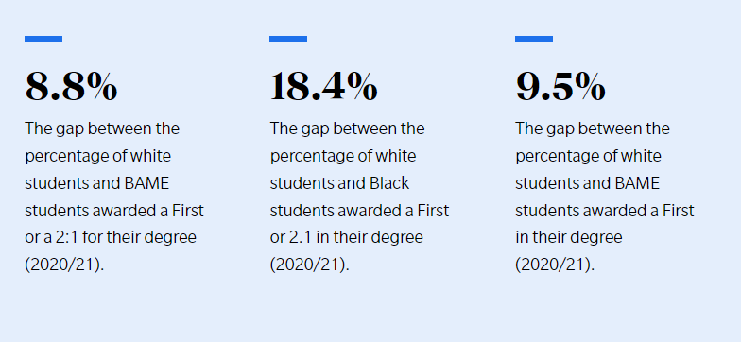
University inequality

Slide 6
Educationally subnormal
Overt racial discrimination in the British school system
Up to 70% of Black children deemed Educationally subnormal in some London schools (Dove, 1993)
Doulton Report (Andrews, 2013)
On a rough calculation about half the immigrants will be West Indians at 7 of the 11 schools, the significance of this being the general recognition that their IQs work out below their English contemporaries. Thus academic standards will be lower in schools where they form a large group
English as second language

Slide 7
Coard(1971)
Teacher racism
There are three main ways in which a teacher can seriously affect the performance of a Black child: by being openly prejudiced, by being patronizing, and by having low expectations of a child’s abilities. All three attitudes can be found among teachers in this country. Indeed these attitudes are widespread. (p.18)
Curriculum
When in addition the pictures of Blacks are golliwog stereotypes, about whom filthy jokes are made; when most plays show Black men doing servant jobs; when the word ‘Black’ in every story is synonymous with evil, then it becomes impossible for the child to want to be Black … the Black child under these influences develops a deep inferiority complex. He soon loses motivation to succeed academically since, at best, the learning experience in the classroom is an elaborate irrelevance to his personal life, and at worst it is a racially humiliating experience. (p.30)

Slide 8
Black Supplementary schools
Parents, churches, community organisations etc spontaneously formed programmes
Mostly held on a Saturday
In the available spaces
Many in people’s homes
Some trained teachers, but mostly volunteers
Little connection between programmes
Though national organisation has been tried
National Association of Black supplementary schools
Became part of ILEA strategy in the 1980s (Andrews, 2013)

Slide 9
Policy recommendations
Understand the problem as racism
Whole education system
Early years to higher education
Transform the Eurocentric curricula
Target schools
Support Black Studies at related university courses
Train more Black teachers
Funding for community education initiatives

Slide 10
References
Andrews, K. (2013) Resisting Racism: Race, Inequality and the Black Supplementary School Movement. London: Institute of Education Press
Andrews, K. (2023) The Psychosis of Whiteness: Surviving the Insanity of a Racist World. London: Allen Lane
Coard, B. (1971) How the West Indian Child is Made Educationally Subnormal in the British School System. London: New Beacon Books
Department of Education (2023) GCSE English and maths results. Available at: https://www.ethnicity-facts-figures.service.gov.uk/education-skills-and-training/11-to-16-years-old/a-to-c-in-english-and-maths-gcse-attainment-for-children-aged-14-to-16-key-stage-4/latest/
Department of Education (2024) Permanent exclusions. Available at: https://www.ethnicity-facts-figures.service.gov.uk/education-skills-and-training/absence-and-exclusions/permanent-exclusions/latest/
Universities UK (2022) Closing the gap, three years on. https://www.universitiesuk.ac.uk/what-we-do/policy-and-research/publications/features/closing-gap-three-years/introduction

