Slide 1
Education and Enterprise: Black Agency and Achievements -
Cooperatives, Credit Unions and Circles
32rd Session of the UN WGEPAD
Colin Bartholomew, Programme Dean, Co-operative Studies
Cipriani College of Labour & Co-operative Studies
Trinidad and Tobago, W.I.

Slide 2
Indigenous Tools of Empowerment
Co-operatives
Credit Unions/
SACCO
Circles
Association of persons united to meet common economic, social and cultural needs and aspirations
informal savings and financing arrangements among people of African descent
Group of persons organized under a business model which engages primarily in credit administration
Gayap/
Lend Hand
Koudmen

Slide 3
Co-operative Empowerment
It is estimated that there are now over 760 million individuals who have chosen the Cooperative Advantage.
Values, principles, ethics and business competence constitute the Cooperative Advantage, both for members and for the communities in which they operate.

Slide 4
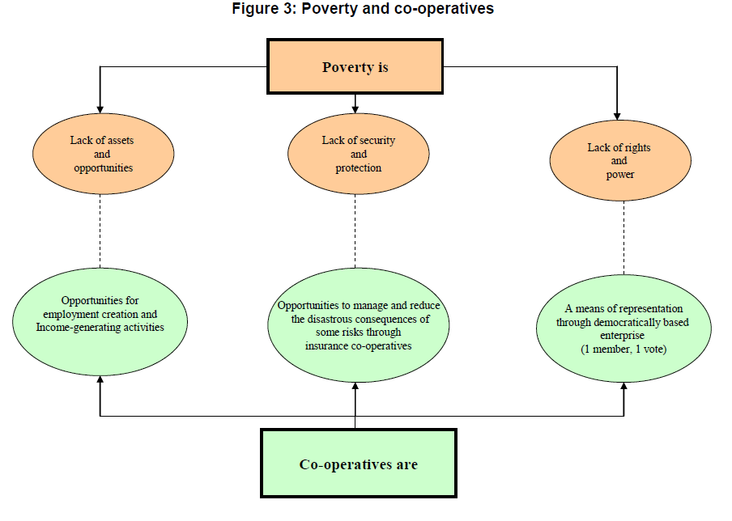

Slide 5
Co-operative Empowerment
Since cooperatives are member-owned and member-controlled under democratic principles, they certainly put people first
Increasingly, they are embracing cooperative entrepreneurship in order to make them competitive enterprises.

Slide 6
Credit Unions & SACCOs
Over 87k credit unions serving in excess of 370 million members worldwide
Africa
  Over 41k Credit Unions/SACCOs
  Over 44 million members
  Assets – USD$22.8 billion
  Deposits - USD$21.5 billion
  Loans – USD$14.1 billion
  Market Penetration – 15.66% (world average 12.69%)

Slide 7
Credit Unions & SACCOs
Over 87k credit unions serving in excess of 370 million members worldwide
Caribbean
  31 Credit Unions
  3.9 million members
  Assets – USD$9.3 billion
  Deposits - USD$7.8 billion
  Loans – USD$5.4 billion
  Market Penetration – 68.58% (world average 12.69%)

Slide 8
Circles/Sou Sou/Box/Box Hand
A properly run sou-sou is a traditional African-derived plan of savings and pooling with a fixed set of participants in a revolving payment of collective deposits. It has been used successfully for over 150 years here (Caribbean).
A sou-sou is structured where one person will be in charge of collecting monies from a group of people. All the monies collected will be given to one person in the group, on selected dates, and it rotates that way until each person has received what they call, a ‘hand.’

Slide 9
Circles/Sou Sou/Box/Box Hand
Interestingly, the historical response to this was a culture of self-reliance and self-development. It saw the creation of institutions […] to provide financial access, and the utilisation of traditional West African norms like the gayap [from the Indigenous word kayapa, describing how people come together to complete an otherwise daunting task] to physically build houses and communities. And of course, the sou-sou to help recreate a CULTURE of savings and to provide the capital needed to invest in their own activities.

Slide 10
Co-operatives, Credit Unions, Circles
Attractive to persons who are poor, deprived, vulnerable and seeking avenues to improve their lives
Business enterprises which allows for an equitable distribution of wealth / resources generated by the co-operative
True cooperative are driven by the needs of the members
Business/Associations/Organizations which operate on a philosophy that require them to empower all persons (men & women) therefore removing the powerlessness feeling

Slide 11
Thank you
Cooperatives, Credit Unions and Circles
32rd Session of the UN WGEPAD

