Slide 1
The Impact of the Global Economic and Financial Architecture and Mechanisms on Peple of African Descent
Ms Mavis Owusu-Gyamfi (ACET, Executive Vice President)
WGEPAD 32nd Session

Slide 2
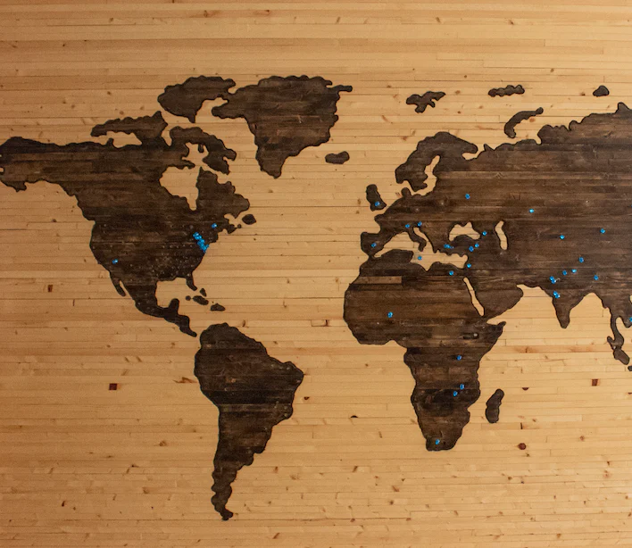
Structure of Presentation
The Positive Impact
African Descendants in Africa
African Descendants in the Caribbean
African Descendants in Europe and North America
Recommendations

Slide 3
Global Financial Architecture: The Positive Impact
Development Finance
Life expectancy, literacy, health outcomes, and access to education over the past few decades
Facilitated a supportive global environment - strong growth with trading partners, favorable global financial conditions, and growing exposure to a surging global economy.
Significant financial support - grant, low interest debt, debt relief, concessional budget support etc
Diversified sources of finance
Help to mitigate the adverse effects of COVID-19 on developing countries:
Debt Service Suspension Initiative (DSSI)
IMF's Rapid Credit Facility
Special Drawing Rights (SDR)
Rapid disbursements of IDA and IBRD disbursements
However, the multiple crises of Covid-19, Financial, Climate, Food Insecurity, Conflict etc. has shown it is has significant flaws and no longer fit for purpose – especially for people of African Descent.

Slide 4
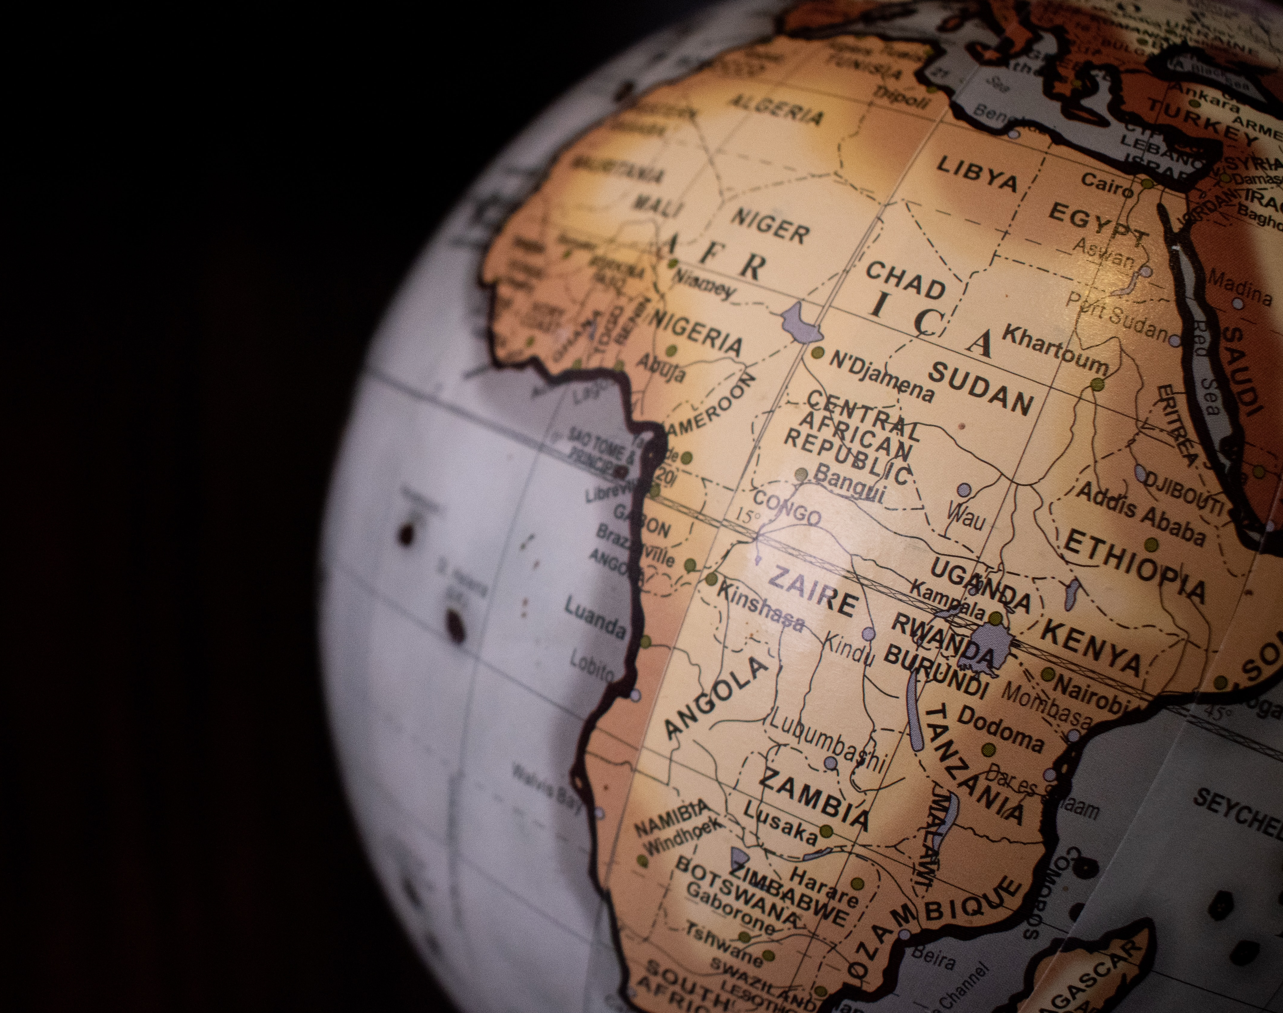
People of African Descent in Africa

Slide 5
Financing needs in Africa
Achieving the SDGs
SDG gains regressed during COVID, the continent needs an estimated estimated at between $614 - $638 billion annually to get back on track.
Africa needs about $484 billion within the next three years to address the socio-economic impacts of the pandemic and support economic recovery alone (AFDB, 2022)
continent's infrastructure financing gap is estimated to range from $68 billion to $108 billion per year.
Debt in Africa
Many African countries are facing increasing fiscal deficits and debt vulnerabilities, with some countries at risk of default.
At least 48% of African countries have debt-to-GDP ratios above 70%.

Slide 6
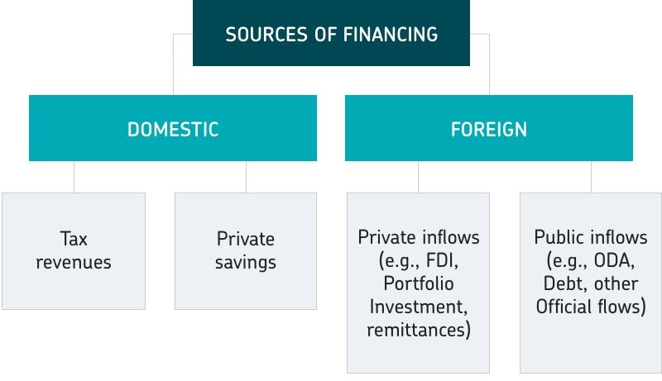
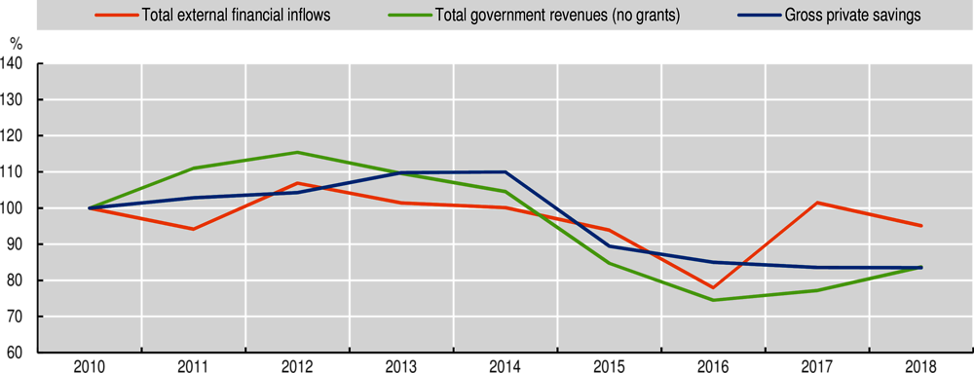
Africa: Sources of Finance for Development
Sources: Authors’ calculations based on data from IMF (2020a), World Economic Outlook (database) www.imf.org/external/pubs/ft/weo/2020/01/weodata/index.aspx; OECD-DAC (2020a), International DevelopmentStatistics(database) www.oecd.org/dac/stats/idsonline.htm; OECD-DAC (2020b), Country Programmable Aid (database) www.oecd.org/dac/financing-sustainable-development/development-finance-standards/cpa.htm; UNCTAD (2020a), World Investment Report 2020 and World Bank (2020a), KNOMAD Remittances Data (database) www.knomad.org/data/remittances.

Slide 7
Global Finance Architecture: Africa
Debt
Short Term Liquidity
Bilateral
Domestic Revenue
Global Taxation Laws
Special Drawing Rights
Debt Suspension Initiative
Debt (Concessional and non-concessional)
Multilateral
Bilateral
Bondholders – domestic & international
Other
Short-term – internal & external
Foreign Direct Investment
Climate Finance
Grants & Investments
Capital Flight
Global financial conditions, led by the US Federal Reserve
Inequality & Race
Grant Finance
Development Finance Institutions
Corporate Investors
Private Investors
Grants
Equity
Investments
Foundations
Business

Slide 8
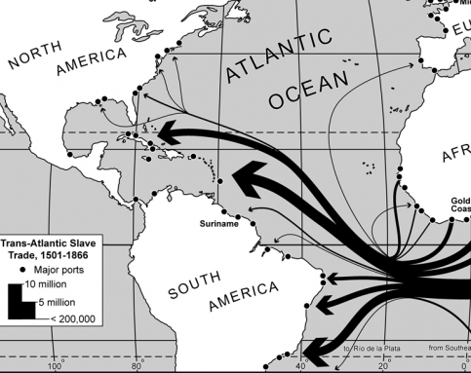
People of African Descent in Africa People of African Descent in the Caribbean and South America

Slide 9
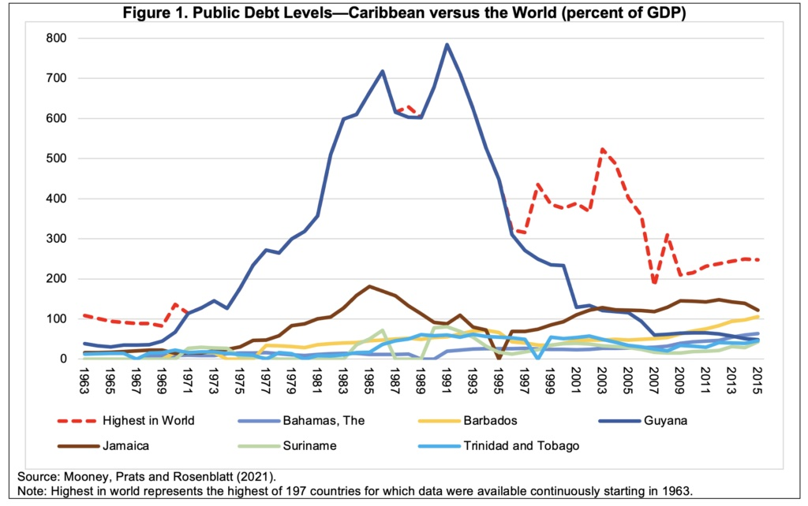
In the Carribbean and South America
Debt
High Levels of Debt & Challenges with Debt Service
Grant and Subsidized loans
ODA has been on the decline as several SIDS graduated to LMIC status
FDI
FDI to Caribbean SIDS has been on the decline over the past decade

Slide 10
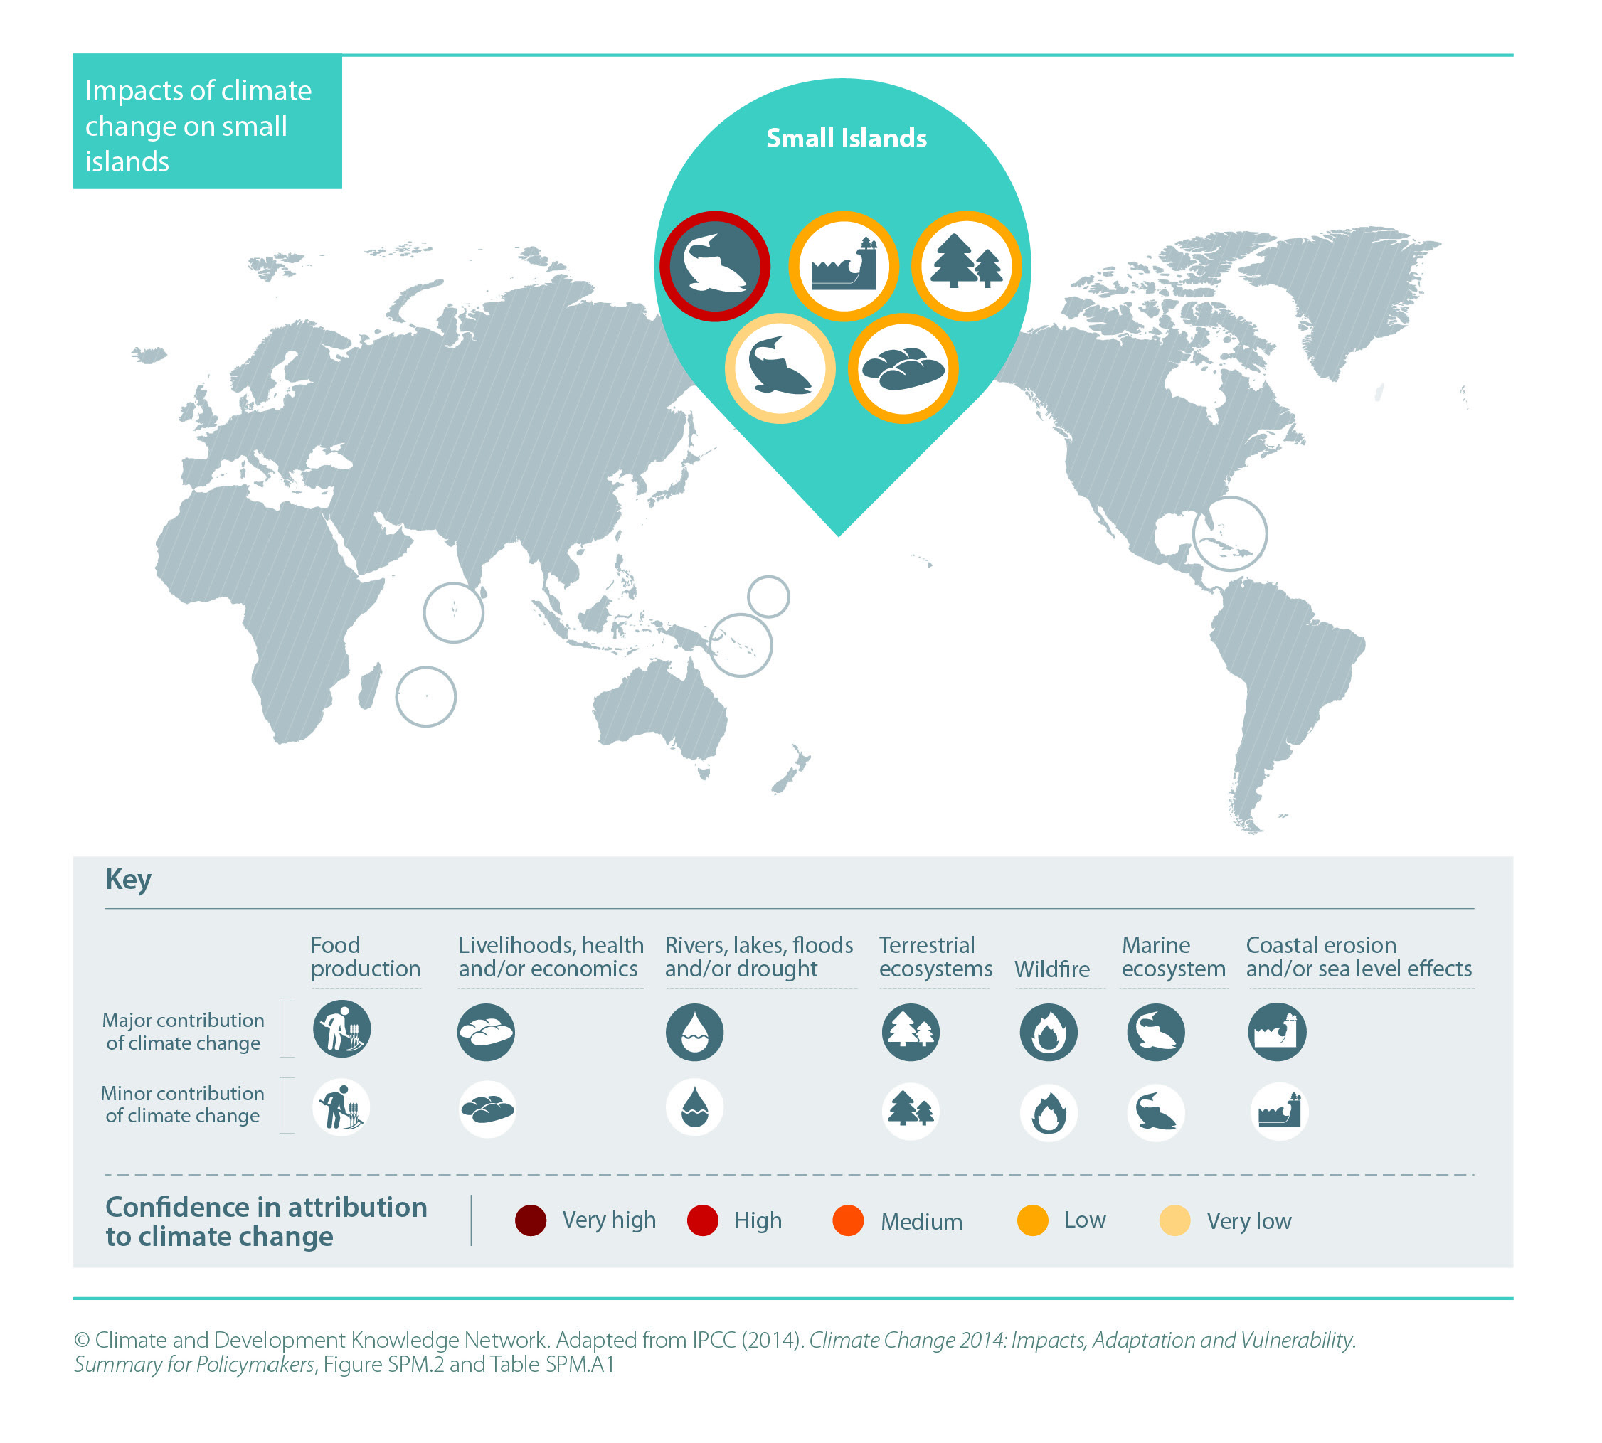
Financial support and exclusion
Climate Finance
Small Island developing states (SIDS), who are particularly vulnerable to extreme natural hazard shocks and climate change shave spent 18 times more in debt repayments than they receive in climate finance (Eurodad 2022).
Financial exclusion in some countries: black and Afro-descendant communities face financial exclusion and limited access to credit and financial services in the region. For example, only 27% of black households in Brazil have access to formal credit, compared to 41% of white households.

Slide 11
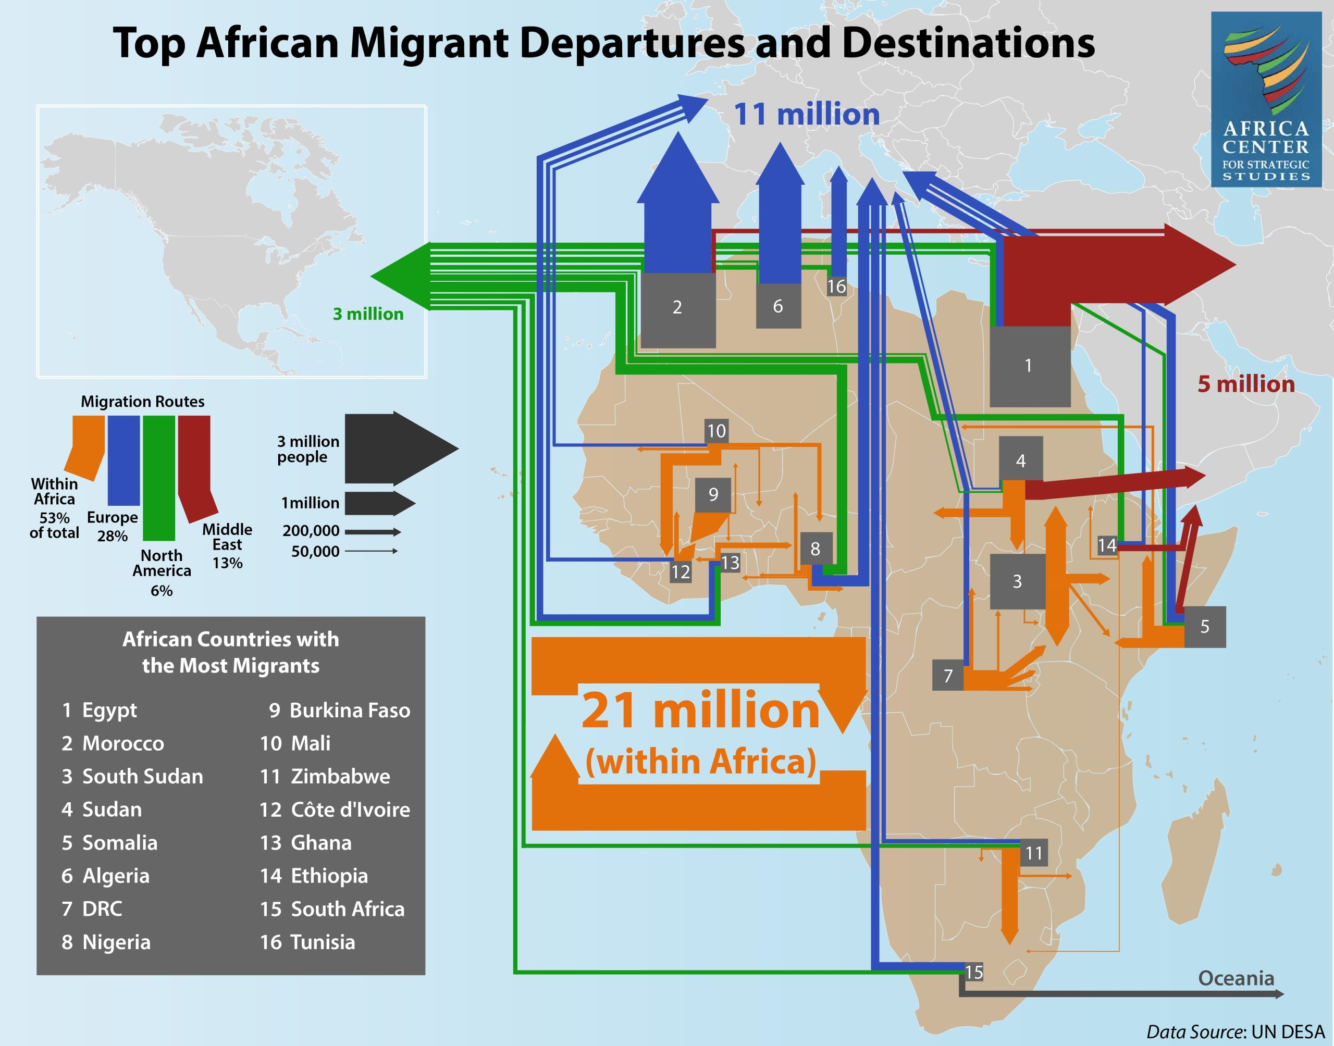
People of African Descent in Europe & North America

Slide 12
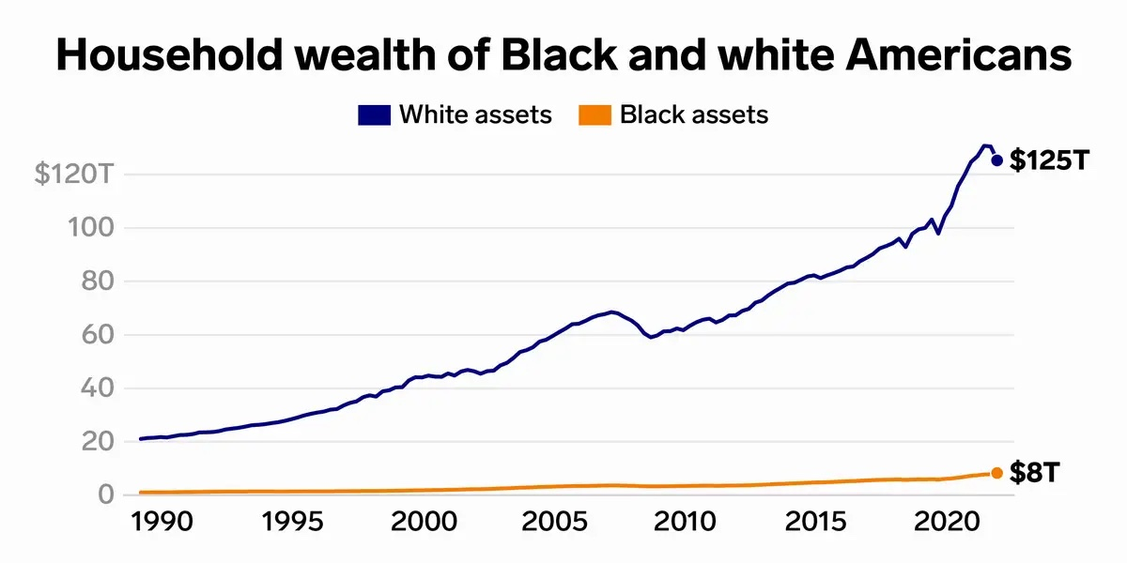
Racial Discrimination in Europe and North America
Wealth Gap – Disproportionate negative impact on people of African. Systemic racism in financial markets limits access to credit and assets and has created a significant racial wealth gap.
The wealth gap between American whites and Blacks is projected to cost the US economy between $1 trillion and $1.5 trillion in lost consumption and investment between 2019 and 2028. This translates to a projected GDP penalty of 4 to 6 percent in 2028 (Noel and others 2019).
Racial discrimination: A barrier to economic and social progress for black and Afro-descendant communities

Slide 13
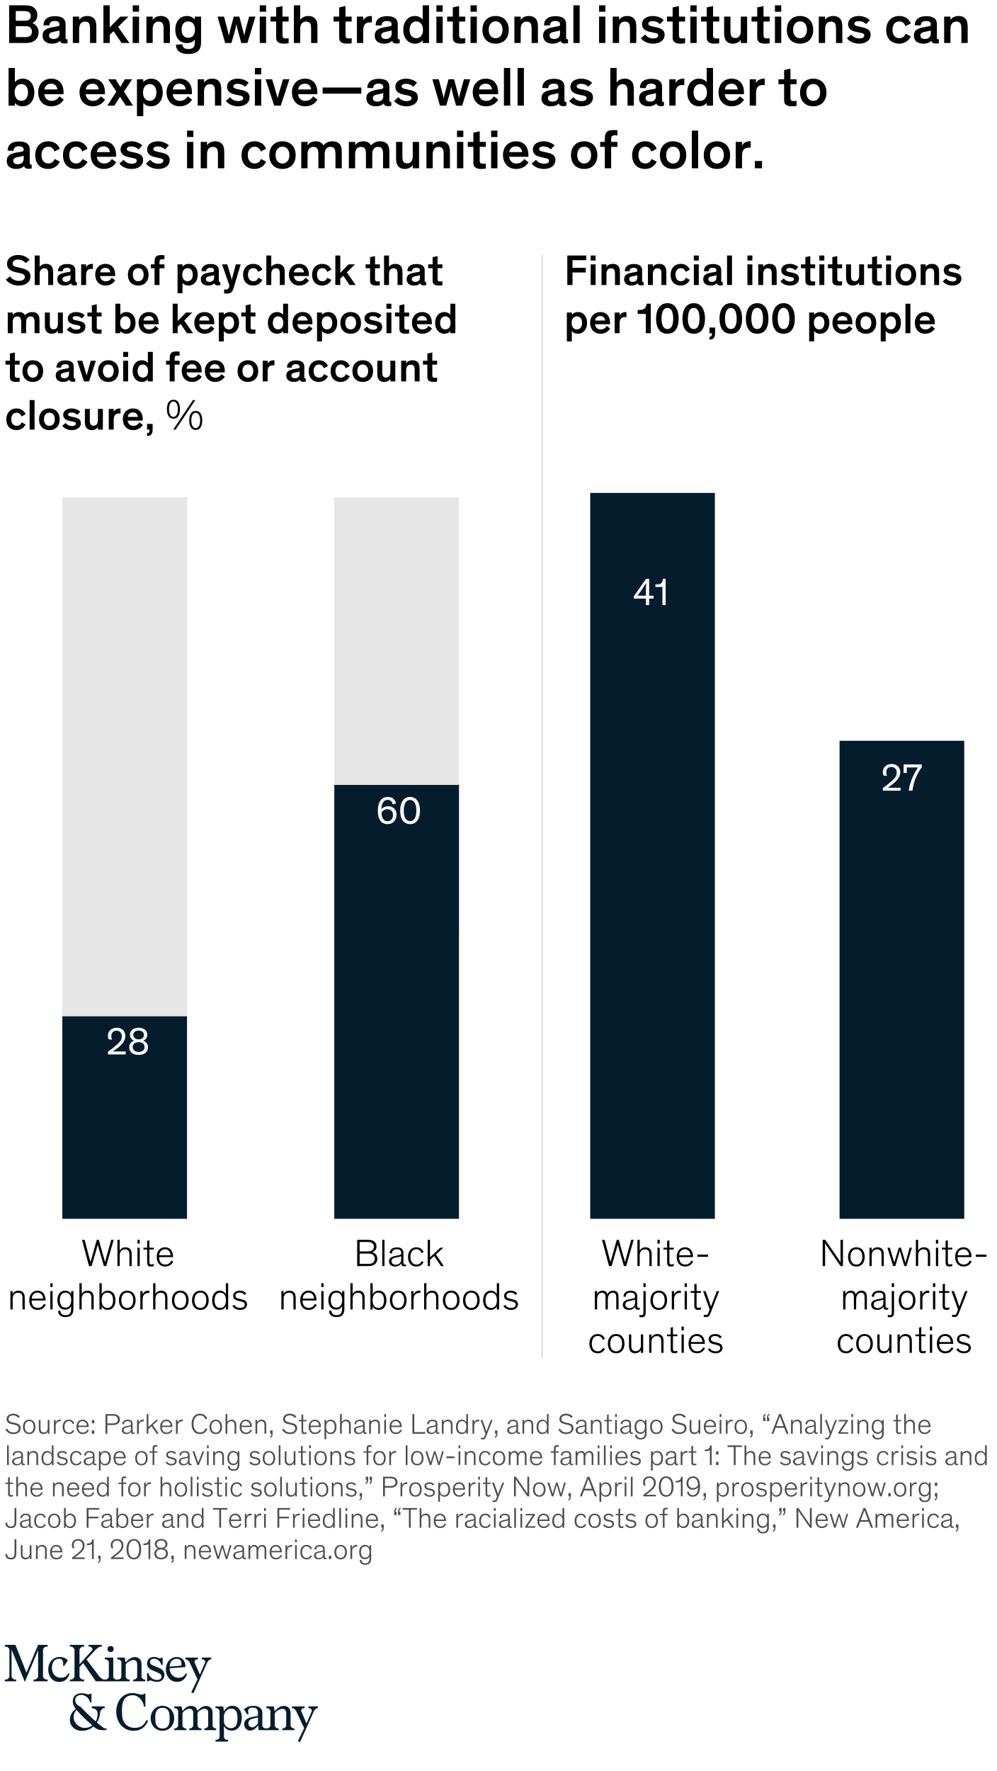
…continued
Displacement - Development projects that involve land acquisition or resource extraction often displaces people of African descent, from their homes and livelihoods.
Redlining in the US remains a silent discriminatory practice which banks and use to deny African American and the diaspora loans or other financial services based on perceived risk thereby depriving them of investment and economic development opportunities.
In cities across North America and Europe, gentrification more often than not displaces people of African descent
People of African descent in North America and Europe are often disproportionately affected by development finance policies that prioritize industrial and infrastructure development without adequate safeguards can exacerbate these disparities. For example, the Flint water crisis in Michigan, USA, disproportionately affected the city's majority African American population, many of whom were already poor.
France’s, GDP increase by 1.5 percent over the next 20 years ($3.6 billion) —by reducing racial gaps in access to employment, work hours, and education (Bon-Maury and others 2016).

Slide 14
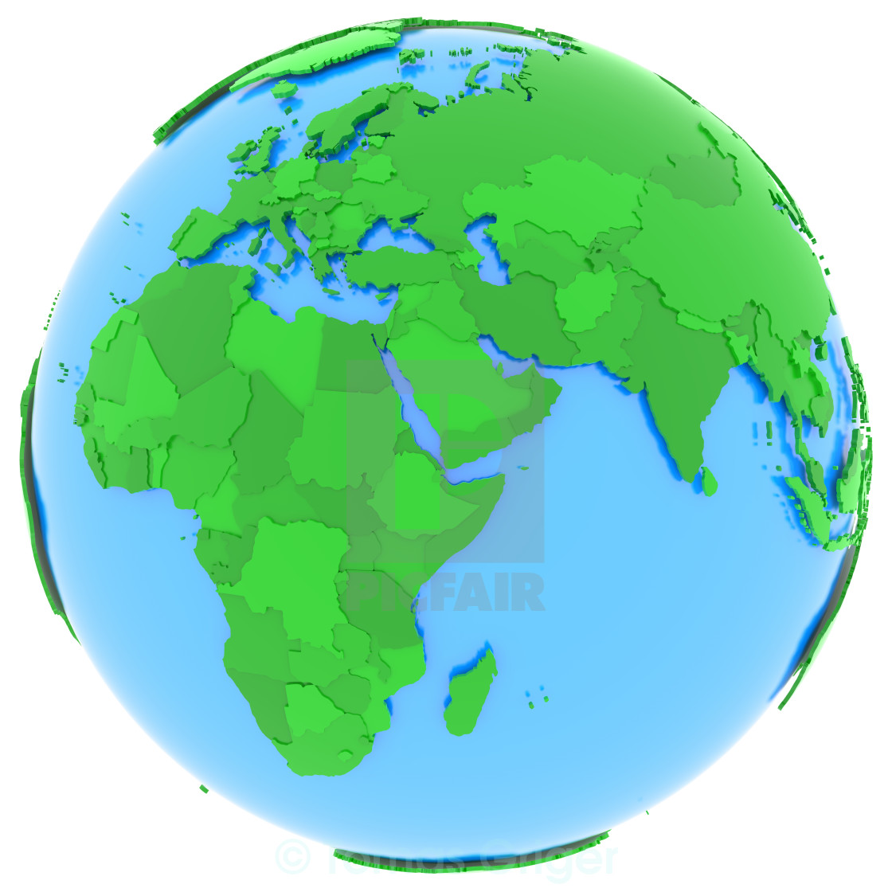
A WAY Forward

Slide 15
African Ministers of Finance: The Road to Marrakech
Increase the amount of low-interest money available to countries, and make sure it stays available over the long term.
Re-channel IMF Special Drawing Rights (SDRs) to the African Development Bank.
Sustain the IMF’s Poverty Reduction and Growth Trust with additional financing.
Overhaul the Common Framework and find a real solution to the debt crisis.
Confirm the African Union as a full member of the G20.

Slide 16
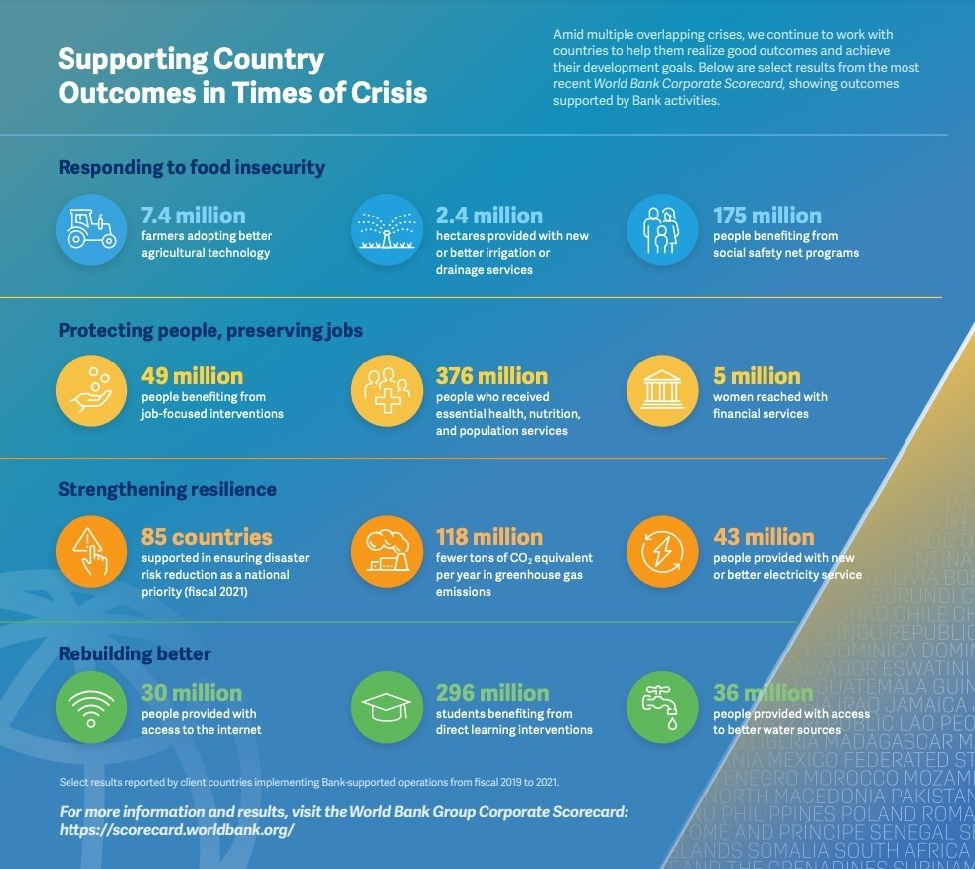
Way forwad: Bridgetown Initiative
Expand multilateral lending to governments by US$1 trillion
Increase official donor resources to multilateral institutions engaged in development banking
Provide debt relief for highly indebted middle-income countries, including debt to MFIs, and establish responsible lending and borrowing rules to prevent debt-fueled capital flight.
Development partners should collaborate with the private sector to create new and innovative financial instruments, like green bonds and debt-for-climate or debt-for-nature swaps that de-risk investments
Barbados is calling for reform of financial institutions including the World Bank to help developing nations on the frontline of climate change. Image: World Bank

Slide 17
Additional Recommendations on a Way Forward
Provide financial and technical support to enhance revenue generation and public spending efficiency
Curtail capital flight by making it difficult for ruling elites to stash cash in Western havens and continue efforts to recover stolen assets.
Leverage diaspora capital for development through better economic management, instilling confidence in political governance and social stability, and establishing National Development Trust Funds, Diaspora Bonds, Collective Remittances and Diaspora Philanthropy, Crowd Funding platforms, and Diaspora Direct Investment
Support the establishment of independent and publicly owned CRAs to assess Africa's credit rating more fairly and transparently
Prioritize the issue of reparations as one important step towards rectifying the historical injustice of slavery and addressing the resulting inequality and unfair treatment towards people of African descent

Slide 18
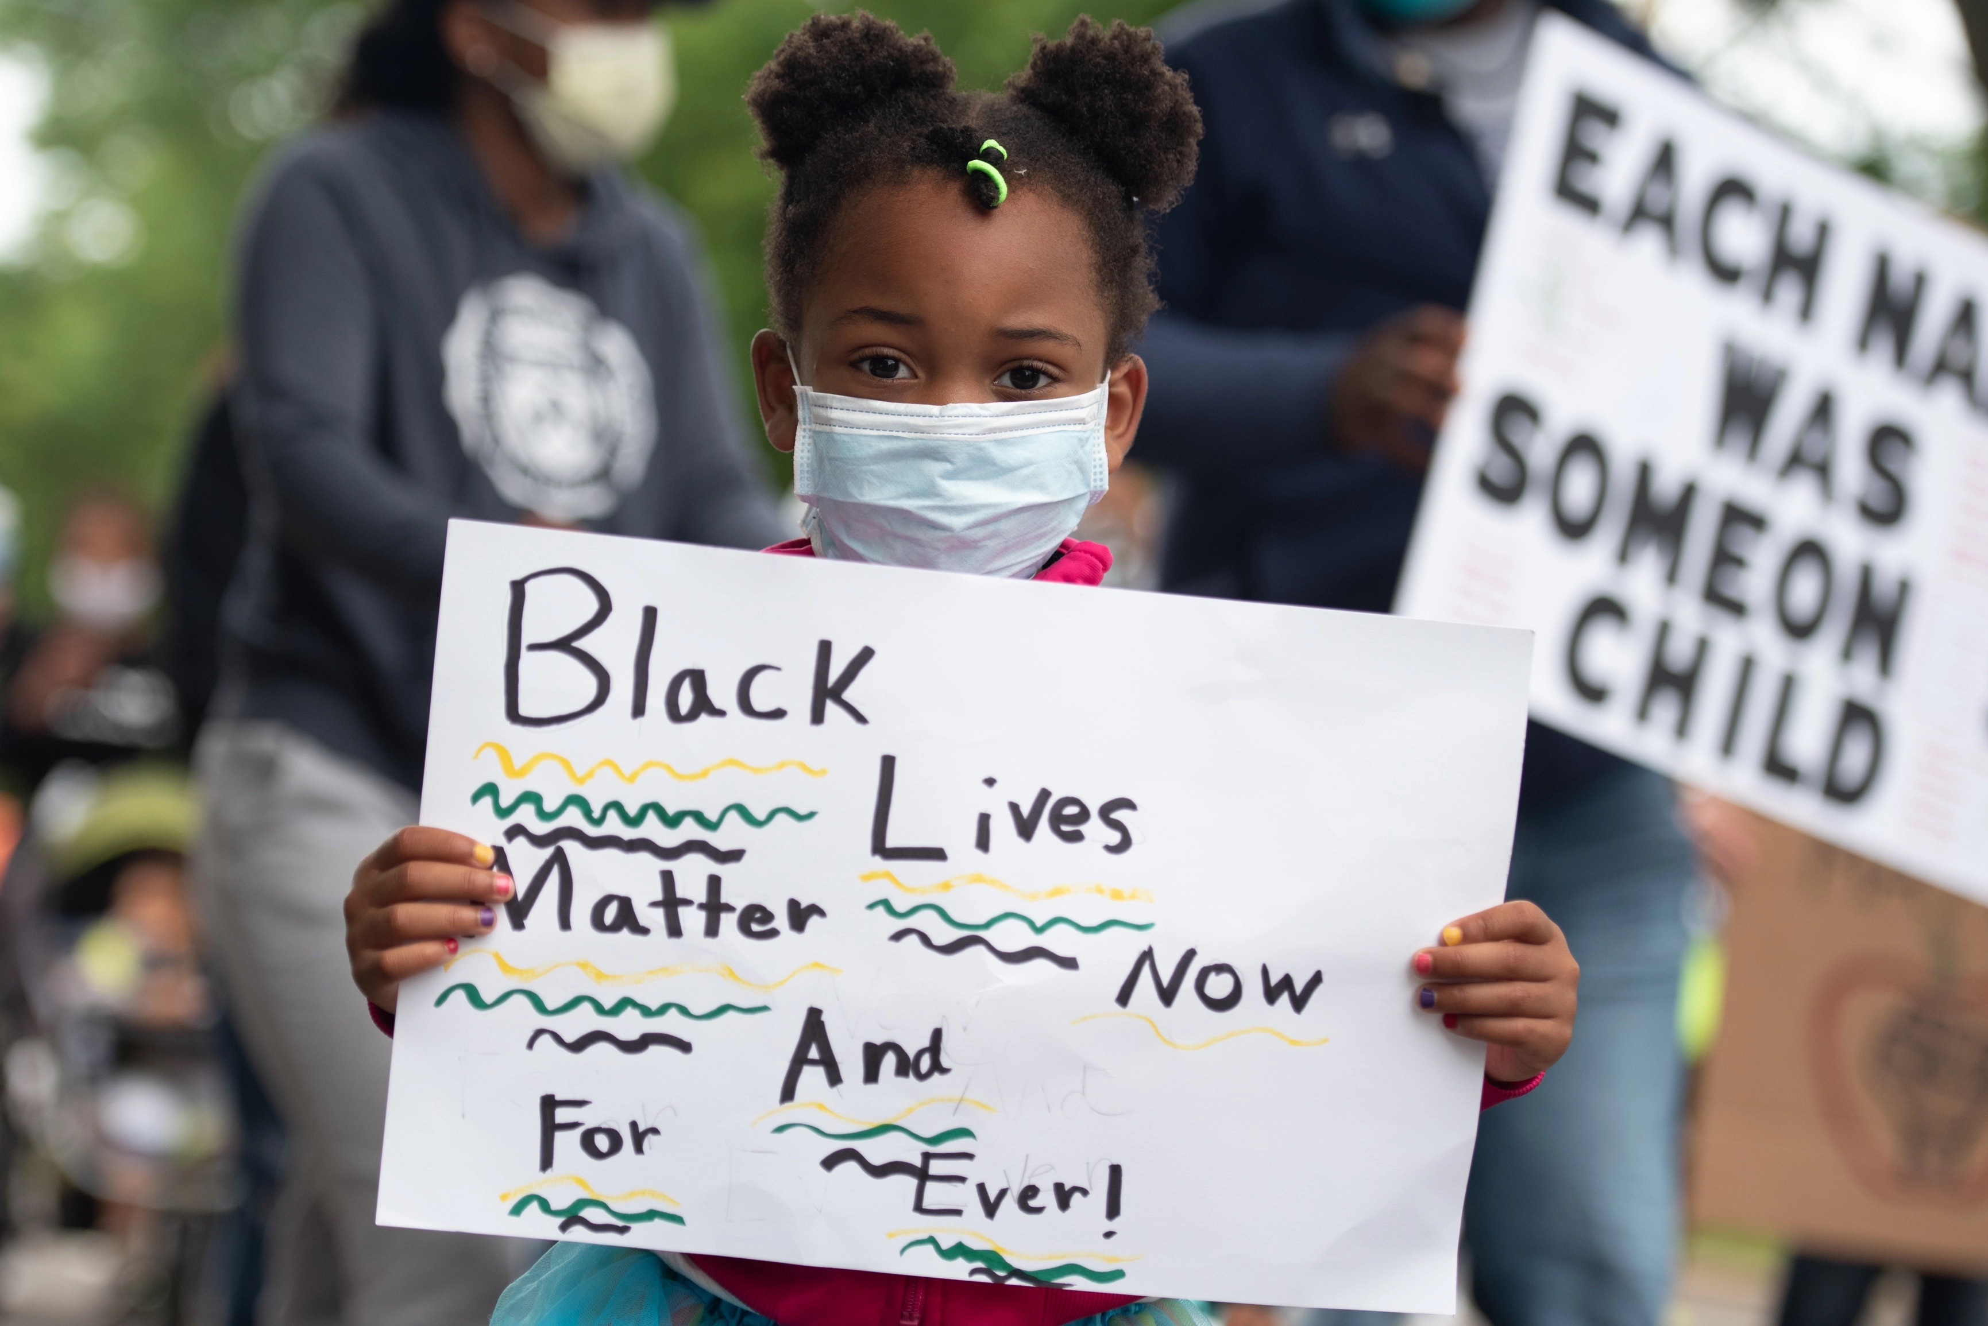
Create more equal societies
For people of African descent in North America and Europe
Ensure meaningful participation and engagement of communities in decision-making processes
Support initiatives that promote economic empowerment and social inclusion of communities
Support initiatives to address historical injustices and inequalities

Slide 19
THANK YOU FOR LISTENING!

