Slide 1
The Banking, Finance, and Insurance Stranglehold on those of African Descent
Benjamin Njila Fields
The Black Economists Network (TBEN)

Slide 2
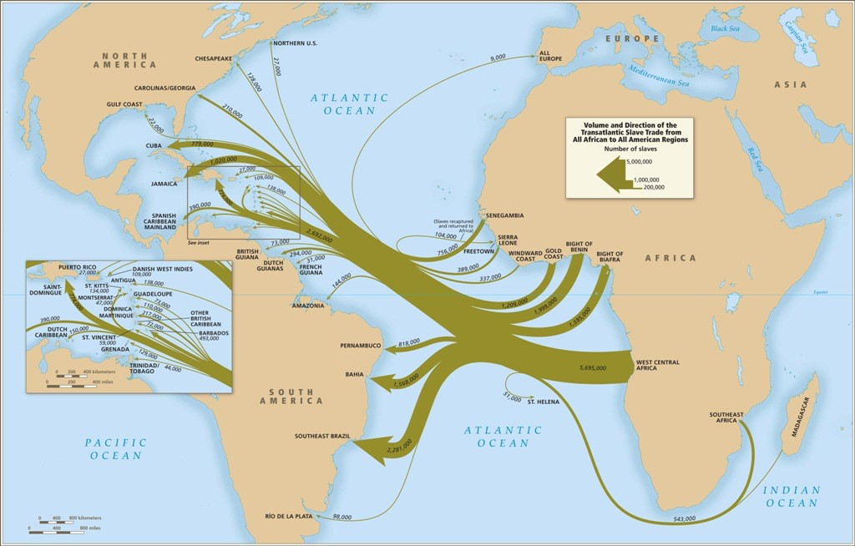
Population of Context
What is “African descent”?
What is the diaspora?
Why is this term contentious?

Slide 3
Education
There are hundreds of financial tools, regulations, rules, and things to use spread across space.
Platforms & Institutions,
Tax Code,
Real Estate,
Bank and Brokerage Accounts,
Credit Cards and Debt Facilities,
and Trusts and Corporate Entities.
Normal people already do not have access, and with this being generational, people of African descent are at a disadvantage.
The education space is full on non-authentic actors, with few being of African descent and having access to provide quality perspective.
There is a paid price to action as well.

Slide 4
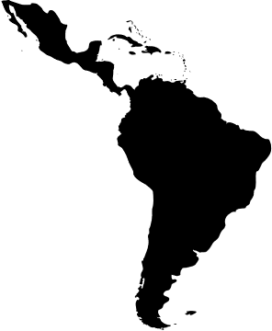
Lack of Protections and "De-Risking"
Land grabbing in Colombia
Banks “derisking” from countries like Jamaica, Trinidad and Tobago, and Barbados while London, New York, and Luxembourg are proven to be money laundering...
Notes:
https://hrlr.law.columbia.edu/hrlr-online/territory-is-everything-afro-colombian-communities-human-rights-and-illegal-land-grabs/

Slide 5
Insurance companies and governments reimbursed slavers for the loss of enslaved people?
Argentina
Bolivia
Brazil
British Empire
Chile
Colombia
Danish colonies
Netherlands
Ecuador
Kingdom of france
French colonial empire
Mexico
Paraguay
Peru
Spanish empire
Sweden
Uruguay
Venezuela
United Kingdom
United States

Slide 6
Banking & Lending
Personal
In the UK, a study from the University of Cambridge found that banks are denying Black victims fraud payback twice as much as White victims.
In the UK, many Black banks are just subsidiaries of banks that are African-centered, originating many times from Nigeria and Ghana.
Among Brazilians without a bank account, nearly 70% are Black.
Business
According to Nick Clegg, "Past evidence shows that firms owned by individuals of black African origin have been four times more likely than so-called 'white firms' to be denied loans outright. And that Bangladeshi, Pakistani, black Caribbean and black African owned businesses have been subject to higher interest rates than white and Indian owned enterprises."
Severely impaired in other places where Black people live, and accommodations that are made are usually harmful (for example a 40-year mortgage in the United States)
Still a nascent industry in Africa.
Notes:
https://nextgenerationinvestor.com/black-owned-banks/
https://www.theguardian.com/commentisfree/2017/jan/13/uk-banks-racial-discrimination-black-victims-fraud#:~:text=It%27s%20time%20they%20admitted%20it,-This%20article%20is&text=A%20Cambridge%20University%20study%20has,their%20bank%20as%20white%20customers.
https://www.theguardian.com/commentisfree/2017/jan/13/uk-banks-racial-discrimination-black-victims-fraud#:~:text=It%27s%20time%20they%20admitted%20it,-This%20article%20is&text=A%20Cambridge%20University%20study%20has,their%20bank%20as%20white%20customers.
https://www.forbes.com/sites/angelicamarideoliveira/2022/07/04/how-brazils-conta-black-is-creating-a-financial-ecosystem-for-black-consumers/?sh=6efda1e461fa

Slide 7
Remittances
Fees
According to the WB, fees amount to about 9.74% (back to Africa).
Restrictions: there can be daily limits of $3,000 - $5,000.
Disparity of funding and lending: you can receive funding to buy a holiday home in the Algarve much easier than something in Africa (which is actually more valuable)
Is forced to be underground, which may actually be better...
People transferring large sums of money under the table to evade rules and fees.
Dominated by Western Union and Money Gram who are bust in their home market (America).
Can account for a significant amount of GDP in African countries (like 5%+.
Notes:
https://qz.com/africa/2086170/the-rise-of-informal-money-transfers-in-west-africa

Slide 8
Recommendations
Transparency
Detailed reports on underwriting processes at multiple levels including in commercial, consumer, and development banking matters.
A global campaign on how international property and banking works.
Restructuring
Improvements in the underwriting process at each of the levels mentioned before that needs more transparency.
Required explanation of rates and amortization to people of African descent.
Improvements and expansion of debt facilities both within and across borders.
More legitimate financial infrastructure in African jurisdictions.
Novel Entities
More support for digital banking and financial tools that are non-predatory.
More support for fin-tech companies headed by those of African descent.
Notes:
https://nextgenerationinvestor.com/black-owned-banks/
https://www.theguardian.com/commentisfree/2017/jan/13/uk-banks-racial-discrimination-black-victims-fraud#:~:text=It%27s%20time%20they%20admitted%20it,-This%20article%20is&text=A%20Cambridge%20University%20study%20has,their%20bank%20as%20white%20customers.
https://www.theguardian.com/commentisfree/2017/jan/13/uk-banks-racial-discrimination-black-victims-fraud#:~:text=It%27s%20time%20they%20admitted%20it,-This%20article%20is&text=A%20Cambridge%20University%20study%20has,their%20bank%20as%20white%20customers.
https://www.forbes.com/sites/angelicamarideoliveira/2022/07/04/how-brazils-conta-black-is-creating-a-financial-ecosystem-for-black-consumers/?sh=6efda1e461fa

