Slide 1


MODULE 2
Understanding migration as a human rights issue
Session 5: The United Nations human rights system

Slide 2

Module overview
Session 3: International human rights and migration
Session 4: The Convention on Migrant Workers
Session 5: The United Nations human rights system

Slide 3

Session overview
The UN system and migration
The UN human rights system:
  The Office of the High Commissioner for Human Rights (OHCHR)
  UN human rights treaty bodies
  UN Charter-based bodies
Their functions and how to engage
What’s in it for me?
Group activity
Summary

Slide 4

The United Nations system includes …
OHCHR
UN WOMEN
UNODC
UNICEF
UNHCR
ILO
IOM

Slide 5

The United Nations system includes …
UN organizations around the world
United Nations Charter, Article 1(3)
“…promoting and encouraging respect for human rights and for fundamental freedoms for all without distinction as to race, sex, language, or religion...”
High Commissioner
for Human Rights
OHCHR
Treaty bodies
Human Rights Council

Slide 6
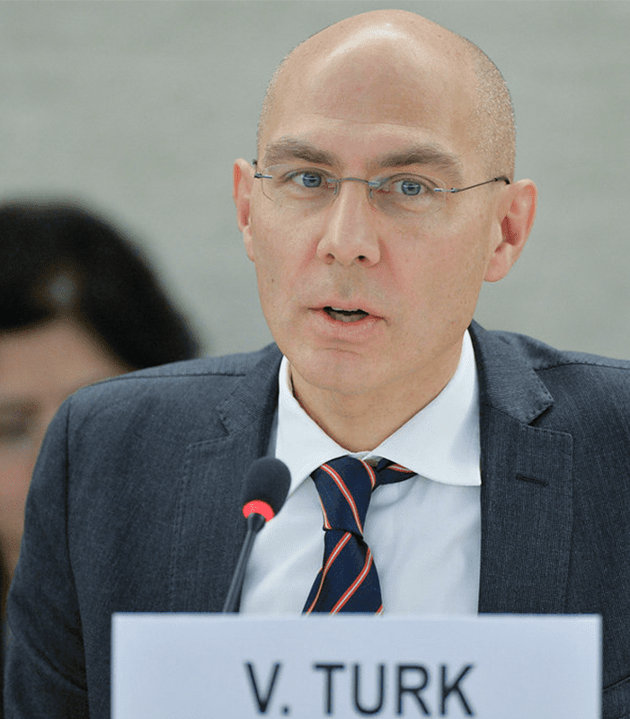
Office of the High Commissioner for Human Rights
General Assembly Resolution 48/141
Promotes and protects human rights
Helps empower people
Assists governments
Mainstreams human rights in UN programmes

Slide 7
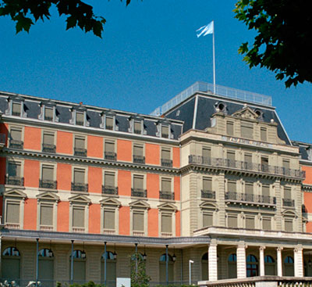
Treaty bodies
Are created by relevant treaty
Are committees of independent experts
Monitor compliance
Issue recommendations
Interpret the relevant treaty
Consider individual complaints
Conduct inquiries
Request interim measures

Slide 8
Treaty bodies
International Covenant on Civil and Political Rights
International Covenant on Economic, Social and Cultural Rights
CEDAW
Human Rights Committee
Convention on the Elimination of All Forms of Discrimination against Women
CAT
Convention against Torture and Other Cruel, Inhuman or Degrading Treatment or Punishment
CRC
Convention on the Rights of the Child (1989)
CMW
International Convention on the Protection of the Rights of All Migrant Workers and Members of Their Families
CRPD
Convention on the Rights of Persons with Disabilities
CED
Convention on the Protection of all Persons from Enforced Disappearance
ICESCR
CERD
Convention on the Elimination of All Forms of Racial Discrimination

Slide 9
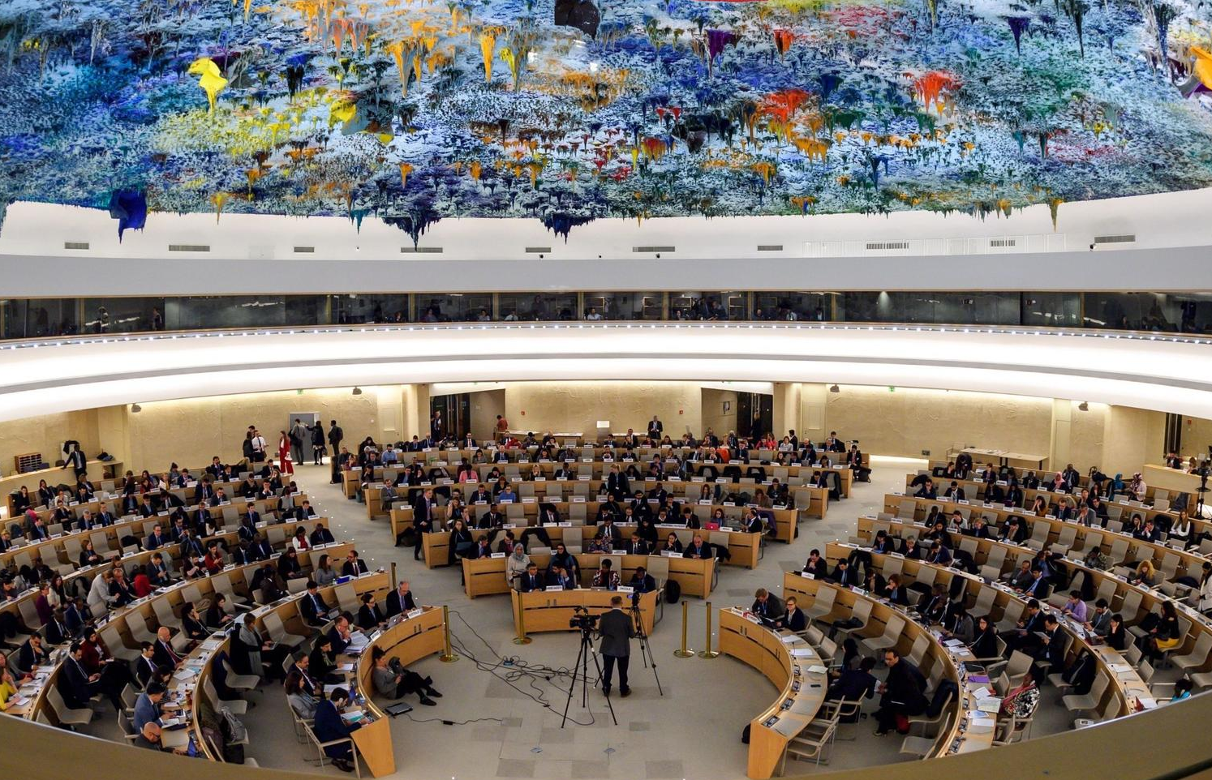
Human Rights Council
Created by General Assembly Resolution 60/251 of 2006
Intergovernmental body with 47 members
Addresses and works to prevent human rights violations
Responds to emergencies
Provides an international forum for human rights dialogue
Recommends developments in human rights law
Reviews countries via Universal Periodic Review

Slide 10
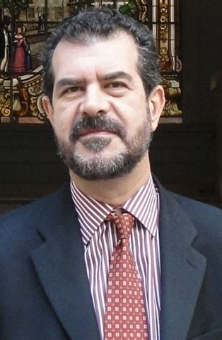

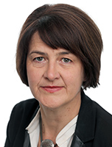
Human Rights Council: Special procedures
Independent experts appointed by the HRC
Thematic and country mandates
Monitor compliance
Make country visits
Issue communications and urgent appeals
Special Rapporteur on the human rights of migrants
Special Rapporteur on trafficking in persons, especially women and children
Special Rapporteur on contemporary forms of racism, racial discrimination, xenophobia and related intolerance
Working Group on arbitrary detention

Slide 11
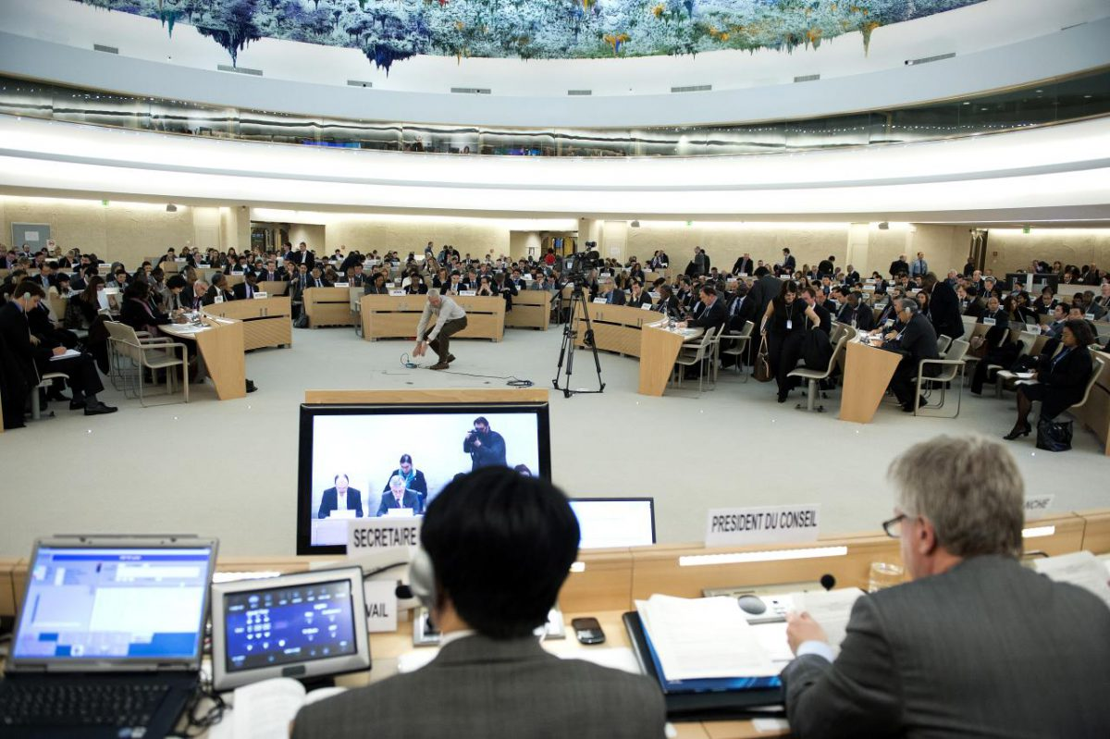
Human Rights Council: Universal Periodic Review
A peer review of all UN Member States
Every four years
All human rights obligations

Slide 12
Functions and how to engage
State review
Inquiries
Individual complaints / allegations
Interim measures / urgent appeals
Country visits
General Comments / Recommendations
Days of general discussion
Human Rights Council sessions

Slide 13
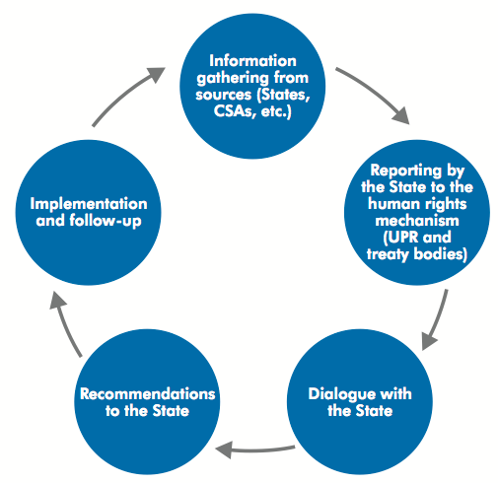
State review
All treaty bodies; UPR
Periodic monitoring of States

Slide 14
State review: Example of treaty bodies (CAT)
Concluding Observations on the second periodic report of Qatar
“The state party should strengthen its efforts to provide legal protection to migrant workers, including female domestic workers, in its territory against torture, ill-treatment and abuse and guarantee access to justice. In that regard, the State party should:
(a) Adopt, as a matter of urgency, labour legislation covering domestic work and providing legal protection to migrant domestic workers against exploitation, ill-treatment and abuse …”

Slide 15
State review: Example from the UPR
UPR of Iceland 2011
“62.9. fight against domestic violence through more effective measures against perpetrators, and especially by protecting and avoiding the deportation of migrant women victims of gender violence (Spain);”
Response: Supported

Slide 16
State review: How to engage
Governments
Drafting of State report: Collect data and information; consult with civil society and NHRI; submit report
State review: Dialogue between the Committee and the delegation of the State
Follow-up at national level
NGOs/CSOs
Document and monitor
Draft shadow reports
Make oral statements and brief Committee members, UN staff, government officials
Follow-up at national level
Advocate and raise awareness

Slide 17
Inquiries
May be undertaken by some treaty bodies (CAT, CED, CEDAW, CESCR, CRC, CRPD); may be mandated by the Human Rights Council, High Commissioner for Human Rights or UN Security Council
Investigations into grave or systematic human rights violations
May include a country visit
Confidential
Example
CEDAW Report on Mexico under article 8 of the Optional Protocol to the Convention

Slide 18
Inquiries under treaty bodies: How to engage
Governments
Cooperate throughout the inquiry process
  Provide observations
  Consent to a request for a country visit
  Respect time limits
NGOs/CSOs
Document the situation
Submit information to relevant treaty body, Human Rights Council or High Commissioner for Human Rights
Seek to meet the delegation if a country visit is made

Slide 19
Individual complaints / allegations
Individual complaints and allegations may be received by: all treaty bodies if accepted by the ratifying State (CMW not yet in force); special procedures; and the Human Rights Council
Individual complaints need to allege a specific human rights violation

Slide 20
Individual complaints: Example (CEDAW)
The Vienna Intervention Centre against Domestic Violence and the Association for Women’s Access to Justice v. Austria
(Communication No. 6/2005, 2007)
“3.7 The authors request the Committee to assess the extent to which there have been violations of the victim’s human rights … and the responsibility of the State party for not detaining the dangerous suspect. The authors also request the Committee to recommend that the State party offer effective protection to women victims of violence, particularly migrant women, by clearly instructing public prosecutors and investigating judges what they ought to do in cases of severe violence against women.
12.1.5 The Committee considers the failure to have detained Irfan Yildirim as having been in breach of the State party’s due diligence obligation to protect Fatma Yildirim.”

Slide 21
Individual complaints/allegations: How to engage
Governments
Respond in a given period to requests for information or questions on a case from a treaty body, Human Rights Council, or special procedures mandate holder
If found to have violated human rights, provide redress to victim/s and ensure non-repetition
NGOs/CSOs
Support victims seeking redress
Litigate
Provide evidence, studies and other relevant reports
Send communications about cases or situations of concern

Slide 22
Interim measures and urgent appeals
May be issued by some treaty bodies (CCPR, CEDAW, CRC, CRPD, CED) and by special procedures
They are communications to governments on time-sensitive cases of concern

Slide 23
Urgent Appeal: Example (special rapporteur)
Joint Urgent Appeal by the Special Rapporteur on extreme poverty and human rights, the Special Rapporteur on the human rights of migrants, and the Special Rapporteur on adequate housing
“GENEVA (16 December 2014) – A group of United Nations human rights experts today urged the Dutch Government to immediately provide homeless irregular migrants in the Netherlands with emergency assistance, such as food, clothing, and shelter (popularly called ‘bed, bath and bread’ in the country). The Netherlands refuses to provide emergency assistance to this group, despite repeated disapproval by international and regional human rights bodies.”
“GENEVA (28 January 2015) – The decision by the Government of the Netherlands to provide funding to help municipalities that offer emergency shelters for homeless migrants is a welcome change of position, three human rights experts said on Wednesday.”

Slide 24
Urgent Appeals: How to engage
Note that organisations acting on behalf of victims can
  Submit a request for an interim measure to a treaty body
  Submit a request for an urgent appeal to a special procedures mandate holder or an Urgent Action Inbox

Slide 25
Interim measures and urgent appeals: How to engage
Governments
A State that receives an interim measure or an urgent appeal should respond within a short time to the relevant treaty body or special procedures mandate holder, detailing the measures it has taken in the particular case to cease an ongoing alleged violation or prevent an imminent violation of human rights
NGOs/CSOs
Support or submit cases on behalf of victims as soon as possible
Act in a timely way
Litigate or intervene in other ways
Use jurisprudence to support their analysis or arguments at national level

Slide 26
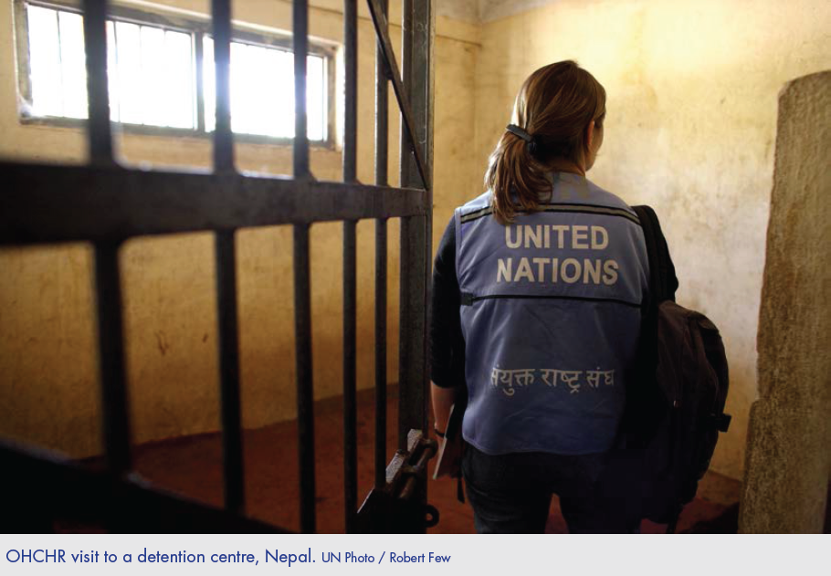
Country visits
May be undertaken by special procedures, the Sub-Committee on the Prevention of Torture (SPT), and the High Commissioner for Human Rights
They are fact-finding missions

Slide 27
Country visits: Example (Special Rapporteur)
Visit to Sri Lanka by the Special Rapporteur on the human rights of migrants
Recommendations:
“Enhance efforts to prevent exploitation and abuse of migrants, during the recruitment stage, while in service in the destination country, and upon return to Sri Lanka.
Enhance the monitoring of the recruitment industry, through putting in place a comprehensive policy with high standards, improving services offered by recruitment agencies, holding them accountable for the non-execution of their duties, reducing costs for migrants, and regulating irregular sub-agents.
Abolish recruitment fees for migrants.”

Slide 28
Country visits: How to engage
Governments
Invite a visit, or accept a request to visit
Agree on dates and appoint a focal point
Provide relevant documents: legislation, policies, other background materials
Ensure the delegation has necessary access
Ensure those who speak to the delegation face no reprisals
NGOs/CSOs
Identify relevant stakeholders
Meet mandate holder(s), delegation members, or the High Commissioner for Human Rights
Provide background papers and reports
Send communications on cases or situations
For Special Procedures, submit written statements to Human Rights Council

Slide 29
General Comments or Recommendations
Issued by all treaty bodies
They offer guidance on, and authoritative interpretation of, a Convention
Example. CEDAW General Recommendation No. 26 on women migrant workers (2009)
“24(a) Lifting of discriminatory bans or restrictions on migration: States parties should repeal sex-specific bans and discriminatory restrictions on women’s migration on the basis of age, marital status, pregnancy or maternity status. They should lift restrictions that require women to get permission from their spouse or male guardian to obtain a passport or to travel (article 2 (f));”

Slide 30
General Comments: How to engage
Governments and NGOs/CSOs
Contribute written submissions
Participate in public discussions and deliver oral statements (see Days of general discussion)

Slide 31
Days of general discussion
May be convened by all treaty bodies
They are public informal meetings of key stakeholders
Example: CRC day of general discussion on the rights of all children in the context of international migration
“Attention should be paid to addressing the gender-specific impacts of reduced access to services, such as sexual and reproductive health rights and security from violence.”

Slide 32
Days of general discussion: How to engage
Governments and NGOs/CSOs
Contribute written submissions
Participate in discussion; deliver oral statements

Slide 33

Human Rights Council sessions
Regular sessions occur three times each year
Example of a side event
Organized by the International Detention Coalition, supported by OHCHR, to launch a global strategy to end child immigration detention

Slide 34
Human Rights Council sessions: How to engage
Governments and NGOs/CSOs
Contribute written statements
Make oral statements
Organize or participate in side events

Slide 35
Engaging with the UN human rights system
Documentation and evidence
A whole-system approach
Legal language and ‘translation’
Organization and cooperation
Strategizing
Limitations

Slide 36
What’s in it for me?
What are the benefits of engaging with UN human rights mechanisms?
For your work; for government; for civil society; for victims of human rights violations; for international organisations, etc.
They provide guidance on legal standards
They monitor progress and shortcomings
They offer tools to raise awareness
Different stakeholders can build relationships through engagement
They give direction to programmes and projects

Slide 37
Case study activity
Which human rights mechanisms will you use?
What aims or goals will you have in mind when using each one?
How will you go about achieving your goals, considering the resources you have available?

Slide 38
Case study activity
Which issues will you report on?
Which ministries / departments / institutions can provide the data you need?
How will you coordinate with the different ministries, and with NGOs, to obtain the information you need?
What arguments can you make to show you are committed to meeting your human rights obligations?

Slide 39
Summary and key messages
Human rights are one of the three pillars of the UN
International human rights law is an accountability framework
OHCHR – treaty bodies – Human Rights Council
Guidance on implementation
Monitoring and accountability
General situations and individual cases
Complementarity
Urgency and the time factor
Active engagement and advocacy

Slide 40

Useful resources
UN General Assembly Resolution 48/141 of 20 December 1993, establishing the Mandate of the High Commissioner for Human Rights
OHCHR, Factsheet No. 7 Rev. 2, Individual Complaint Procedures under the United Nations Human Rights Treaties, 2013
OHCHR, Factsheet No. 30 Rev. 1, The United Nations Human Rights Treaty System, 2012
OHCHR, Training Package on Reporting to the United Nations Human Rights Treaty Bodies, 2017
OHCHR, Commissions of Inquiry and Fact-Finding Missions on International Human Rights and Humanitarian Law: Guidance and Practice, 2015
OHCHR, Working with the United Nations Human Rights Programme: A Handbook for Civil Society, 2008

